Slide 1
Celebrating/Strengthening CNAfME
Collegiate Leadership Pre-Conference
“One is Too Small a Number
to Achieve
Something GREAT”
…John Maxwell
Marcia Neel
January 15, 2015

Slide 2
School is. . .
Impressionistic
vs
Expressionistic
Music is. . .

Slide 3
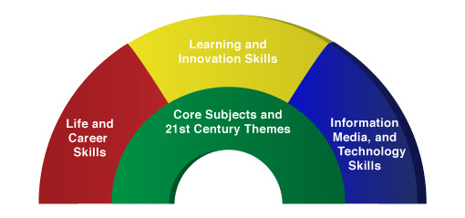

A focus on these “5 Cs” is essential
Critical Thinking
Communication
Collaboration
Creativity
Confidence
Therefore. . .

Slide 4
The Music Skills Practice Room is. . .
The Life Skills Practice Room
1. Critical Thinking. . .
  Ability to reason effectively and solve
  problems
  Ability to analyze how parts of a whole
  interact with each other to produce overall
  outcomes in complex systems

Slide 5
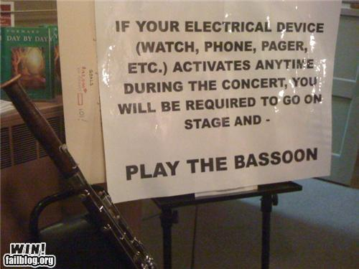
The Music Skills Practice Room is. . .
The Life Skills Practice Room
Problem Solving:
Ability to solve problems creatively.
Example:
Having trouble getting people to turn
off cell phones, pagers, etc.,
during concerts?
Here’s one PROBLEM SOLVED!!!

Slide 6
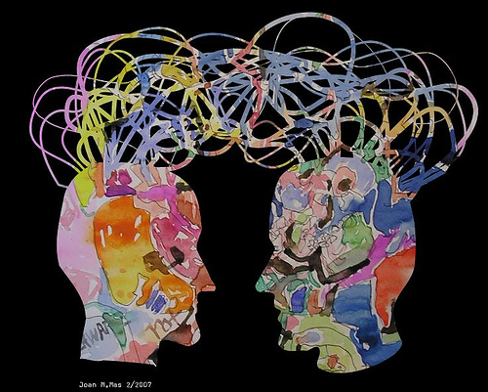
The Music Skills Practice Room is. . .
The Life Skills Practice Room
2. Communication. . .
  Ability to express
  thoughts effectively
  with others --
  both verbally and
  non-verbally
  Ability to listen effectively

Slide 7

The Music Skills Practice Room is. . .
The Life Skills Practice Room
Result-driven Communication. . .

Slide 8
The Music Skills Practice Room is. . .
The Life Skills Practice Room
3. Collaboration/Teamwork. . .
  Ability to work effectively and respectfully
  with ALL

Slide 9
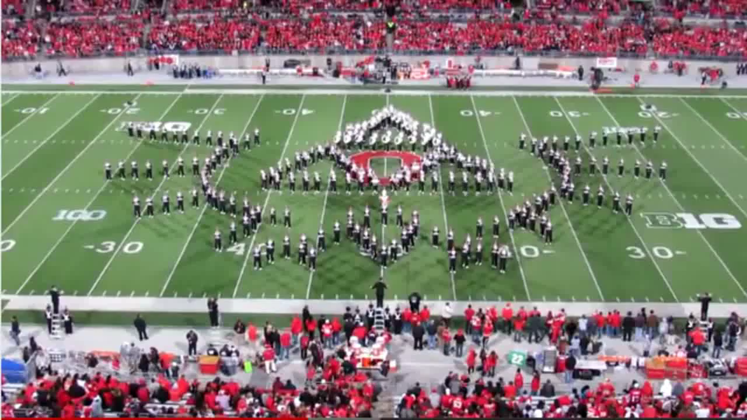
The Music Skills Practice Room is. . .
The Life Skills Practice Room
3. Collaboration/Teamwork:
Effective when EVERYONE does their job.

Slide 10
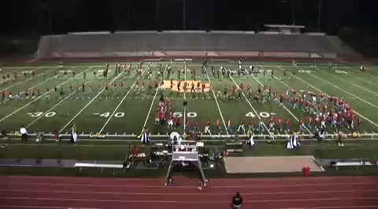
The Music Skills Practice Room is. . .
The Life Skills Practice Room
Teamwork: NOT effective when even ONE PERSON does NOT do their job.

Slide 11
The Music Skills Practice Room is. . .
The Life Skills Practice Room
4. Creativity (Innovation). . .
  Ability to think creatively with others
  Ability to create new and more worthwhile
  ideas and products

Slide 12

The Music Skills Practice Room is. . .
The Life Skills Practice Room
Innovation:
Ability to think and work creatively with others

Slide 13
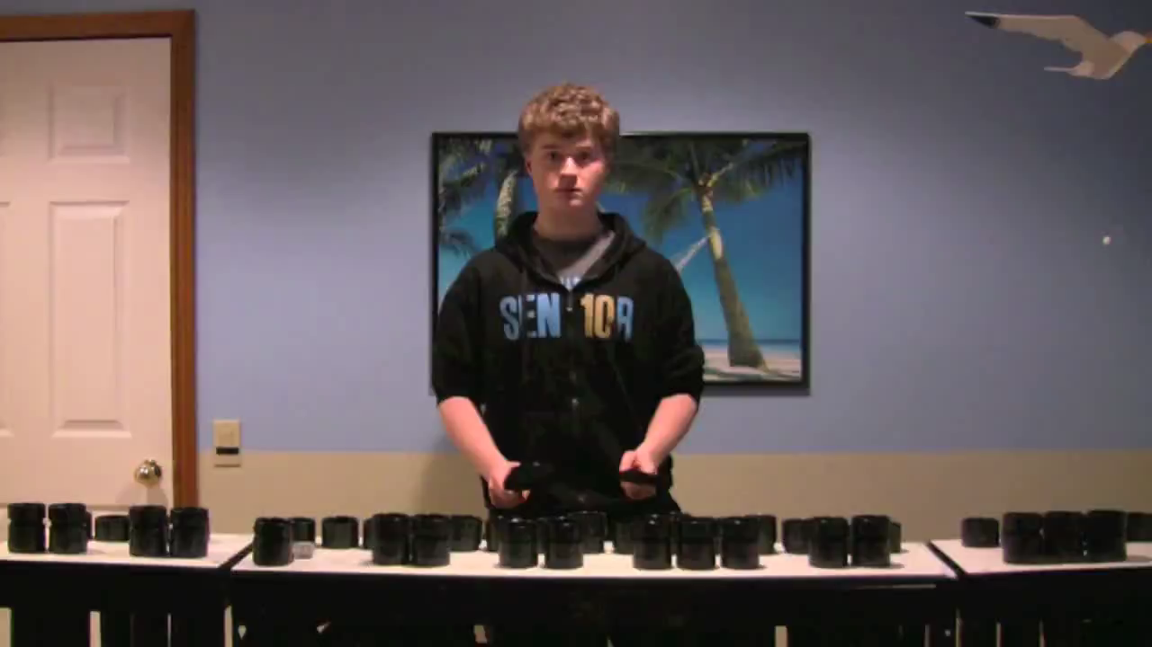
The Music Skills Practice Room is. . .
The Life Skills Practice Room
Creativity: Ability to create new ideas and/or products

Slide 14
The Music Skills Practice Room is. . .
The Life Skills Practice Room
5. Confidence. . .
  Ability to handle EVERY CIRCUMSTANCE
  and grow from it

Slide 15
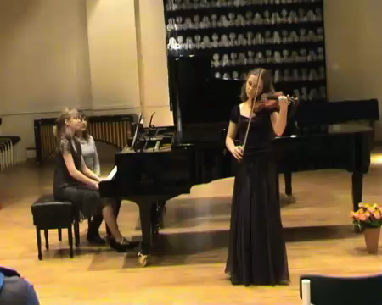
The Music Skills Practice Room is. . .
The Life Skills Practice Room
Confidence:
Ability to handle EVERY CIRCUMSTANCE

Slide 16
but. . .
“ONE IS TOO SMALL A
NUMBER TO ACHIEVE
SOMETHING GREAT”
so. . .
WHAT CAN WE DO
TOGETHER TO ACHIEVE
GREATNESS?
Parents
Teachers
Principals
Custodians
Support Staff
Community

Slide 17
What Makes Our Programs Special?
Do We C.A.R.E.?
With GREAT THANKS to Dr. Tim!
C: Communication
Do we encourage one another to reach out to each other?
…Tim Lautzenheiser

Slide 18
What Makes Our Programs Special?
Do We C.A.R.E.?
A: Attitude
Do we generate the proper attitude?
Does our attitude play a crucial role in the outcome of the program’s success?

Slide 19
What Makes Our Programs Special?
Do We C.A.R.E.?
R: Responsibility
Do we come to rehearsals ready to
invest energy for ongoing growth
and development of our goals?
Do we respond to our teacher/director in a way that will advance the entire program to the next level?

Slide 20
What Makes Our Programs Special?
Do We C.A.R.E.?
E: Excellence
Do we reflect a sense of excellence to go beyond the requirements, to put forth extra effort?

Slide 21
“We either hang together, or
we hang separately.”
Ben Franklin
When ALL of the people in a musical group decide to unselfishly GIVE to that group, it’s THEN that we realize the value of the ensemble -- a gathering of wonderful musicians who genuinely C.A.R.E. for one another. . .Tim Lautzenheiser

Slide 22

In YOUR Own Words:
Music makes the difference because. . .

Slide 23

In YOUR Own Words:
I will make a difference by. . .

Slide 24
And finally. . .
Are you committed to the program by making the best of every situation NO MATTER WHAT?
One final bit of inspiration. . .

Slide 25
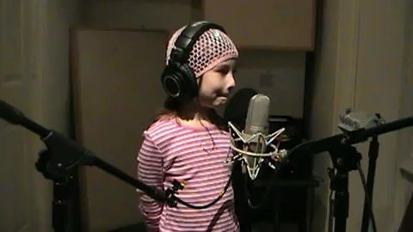
THE WHY!

Slide 26


Thank You, CSI & IMEA!!!
Marcia Neel
marcia@musicedconsultants.net
@MusicEdConsult
Posted: www.musicedconsultants.net/conference-materials.html

