Slide 1




“One is Too Small a Number
to Achieve Something Great”
University Park
Allocation Committee
Marcia Neel
November 14, 2015
Peter Sides
marcia@musicedconsultants.net
www.musiceducationconsultants.net

Slide 2
School is. . .
Impressionistic
vs
Expressionistic
Music is. . .

Slide 3
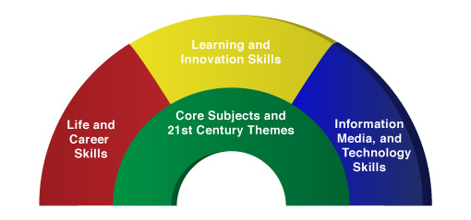

A focus on these 5 C’s is essential
to prepare students for the future.
Critical Thinking
Communication
Collaboration
Creativity
Confidence
Therefore. . .

Slide 4
The Music Skills Practice Room is. . .
The Life Skills Practice Room
1. Critical Thinking. . .
  Ability to reason effectively and solve
  problems
  Ability to analyze how parts of a whole
  interact with each other to produce overall
  outcomes in complex systems

Slide 5
The Music Skills Practice Room is. . .
The Life Skills Practice Room
Problem Solving:
Ability to solve problems
Harry Connick, Jr. holds a patent for a system that coordinates musical displays for musicians in an orchestra.
Vic Firth came up with the idea of making a better drumstick while playing timpani for the Boston Symphony Orchestra.
Les Paul invented the solid body guitar because his audience at a BBQ joint couldn’t hear him play.

Slide 6
The Music Skills Practice Room is. . .
The Life Skills Practice Room
EXAMPLE: Ability to analyze how parts
of a whole interact with each other to produce overall outcomes in complex systems.
See how this creative young man used this concept to produce a remarkable outcome!

Slide 7
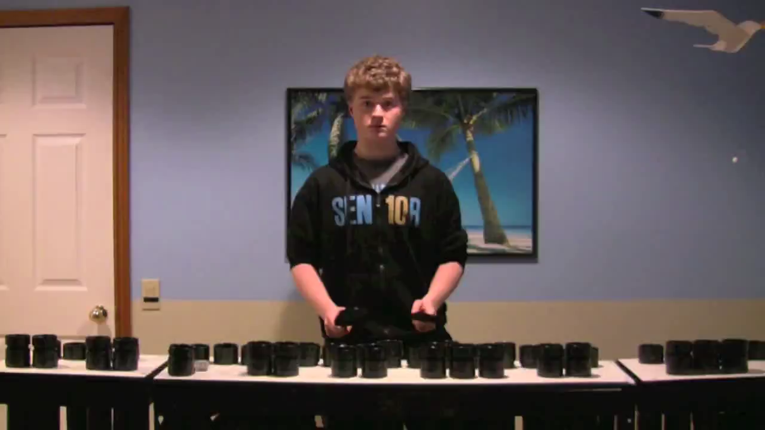
The Music Skills Practice Room is. . .
The Life Skills Practice Room

Slide 8
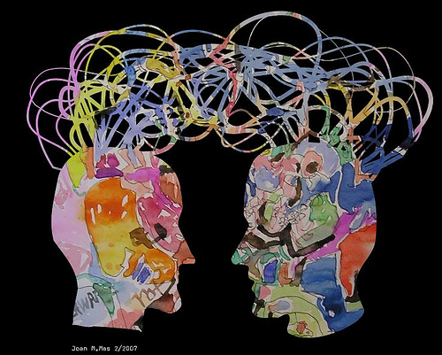
The Music Skills Practice Room is. . .
The Life Skills Practice Room
2. Communication. . .
  Ability to listen
  effectively
  Ability to express
  thoughts effectively
  with others –
  both verbally and non-verbally
  Have you tried Result-driven Communication?

Slide 9

The Music Skills Practice Room is. . .
The Life Skills Practice Room
Result-driven Communication: Listening and
communicating effectively will guarantee success!

Slide 10
The Music Skills Practice Room is. . .
The Life Skills Practice Room
3. Collaboration (Teamwork). . .
  Ability to work effectively and respectfully
  with ALL

Slide 11

The Music Skills Practice Room is. . .
The Life Skills Practice Room
Teamwork: Effective when EVERYONE does their job.
Dudamel conducts Bernstein’s “Mambo”

Slide 12
The Music Skills Practice Room is. . .
The Life Skills Practice Room
Creativity (Innovation). . .
  Ability to create new and more worthwhile
  ideas and to work creatively with others.
  “The MFA is the new MBA” Daniel Pink

Slide 13

The Music Skills Practice Room is. . .
The Life Skills Practice Room
(Innovation): Ability to think and work creatively with others

Slide 14
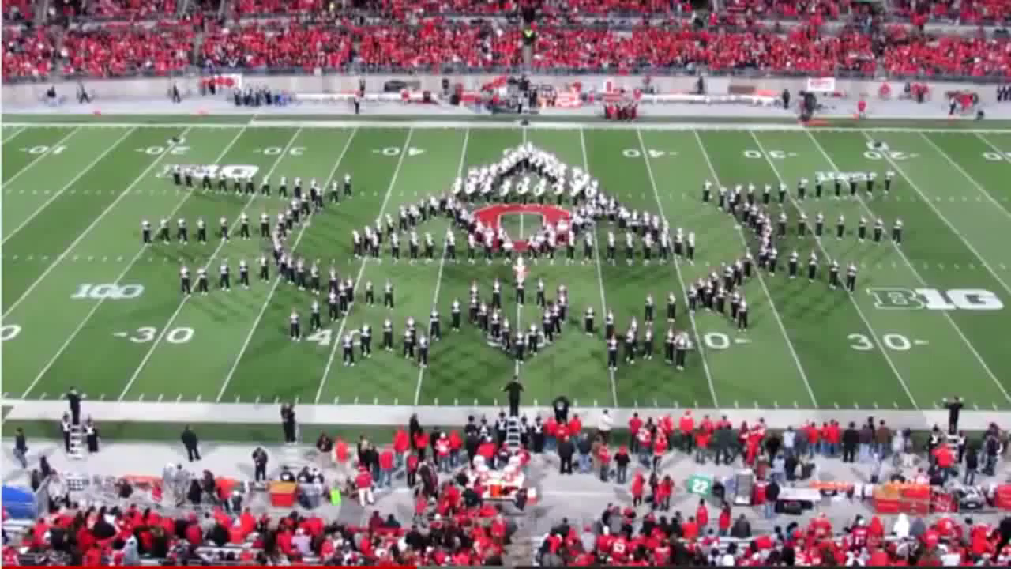
The Music Skills Practice Room is. . .
The Life Skills Practice Room
(Innovation): Ability to think and work creatively with others

Slide 15
The Music Skills Practice Room is. . .
The Life Skills Practice Room
5. Confidence. . .
  Ability to handle EVERY CIRCUMSTANCE
  and grow from it

Slide 16

The Music Skills Practice Room is. . .
The Life Skills Practice Room
Confidence: Ability to handle EVERY CIRCUMSTANCE

Slide 17
but. . .
“ONE IS TOO SMALL A
NUMBER TO ACHIEVE
SOMETHING GREAT”
SOOOOOO. . .
WHAT CAN WE DO
TOGETHER TO ACHIEVE
GREATNESS?
Parents
Teachers
Principals
Custodians
Support Staff
Dealers
Community

Slide 18
What Makes Our Programs Special?
Do We C.A.R.E.?
With GREAT THANKS to Dr. Tim!
C: REAL Communication
Do we encourage one another to reach out to each other?
Do harmony and balance apply to more than great music-making?

Slide 19
What Makes Our Programs Special?
Do We C.A.R.E.?
A: Attitude
Do we generate the proper attitude?
Does our attitude play a crucial role in the outcome of the program’s success?

Slide 20
What Makes Our Programs Special?
Do We C.A.R.E.?
R: Responsibility
Do we come together ready to invest energy for ongoing growth and development of our goals?
Do we respond to each other in a fashion that will advance the entire program to the next level?

Slide 21
What Makes Our Programs Special?
Do We C.A.R.E.?
E: Excellence
Do we reflect a sense of excellence to go beyond the basic requirements -- to put forth extra effort?

Slide 22
“We either hang together, or
we hang separately” . . . Ben Franklin
When ALL of the people involved in a music program decide to unselfishly GIVE, it’s THEN that we realize the true value of the program --
a gathering of wonderful people who genuinely C.A.R.E. for one another.
. . . Tim Lautzenheiser

Slide 23
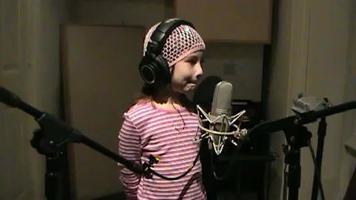
After all, doesn’t she deserve our very best?

Slide 24

Contact Information:
marcia@musicedconsultants.net
@MusicEdConsult
On Twitter
Thank You!
University Park
Allocation Committee
Peter Sides

