Slide 1
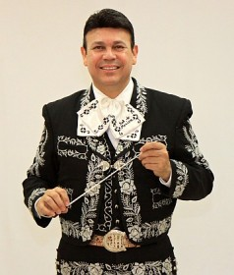


MARIACHI IN CHENEY
May 12-13, 2015
Jose Hernandez
Marcia Neel

Slide 2
GETTING STARTED
Write your name on the front cover.
Insert page numbers—top right hand of page
Complete and hand in form on page 5
at end of class.
Rationale: Why Mariachi?
Goals and Objectives

Slide 3
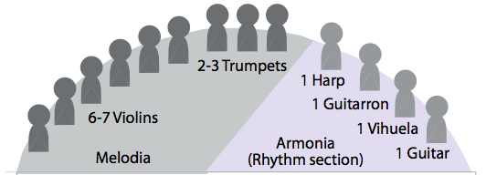
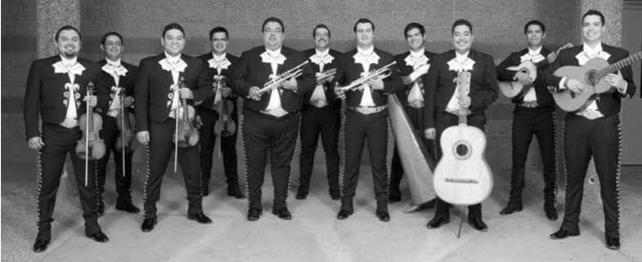
The Mariachi Ensemble
Use Photo of Sol de Mexico

Slide 4
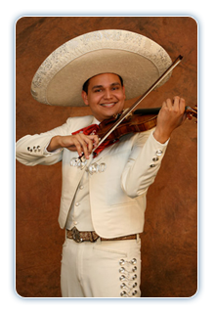
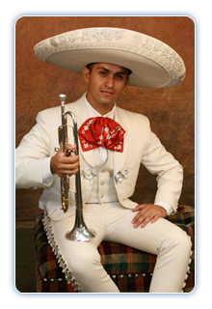
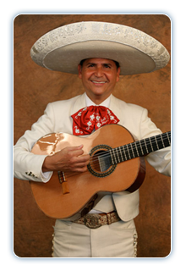
Instrumentation: Traditional Instruments
Erick Hernandez
Violin
Roberto Diaz
Trompeta
Jesus (Chuy) Hernandez
Guitarra
Notes:
4

Slide 5
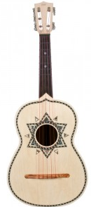

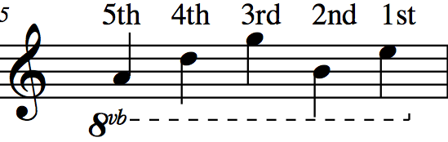
Characteristic Instruments: The Vihuela
A
D
G
B
E
5
4
3
2
1

Slide 6
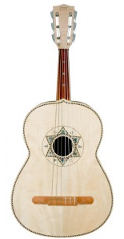
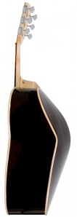
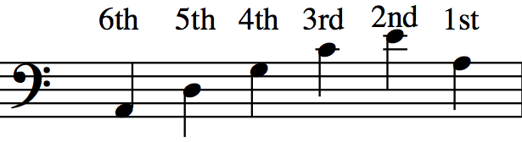
Characteristic Instruments: The Guitarron
A
D
G
C
E
A
T
Tape: One Whole Step
From the Nut
6
5
4
3
2
1
Written Range: Sounds Octave Lower

Slide 7
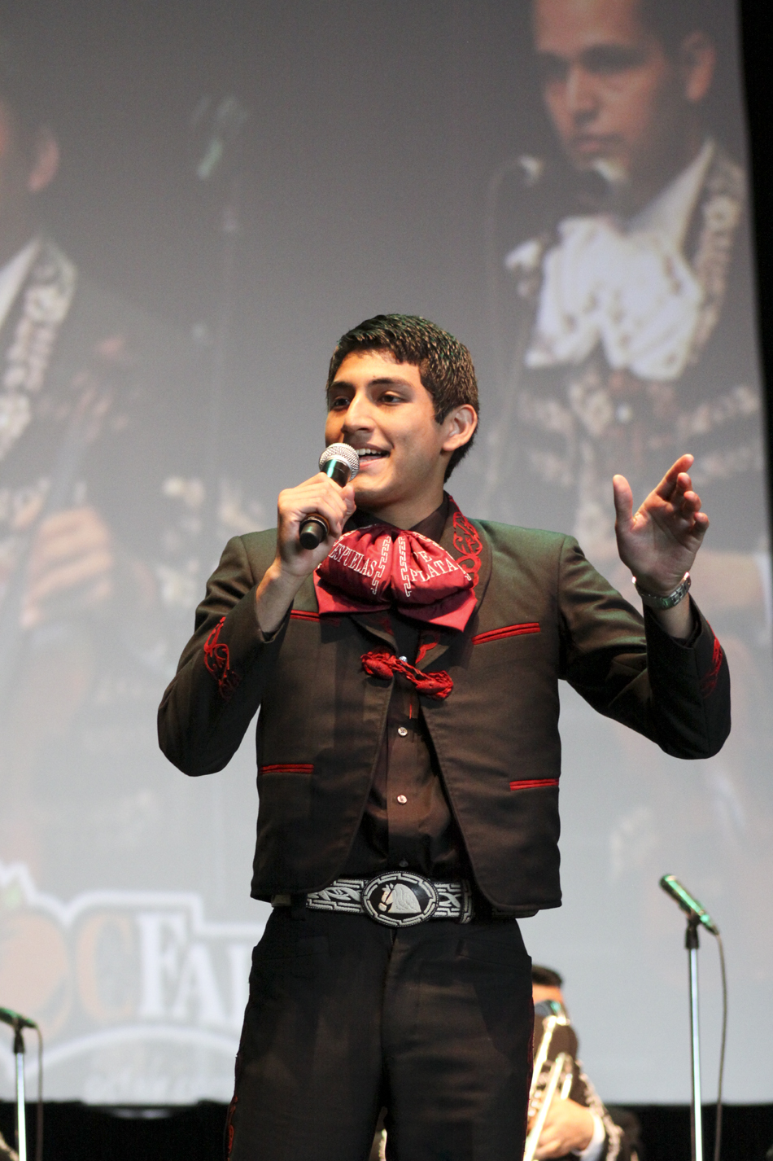
Some New Terms
1. Melodia
Violin, Trumpet
Vocal
2. Armonia:
The Rhythm Section
Guitar, Vihuela
Guitarron
3. Mánico
Strumming Pattern
Notes:
7

Slide 8
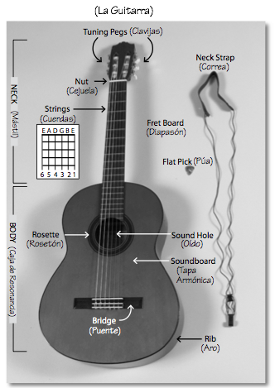
Getting to Know the Guitarra
(pp 10-11)
Notes:
8

Slide 9
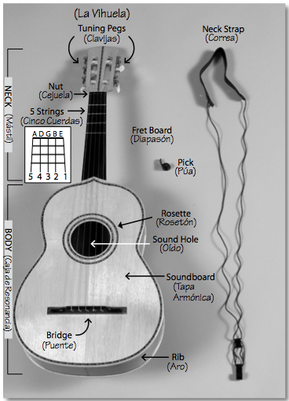
Getting to Know the Vihuela
(pp 12-13)
Notes:
9

Slide 10
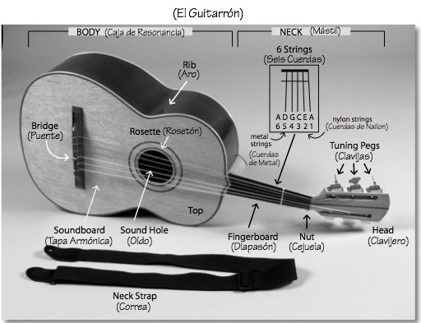
Getting to Know the Guitarron
(pp 14-15)
Notes:
10

Slide 11
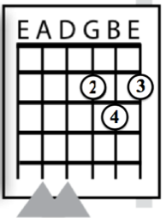
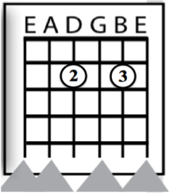
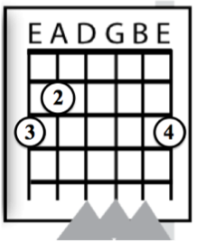
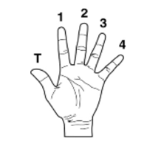
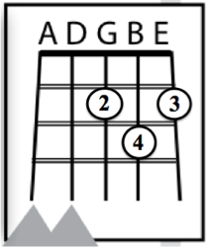
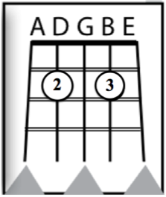
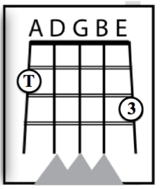
Today’s Chords: D Major, A7, G Major
Key of “Re” (p 16)
Primera
Segunda
Tercera
D Major
A7
G Major
Guitarra
Vihuela
11

Slide 12
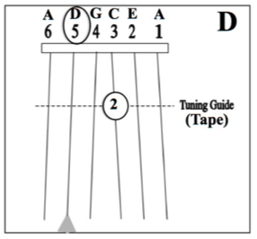
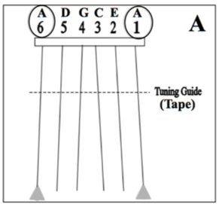
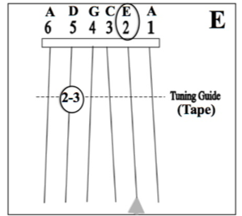
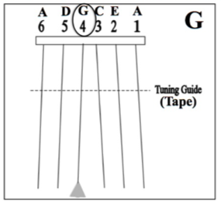
Guitarron Notes: D, A, E, G
Key of “Re” (pp 17)
Tape: One Whole
Step from Nut

Slide 13
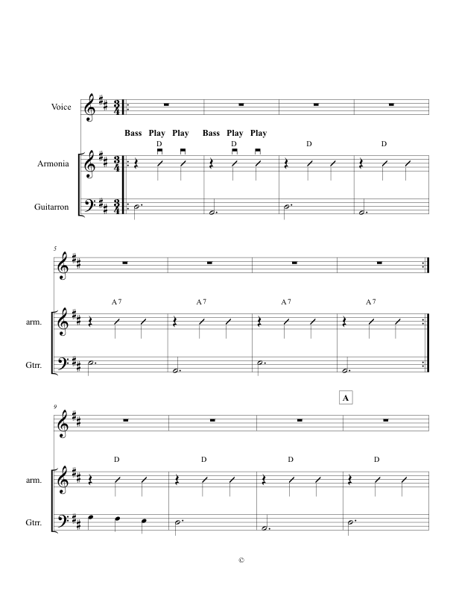
Ranchera Valseada Style (p 18)
3/4 Time Signature Mánico: Down Strums
Mostly Major Keys Golpe Strum
HINT: Have students speak text in rhythm before playing.

Slide 14
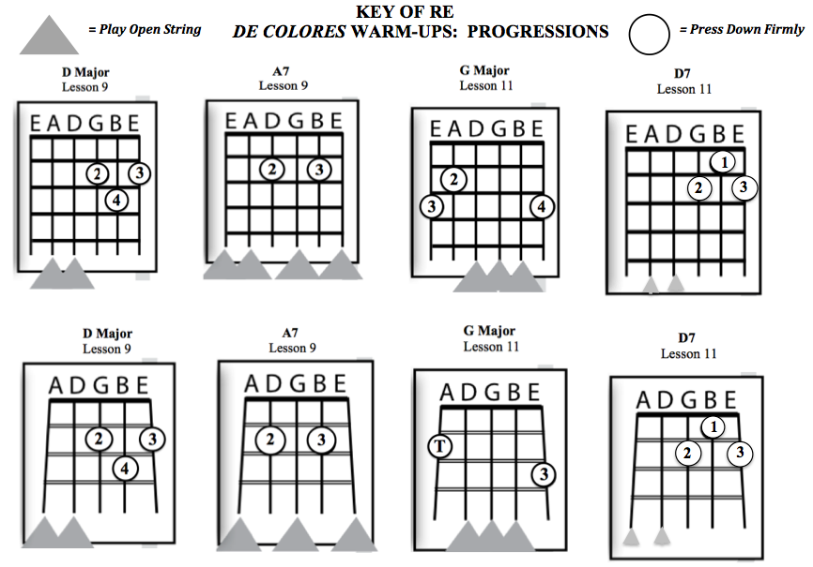
(p 19)
New Chord
New Chord

Slide 15
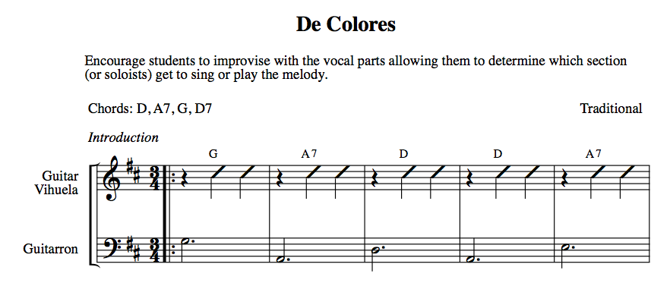
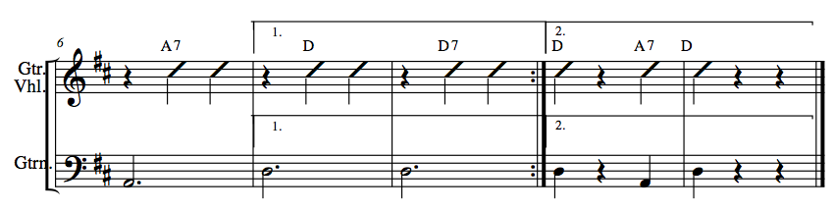
(p 20)
Rehearsing Chord Progressions

Slide 16
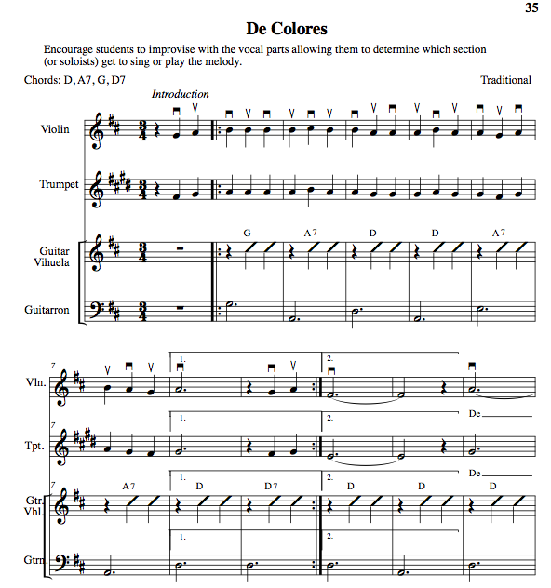
De Colores
p 21
Speak text first.

Slide 17
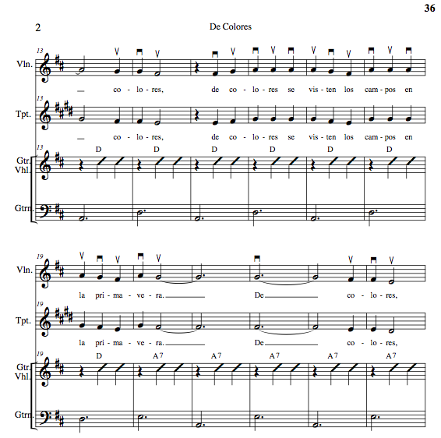
p 22

Slide 18
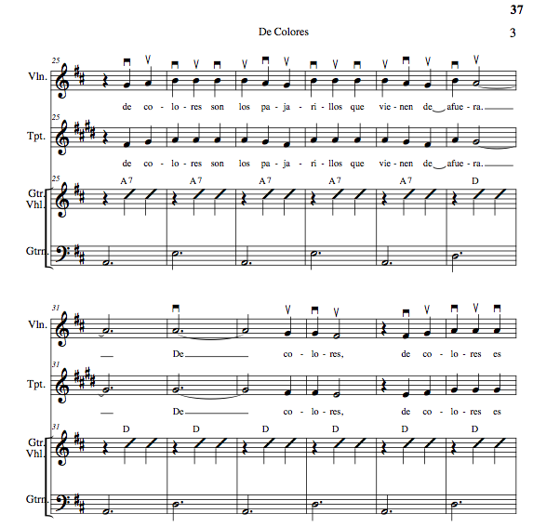
p 23

Slide 19
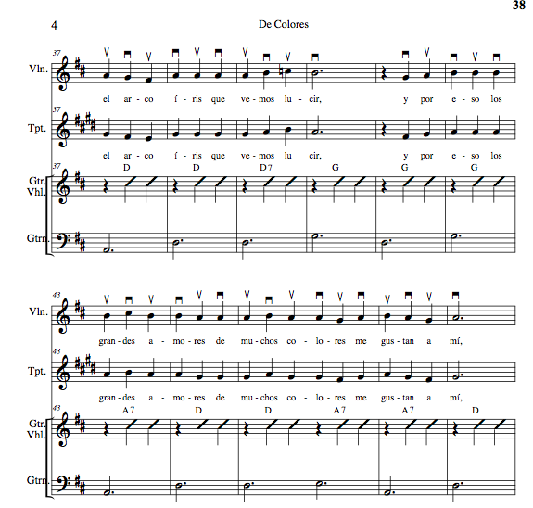
p 24

Slide 20
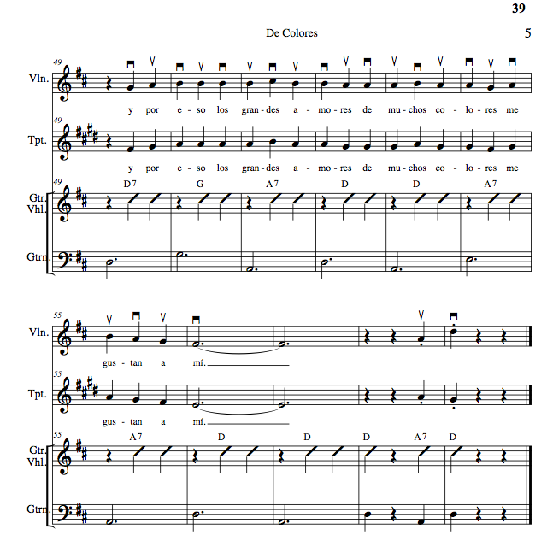
p 25

Slide 21
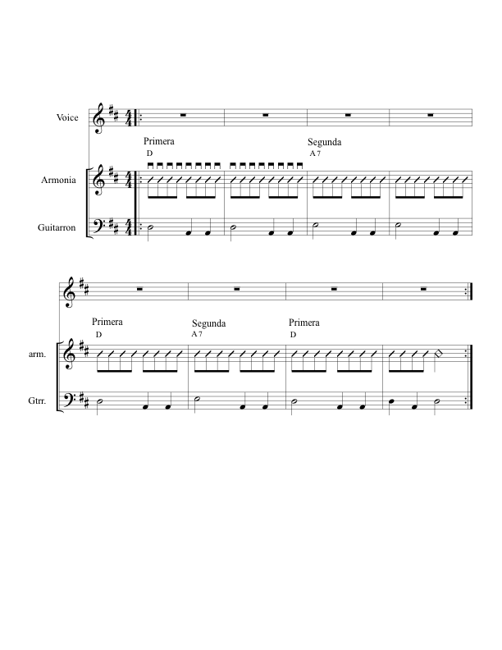
Bolero Style (p 26)
Mánico: Note Down Strums Common Time
Note Guitarron Rhythm Mostly Major Keys
Notes:
21

Slide 22
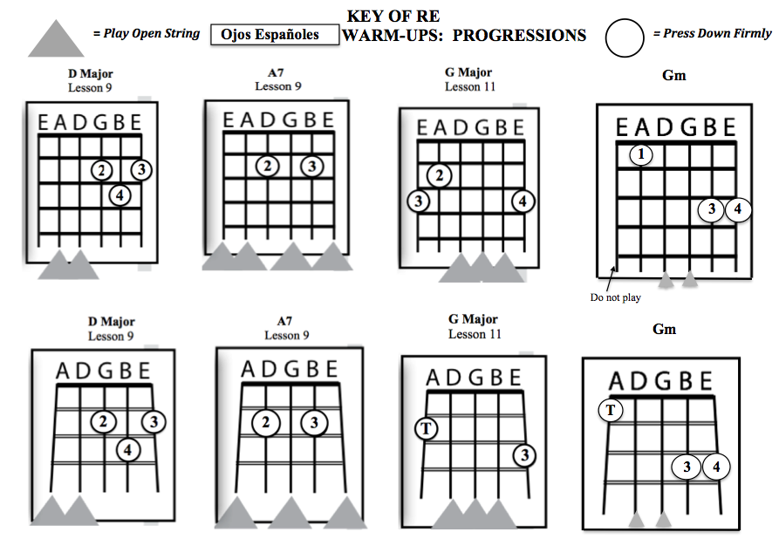
Ojos Españoles (p 28)
(Spanish Eyes)
Gm
New Chord
New Chord
Notes:
22

Slide 23
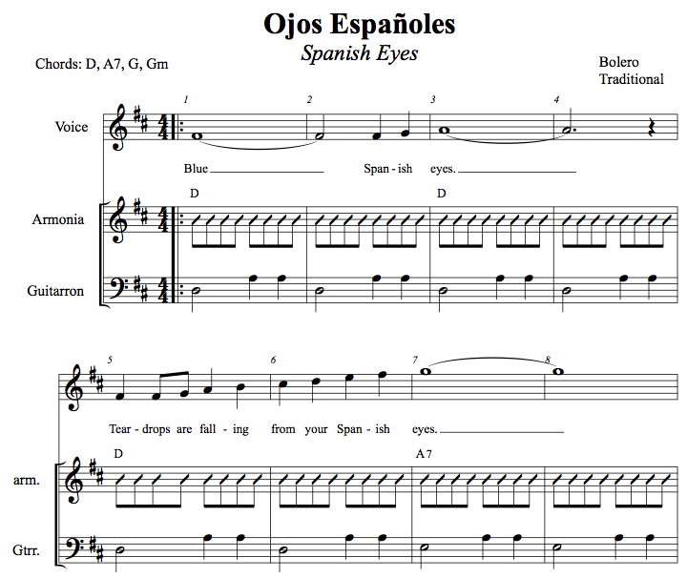
p. 28
23
Notes:
23

Slide 24
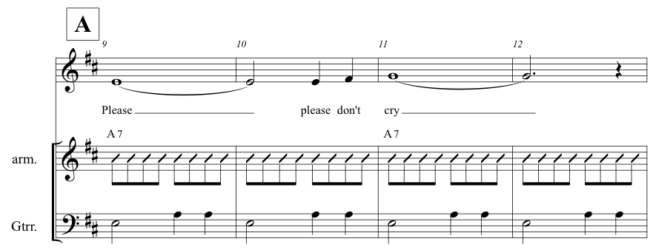
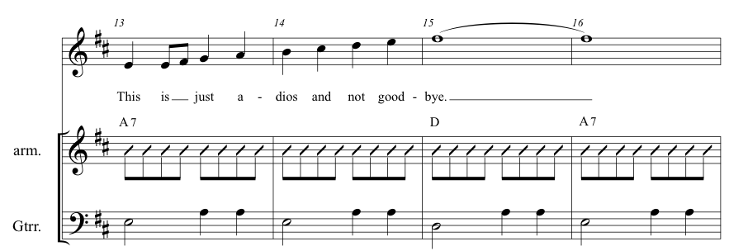
Notes:
24

Slide 25
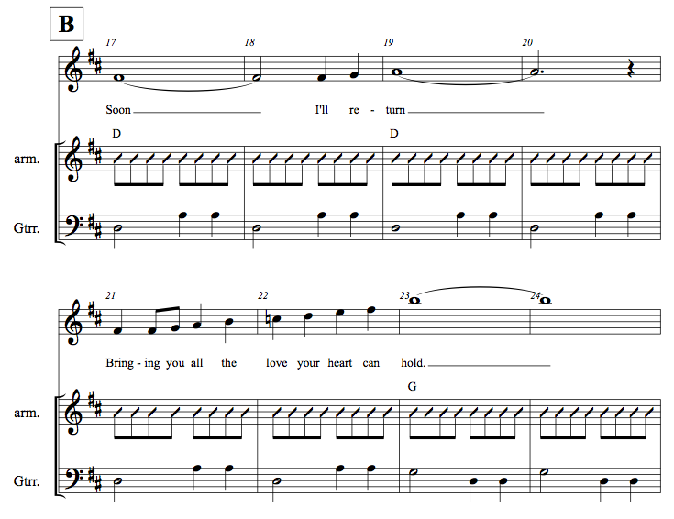
Gm Coming Up
25
Notes:
25

Slide 26
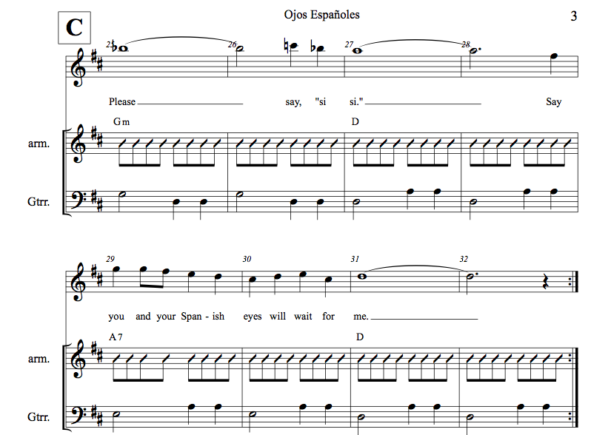
Skip Repeats
26
Notes:
26

Slide 27
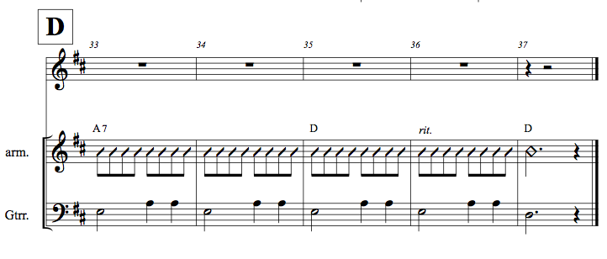

Slide 28
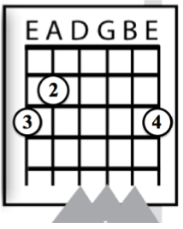
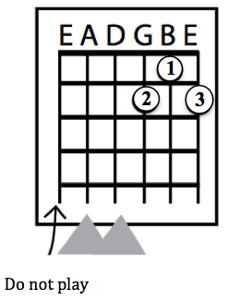
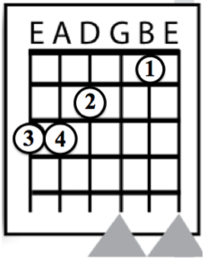
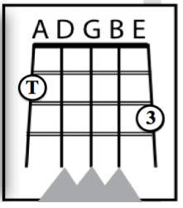
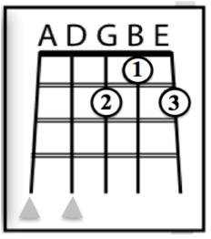
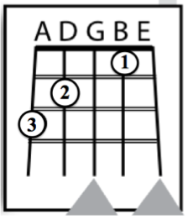
Key of “Sol” Chords: G Major, D7, C Major (p 31)
Primera
Segunda
Tercera
G Major
D7
C Major
Guitarra
Vihuela

Slide 29
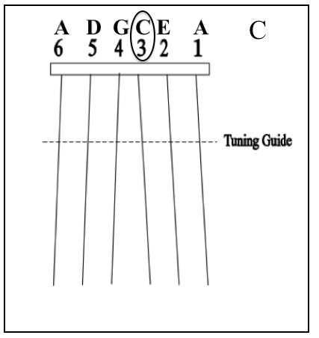
Guitarron Notes: G, D, A, C
Key of “Sol” (p 32)
C
(Tape)

Slide 30

Can you play a Valseada in Sol?
Chords: Play Progresion G, D7, G, G7, C
Can you play a Bolero in Sol?
Chords: G, D7, G, G7, C
What is a Bolero Circulo?
G Major, Em7, Am7, D7 Repeat

Slide 31

Cariño Chord Progressions (p 33)
Key of Sol

Slide 32



Slide 33

Play and Sing
Cariño
(p 35-39)

Slide 34

Ranchera Lenta (Romantica) Style
p. 40
Mánico: Note Down Strums
Note Guitarron Rhythm
4/4 Time Signature
Mostly Major Keys
Articulation
HINT: Have students speak text in rhythm.

Slide 35
What is the Son?

Slide 36

The Son
p. 41
Perhaps the most Traditional Song Style in Mariachi Genre
Mánico: Alternating 3/4 -6/8 Feel

Slide 37





ALL AGES
EVERYONE SINGS!
EVEN YOU!!!!!

Slide 38

pp 42-45

Slide 39
Rondallas:
Los Barandales del Puenta (p. 48)
Tu Solo Tu (p 53)
  The Rondalla – GREAT for 3rd-4th Grade
  Originated in Spain in the 16th century
  Came from the Spanish word, “Ronda” meaning ‘serenade”
  Made up of at least one singer being accompanied by a guitar

Slide 40


Presenting Rondallas
  Introduce:
  The Beat – in 3
  (Syncopated) Rhythms – esp in 3
  Solfeo
  Speaking Spanish in Rhythm
  Sing with Supporting Accompaniment
  Los Barandales del Puenta (p 48-52)
  Tu Solo Tu (p 53-59)
I want to. . .
go out to din - ner_____
go to a mo - vie______

Slide 41

Benefits of a School Mariachi Program
Involves More Students in Music
Entry-level music experience
anytime
Helps keep students in school
Increases student self-esteem and
  self-confidence
Effective bridge to parental involvement
Celebration/Recognition of culture and heritage

Slide 42
Scope and Goals – Course Syllabi
BEGINNING MARIACHI
Course Scope:
This one-year course is designed for the student who is interested in learning to play a mariachi instrument including violin, trumpet, guitar, vihuela and guitarron. It includes the development of skills necessary to become independent as a musician. This course concentrates on the development of note-reading skills, aural skills, singing skills, rhythmic patterns, intonation, and tonality inherent to the mariachi genre. A progression of fundamental and technical proficiency is expected.
Course Goals:
To develop age-appropriate individual singing and playing skills leading to independence as a mariachi musician.
To develop the singing and playing skills necessary to create an ensemble sound in the basic mariachi styles.
To identify and respond appropriately to music notation.
To develop the ability to play with correct intonation.
To demonstrate an understanding of the form and structure of the basic mariachi styles.
To demonstrate nuances inherent to the basic mariachi styles.
To demonstrate reasonable progression in fundamental and technical proficiency.

Slide 43


Standards-based Materials for Beginning Level Programs
Method Series Song Book Series

Slide 44

¡Simplemente Mariachi!
EX: Lesson 1 Plan
Notes:
44

Slide 45


More References for Beginning Level Programs
Must-have Materials

Slide 46





Just Released from
Hal Leonard!
Arranged by
Jose Hernandez

Slide 47


Slide 48


Slide 49

The Fabulous Golden Nugget
Hotel and Casino Las Vegas
www.musicedconsultants.net/2015-mariachi-workshops
National Mariachi Workshops
for Educators®
3 Grad Credits Available
June 22-26, 2015

Slide 50



Instrument Options
KNOW YOUR VENDOR!!!
You Get What You Pay For!
ALWAYS Buy from a Reputable Dealer!

Slide 51



Uniform Options
White Shirt and Black Pant with Basic Moño
Traje de Gala
(Full Mariachi Suit)
Decorative Jacket
with pant/skirt
and coordinating Moño.
Vaquero Uniform
(Ranch/Cowboy)
Decorative pant/skirt
and shirt with
Coordinating Moño

Slide 52

Bailey MS Mariachi
Year 2 of Program

Slide 53


Slide 54


MUCHAS GRACIAS!!!
Eastern Washington University
@MusicEdConsult
@JoseSoldeMexico
Posted Online at:
http://www.musicedconsultants.net/conference-materials
marcia@musicedconsultants.net

