Slide 1






2015 PCMEA
November 14, 2015
You CAN Successfully Recruit and Retain
Even MORE Music Students!
Marcia Neel
University Park
Allocation Committee
Peter Sides

Slide 2
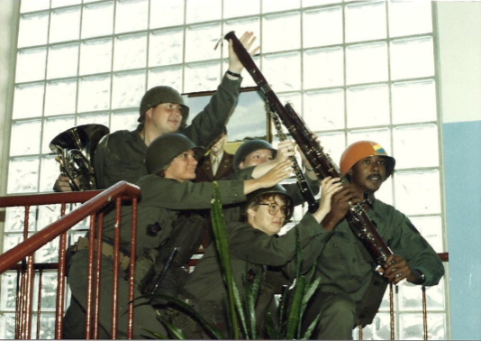
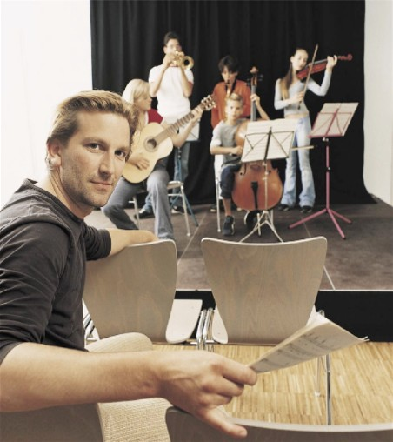
Today’s Session
WE WANT YOU!
Tips for Recruiting Students
Tips for Retaining Students
First Performance Program

Slide 3
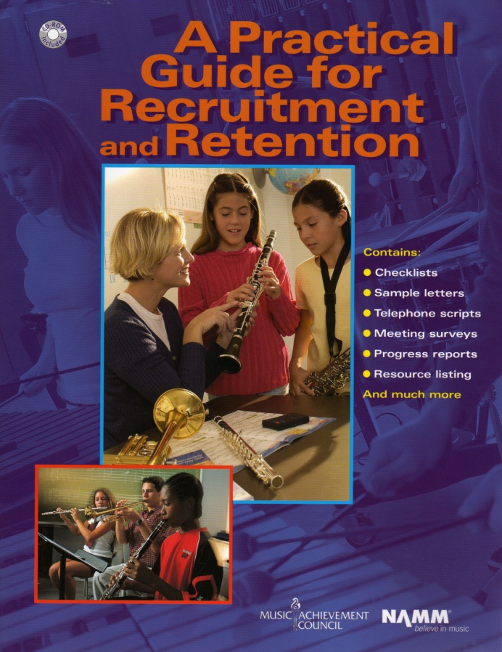
Materials Available for You to Use. . . A Year-Round Planner
12 pages of proven methods
10 pages of sample forms
Guidelines for directors

Slide 4
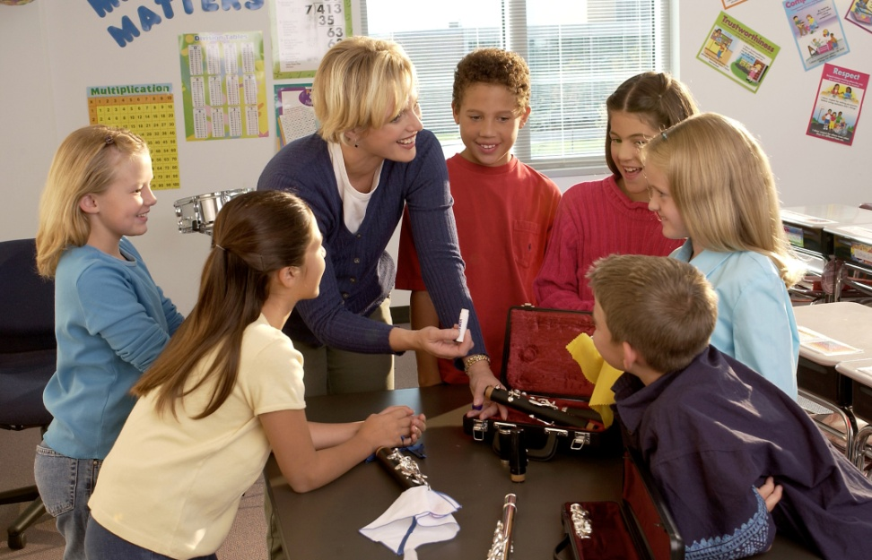
Fundamental Beliefs of
Effective Recruiters:
Every student will be interested
All students will have an equal opportunity to succeed
Music is an integral part of their total education
Every student is eagerly welcome-- regardless of talent or ability
Students want to play because it looks like fun

Slide 5
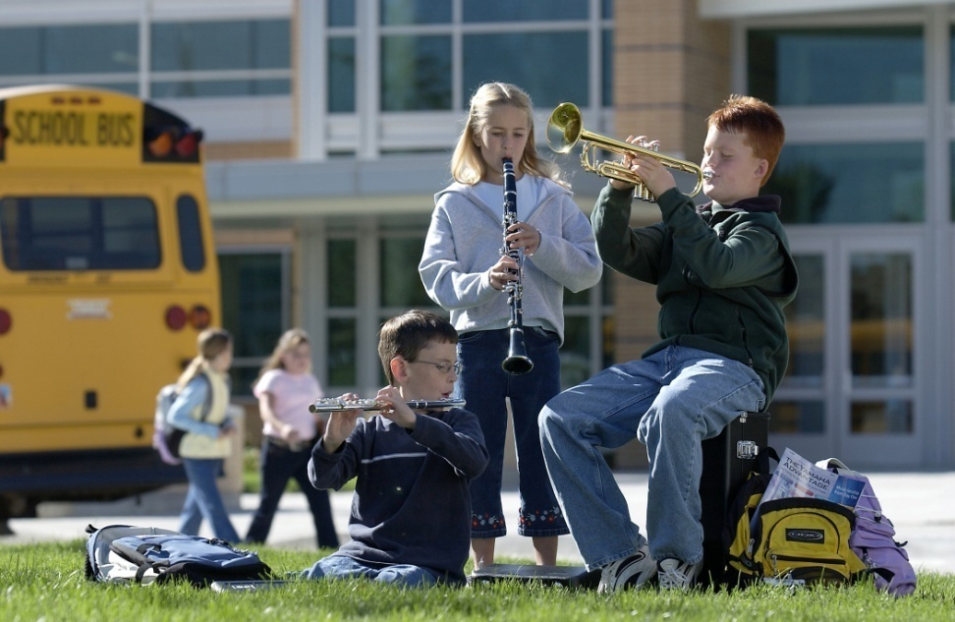
Key Steps in Recruiting:
Attracting Students. . .
Foster student interest through visibility
Inform parents of benefits of music
Build and nurture support among administration & classroom teachers

Slide 6
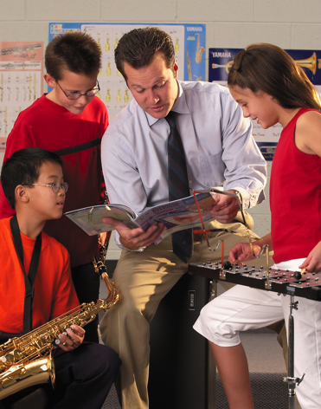
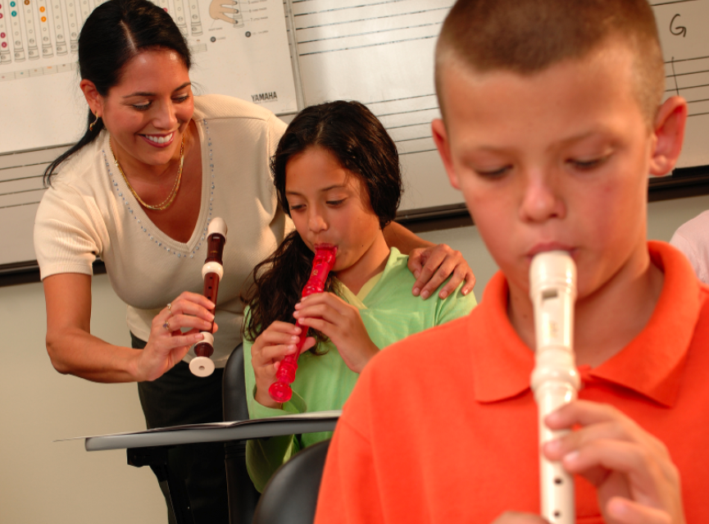
Key Steps in Recruiting
Recruiting is a YEAR-ROUND process including:
Regular visits with feeder programs/teachers
Effective PR: Bulletin boards, school newsletters, PTA announcements, concert programs, school announcements
Mass concerts with feeder programs
including recorder classes
Recruitment meetings with
students and parents—REACH OUT!
Instrument demos/petting zoos
Follow-ups – SHOW UP FOR EVERYTHING!
www.musicachievementcouncil.org
Notes:
6

Slide 7
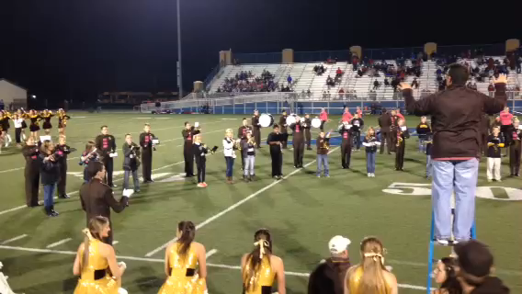
Key Steps in Recruiting:
Engage Students Early. . .
www.musicachievementcouncil.org
Notes:
7

Slide 8
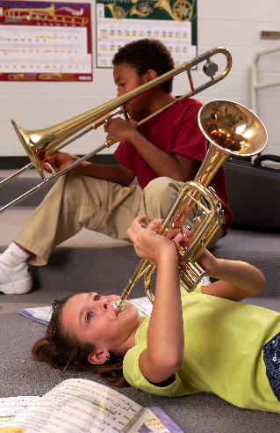
Key Steps in Recruiting:
What’s Really Important. . .
Ensure HIGH quality and fulfillment
Your ENTHUSIASM matters
Be friendly, approachable
Students have big dreams of success—give it to them!
It’s never to early to recruit
Learning can be FUN! SMILE!
www.musicachievementcouncil.org
Notes:
8

Slide 9

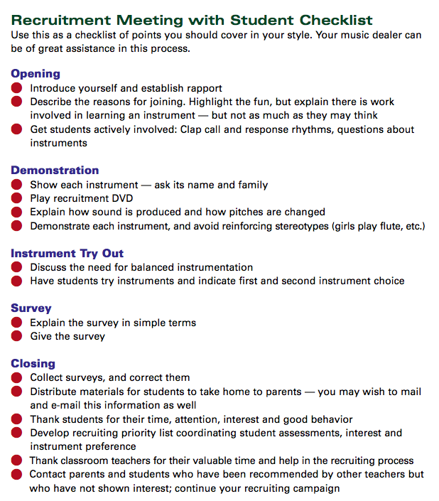

Key Steps in Recruiting: Plan Way Ahead
  Meet with feeder/classroom teachers to identify future instrumentalists
  Select recruitment materials: DVDs, posters, surveys, forms, pamphlets, PR items
  Enlist dealer help well in advance--let them know what you need

Slide 10

Presentation Day
Can be: Musical Aptitude Survey
Instrument Try-out
  Best in classroom setting
  Show up unannounced
  Never ask, “how many want to be in the band, choir, orchestra. . .”
    Instead, ask for a who of hands “how many of you want to try an instrument?”
  Keep presentation short (30 minutes)
  BE ENTHUSIASTIC!!!!!
Notes:
10

Slide 11

Follow-up idea from:
Jeff Scott and Emily Wilkinson
  “Congratulations!
  You have been chosen to
  play (insert instrument)
  in the (name of school) band!”
  Giving a “Golden Invitation” to band makes
  them feel special!”
Notes:
11

Slide 12

Engage Parent Support
Recruitment Letters
  Keep them simple, upbeat and informational
  Emphasize rewards, details,
  your expectations
  RSVP form
Initial Meeting
  Involve current parents
  Explain rental program
  Provide advocacy materials
Best Ambassador is an Excited Child

Slide 13
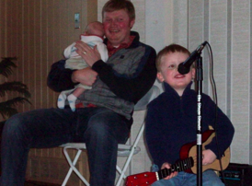
Teach the Parents Too. . .
They don’t know what NORMAL is!
  Teach PARENTS how to support their child’s practicing
Notes:
www.musiceducationconsultants.net/mmea2010
13

Slide 14
Teach the Parents Too. . .
They don’t know what NORMAL is!
  Teach PARENTS how to support their child’s practicing
  Give PARENTS ideas of how to keep their children motivated
Notes:
www.musiceducationconsultants.net/mmea2010
14

Slide 15
Teach the Parents Too. . .
They don’t know what NORMAL is!
  Teach PARENTS how to support their child’s practicing
  Give PARENTS ideas of how to keep their children motivated
  Encourage PARENTS to play an active role in the learning process and to become involved
Notes:
www.musiceducationconsultants.net/mmea2010
15

Slide 16
Teach the Parents Too. . .
They don’t know what NORMAL is!
  Teach PARENTS how to support their child’s practicing
  Give PARENTS ideas of how to keep their children motivated
  Encourage PARENTS to play an active role in the learning process and to become involved
  Communicate with Parents REGULARLY to keep them engaged
Notes:
www.musiceducationconsultants.net/mmea2010
16

Slide 17
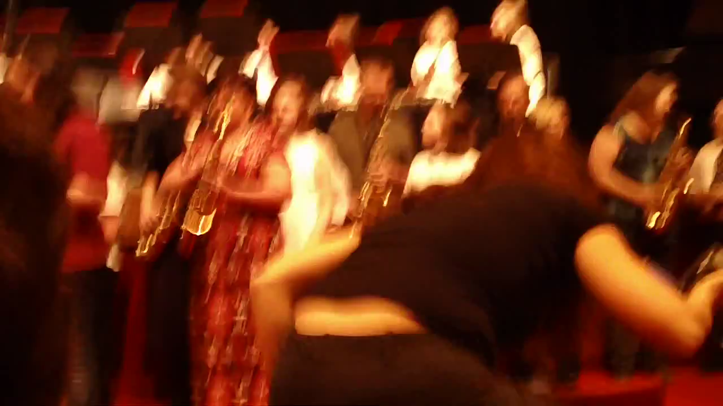
Engage Parent Support…Directly!
The Parent Band – REALLY FUN!
Notes:
www.musiceducationconsultants.net/mmea2010
17

Slide 18
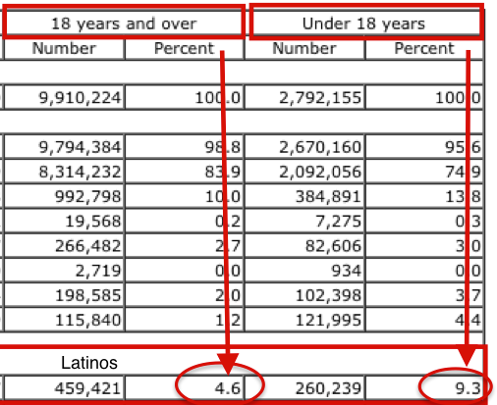
Increase Your Base
Add NEW Students
(and Offerings) to
your school’s comprehensive
Music Ed Program
PA’s Hispanic population grew by 82.6% between 2000 and 2010*
PA Ave Growth
Latinos Over 18 = 4.6%
PA Ave Growth
Latinos Under 18 = 9.3%
*ProximityOne.com
Notes:
www.musiceducationconsultants.net/mmea2010
18

Slide 19
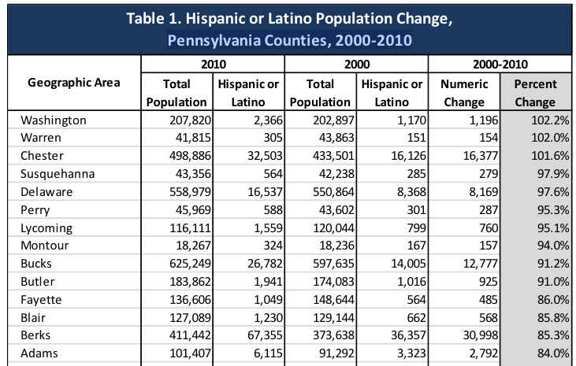
Increase Your Base
Notes:
www.musiceducationconsultants.net/mmea2010
19

Slide 20
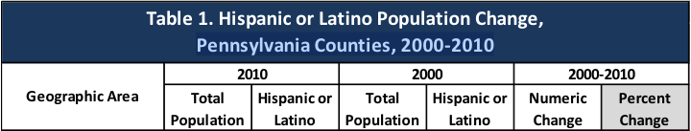
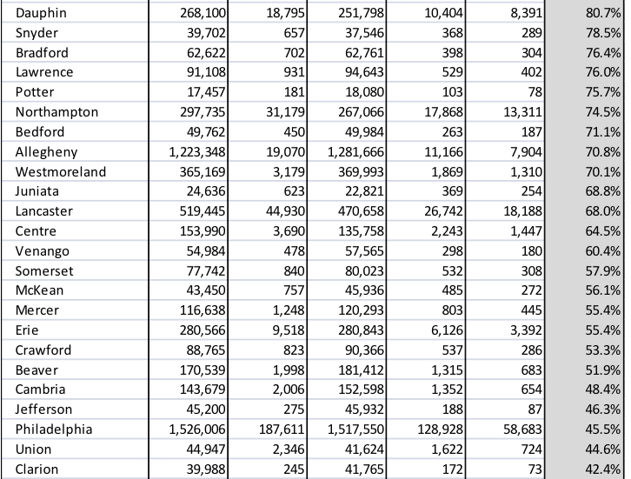
Increase Your Base
Notes:
www.musiceducationconsultants.net/mmea2010
20

Slide 21

¡Mariachi!
Bailey MS Mariachi Program: Year 2
Notes:
www.musiceducationconsultants.net/mmea2010
21

Slide 22
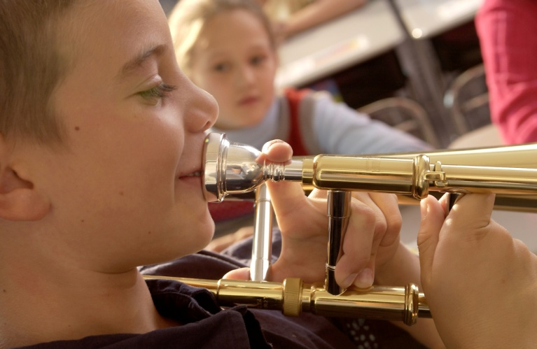
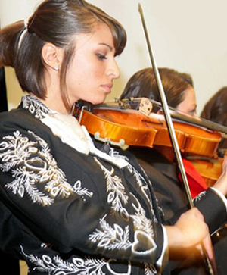
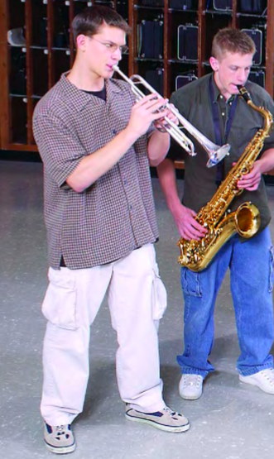
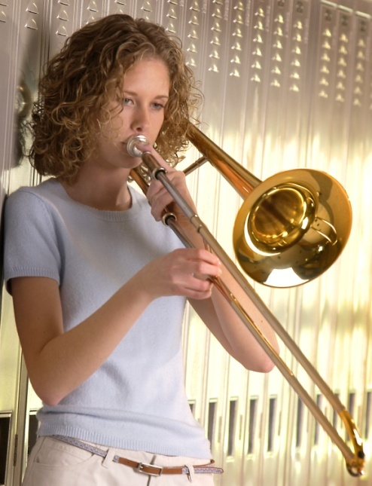
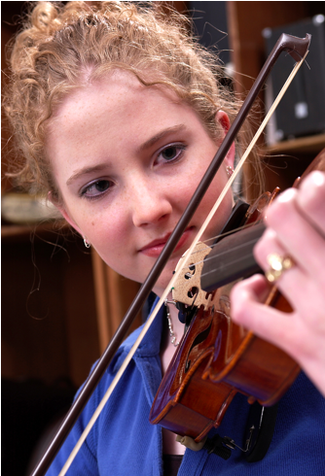
Keeping Your New Recruits

Slide 23

Keeping Your New Recruits. . .
Why Do Kids Stay? Let’s Ask THEM!

Slide 24
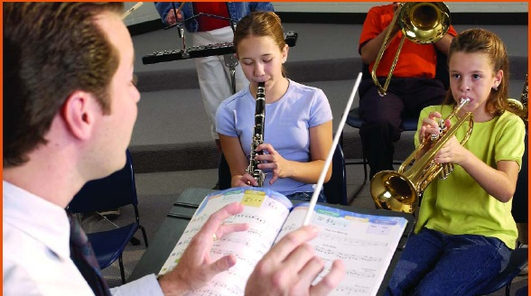

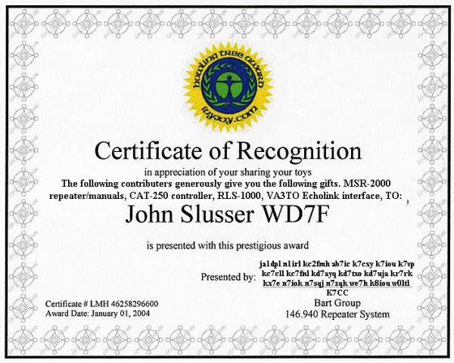
Retention: Keys to Success
Provide a satisfying experience from the day they receive their instruments
Build appreciation for the ensemble
Give recognition and reinforcement

Slide 25
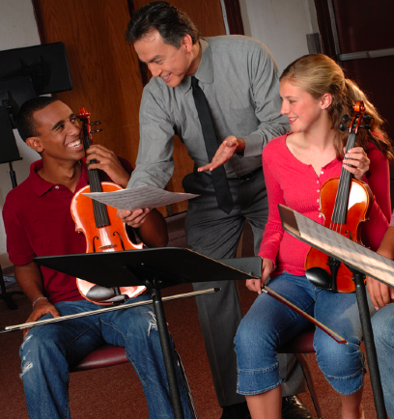
Actions That Help Retain Students
Developing group pride
Improving communication with parents
Evaluating yourself on a continual basis – “What else?”
Understanding each student as
an individual
Being positive and enthusiastic
Providing engaging lessons consistently
www.musicachievementcouncil.org
Notes:
25

Slide 26

Why Should Students Continue?
Tell Your OWN Story:
www.musicachievementcouncil.org
Notes:
26

Slide 27
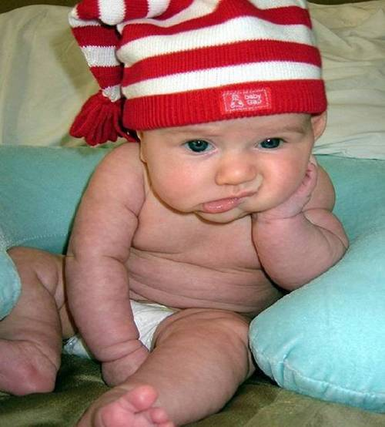

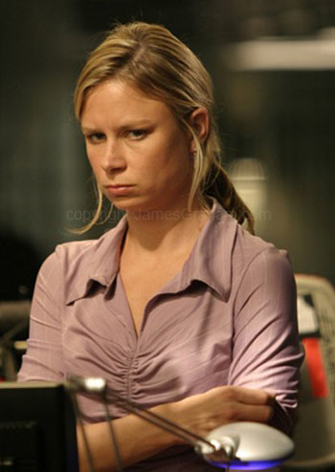

Common Reasons for Drop-outs?
The first disappointment
Lost interest
Didn’t like the teacher
Conflicts
Notes:
27

Slide 28
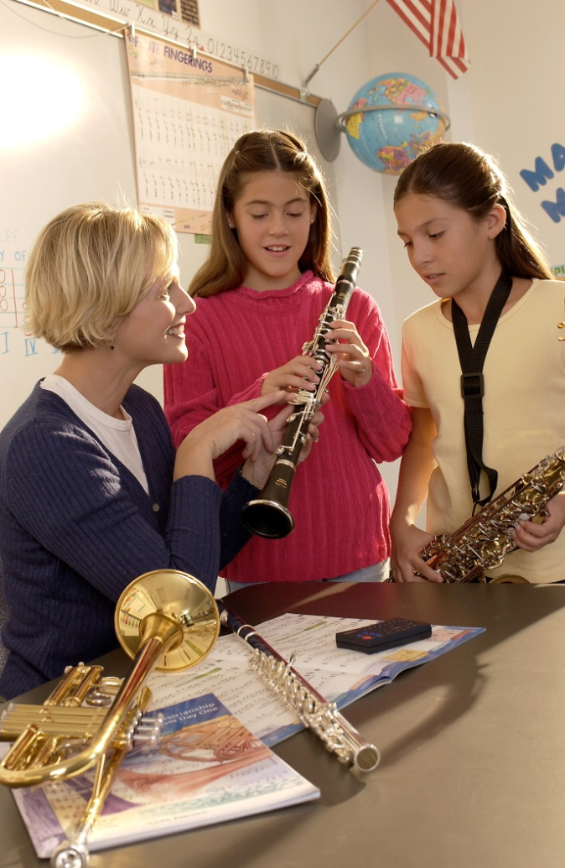
What Can You Do?
Talk to the student
  Probe for real reason they want to quit
  Show interest
Check their instrument
Talk with the parents
Iowa Bandmasters Exit Survey online

Slide 29
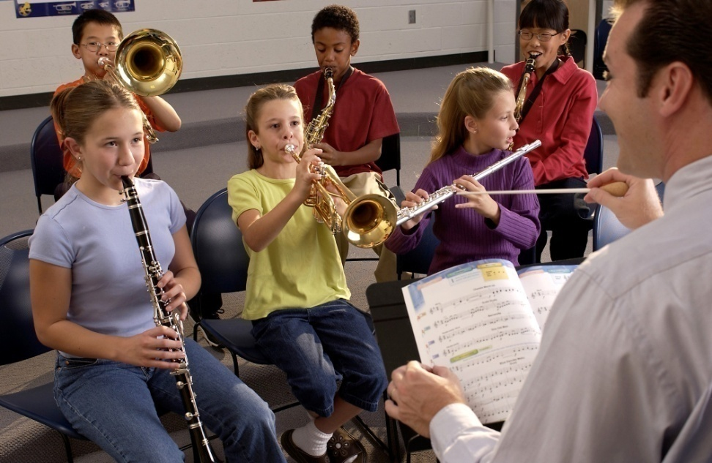
What If …
Students saw immediate success?
Parents heard their kids play their first performance just weeks after they started?
Learning to play was really fun?

Slide 30
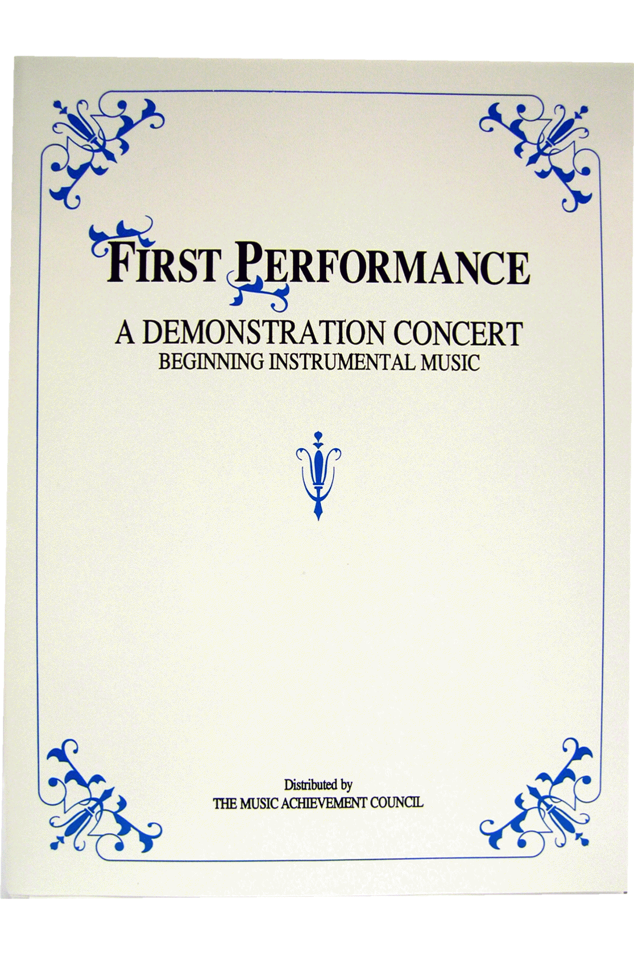
First Performance Concert!
A scripted demonstration of what your students have learned

Slide 31
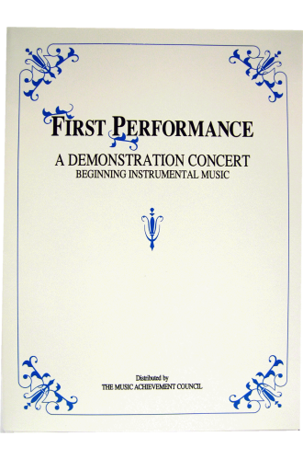
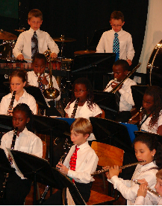
First Performance Demonstration Concert for Band or Orchestra
Schedule 6-8 weeks after the first class
Complete “turn-key” package
May be the best performance in terms of excitement and audience!

Slide 32

First Performance Demonstration

Slide 33
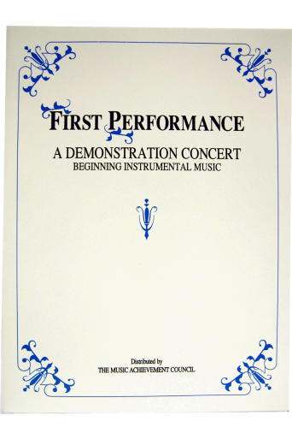
Why Does First Performance Work?
The timing of the performance
  Parents want to hear their kids play
  Student interest soars and they learn to love performing
Students practice more prior to a performance
It works with any group … any schedule … any situation … and any method book
The audience will be large … enthusiastic … and will arrive early -- lots of quality time with those who care most about the outcome -- the parents!

Slide 34

Parents will be amazed … most have no idea how much their child has learned based on what they hear at home!

Slide 35
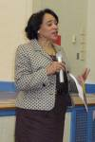

Students enjoy the satisfaction of a performance after good preparation – the process starts early
Many schools have the principal serve as the narrator -- GREAT PR!
The sound of
applause is
infectious

Slide 36
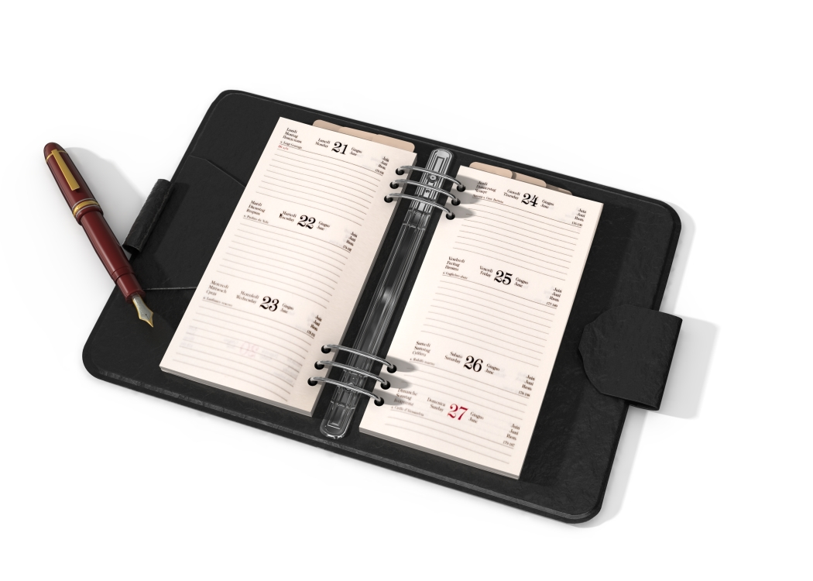
Put the Date on Your Calendar!
Schedule First Performance NOW!

Slide 37

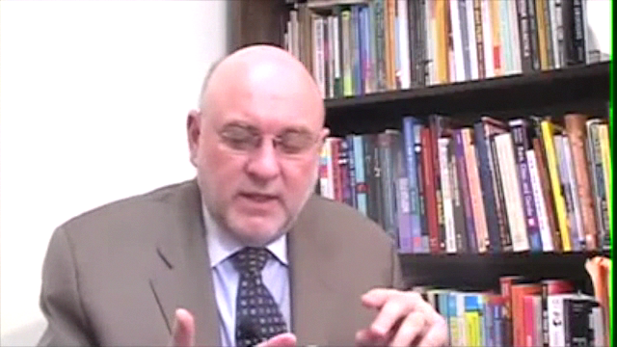
M.A.C. Wants to Help. . .
Check Out Our Online Resources
www.musicachievementcouncil.org
@MusicAchCouncil
Notes:
37

Slide 38
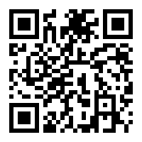

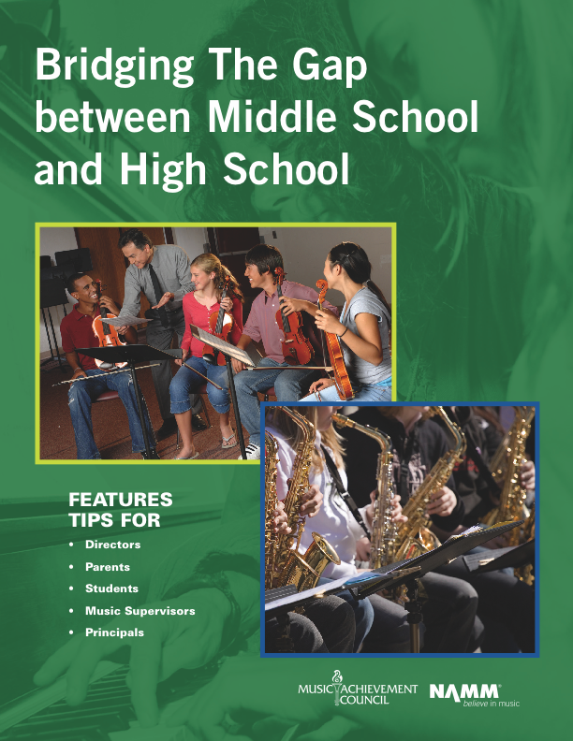
Got SMART Phone?
Notes:
38

Slide 39












Thanks to
These Quality Companies!
@MusicAchCouncil @MusicEdConsult
Notes:
www.musiceducationconsultants.net/mmea2010
39

Slide 40
Thanks to
These Quality Companies!
@MusicAchCouncil @MusicEdConsult
Notes:
www.musiceducationconsultants.net/mmea2010
40

