Slide 1





2015 WMEA
October 30, 2015
Bridging the Gap Between
Middle School and High School
Marcia Neel
Todd and Dede Heid
Fred Melk
Steve Mellin
Chris White
http://www.musicedconsultants.net/conference-materials

Slide 2
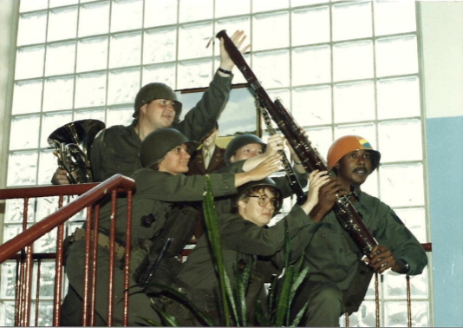
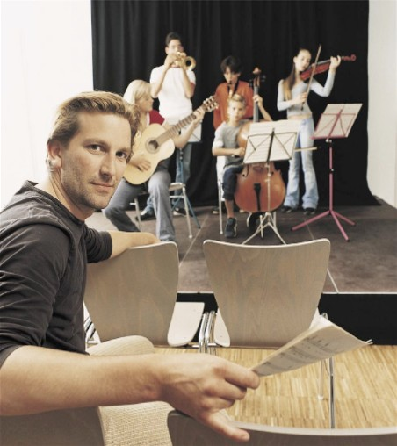
Today’s Session:
WE WANT (TO KEEP) YOU!
The WHAT
The WHY
The HOW

Slide 3

WHAT Other Teachers Think I Do!

Slide 4
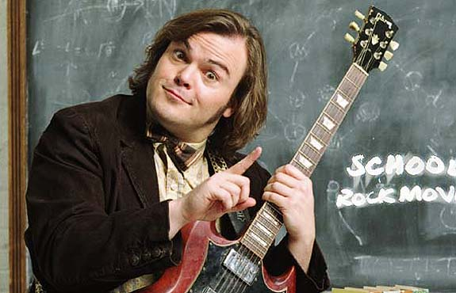
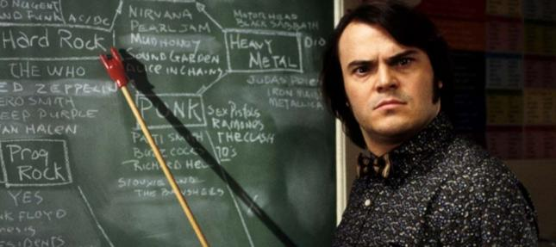
WHAT the Kids Think I Do!

Slide 5

WHAT Society Thinks I Do!

Slide 6
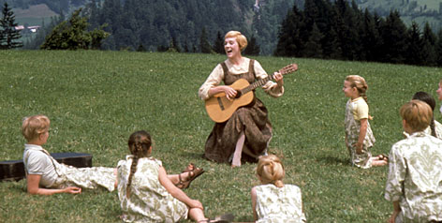
WHAT My Mom Thinks I Do!

Slide 7
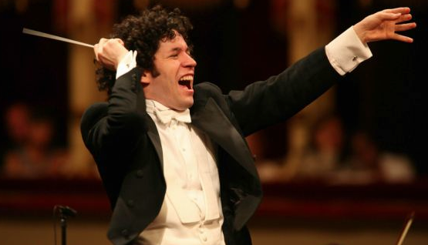
WHAT I Think I Do!

Slide 8
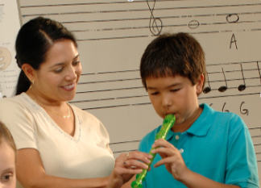
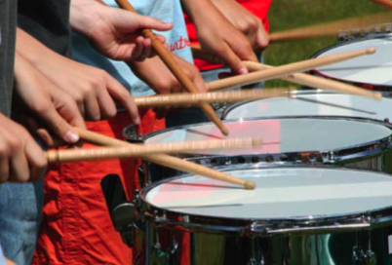
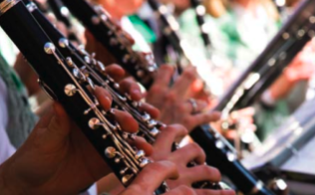
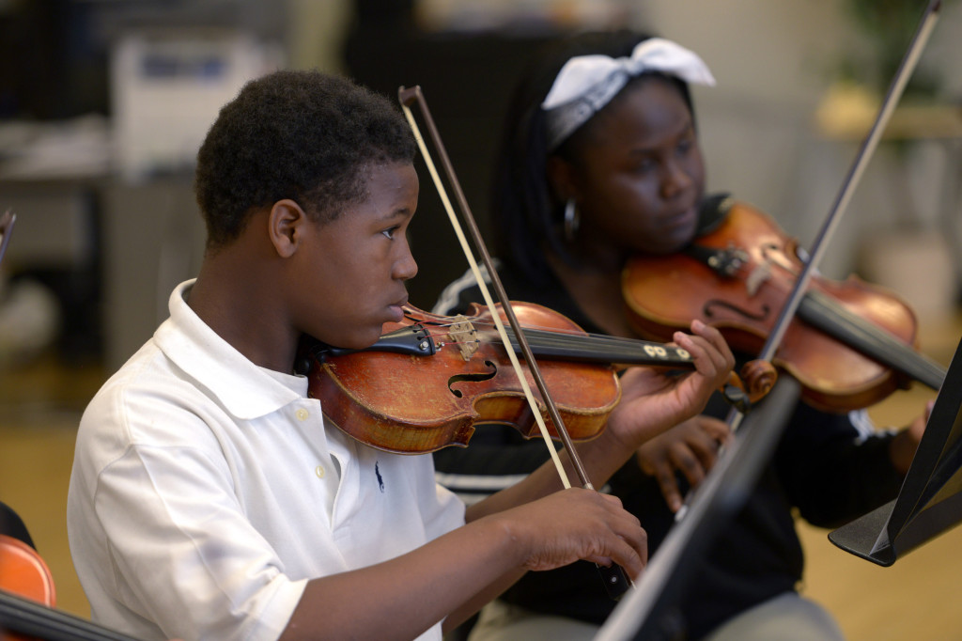
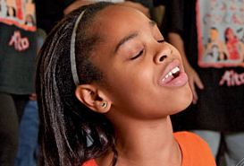
WHAT I Really Get to Do!
Facilitate Success and Fulfillment

Slide 9
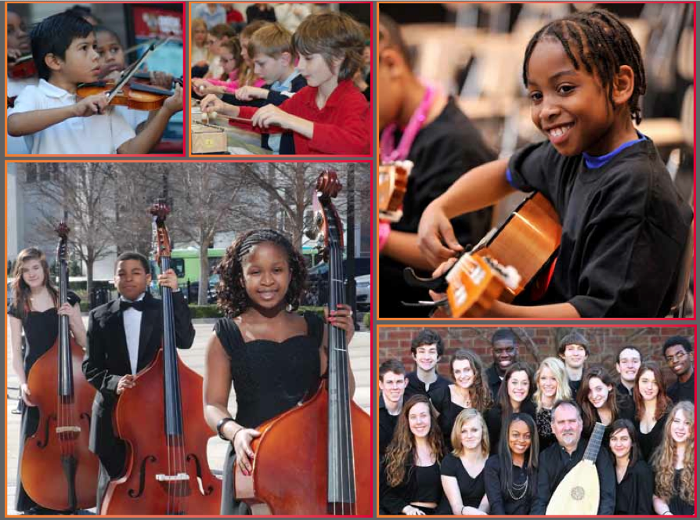

The WHY
RECENT FINDINGS
Music Makes Us
Baseline Research Report
http://musicmakesus.org/resources/research

Slide 10
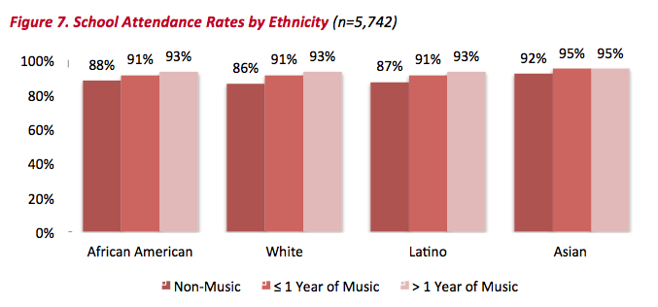
The WHY
ATTENDANCE RATES
http://musicmakesus.org/resources/research

Slide 11
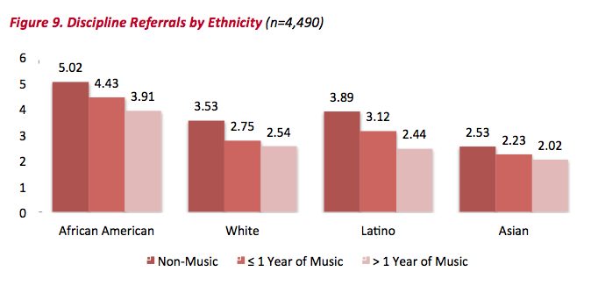
The WHY
DISCIPLINE REFERRALS
http://musicmakesus.org/resources/research

Slide 12
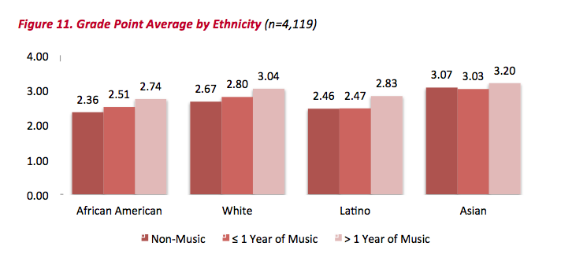
The WHY
GPA
http://musicmakesus.org/resources/research

Slide 13
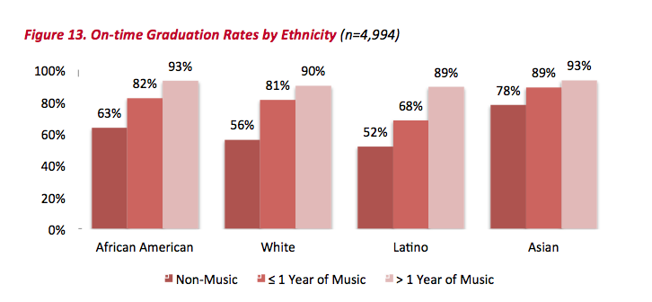
The WHY
ON-TIME GRADUATION RATES
http://musicmakesus.org/resources/research

Slide 14
The WHY
SUMMARY: What Was Learned?
“The more a student participates
in music, the more positive
these benefits become.”
http://musicmakesus.org/resources/research

Slide 15
The HOW
STRATEGIES TO BRIDGE THE GAP
What Music Educators Can Do
What HS/MS Parents Can Do
What HS/MS Students Can Do
What HS/MS Principals Can Do
What Music Supervisors Can Do

Slide 16
The HOW
STRATEGIES TO BRIDGE THE GAP
What Music Educators Can Do:
Work as a district-wide
Music Education TEAM with one goal:
To ensure continued,
active music-making.
Build the vision EARLY – ELEMENTARY!
First Performance!

Slide 17

The HOW: First Performance
Build the vision EARLY – ELEMENTARY!

Slide 18
The HOW
STRATEGIES TO BRIDGE THE GAP
COMMIT as a TEAM to:
Establish a district-wide vision/mission that promotes unity. . .even include a logo and tag line!
Good Examples of Visions (destinations):
A world where all children
grow up feeling safe, loved, and joyful.
A. Life Is Good T-Shirts:
A great public
school for all students.
B. National Education Assoc. (NEA):

Slide 19
The HOW
STRATEGIES TO BRIDGE THE GAP
COMMIT as a TEAM to:
Establish a district-wide vision/mission that promotes unity. . .even include a logo and tag line!
A. Google:
Good Examples of Missions (purpose):
Google’s mission is to organize the world’s
information and make it universally accessible
and useful.
B. NAfME:
To advance music education by
encouraging the studying and making of music
by all.

Slide 20
The HOW
STRATEGIES TO BRIDGE THE GAP
COMMIT as a TEAM to:
Establish a district-wide vision/mission that promotes unity. . .even include a logo and tag line!
Good Examples of a Music Dept Vision/Mission:
Badgers School District Music Education
Department Vision:
A community where all children
grow up experiencing the joy of active music-making.
To prepare all students for fulfilling, life-long music-making experiences.
B. BSD MED Mission:

Slide 21
The HOW
STRATEGIES TO BRIDGE THE GAP
COMMIT as a TEAM to:
Establish a district-wide vision/mission that promotes unity. . .even include a logo and tag line!
GREAT Example of a Tag Line:
What happens in Vegas. . .

Slide 22

The HOW
STRATEGIES TO BRIDGE THE GAP
COMMIT as a TEAM to:

Slide 23
The HOW
STRATEGIES TO BRIDGE THE GAP
COMMIT as a TEAM to:
Establish a district-wide vision/mission that promotes unity. . .even include a logo and tag line!
A. Possible BSD logo and tag line:
What happens in Music. . .
Stays for a Lifetime!

Slide 24
The HOW
STRATEGIES TO BRIDGE THE GAP
COMMIT as a TEAM to:
2. Meet as a district-wide TEAM on a regular basis
to establish goals and measure progress.
Plan performances/activities together
Conduct each other’s ensembles
Attend each other’s performances
Chaperone each other’s trips
Hang out with each other!

Slide 25
The HOW
STRATEGIES TO BRIDGE THE GAP
COMMIT as a TEAM to:
3. Build a “retention” section on all K-12 school
music websites. Content could include. . .

Slide 26
A Photo is Worth 1000 Words!
  Lots of photos of elementary/middle students with the high school students at cool events (as well as at musical activities).
  B. Lots of photos of elementary/middle parents with the high school parents/students at cool events (as well as at musical activities).
  C. Lots of photos of elementary/middle/high school directors together at cool events (etc.).
  D. Lots of photos of elementary/middle/high school principals together at cool events. (etc.)

Slide 27
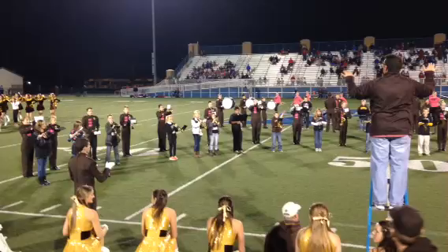
A Video is Worth 10,000 Words!

Slide 28
The HOW
Build the vision EARLY—ELEMENTARY!
COMMIT as a TEAM to:
1. Show up – Be visible – For everything!
2. Schedule a “Switch Day”
3. Engage parents EARLY!

Slide 29
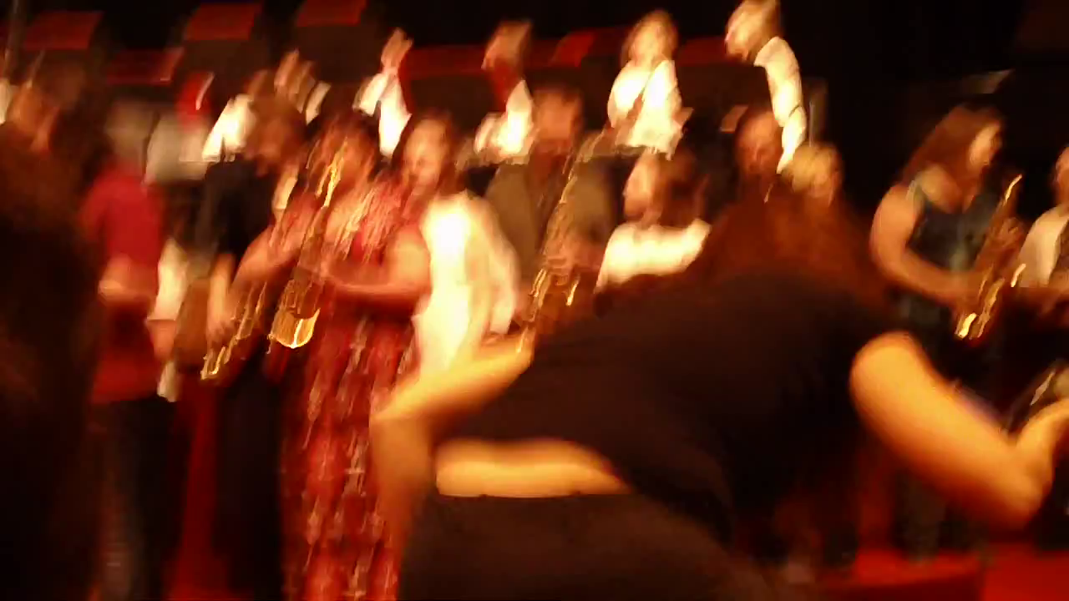
The HOW
Engage Parents EARLY—The Parent Band!

Slide 30
The HOW
What HS/MS Parents Can Do:
1. Schedule a VIP Parent Night at a joint
concert/halftime show performance
2. Facilitate events and activities
3. Host MS parent meetings at the high
school
4. Mentor parent leaders of feeder
programs

Slide 31
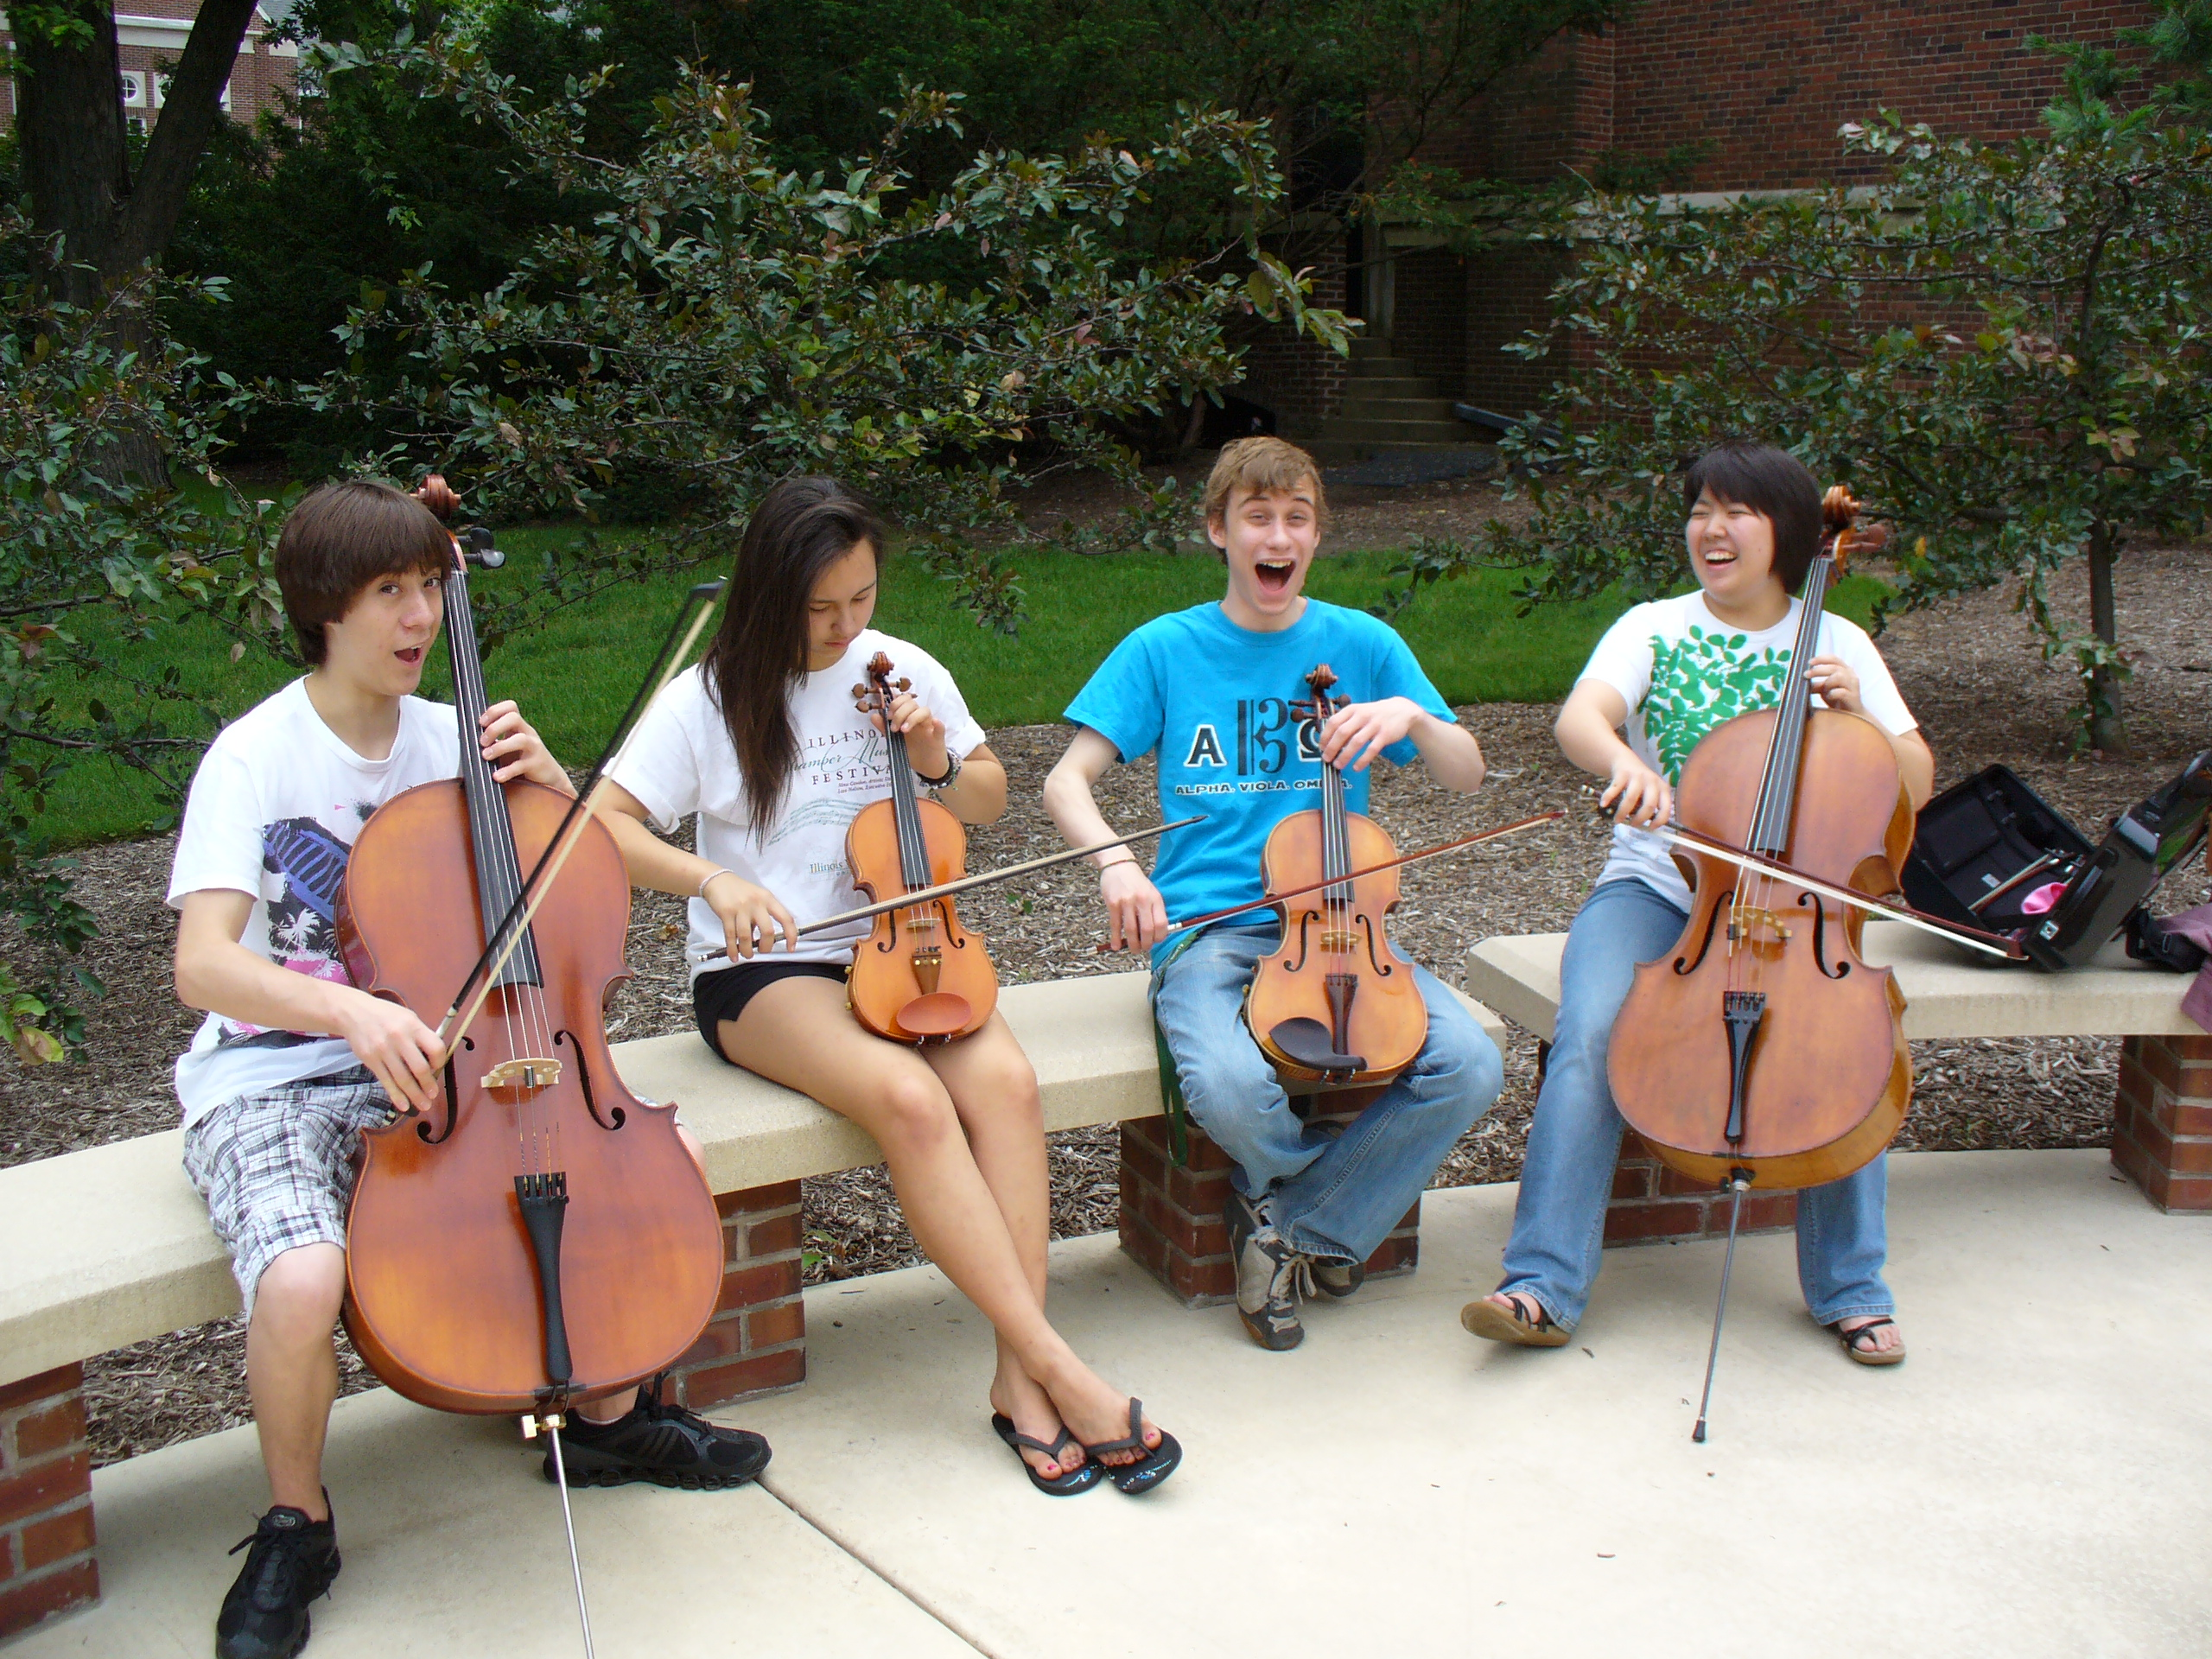
The HOW
What HS/MS Students Can Do:
1. Serve as “Intern Instructors” for FREE Summer Lesson Program for beginning (at-risk) students.

Slide 32
The HOW
What HS/MS Students Can Do:
1. Serve as “Intern Instructors” for FREE Summer Lesson Program for beginning (at-risk) students.
2. Participate ACTIVELY in ALL retention
efforts – give “testimonials”

Slide 33

The HOW
Give “testimonials”

Slide 34
The HOW
What HS/MS Students Can Do:
1. Serve as “Intern Instructors” for Summer
Lesson Program for beginning students
2. Participate ACTIVELY in ALL recruitment efforts – give “testimonials”
3. Remain engaged with former programs
A. Mentor upcoming students. . .Give back!
B. Coach upcoming students.
C. Serve that program: Usher, sell refreshments

Slide 35
The HOW
What HS/MS Students Can Do:
1. Serve as “Intern Instructors” for Summer
Lesson Program for beginning students
2. Participate ACTIVELY in ALL recruitment efforts – give “testimonials”
3. Remain engaged with former programs
4. Write letters of invitation (Big Bro/Sis)
and congratulations as appropriate

Slide 36

The HOW
What HS/MS Students Can Do:
4. Write letters of invitation (Big Bro/Sis)
and congratulations as appropriate
  “Congratulations!
  You have been chosen to
  play (insert instrument)
  in the (name of school) band!”
  Giving a “Golden Invitation” to band makes
  them feel special!”

Slide 37
The HOW
What HS/MS Principals Can Do:
1. Help facilitate recruitment assemblies/
events/activities at feeder schools
2. Work with feeder principals on
scheduling
3. Create joint presentation for (feeder)
parents
4. Provide opening remarks at each other’s
concerts

Slide 38
The HOW
What Music Supervisors Can Do:
1. Ensure that faculty sees itself as part of
one, K–12 Music Program –
build purpose and unity!

Slide 39
The HOW
What Music Supervisors Can Do:
2. Track articulation data
1. Ensure that faculty sees itself as part of
one, K–12 Music Program –
build purpose and unity!

Slide 40
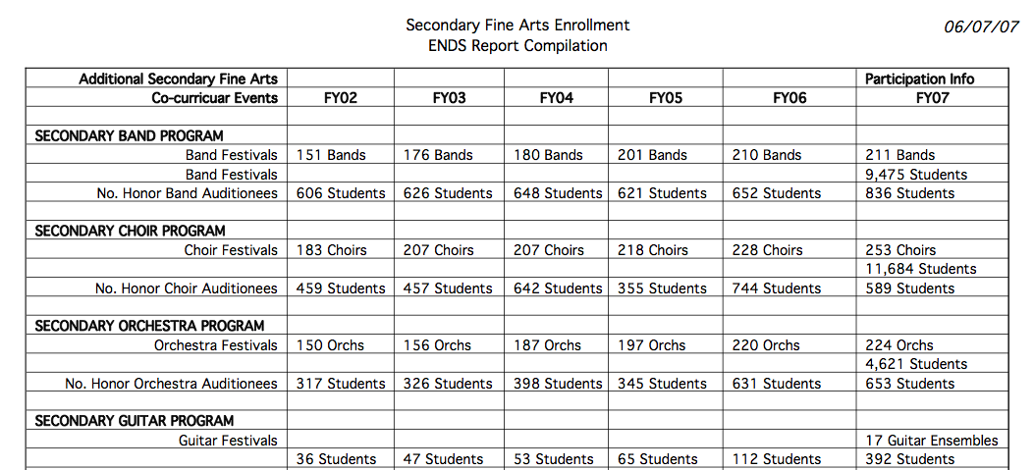
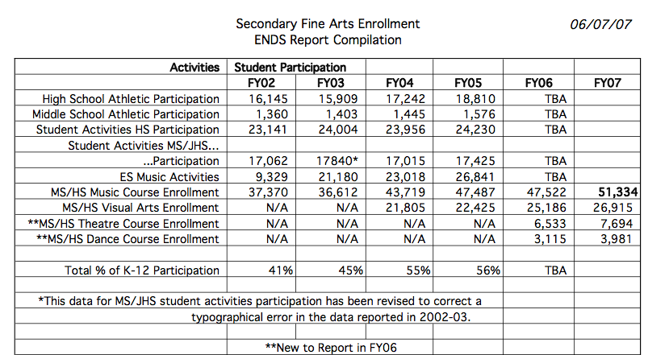
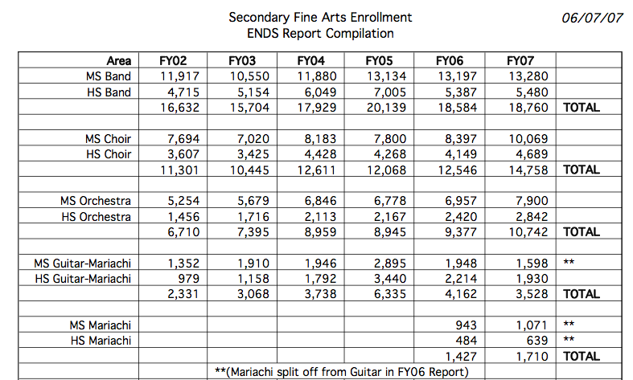

Slide 41
The HOW
What Music Supervisors Can Do:
1. Ensure that faculty sees itself as part of
one, K–12 Music Program –
build purpose and unity!
2. Track articulation data
3. Provide sample student schedules

Slide 42
The HOW
What Music Supervisors Can Do:
3. Provide sample student schedules
Wind Symphony
Algebra I
Biology
AP English
Music Theory
Orchestra
Algebra II
Geometry
Chemistry
Jazz Band
Chamber Ensemble
Algebra XV
Calculus

Slide 43
The HOW
What Music Supervisors Can Do:
1. Ensure that faculty sees itself as part of
one, K–12 Music Program –
build purpose and unity!
2. Track articulation data
3. Provide sample student schedules
4. Ensure that students receive quality
learning opportunities and experiences

Slide 44

A GREAT EXAMPLE: Foothill HS
“There is a place. . .”

Slide 45
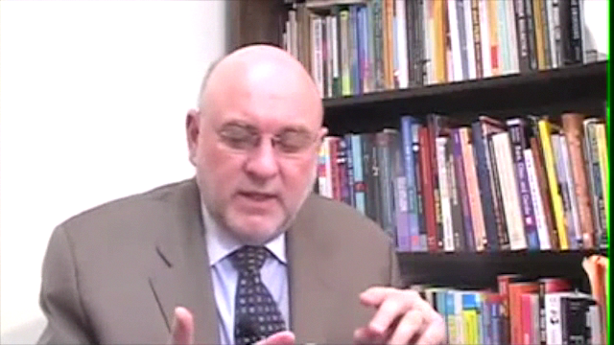
Check Out All of MAC
Online Resources
www.musicachievementcouncil.org

Slide 46
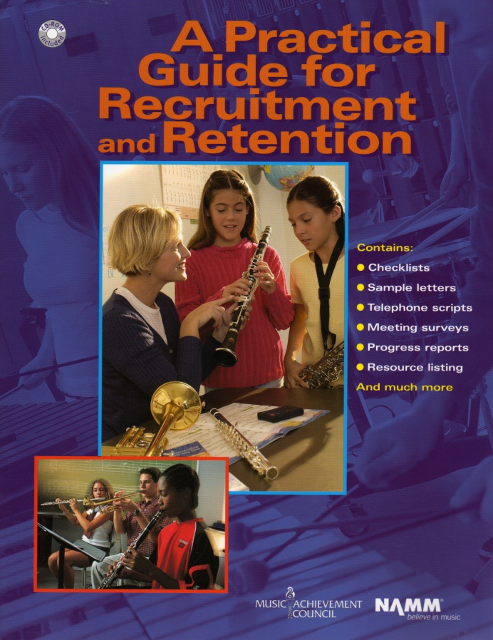
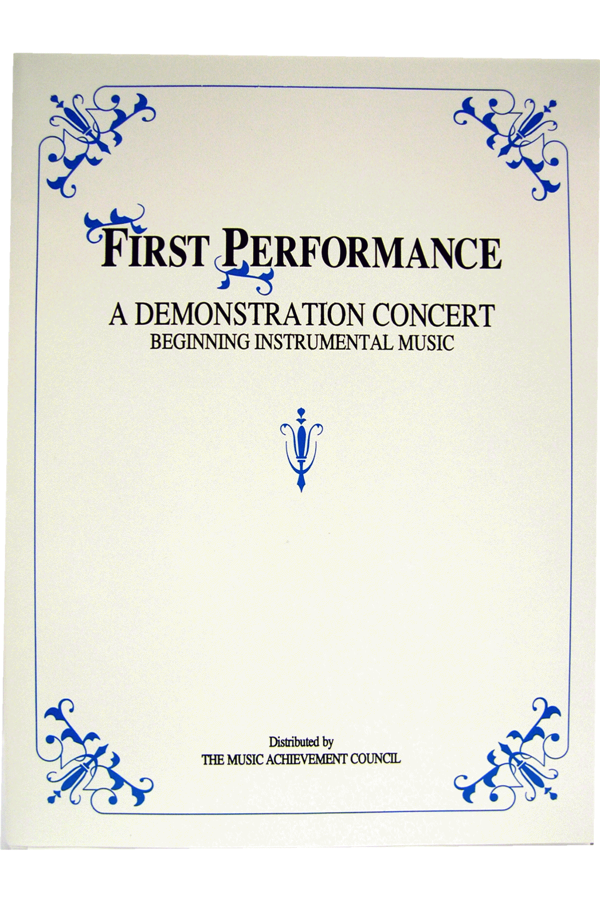
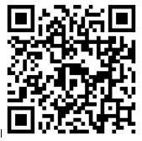
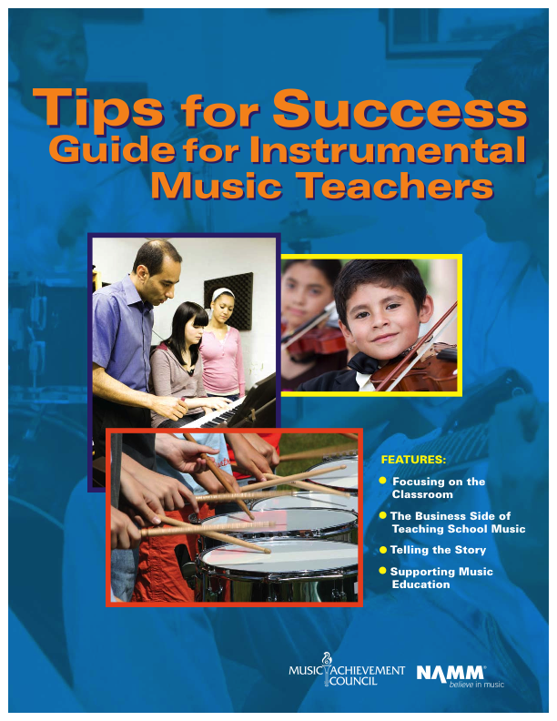
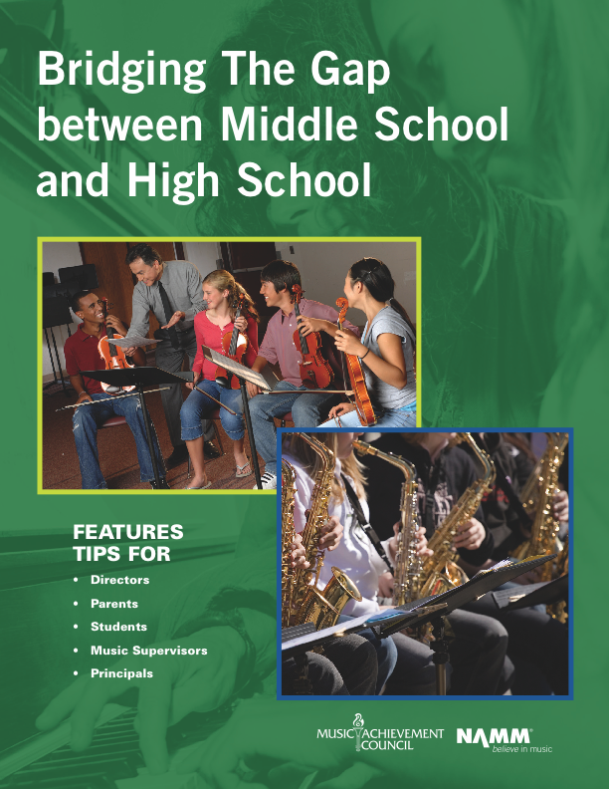
Got SMART Phone?
www.musicedconsultants.net/conference-materials
www.musicachievementcouncil.org

Slide 47

Give Your Music Program the
Recognition It Deserves!
https://www.surveymonkey.com/r/2016BCME

Slide 48












Thanks to the Music Achievement Council
Sponsors and These Quality Companies!

Slide 49
Thanks to the Music Achievement Council
Sponsors and These Quality Companies!

