Slide 1

DID YOU KNOW . . .
The Music Achievement Council (MAC) is an action-oriented, non-profit organization whose sole
purpose is to enable more students to begin and continue in instrumental music programs.
www.musicachievementcouncil.org

Slide 2

DID YOU KNOW . . .
96 percent of public school principals
believe that participating in music
education encourages and motivates
students to stay in school longer.
(Harris Poll)
www.musicachievementcouncil.org

Slide 3
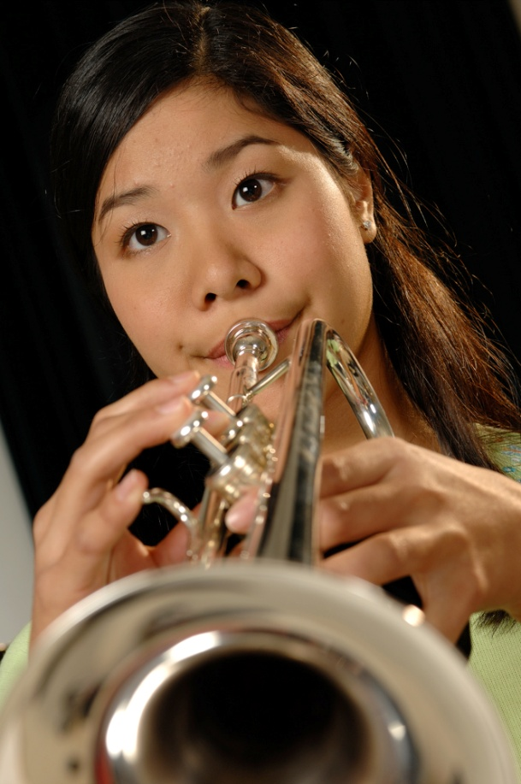
DID YOU KNOW . . .
An interactive poll confirms that music education at an early age greatly increases the likelihood that a child will grow up to seek higher education and ultimately even earn a higher salary. (2007 Harris Poll)
www.musicachievementcouncil.org

Slide 4

THE MESSAGE IS. . .
If you want to be a CEO, College President, or
even a Rock Star,
TAKE MUSIC!
www.musicachievementcouncil.org

Slide 5

THE MESSAGE IS. . .
If you want to be a CEO, College President, or
even a Rock Star,
TAKE MUSIC!
www.musicachievementcouncil.org

Slide 6



THE MESSAGE IS. . .
If you want to be a CEO, College President, or
even a Rock Star,
TAKE MUSIC!
www.musicachievementcouncil.org

Slide 7
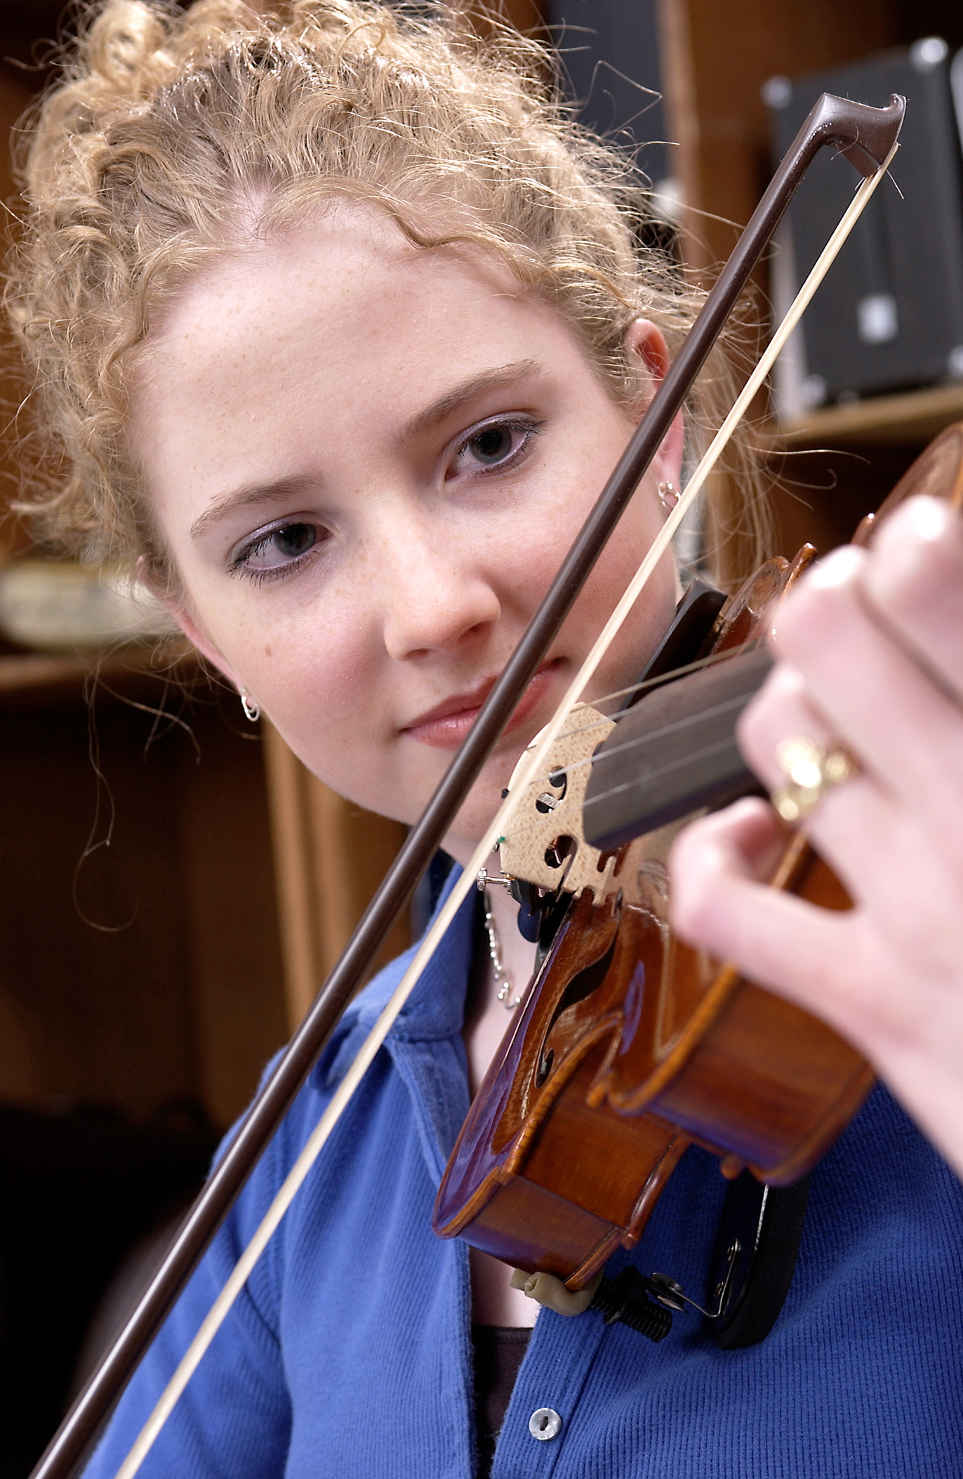
DID YOU KNOW . . .
82 percent of Americans who don’t currently play an instrument wish they had learned to play one. (Gallup Poll)
www.musicachievementcouncil.org

Slide 8
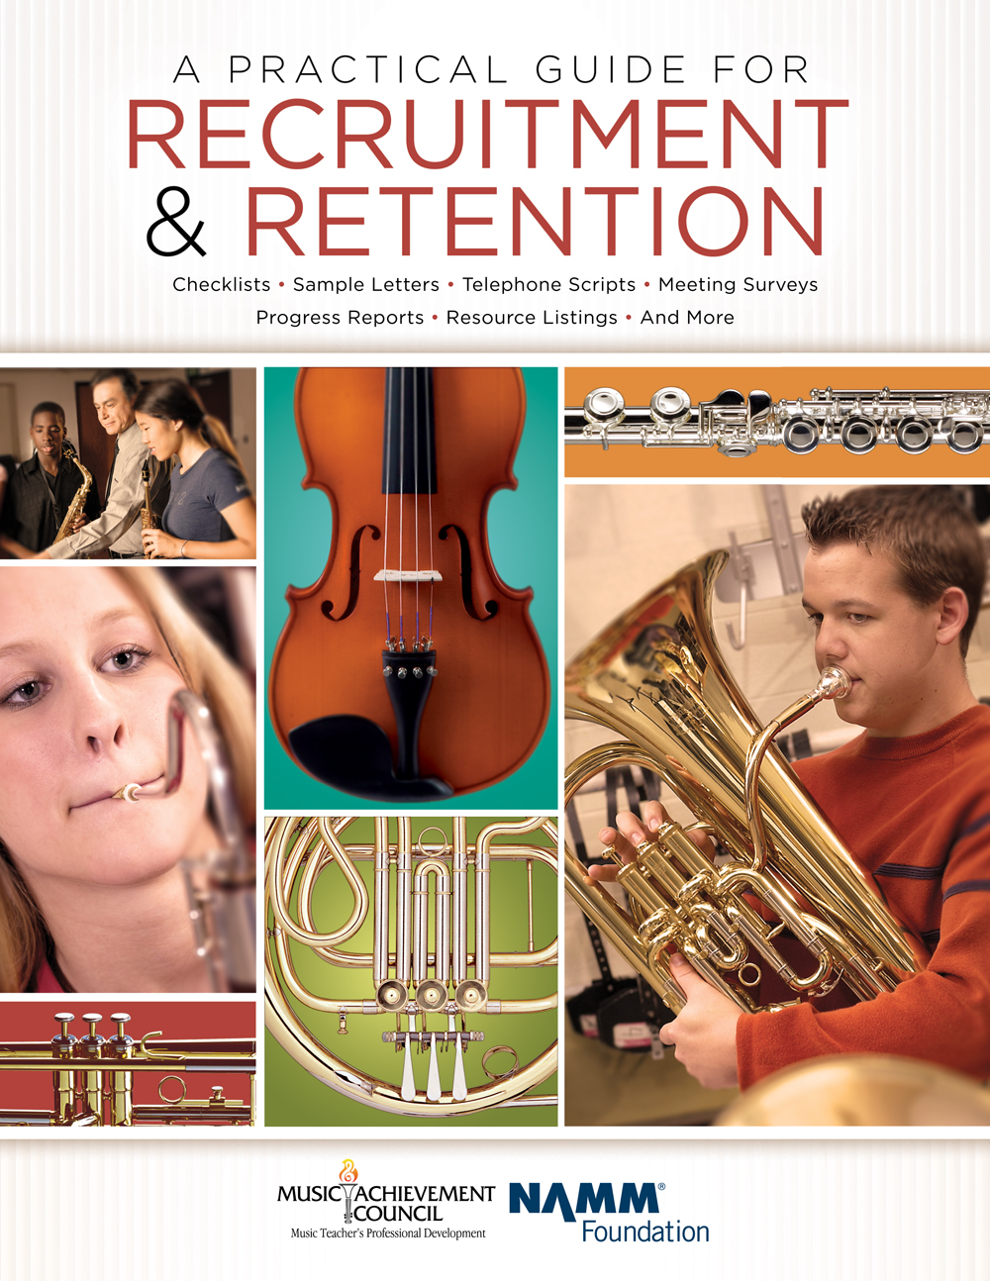
DID YOU KNOW . . .
All of today’s session attendees will receive FREE COPIES of:
A Practical Guide for Recruitment and Retention
www.musicachievementcouncil.org

Slide 9
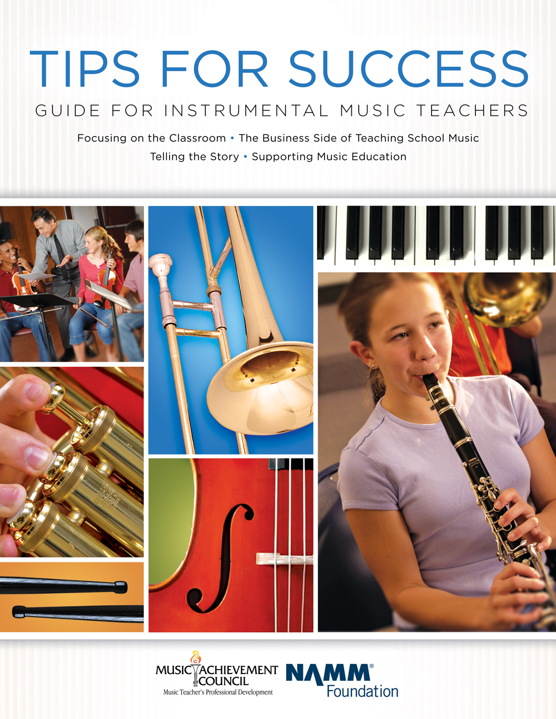
DID YOU KNOW . . .
All of today’s session attendees will receive FREE COPIES of:
Tips for Success:
A Guide for Instrumental Music Teachers
www.musicachievementcouncil.org

Slide 10
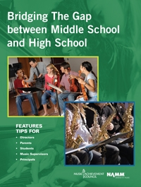
DID YOU KNOW . . .
All of today’s session attendees will receive FREE COPIES of:
Bridging the Gap between
Middle School and High School
www.musicachievementcouncil.org

Slide 11
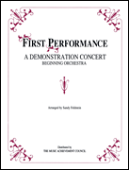
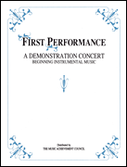
DID YOU KNOW . . .
First Performance Demo Concert for Band and/or Orchestra features sheet music, parts, sample letters, programs and student certificates for beginning ensembles. Students can perform a composition in seven short weeks with the materials provided!
www.musicachievementcouncil.org

Slide 12
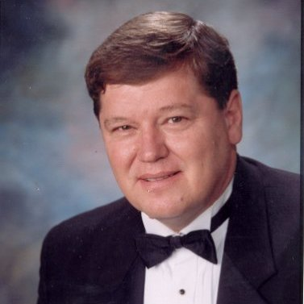
DID YOU KNOW . . .
Three of these publications are provided online at no charge by the Music Achievement Council.
They are based on real world strategies shared by the profession’s most successful music educators.
Greg Bimm

Slide 13
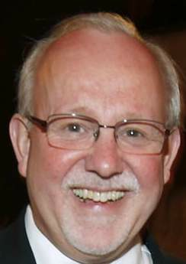
DID YOU KNOW . . .
Three of these publications are provided online at no charge by the Music Achievement Council.
They are based on real world strategies shared by the profession’s most successful music educators.
Charlie Menghini

Slide 14

DID YOU KNOW . . .
Three of these publications are provided online at no charge by the Music Achievement Council.
They are based on real world strategies shared by the profession’s most successful music educators.
Marcia Neel

Slide 15
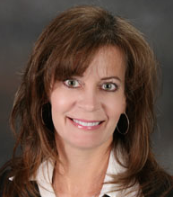
DID YOU KNOW . . .
Three of these publications are provided online at no charge by the Music Achievement Council.
They are based on real world strategies shared by the profession’s most successful music educators.
Terry Shade

Slide 16
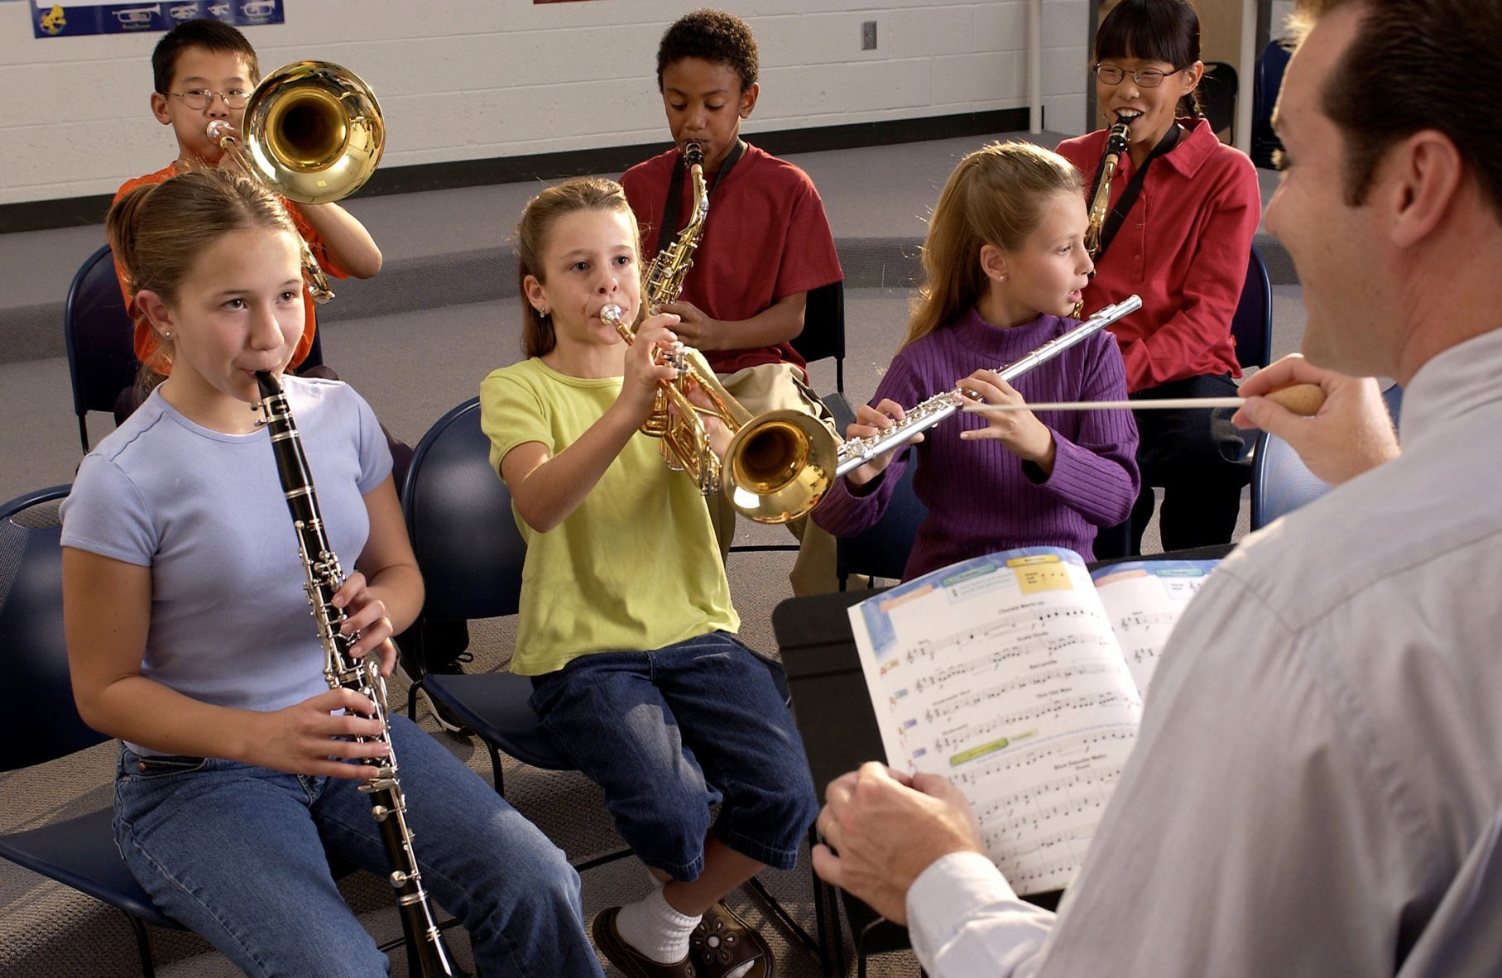

DID YOU KNOW . . .
www.musicachievementcouncil.org

Slide 17
DID YOU KNOW . . .
Music making has been scientifically proven to:
Exercise the brain
Inspire creativity
Increase productivity
Fight memory loss
Reduce stress
Lower blood pressure
Build confidence
Stave off depression

Slide 18

DID YOU KNOW . . .
Metropolitan Nashville Public Schools found that ATTENDANCE RATES ROSE with increased study in music.
No Music:
< 1 Year of Music:
> 1 Year of Music:
87% Attendance
91% Attendance
93% Attendance

Slide 19
DID YOU KNOW . . .
Metropolitan Nashville Public Schools found that DISCIPLINE REPORTS FELL with increased study in music.
No Music:
< 1 Year of Music:
> 1 Year of Music:
4.34 over 4 years
3.75 over 4 years
3.23 over 4 years

Slide 20
DID YOU KNOW . . .
Metropolitan Nashville Public Schools found that GPAs ROSE with increased study in music.
No Music:
< 1 Year of Music:
> 1 Year of Music:
2.51 Average
2.61 Average
2.89 Average

Slide 21
DID YOU KNOW . . .
Metropolitan Nashville Public Schools found that GRADUATION RATES ROSE with increased study in music.
No Music:
< 1 Year of Music:
> 1 Year of Music:
60% Average
81% Average
91% Average

Slide 22
DID YOU KNOW . . .
Metropolitan Nashville Public Schools found that ACT SCORES ROSE with increased study in music.
No Music:
< 1 Year of Music:
> 1 Year of Music:
16.95 Eng, 17.20 Math
17.64 Eng, 17.62 Math
19.58 Eng, 18.67 Math

Slide 23
WHAT WAS LEARNED?
The MORE a student participates in MUSIC,
the more POSITIVE these BENEFITS become.

Slide 24
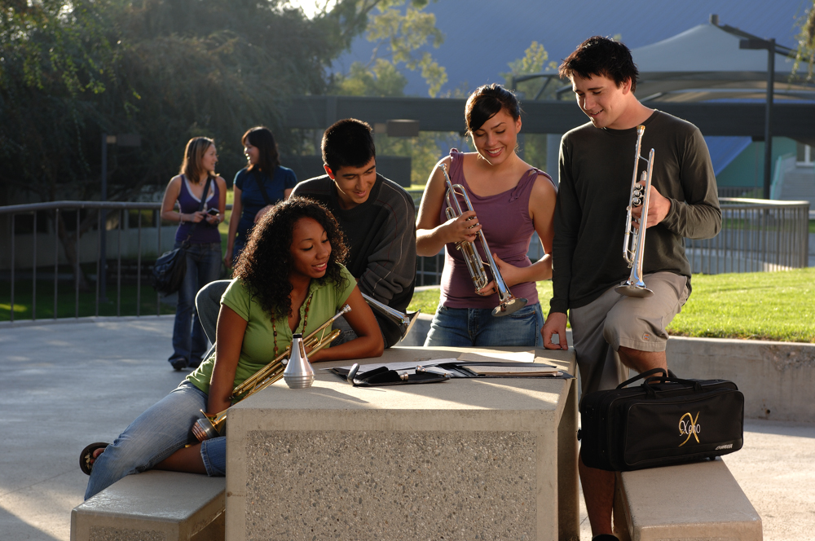
FAMOUS QUOTES. . .
Music has the power of producing a
certain effect on the moral character of
of the soul.
. . . Aristotle

Slide 25
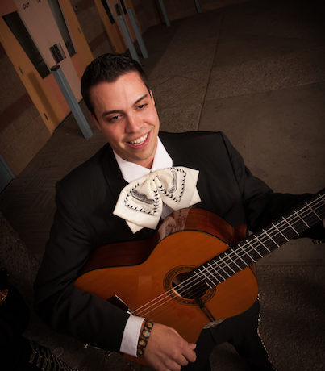
FAMOUS QUOTES. . .
Music furnishes a delightful recreation
for the hours of respite from the cares of the day, and lasts us through life.
. . . Thomas Jefferson

Slide 26










Bridging the Gap Between
Middle School and High School
Marcia Neel
2016 IMEA January 28, 2016
Peter Ellman
Russ Bullis
Beth Houlihan
Paul Bauer
Randy Wood
Randy King
George Quinlan
Robin Walenta

Slide 27
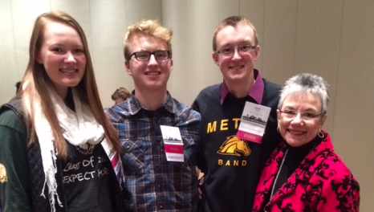
Special Thank You!!!!!
Allison Vickers
Jack Smid
Dan Drake

Slide 28
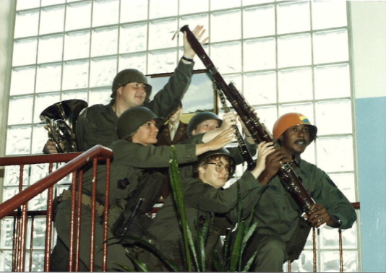
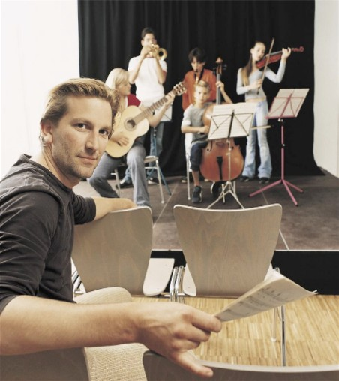
Today’s Session
WE WANT (TO KEEP) YOU!
The WHAT
The WHY
The HOW

Slide 29

WHAT Other Teachers Think I Do!

Slide 30
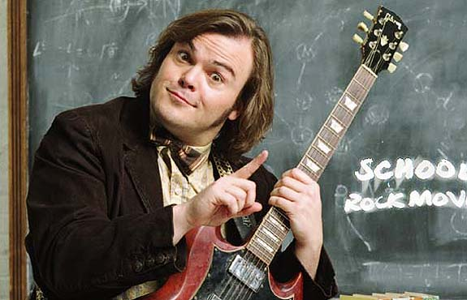
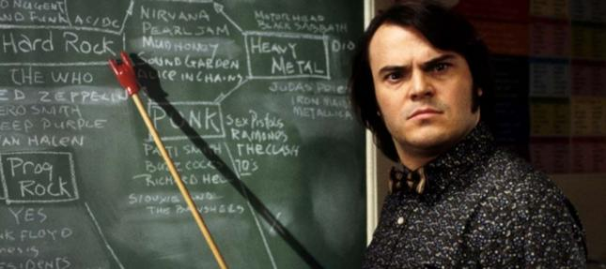
WHAT the Kids Think I Do!

Slide 31

WHAT Society Thinks I Do!

Slide 32
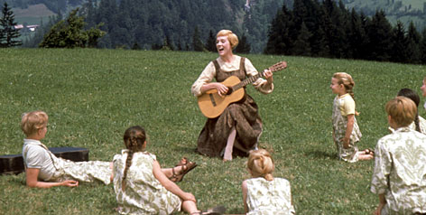
WHAT My Mom Thinks I Do!

Slide 33
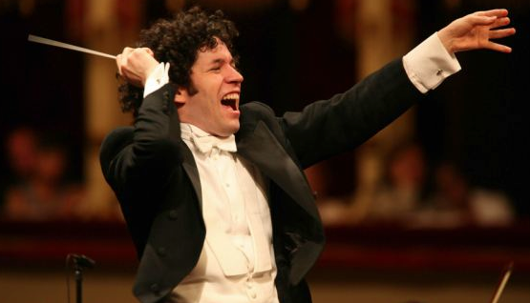
WHAT I Think I Do!

Slide 34
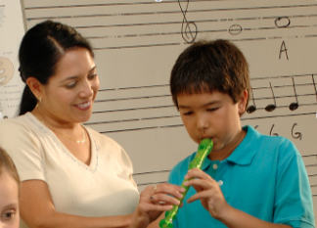


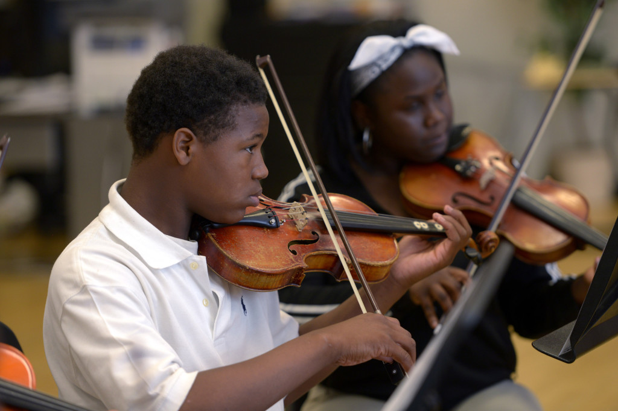
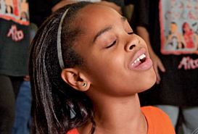
WHAT I Really Get to Do!
Facilitate Success and Fulfillment
www.musicachievementcouncil.org

Slide 35

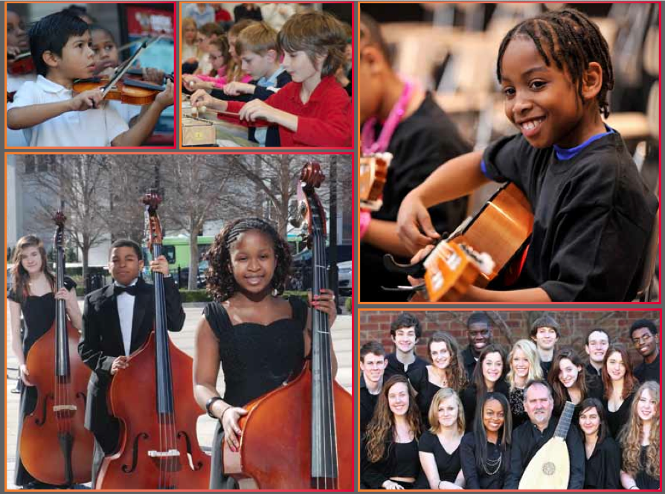

The WHY
RECENT FINDINGS
Music Makes Us
Baseline Research Report
http://musicmakesus.org/resources/research

Slide 36
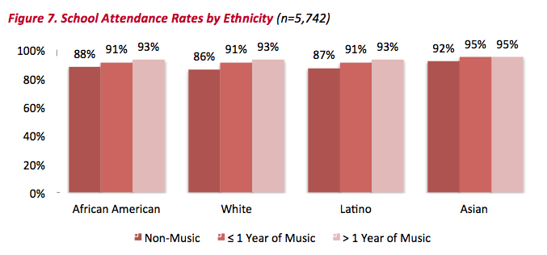
The WHY
ATTENDANCE RATES
http://musicmakesus.org/resources/research

Slide 37
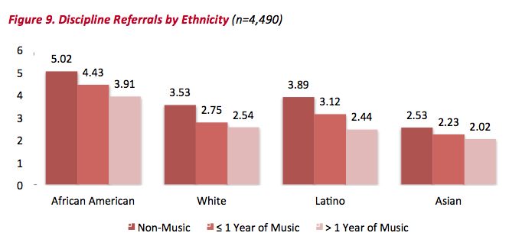
The WHY
DISCIPLINE REFERRALS
http://musicmakesus.org/resources/research

Slide 38
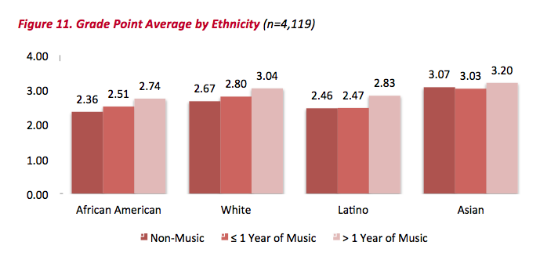
The WHY
GPA
http://musicmakesus.org/resources/research

Slide 39
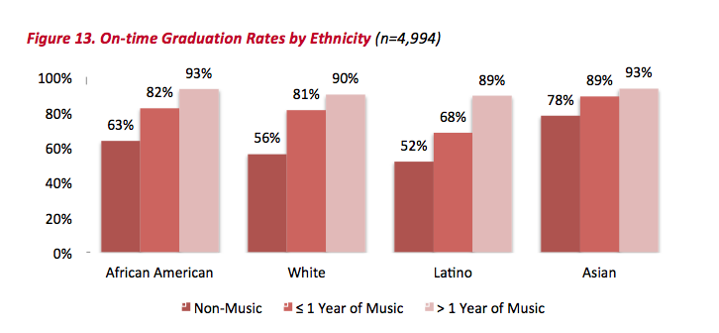
The WHY
ON-TIME GRADUATION RATES
http://musicmakesus.org/resources/research

Slide 40
The WHY
SUMMARY: What Was Learned?
“The more a student participates
in music, the more positive
these benefits become.”
http://musicmakesus.org/resources/research

Slide 41
The HOW
STRATEGIES TO BRIDGE THE GAP
What Music Educators Can Do
What HS/MS Parents Can Do
What HS/MS Students Can Do
What HS/MS Principals Can Do
What Music Supervisors Can Do

Slide 42
The HOW
STRATEGIES TO BRIDGE THE GAP
What Music Educators Can Do:
Work as a district-wide
Music Education TEAM with one goal:
To ensure continued,
active music-making.
Build the vision EARLY – ELEMENTARY!
First Performance!

Slide 43

The HOW: First Performance
Build the vision EARLY – ELEMENTARY!

Slide 44
The HOW
STRATEGIES TO BRIDGE THE GAP
COMMIT as a TEAM to:
Establish a district-wide vision/mission that promotes unity. . .even include a logo and tag line!
A. Life is Good T-Shirts:
Good Examples of Visions (destinations):
A world where all children
grow up feeling safe, loved, and joyful.
A great
public school for all students.
B. National Education Association (NEA):

Slide 45
The HOW
STRATEGIES TO BRIDGE THE GAP
COMMIT as a TEAM to:
Establish a district-wide vision/mission that promotes unity. . .even include a logo and tag line!
A. Google:
Good Examples of Missions (purpose):
Google’s mission is to organize the
world’s information and make it universally
accessible and useful.
B. NAfME:
To advance music education by
encouraging the studying and making of music
by all.

Slide 46
The HOW
STRATEGIES TO BRIDGE THE GAP
COMMIT as a TEAM to:
Establish a district-wide vision/mission that promotes unity. . .even include a logo and tag line!
Good Examples of a Music Dept Vision/Mission:
XYZ School District Music Education
Department Vision:
A community where all children grow up experiencing the joy of active music-making.
To prepare all students for fulfilling, life-long music-making experiences.
B. XYZ MED Mission:

Slide 47
The HOW
STRATEGIES TO BRIDGE THE GAP
COMMIT as a TEAM to:
Establish a district-wide vision/mission that promotes unity. . .even include a logo and tag line!
GREAT Example of a Tag Line:
What happens in Vegas. . .

Slide 48

The HOW
STRATEGIES TO BRIDGE THE GAP
COMMIT as a TEAM to:

Slide 49
The HOW
STRATEGIES TO BRIDGE THE GAP
COMMIT as a TEAM to:
Establish a district-wide vision/mission that promotes unity. . .even include a logo and tag line!
A. Possible XYZ logo and tag line:
What happens in Music. . .
Stays for a Lifetime!

Slide 50
The HOW
STRATEGIES TO BRIDGE THE GAP
COMMIT as a TEAM to:
2. Meet as a district-wide TEAM on a regular basis
to establish goals and measure progress.
Plan performances/activities together
Conduct each other’s ensembles
Attend each other’s performances
Chaperone each other’s trips
Hang out with each other!

Slide 51
The HOW
STRATEGIES TO BRIDGE THE GAP
COMMIT as a TEAM to:
3. Build a “retention” section on all K-12 school
music websites. Content could include. . .

Slide 52
A Photo is Worth 1000 Words!
  Lots of photos of elementary/middle students with the high school students at cool events (as well as at musical activities).
  B. Lots of photos of elementary/middle parents with the high school parents/students at cool events (as well as at musical activities).
  C. Lots of photos of elementary/middle/high school directors together at cool events (etc.).
  D. Lots of photos of elementary/middle/high school principals together at cool events. (etc.)

Slide 53
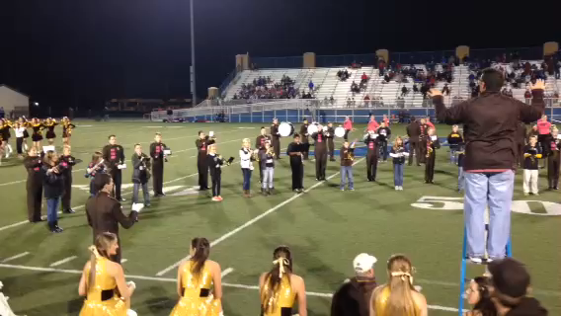
A Video is Worth 10,000 Words!

Slide 54
The HOW
Build the vision EARLY—ELEMENTARY!
COMMIT as a TEAM to:
4. Show up – Be visible – For everything!
5. Schedule a “Switch Day”
6. Engage parents EARLY!

Slide 55
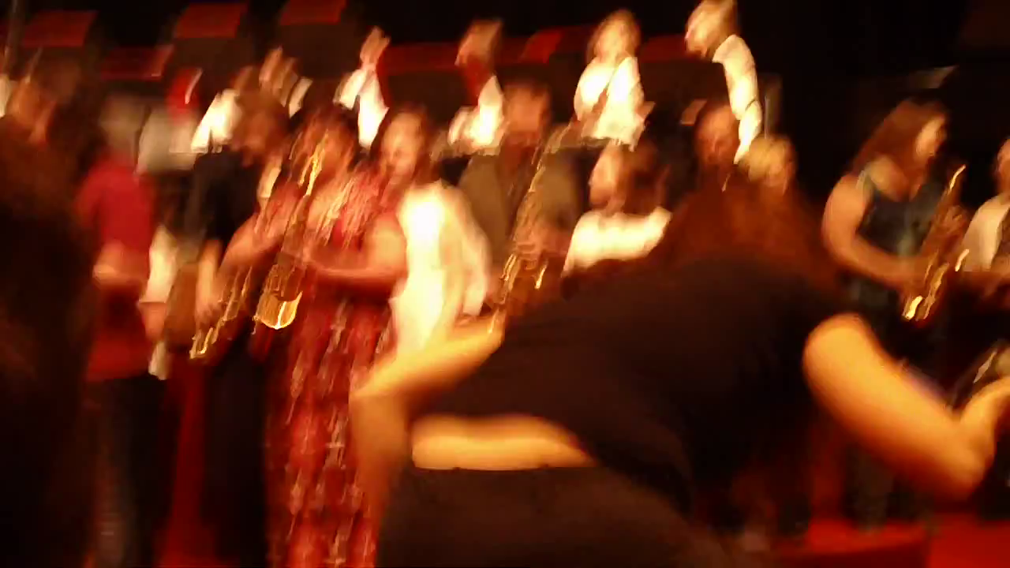
The HOW
Engage Parents EARLY—The Parent Band!

Slide 56
The HOW
What HS/MS Parents Can Do:
1. Schedule a VIP Parent Night at a joint
concert/halftime show performance
2. Facilitate events and activities for MS/ES
parent groups
3. Host MS/ES parent meetings at the high
school
4. Mentor parent leaders of feeder
programs

Slide 57
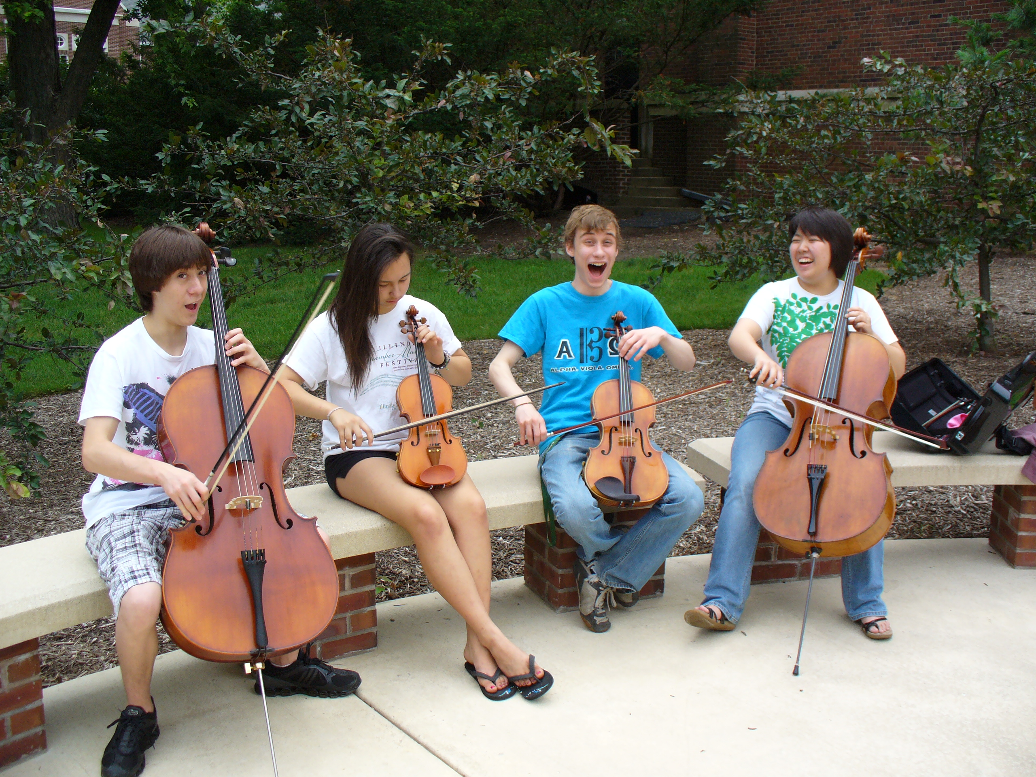
The HOW
What HS/MS Students Can Do:
1. Serve as “Intern Instructors” for FREE Summer Lesson Program for beginning students.

Slide 58
The HOW
What HS/MS Students Can Do:
1. Serve as “Intern Instructors” for FREE Summer Lesson Program for beginning (at-risk) students.
2. Participate ACTIVELY in ALL retention
efforts – give “testimonials”

Slide 59

The HOW
Have Students Give “Testimonials”

Slide 60
The HOW
What HS/MS Students Can Do:
Serve as “Intern Instructors” for Summer
Lesson Program for beginning students
2. Participate ACTIVELY in ALL recruitment efforts – give “testimonials”
3. Remain engaged with former programs
A. Mentor upcoming students. . .Give back!
B. Coach upcoming students.
C. Serve that program: Usher, sell refreshments

Slide 61
The HOW
What HS/MS Students Can Do:
Serve as “Intern Instructors” for Summer
Lesson Program for beginning students
2. Participate ACTIVELY in ALL recruitment efforts – give “testimonials”
3. Remain engaged with former programs
Write letters of invitation (Big Bro/Sis)
and congratulations as appropriate

Slide 62

The HOW
What HS/MS Students Can Do:
4. Write letters of invitation (Big Bro/Sis)
and congratulations as appropriate
  “Congratulations!
  You have been chosen to
  play (insert instrument)
  in the (name of school) band!”
  Giving a “Golden Invitation” to
  band/orchestra makes them feel special!”

Slide 63
The HOW
What HS/MS Principals Can Do:
1. Help facilitate recruitment assemblies/
events/activities at feeder schools
2. Work with feeder principals on
scheduling
3. Create joint presentation for (feeder)
parents
4. Provide opening remarks at each other’s
concerts

Slide 64
The HOW
What Music Supervisors Can Do:
1. Ensure that faculty sees itself as part of
one, K–12 Music Program –
build purpose and unity!

Slide 65
The HOW
What Music Supervisors Can Do:
2. Track articulation/achievement data
1. Ensure that faculty sees itself as part of
one, K–12 Music Program –
build purpose and unity!

Slide 66
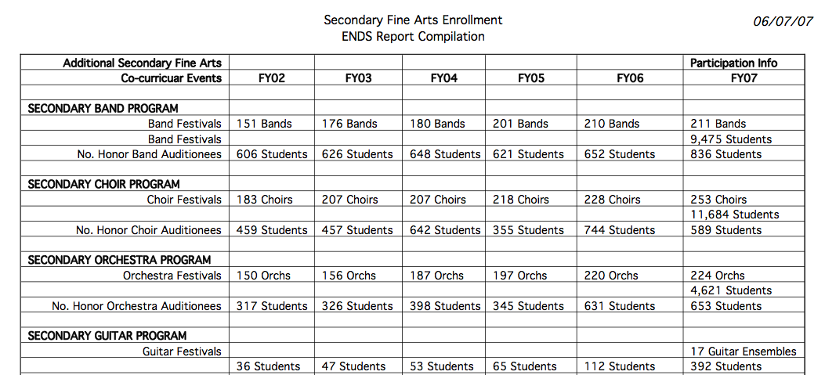
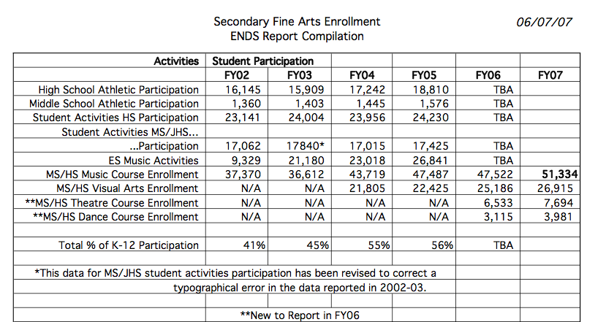
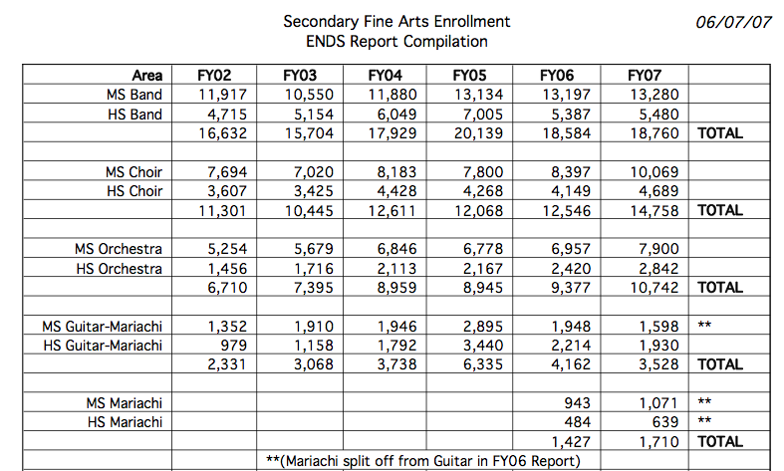

Slide 67
The HOW
What Music Supervisors Can Do:
1. Ensure that faculty sees itself as part of
one, K–12 Music Program –
build purpose and unity!
2. Track articulation/achievement data
3. Provide sample student schedules

Slide 68
The HOW
What Music Supervisors Can Do:
3. Provide sample student schedules
Wind Symphony
Algebra I
Biology
AP English
Music Theory
Orchestra
Jazz Band
Geometry
Chemistry
Chamber Ensemble
Algebra II
Algebra XV
Calculus

Slide 69
The HOW
What Music Supervisors Can Do:
1. Ensure that faculty sees itself as part of
one, K–12 Music Program –
build purpose and unity!
2. Track articulation data
3. Provide sample student schedules
4. Ensure that students receive quality
learning opportunities and experiences

Slide 70

A GREAT EXAMPLE: Foothill HS
“There is a place. . .”

Slide 71
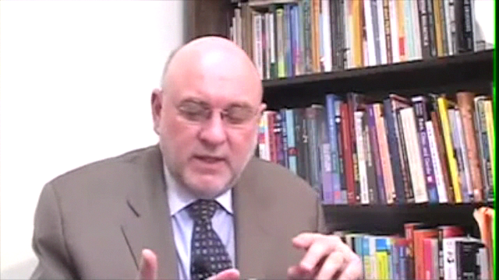
Check Out All of MAC
Online Resources
www.musicachievementcouncil.org

Slide 72
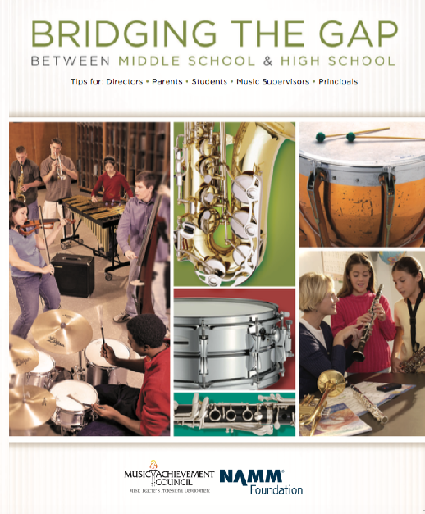
Got SMART Phone? www.musicedconsultants.net/conference-materials
Notes:
72

Slide 73










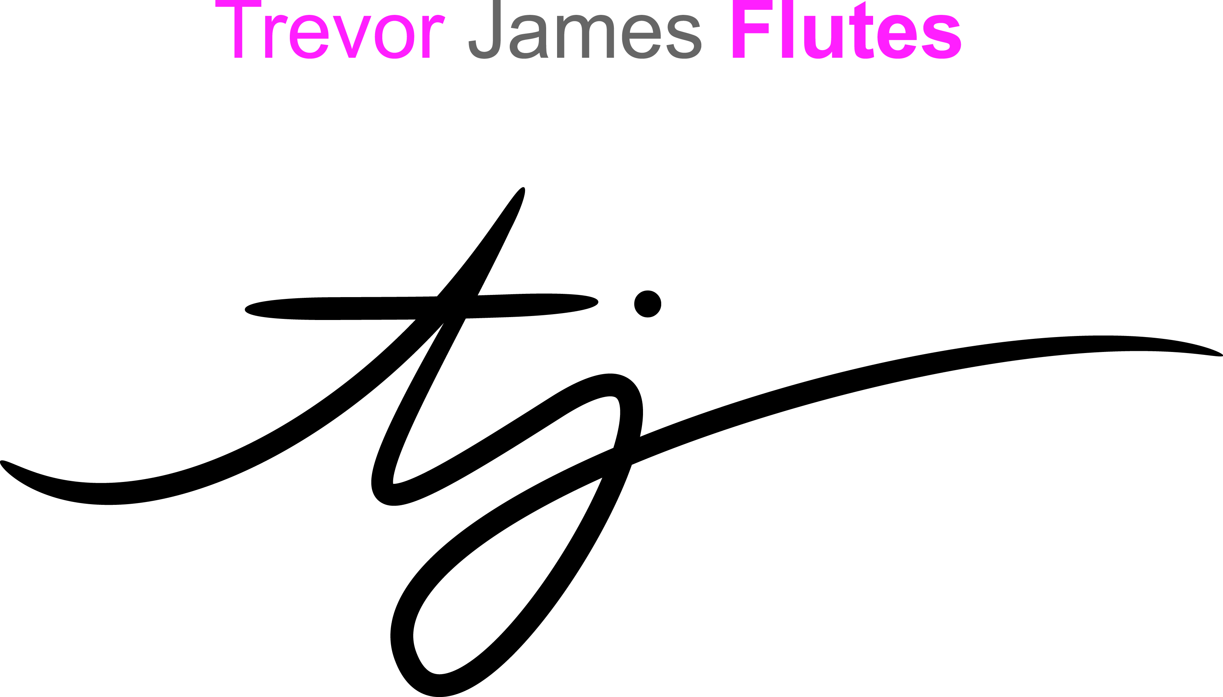


Thanks to these Quality Companies!
www.musicachievementcouncil.org
@MusicAchCouncil
@MusicEdConsult
Notes:
www.musiceducationconsultants.net/mmea2010
73

Slide 74
Thanks to these Quality Companies!
www.musicachievementcouncil.org
@MusicAchCouncil
@MusicEdConsult
Notes:
www.musiceducationconsultants.net/mmea2010
74

