Slide 1


2016 WMEA
“One is Too Small a Number to Achieve Something Great”
Marcia Neel
February 12, 2016
marcia@musicedconsultants.net
www.musiceducationconsultants.net/conference-materials

Slide 2
School is. . .
Impressionistic
vs
Expressionistic
Music is. . .

Slide 3
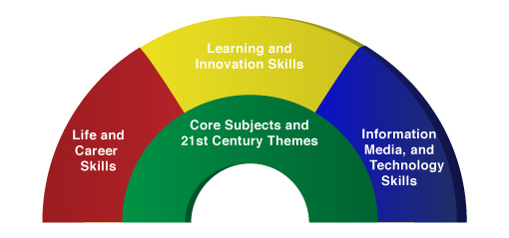

A focus on these 5 C’s is essential
to prepare students for their future.
Critical Thinking
Communication
Collaboration
Creativity
Confidence
Therefore. . .

Slide 4

The Music Skills Practice Room is. . .
The Life Skills Practice Room
How does music create MORE than music and how does it all comes together to create something GREAT?

Slide 5
The Music Skills Practice Room is. . .
The Life Skills Practice Room
1. Critical Thinking. . .
  Ability to reason effectively and solve
problems and analyze how parts
of a whole interact with each other to produce overall outcomes in complex systems.

Slide 6
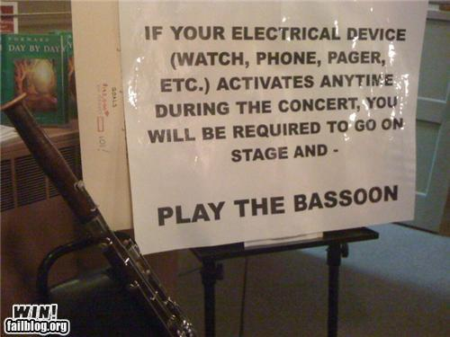
The Music Skills Practice Room is. . .
The Life Skills Practice Room
Solve Problems
EX: Having a problem getting
people to turn off their phones and
beepers at your concerts? One teacher
challenged his students to come up
with the solution. Here it is. . .

Slide 7
The Music Skills Practice Room is. . .
The Life Skills Practice Room
EXAMPLE: Ability to analyze how parts
of a whole interact with each other to produce overall outcomes in complex systems.
See how this creative young man used this concept to produce a remarkable outcome!

Slide 8
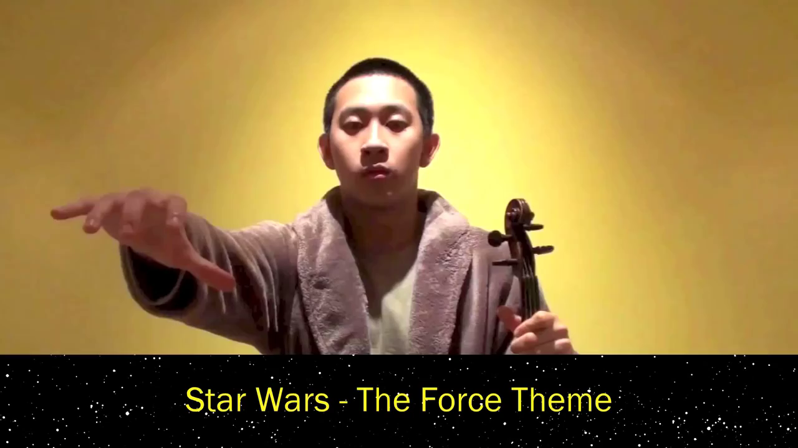
The Music Skills Practice Room is. . .
The Life Skills Practice Room
JEFFREY DING - Produce overall outcomes

Slide 9

The Music Skills Practice Room is. . .
The Life Skills Practice Room
2. Communication. . .
  Ability to listen
  effectively
  Ability to express
  thoughts effectively
  with others –
  both verbally and non-verbally
  Have you tried Result-driven Communication?

Slide 10

The Music Skills Practice Room is. . .
The Life Skills Practice Room
Result-driven Communication: Listening and
communicating effectively will guarantee success!

Slide 11
The Music Skills Practice Room is. . .
The Life Skills Practice Room
3. Collaboration (Teamwork). . .
  Ability to work effectively and respectfully
  with ALL

Slide 12

The Music Skills Practice Room is. . .
The Life Skills Practice Room
Teamwork: EFFECTIVE when EVERYONE does their job.

Slide 13
The Music Skills Practice Room is. . .
The Life Skills Practice Room
Creativity (Innovation). . .
  Ability to create new and more worthwhile
  ideas and to work creatively with others.

Slide 14
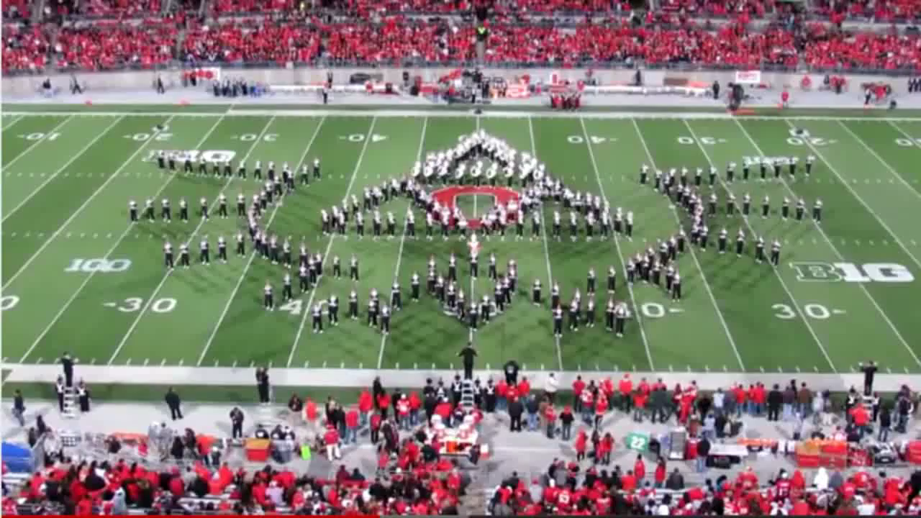
The Music Skills Practice Room is. . .
The Life Skills Practice Room
(Innovation): Ability to think and work creatively with others
OSU Video

Slide 15
The Music Skills Practice Room is. . .
The Life Skills Practice Room
5. Confidence. . .
  Ability to handle EVERY CIRCUMSTANCE
  and grow from it

Slide 16

The Music Skills Practice Room is. . .
The Life Skills Practice Room
Confidence: Ability to handle EVERY CIRCUMSTANCE

Slide 17
but. . .
“ONE IS TOO SMALL A
NUMBER TO ACHIEVE
SOMETHING GREAT”
SOOOOOO. . .
HOW CAN WE ALL WORK
TOGETHER?
Parents
Teachers
Principals
Custodians
Support Staff
Community

Slide 18
Get EVERYONE on the Same Page
One Goal:
To ensure continued,
active music-making.

Slide 19
Get EVERYONE on the Same Page
A district-wide vision/mission that promotes unity. . .even include a logo and tag line!
Seahawks HS Music Dept::
a. Good Example of a Vision (destination):
A community
where children grow up experiencing the joy
of music-making.
To prepare all
students for fulfilling, life-long music-making
experiences
b. Good Example of a Mission (pupose):
Seahawks HS Music Dept:

Slide 20
Get EVERYONE on the Same Page
Establish a district-wide vision/mission that promotes unity. . .even include a logo and tag line!
GREAT Example of a Tag Line:
What happens in Vegas. . .

Slide 21


Slide 22
Get EVERYONE on the Same Page
How could this work for you?
What happens in Music. . .
Stays for a Lifetime!

Slide 23
What Makes Our Programs Special?
Do We C.A.R.E.?
With GREAT THANKS to Dr. Tim!
C: REAL Communication
Do we encourage one another to reach out to each other?
Do harmony and balance apply to more than great music-making?

Slide 24
What Makes Our Programs Special?
Do We C.A.R.E.?
A: Attitude
Do we generate the proper attitude?
Does our attitude play a crucial role in the outcome of the program’s success?

Slide 25
What Makes Our Programs Special?
Do We C.A.R.E.?
R: Responsibility
Do we come together ready to invest energy for ongoing growth and development of our goals?
Do we respond to each other in a fashion that will advance the entire program to the next level?

Slide 26
What Makes Our Programs Special?
Do We C.A.R.E.?
E: Excellence
Do we reflect a sense of excellence to go beyond the basic requirements -- to put forth extra effort?

Slide 27
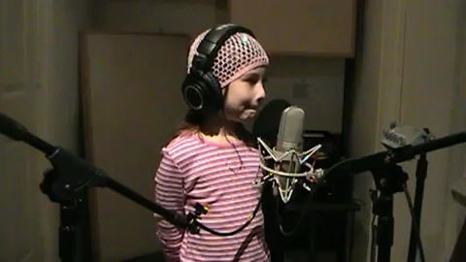
After all, doesn’t she deserve the very best
from EVERYONE?

Slide 28

Contact Information:
marcia@musicedconsultants.net
Sessions Posted:
www.musicedconsultants.net/conference-materials
@MusicEdConsult
Thank You, WMEA!

