Slide 1

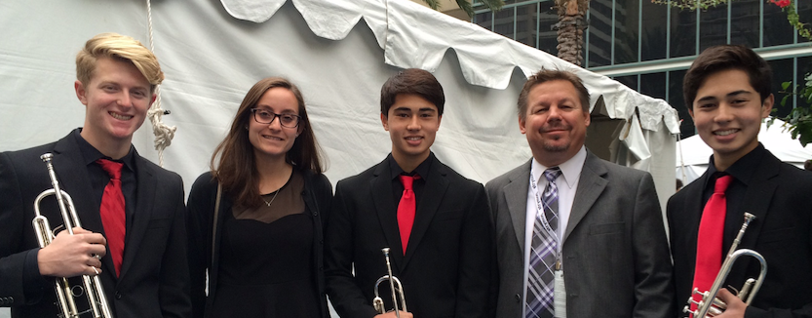


2016 Music Education Days
January 23, 2015 2:30 PM Room Avila AB
You CAN Successfully
Recruit and Retain
Even MORE Music Students!
Brent Sienko
Takazo Hall
Kaizo Hall
Sydney Carpentier
Dennis Crystal
The Music Achievement Council
www.musicachievementcouncil.org

Slide 2
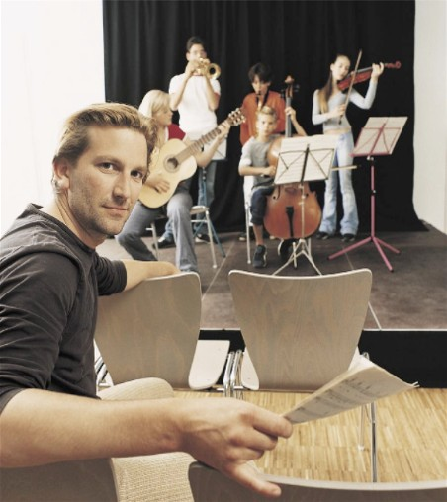
Today’s Session
Tips for Recruiting Students
Tips for Retaining Students
First Performance Program

Slide 3
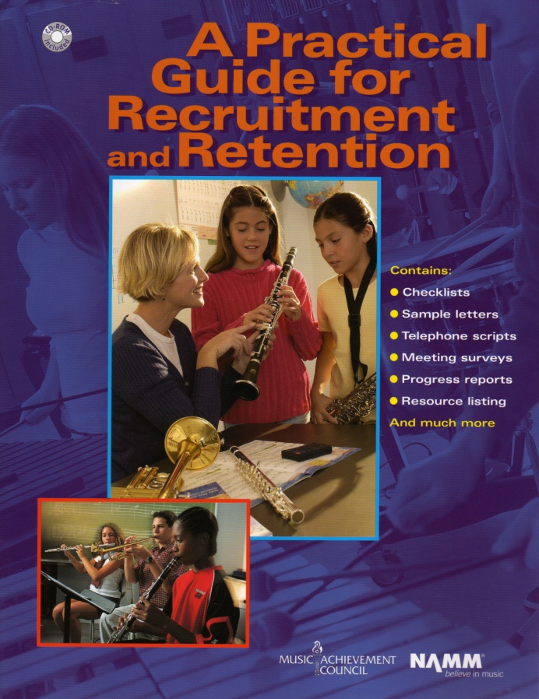
Materials Available for You to Use. . . A Year-Round Planner
12 pages of proven methods
10 pages of sample forms
Guidelines for directors

Slide 4
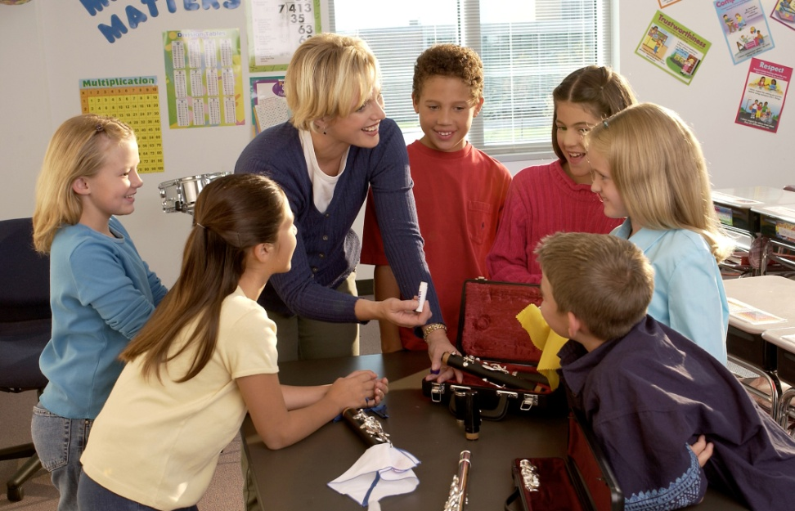
Fundamental Beliefs of
Effective Recruiters
Every student will be interested
All students will have an equal opportunity to succeed
Music is an integral part of their total education
Every student is eagerly welcome-- regardless of talent or ability
Students want to play because it looks like fun

Slide 5
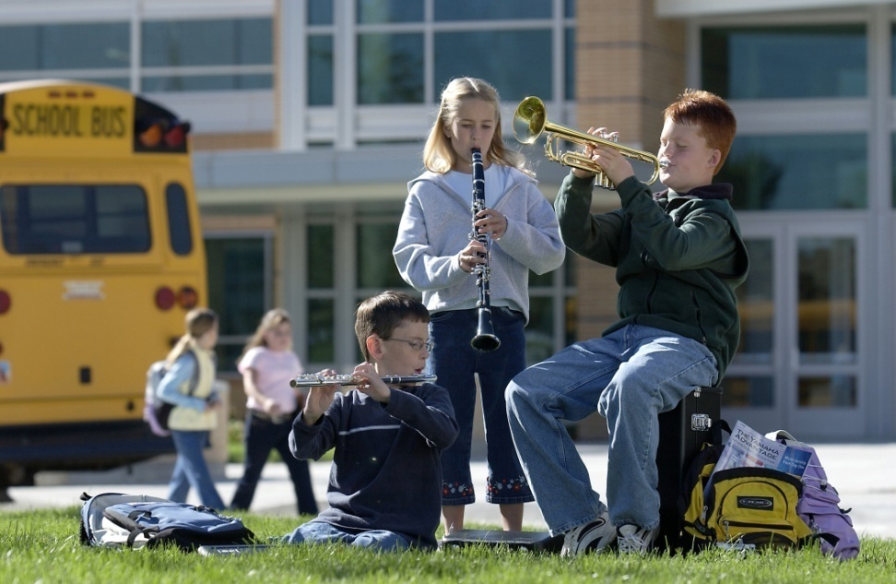
Key Steps in Recruiting:
Attracting Students. . .
Foster student interest through visibility
Inform parents of benefits of music
Build and nurture support among administration & classroom teachers

Slide 6
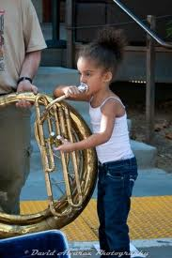
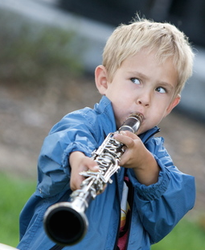
Key Steps in Recruiting
Recruiting is a YEAR-ROUND process including:
Regular visits with feeder programs/teachers
Effective PR: Bulletin boards, school newsletters, PTA announcements, concert programs, school announcements
Mass concerts with feeder programs
including recorder classes
Recruitment meetings with
students and parents—REACH OUT!
Instrument demos/petting zoos
Follow-ups – SHOW UP FOR EVERYTHING!
www.musicachievementcouncil.org
Notes:
6

Slide 7
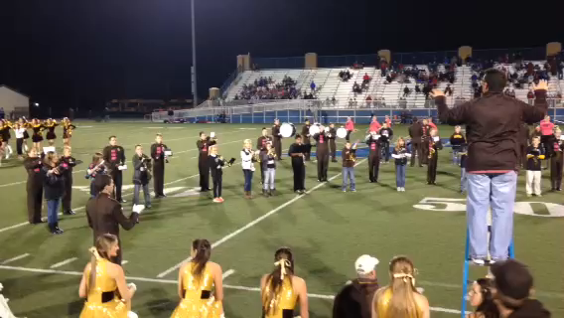
Key Steps in Recruiting:
Engage Students Early. . .
www.musicachievementcouncil.org
Notes:
7

Slide 8
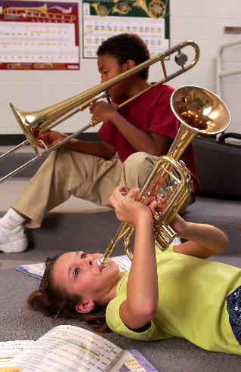
Key Steps in Recruiting:
What’s Really Important. . .
Ensure HIGH quality and fulfillment
Your ENTHUSIASM matters
Be friendly, approachable
Students have big dreams of success—give it to them!
It’s never to early to recruit
Learning can be FUN! SMILE!
www.musicachievementcouncil.org
Notes:
8

Slide 9
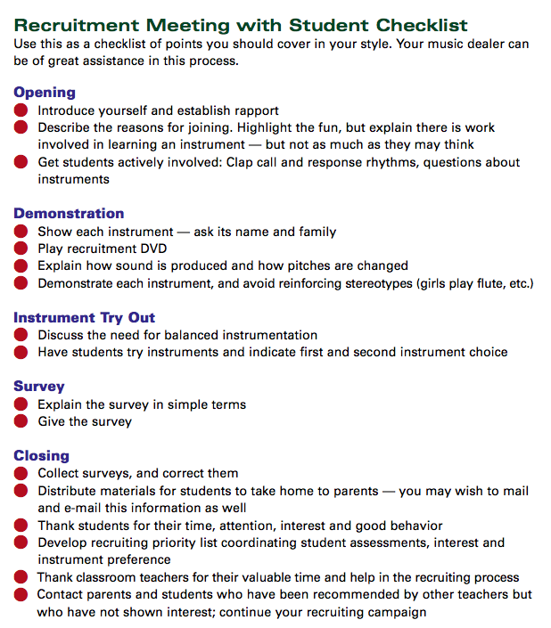


Key Steps in Recruiting: Plan Way Ahead
  Meet with feeder/classroom teachers to identify future instrumentalists
  Select recruitment materials: DVDs, posters, surveys, forms, pamphlets, PR items
  Enlist dealer help well in advance--let them know what you need

Slide 10

Presentation Day
Can be: Musical Aptitude Survey
Instrument Try-out
  Best in classroom setting
  Show up unannounced
  Never ask, “how many want to be in
  the band, choir, orchestra. . .”
  Instead, ask for a who of hands “how many of
  you want to try an instrument?”
  Keep presentation short (30 minutes)
  BE ENTHUSIASTIC!!!!!
Notes:
10

Slide 11

Follow-up idea #1 from:
Jeff Scott & Emily Wilkinson, ALMEA
  “Congratulations!
  You have been chosen to
  play (insert instrument)
  in the (name of school) band!”
  Giving a “Golden Invitation” to band makes
  them feel special!”
Notes:
11

Slide 12
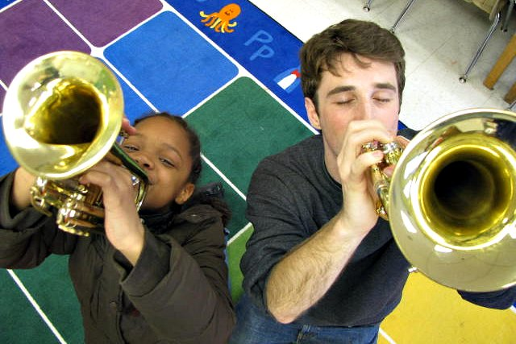
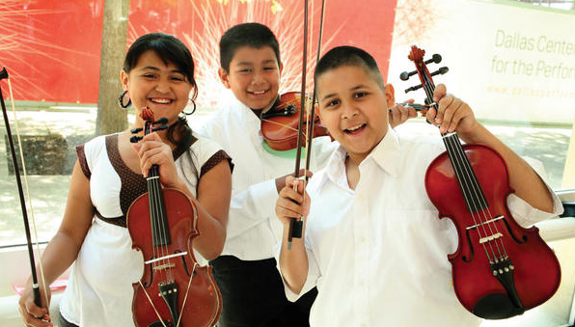
Follow-up idea from:
Chris Crone, PAMEA
Make the time to have each 4th grader touch, hold, and play three instruments of their choice and then send a personal letter home with each student letting the parents know which instrument their child had success on. . .your instrumental numbers go through the roof!”
Notes:
12

Slide 13

Engage Parent Support
Recruitment Letters
  Keep them simple, upbeat and informational
  Emphasize rewards, details, your expectations
  RSVP form
Initial Meeting
  Involve current parents
  Explain rental program
  Provide advocacy materials
Best Ambassador is an Excited Child

Slide 14
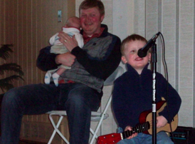
Teach the Parents Too. . .
They don’t know what NORMAL is!
  Teach PARENTS how to support their child’s practicing
Notes:
www.musiceducationconsultants.net/mmea2010
14

Slide 15
Teach the Parents Too. . .
They don’t know what NORMAL is!
  Teach PARENTS how to support their child’s practicing
  Give PARENTS ideas of how to keep their children motivated
Notes:
www.musiceducationconsultants.net/mmea2010
15

Slide 16
Teach the Parents Too. . .
They don’t know what NORMAL is!
  Teach PARENTS how to support their child’s practicing
  Give PARENTS ideas of how to keep their children motivated
  Encourage PARENTS to play an active role in the learning process and to become involved
Notes:
www.musiceducationconsultants.net/mmea2010
16

Slide 17
Teach the Parents Too. . .
They don’t know what NORMAL is!
  Teach PARENTS how to support their child’s practicing
  Give PARENTS ideas of how to keep their children motivated
  Encourage PARENTS to play an active role in the learning process and to become involved
  Communicate with Parents REGULARLY to keep them engaged
Notes:
www.musiceducationconsultants.net/mmea2010
17

Slide 18
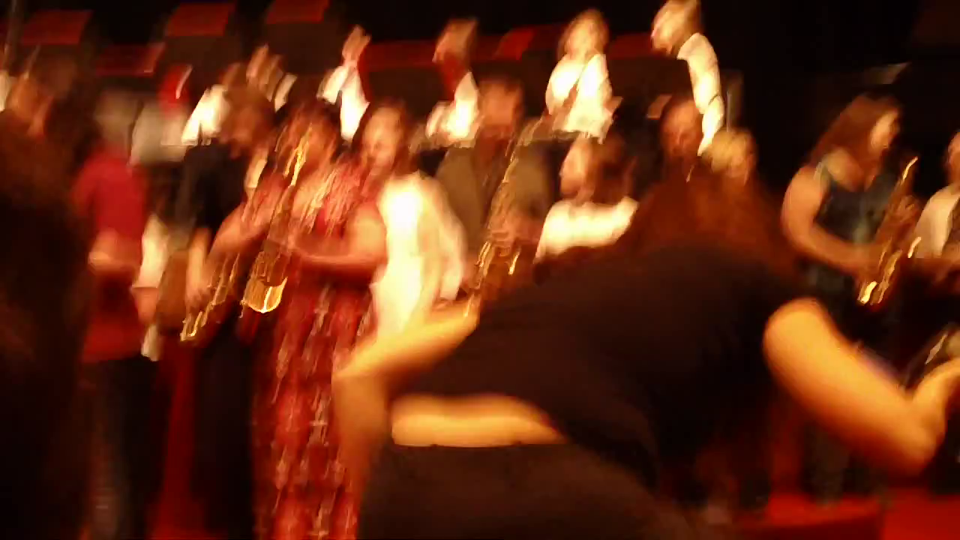
Engage Parent Support…Directly!
The Parent Band – REALLY FUN!
Notes:
www.musiceducationconsultants.net/mmea2010
18

Slide 19


Increase Your Base!
Hispanic population has seen explosive growth in the last four decades:
1970 9.6 million
1980 14.5 million
1990 22.6 million
2000 35.7 million
2010 50.8 million
2014 55.4 million
August 31, 2013
Notes:
www.musiceducationconsultants.net/mmea2010
19

Slide 20
Increase Your Base
Projected Growth of Hispanics: 2014 - 2060
2014 Total: 17.4 %
Projected 2060 Total: 24.4%
http://infoworks.ride.ri.gov/state/ri
Notes:
www.musiceducationconsultants.net/mmea2010
20

Slide 21
https://www.census.gov/content/dam/Census/library/publications/2015/demo/p25-1143.pdf
Notes:
www.musiceducationconsultants.net/mmea2010
21

Slide 22

¡Mariachi!
Bailey MS Mariachi Program: Year 2
Notes:
www.musiceducationconsultants.net/mmea2010
22

Slide 23
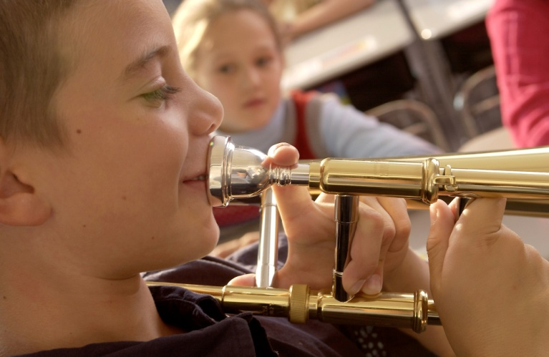
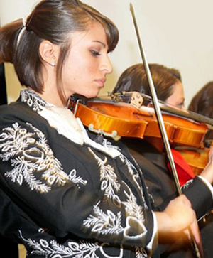
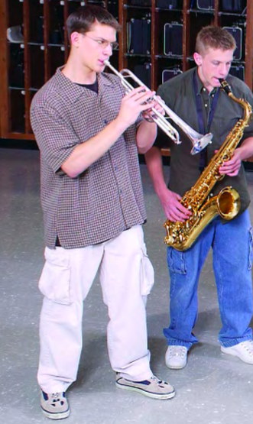
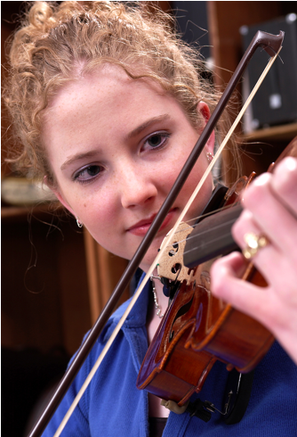
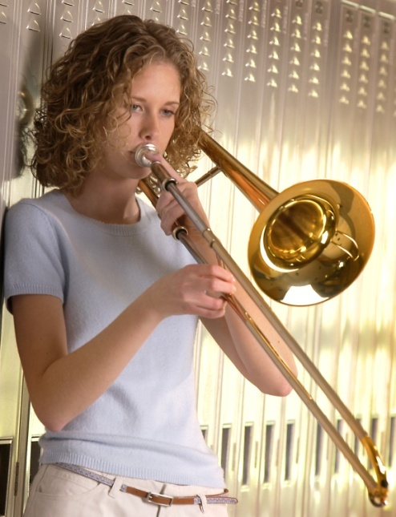
Keeping Your New Recruits

Slide 24
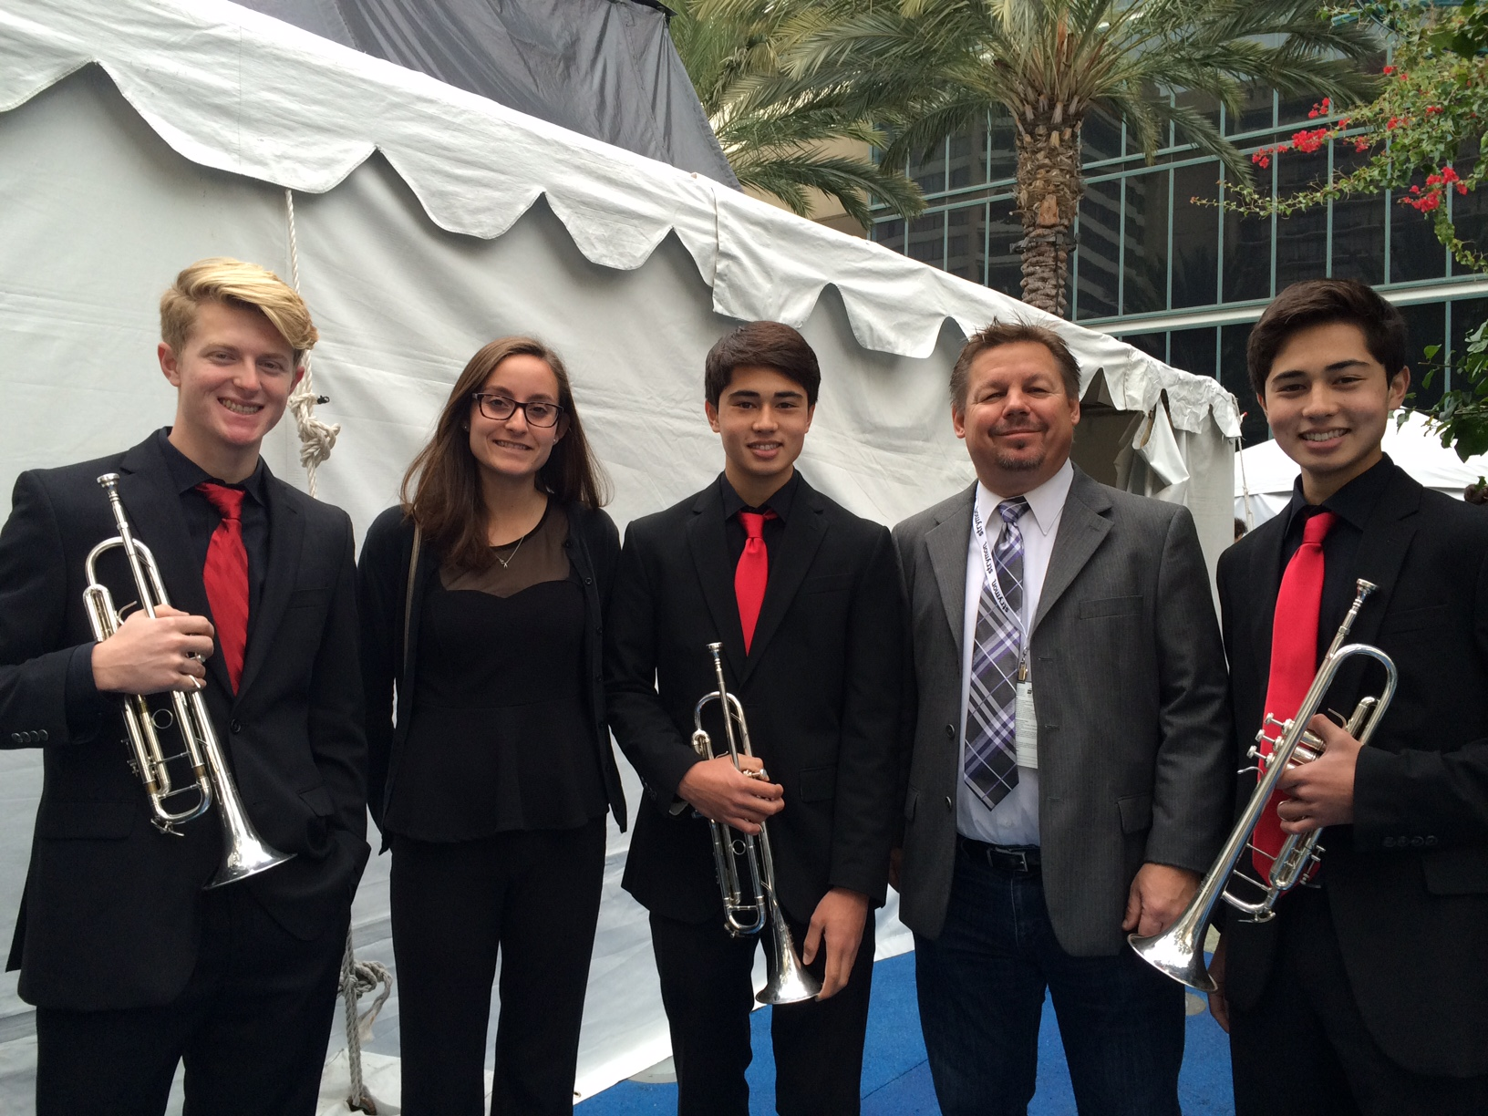
Keeping Your New Recruits
Why Do Kids Stay? Let’s Ask THEM!

Slide 25

Keeping Your New Recruits
Why Do Kids Stay? Let’s Ask THEM!

Slide 26
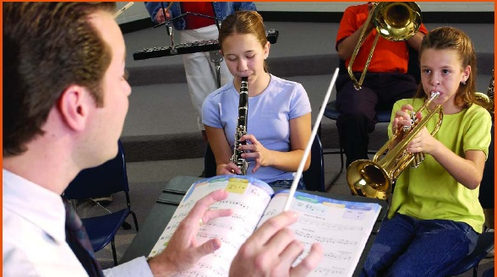

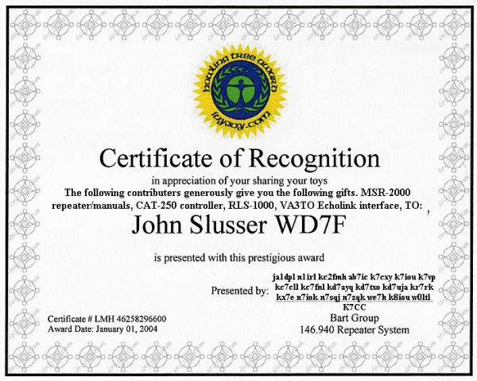
Retention: Keys to Success
Provide a satisfying experience from the day they receive their instruments
Build appreciation for the ensemble
Give recognition and reinforcement

Slide 27
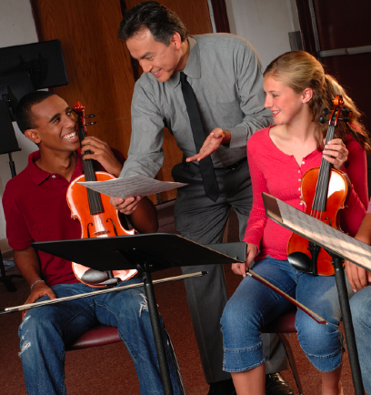
Actions That Help Retain Students
Developing group pride
Improving communication with parents
Evaluating yourself continually “What else?”
Understanding each student as an individual
Being positive and enthusiastic
Providing engaging lessons consistently
www.musicachievementcouncil.org
Notes:
27

Slide 28

Common Reasons for Drop-outs?
The first disappointment
Notes:
28

Slide 29
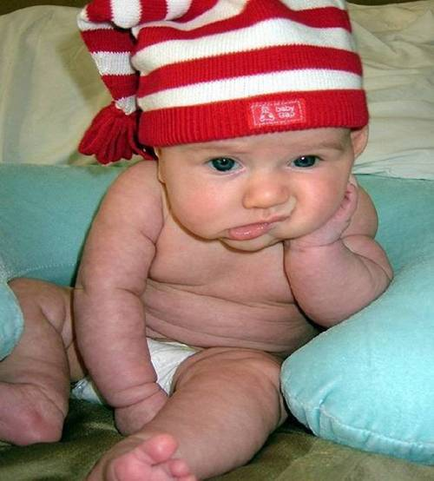
Common Reasons for Drop-outs?
The first disappointment
Lost interest
Notes:
29

Slide 30
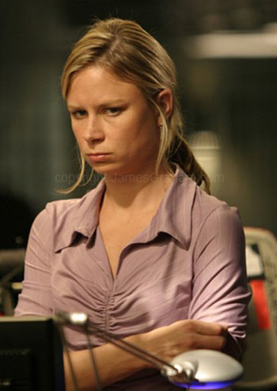
Common Reasons for Drop-outs?
The first disappointment
Lost interest
Didn’t like the teacher
Notes:
30

Slide 31

Common Reasons for Drop-outs?
The first disappointment
Lost interest
Didn’t like the teacher
Conflicts
Notes:
31

Slide 32
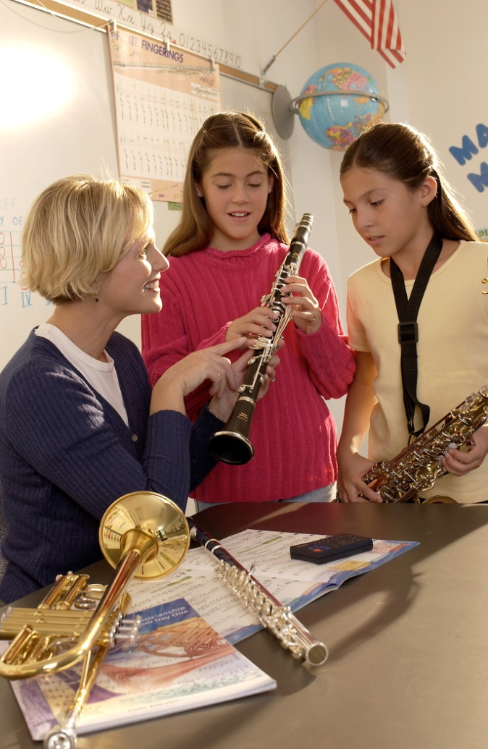
What Can You Do?
Talk to the student
  Probe for real reason they want to quit
  Show interest
Check their instrument
Talk with the parents
Iowa Bandmasters Exit Survey online

Slide 33

Why Should Students Continue?
Tell Your OWN Story:
www.musicachievementcouncil.org
Notes:
33

Slide 34
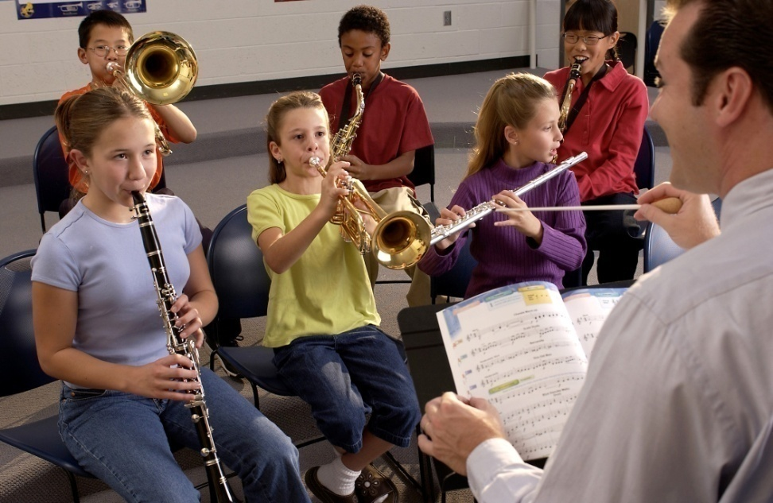
What If …
Students saw immediate success?
Parents heard their kids play their first performance just weeks after they started?
Learning to play was really fun?

Slide 35
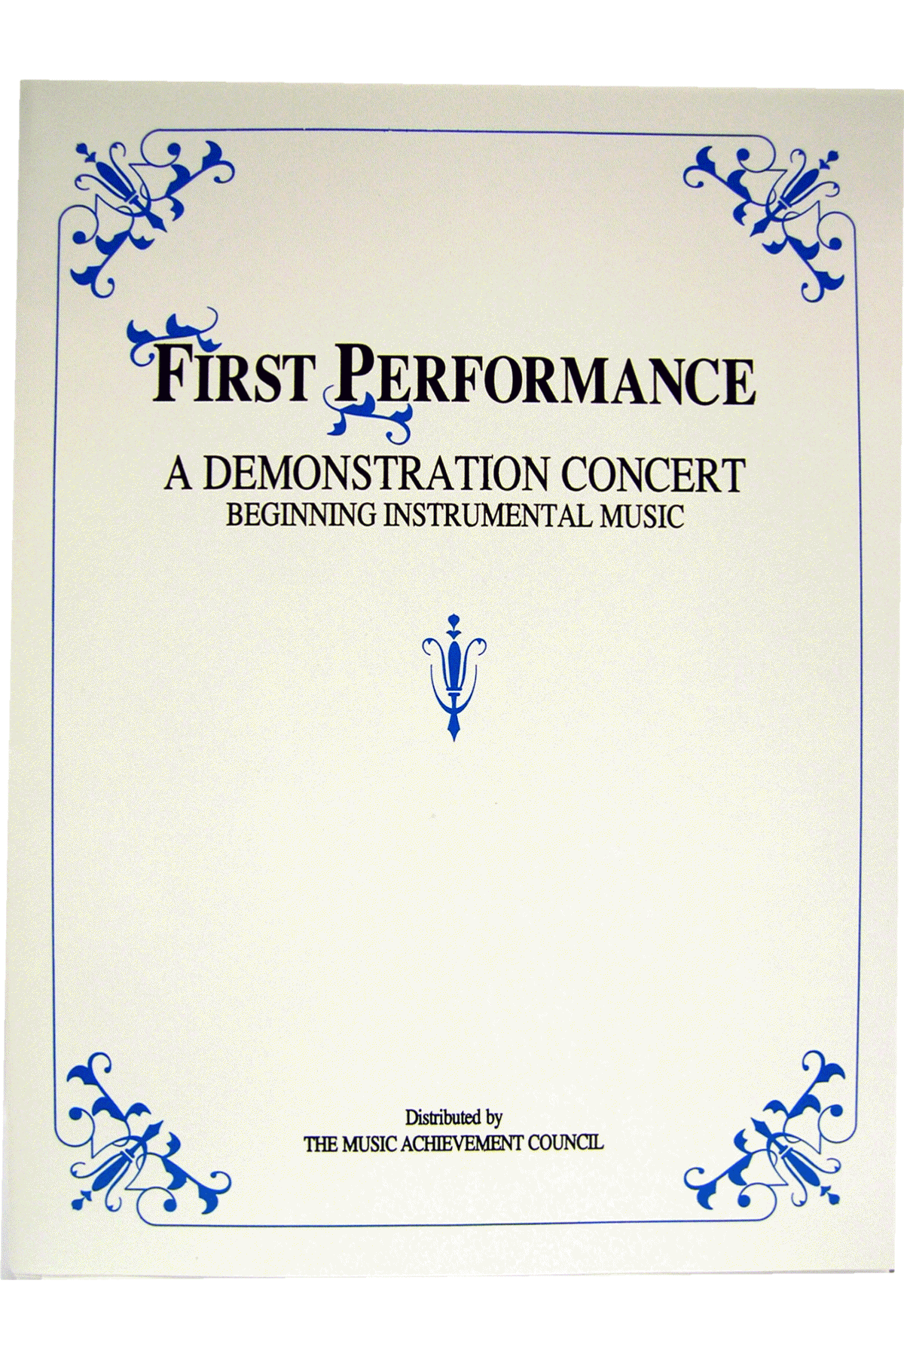
First Performance Concert!
A scripted demonstration of what your students have learned

Slide 36
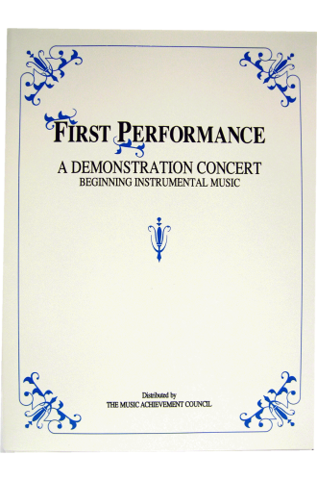
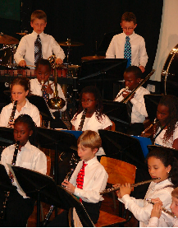
First Performance Demonstration Concert for Band or Orchestra
Schedule 6-8 weeks after the first class
Complete “turn-key” package
May be the best performance in terms of excitement and audience!

Slide 37

First Performance Demonstration

Slide 38
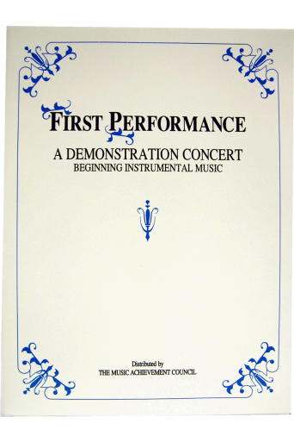
Why Does First Performance Work?
The timing of the performance
  Parents want to hear their kids play
  Student interest soars and they learn to love performing
Students practice more prior to a performance
It works with any group … any schedule … any situation … and any method book
The audience will be large … enthusiastic … and will arrive early -- lots of quality time with those who care most about the outcome -- the parents!

Slide 39

Parents will be amazed … most have no idea how much their child has learned based on what they hear at home!

Slide 40
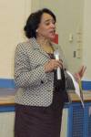

Students enjoy the satisfaction of a performance after good preparation – the process starts early
Many schools have the principal serve as the narrator -- GREAT PR!
The sound of
applause is
infectious

Slide 41
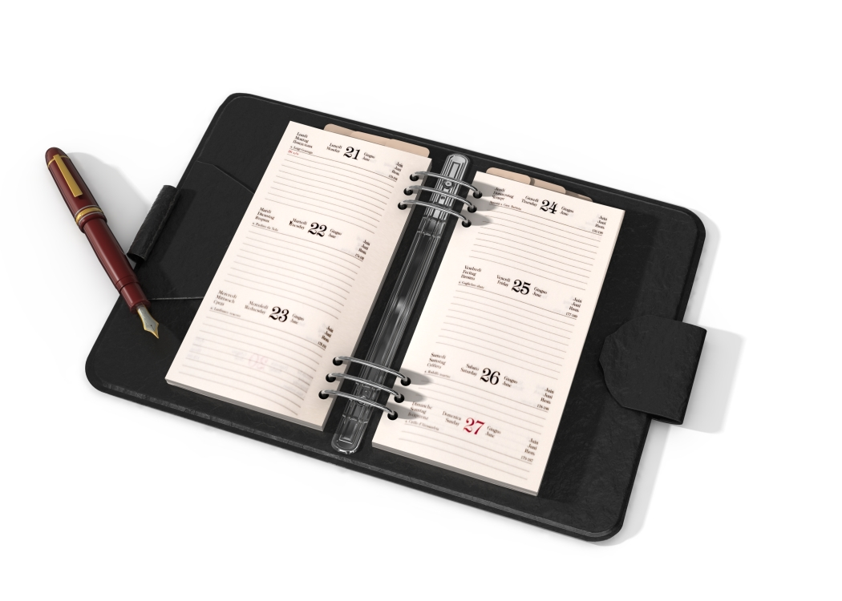
Put the Date on Your Calendar!
Schedule First Performance NOW!

Slide 42

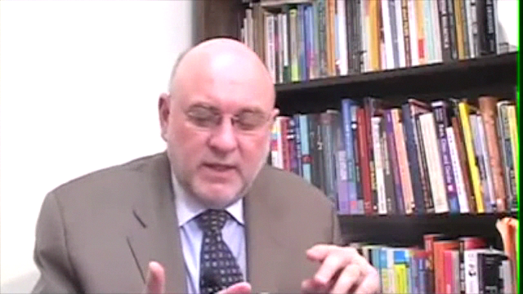
M.A.C. Wants to Help. . .
Check Out Our Online Resources
www.musicachievementcouncil.org
@MusicAchCouncil
Notes:
42

Slide 43
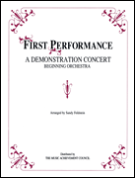
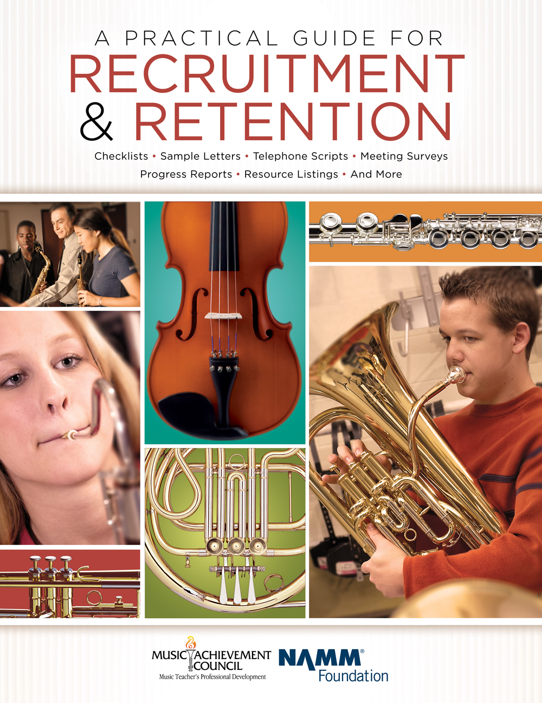


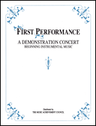
Got SMART Phone? http://www.musicedconsultants.net/conference-materials
Notes:
43

Slide 44









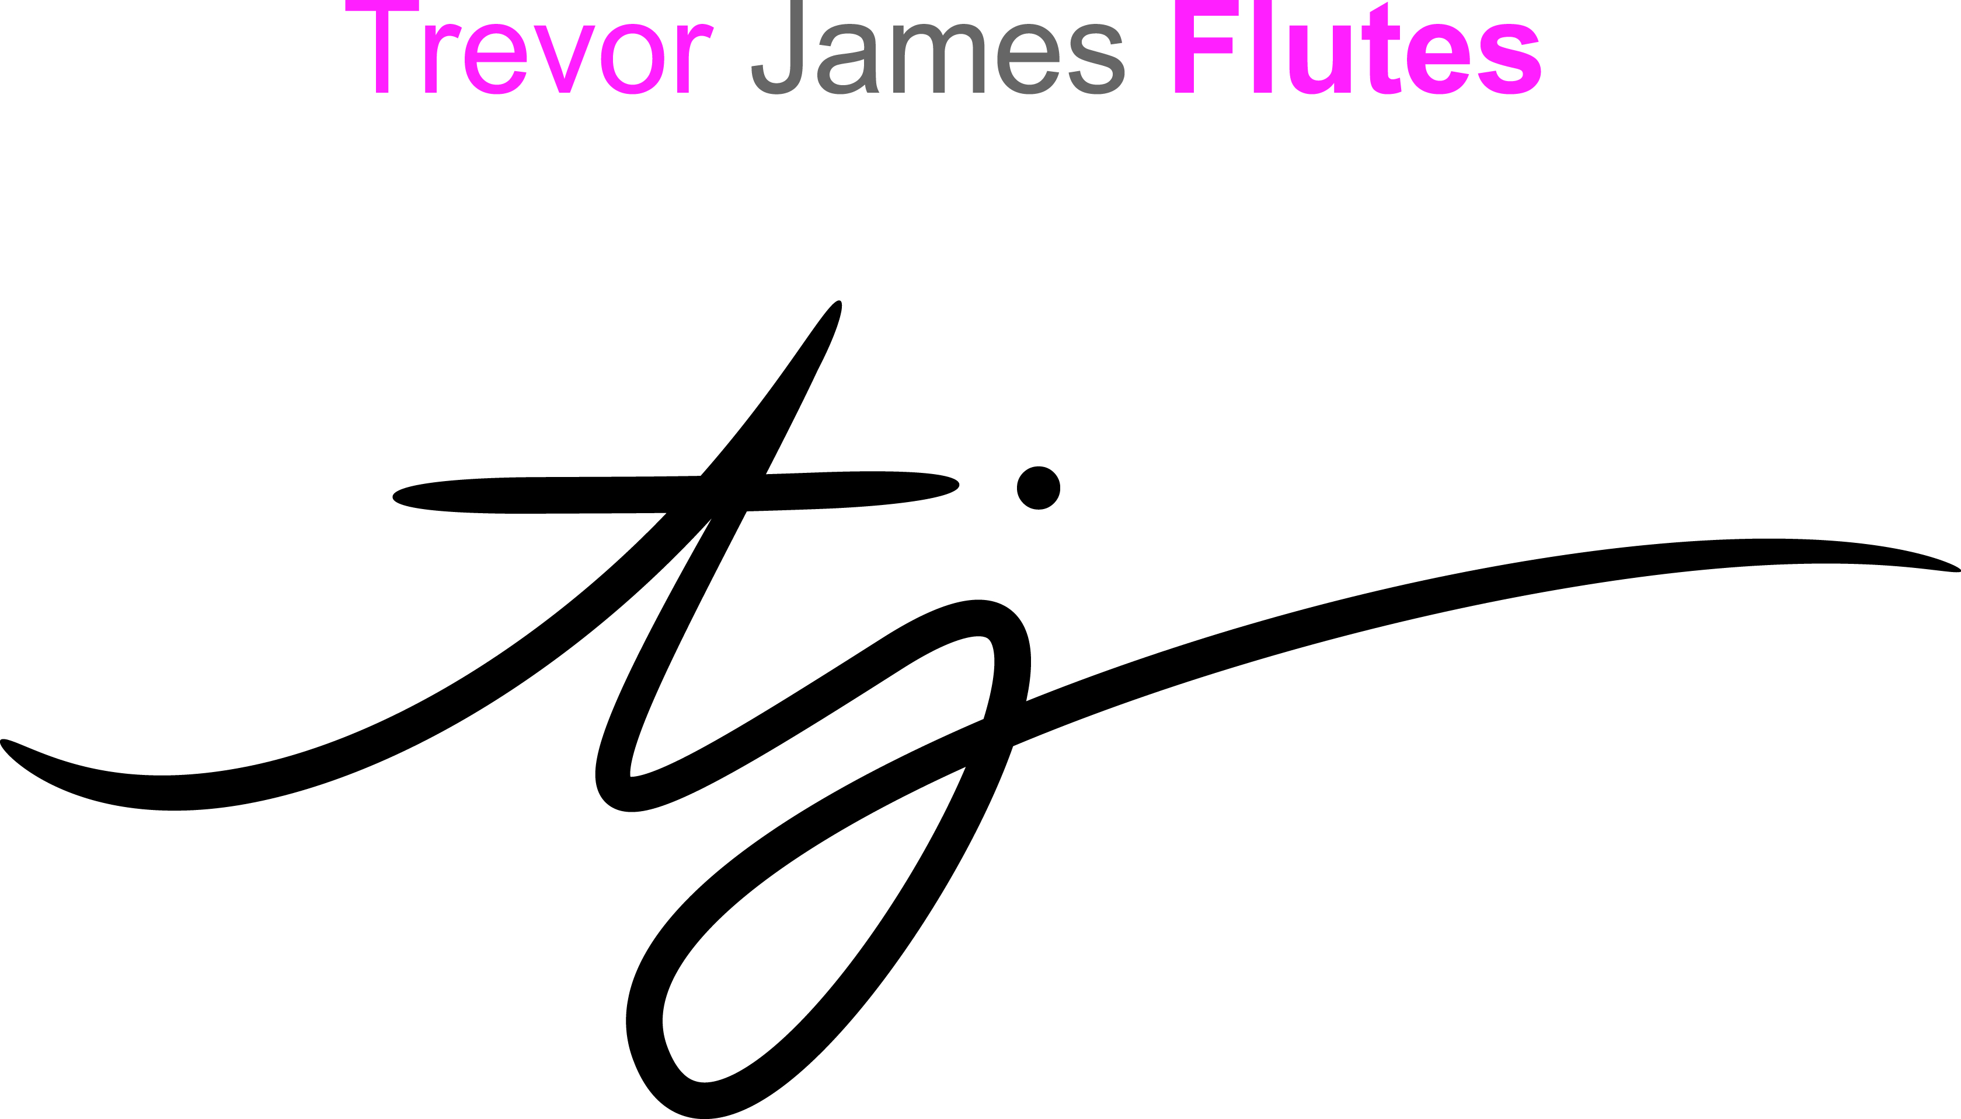


Thanks to these Quality Companies!
www.musicachievementcouncil.org
@MusicAchCouncil
@MusicEdConsult
Notes:
www.musiceducationconsultants.net/mmea2010
44

Slide 45
Thanks to these Quality Companies!
www.musicachievementcouncil.org
@MusicAchCouncil
@MusicEdConsult
Notes:
www.musiceducationconsultants.net/mmea2010
45

