Slide 1




Is THAT What You’re Wearing?
a.k.a.
I Can’t Hear You –
You’re SCREAMING!
University Park
Allocation Committee
Peter Sides
Marcia Neel
November 15, 2015
marcia@musicedconsultants.net
www.musiceducationconsultants.net

Slide 2

Ever had trouble getting someone to
understand what you’re trying to say?

Slide 3

You keep trying and trying and trying?

Slide 4

So what’s the problem?
Everyone communicates but. . .
Few Connect!

Slide 5
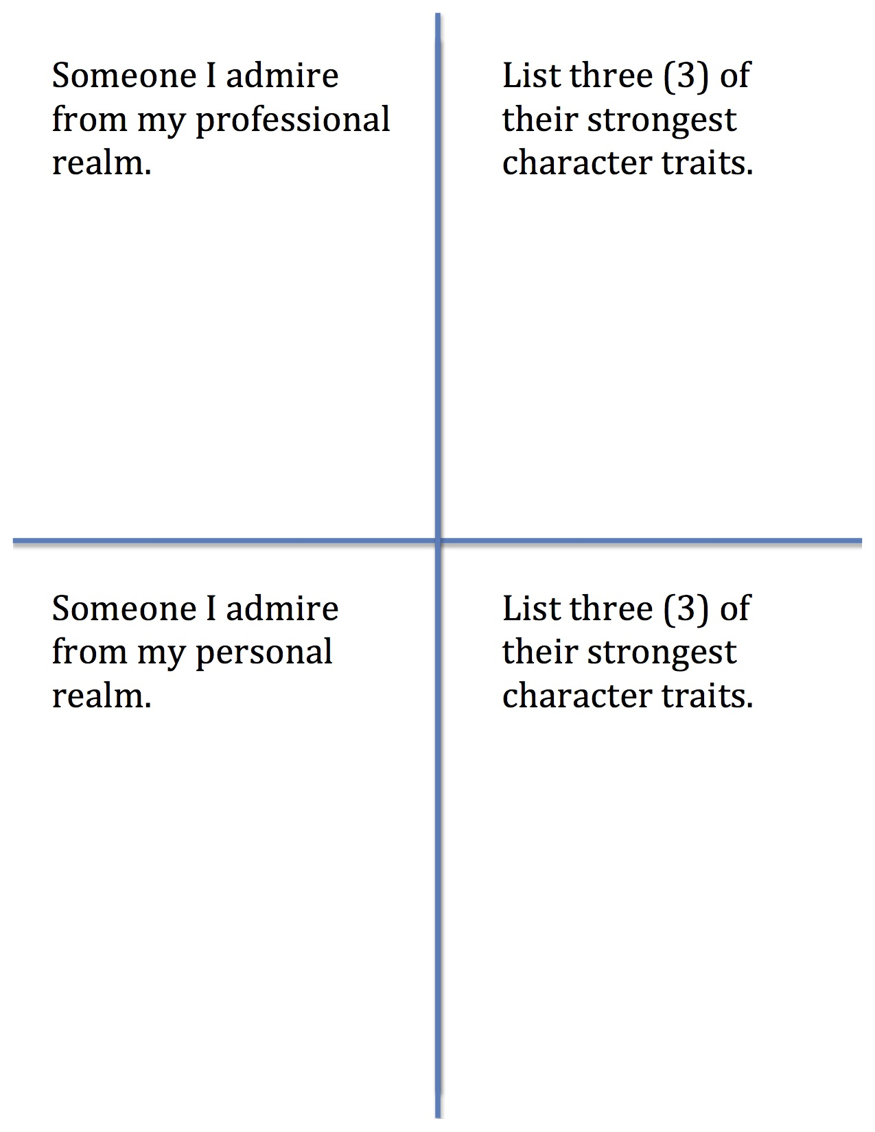

Slide 6
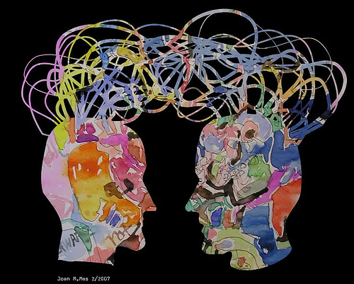
1. Communication. . .
  Ability to listen
  effectively
  Ability to express
  thoughts effectively
  with others –
  both verbally and non-verbally
  Have you tried. . . .
  Result-driven Communication?

Slide 7

Result-driven Communication: Precise communication at the right place and the right time is a guarantee for success.

Slide 8
So what is CONNECTING?
“Connecting is the ability to identify with people
and relate to them in a way that increases your
influence with them.”
Why is that IMPORTANT?
“Because the ability to communicate and connect
with others is a major determining factor in
reaching YOUR potential.”

Slide 9

Prime Goal: YOU’VE GOT TO
HAVE A VISION!

Slide 10
Three (3) Connecting Principles
1. Connecting Increases Your Influence in
Every Situation. . .
set people up to connect
with and receive your “message” or “vision.”
a. With Students
b. With Parents
c. With Administrators
d. With EVERYONE!

Slide 11

Three (3) Connecting Principles
2. Connecting is All About Others. . .
It begins
when the other person feels valued.
STOP
LOOK
LISTEN!

Slide 12
Three (3) Connecting Principles
2. Connecting is All About Others. . .It begins when the other person feels valued.
a. Transfer the Vision
b. Walk Slowly Through the Halls
c. Develop Each “Team Member” as a Person
d. Place People in their Strength Zones

Slide 13
Three (3) Connecting Principles
2. Connecting is All About Others. . .It begins when the other person feels valued.
e. Model the Behavior You Desire
f. Reward for Results
g. See Everyone as a “10!”

Slide 14
Three (3) Connecting Principles
3. Connecting Goes Beyond Words. . .
Body
Language

Slide 15
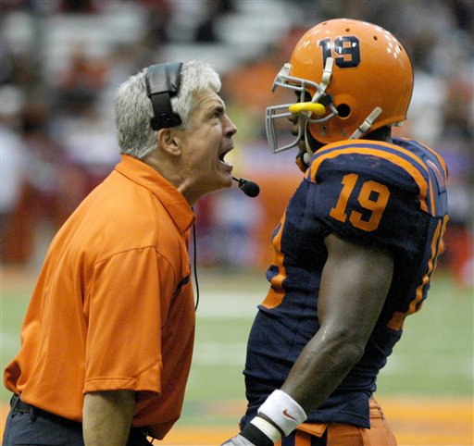
Three (3) Connecting Principles
3. Connecting Goes Beyond Words. . .
…Your actions speak so loudly, I can’t hear what you’re saying!

Slide 16
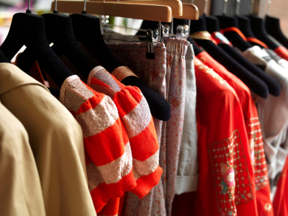
Three (3) Connecting Principles
3. Connecting Goes Beyond Words. . .
…So what do clothes have to do with it?
Clothes aren’t actions!
Or are they????

Slide 17
Three (3) Connecting Principles
3. Connecting Goes Beyond Words. . .
a. Your “look” determines your brand so
you must pay attention to. . .
Your Attire
Your Personal Grooming
Your Language
Your Attitude

Slide 18
Three (3) Connecting Principles
3. Connecting Goes Beyond Words. . .
The “look” of your students determines their brand so you must pay attention to. . .
Their Attire
Their Personal Grooming
Their Language
Their Attitude

Slide 19
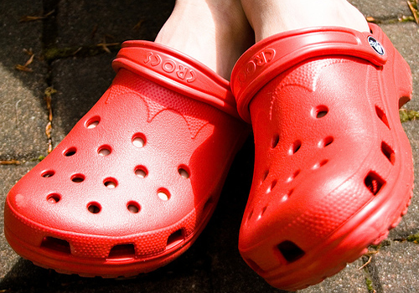
Three (3) Connecting Principles
CROCKS
NEVER – EVER WEAR. . .
Crocks are for the beach – NOT the classroom

Slide 20
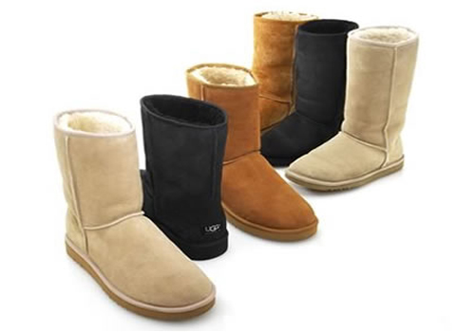
Three (3) Connecting Principles
UGGS
NEVER – EVER WEAR. . .
Uggs are just glorified slippers. Slippers are PJs.
Would you wear PJs to conduct your ensemble?

Slide 21

Three (3) Connecting Principles
SWEATS
NEVER – EVER WEAR. . .
Sweats scream, “I’m lazy! Please fire me!”

Slide 22
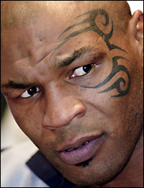
Three (3) Connecting Principles
FACE TATOOS
NEVER – EVER WEAR. . .
Just. . .don’t. . .do. . .it!

Slide 23

Three (3) Connecting Principles
MESSAGE T’s
NEVER – EVER WEAR. . .
Unless it’s promoting your Music Ed Program

Slide 24
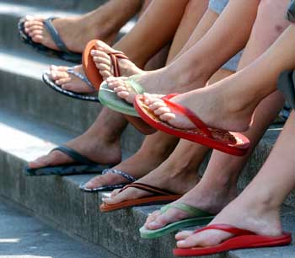
Three (3) Connecting Principles
FLIP-FLOPS
NEVER – EVER WEAR. . .
Dressy sandals or casual loafers are fine!

Slide 25
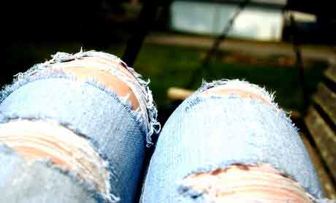
Three (3) Connecting Principles
MESSY,
NEVER – EVER WEAR. . .
WRINKLED, OR TORN CLOTHING
Buy an iron or take your clothes to the laundry.

Slide 26
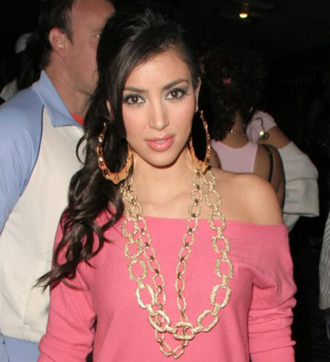
Three (3) Connecting Principles
TOO MUCH
JEWELRY
NEVER – EVER WEAR. . .
Loud, clanky jewelry could create
unwanted percussion

Slide 27

Three (3) Connecting Principles
ANYTHING TOO
REVEALING!
NEVER – EVER WEAR. . .
School is not the place to show off your abs
or your extra cellulite

Slide 28
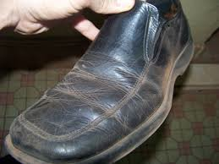
Three (3) Connecting Principles
DIRTY SHOES
NEVER – EVER WEAR. . .
Get some polish and clean them to a high shine

Slide 29

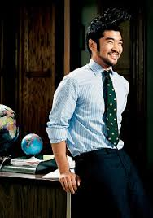
Three (3) Connecting Principles
YOU ARE A PROFESSIONAL!
DRESS LIKE ONE!
Students, parents, and administrators
take you more seriously when you
come to work dressed as a professional.

Slide 30
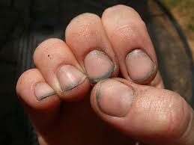
Three (3) Connecting Principles
PERSONAL GROOMING. . .
NAILS
Dirty nails say, “I don’t care enough about myself
to take care of myself.”

Slide 31
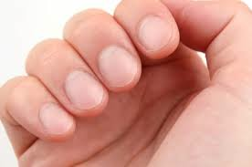
Three (3) Connecting Principles
PERSONAL GROOMING. . .
NAILS
Yes—I took a shower this morning!

Slide 32
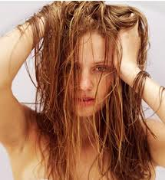
Three (3) Connecting Principles
PERSONAL GROOMING. . .
HAIR
Greasy hair means that you got up late which means that you are ill-prepared to teach today.

Slide 33
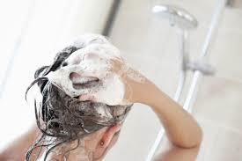
Three (3) Connecting Principles
PERSONAL GROOMING. . .
HAIR
Habit 3 from Covey’s “7 Habits of Highly Successful People” is: PUT FIRST THINGS FIRST

Slide 34
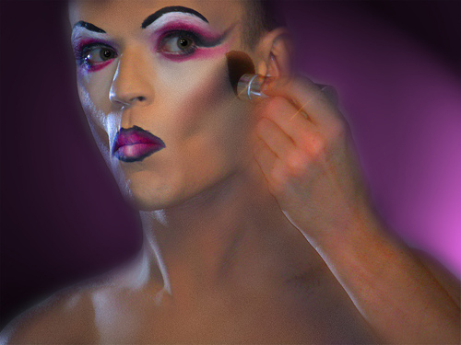
Three (3) Connecting Principles
HEAVY
MAKE-UP
PERSONAL GROOMING. . .
Heavy make-up says, “It’s all about me! Notice me!”

Slide 35
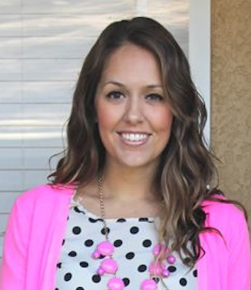
Three (3) Connecting Principles
PERSONAL GROOMING. . .
HEAVY
MAKE-UP
Make-up should look like it’s barely there.

Slide 36
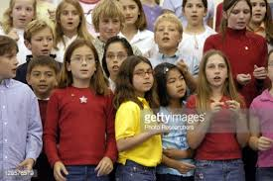
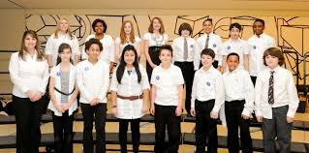
Three (3) Connecting Principles
The “look” of your students determines their brand so you must pay attention to. . .
. . .Your Elementary School Chorus “look.”
How could this “look” be improved?

Slide 37
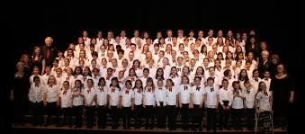
Three (3) Connecting Principles
The “look” of your students determines their brand so you must pay attention to. . .
. . .Your Elementary School Chorus “look.”
How was this “look” achieved?

Slide 38
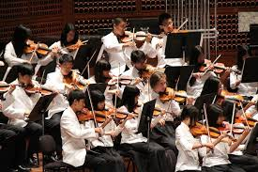
Three (3) Connecting Principles
The “look” of your students determines their brand so you must pay attention to. . .
. . .Your Orchestra“look.”
How could this “look” be improved?

Slide 39
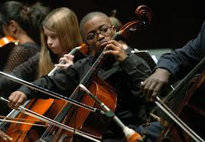
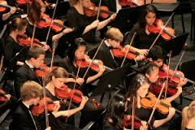
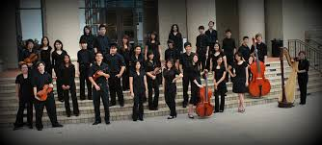
Three (3) Connecting Principles
The “look” of your students determines their brand so you must pay attention to. . .
. . .Your Orchestra“look.”
How was this “look” achieved?

Slide 40
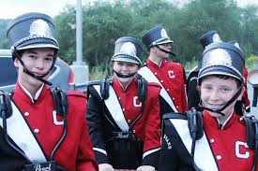
Three (3) Connecting Principles
The “look” of your students determines their brand so you must pay attention to. . .
. . .Your Marching Band “look.”
How could this “look” be improved?

Slide 41
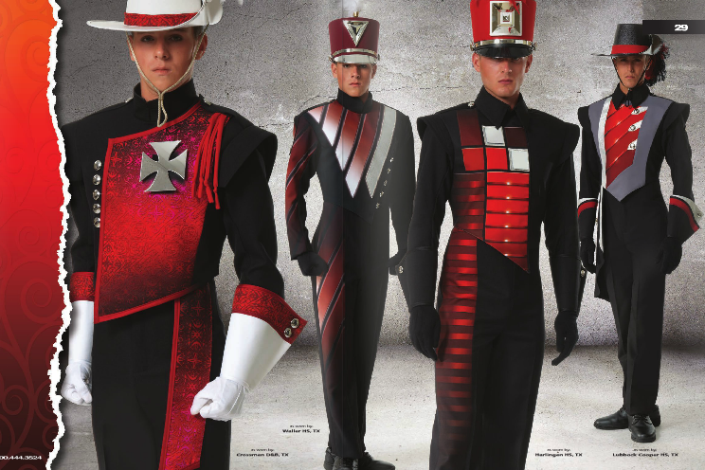
Three (3) Connecting Principles
The “look” of your students determines their brand so you must pay attention to. . .
. . .Your Marching Band “look.”
How was this “look” achieved?

Slide 42
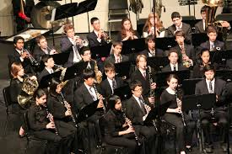
Three (3) Connecting Principles
The “look” of your students determines their brand so you must pay attention to. . .
. . .Your Concert Band “look.”
How was this “look” achieved?

Slide 43
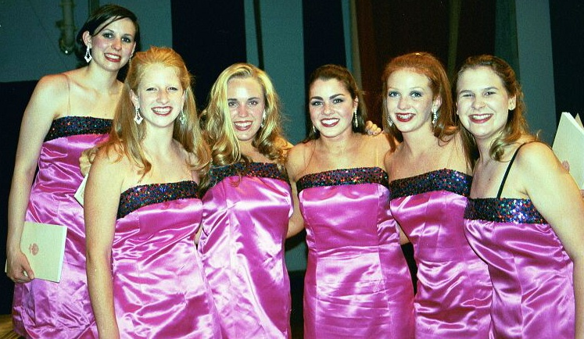
Three (3) Connecting Principles
The “look” of your students determines their brand so you must pay attention to. . .
. . .Your Choir“look.”
How can this “look” be improved?

Slide 44
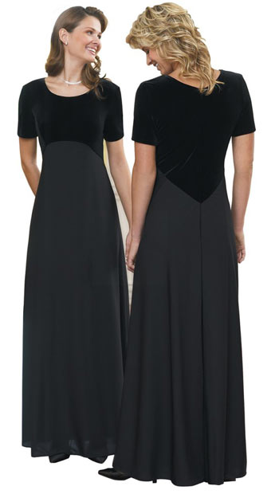
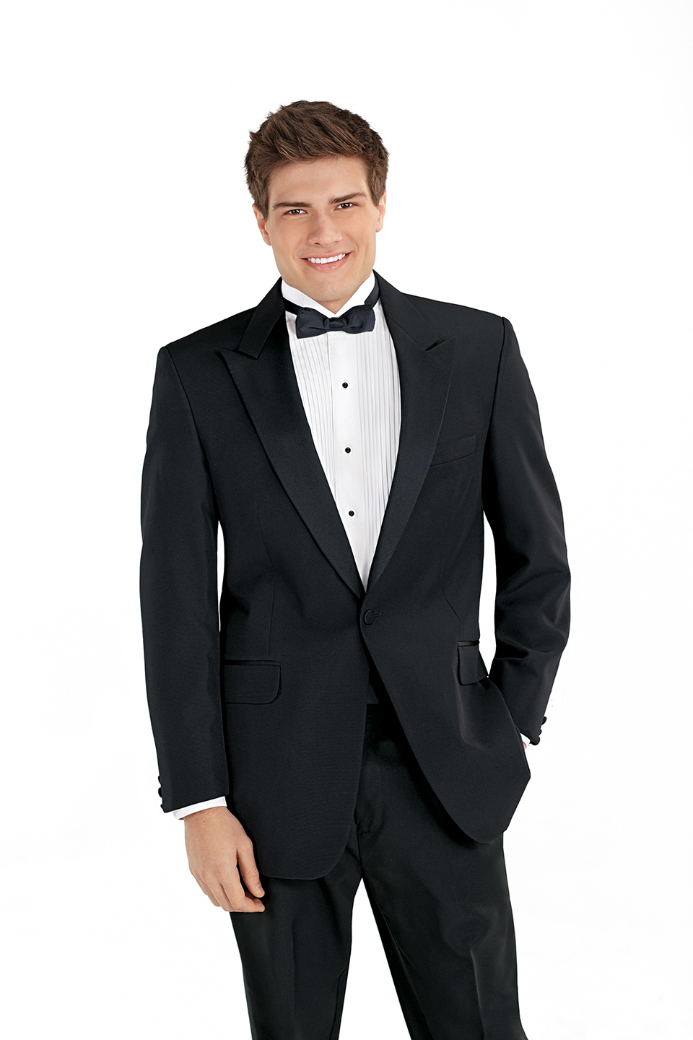
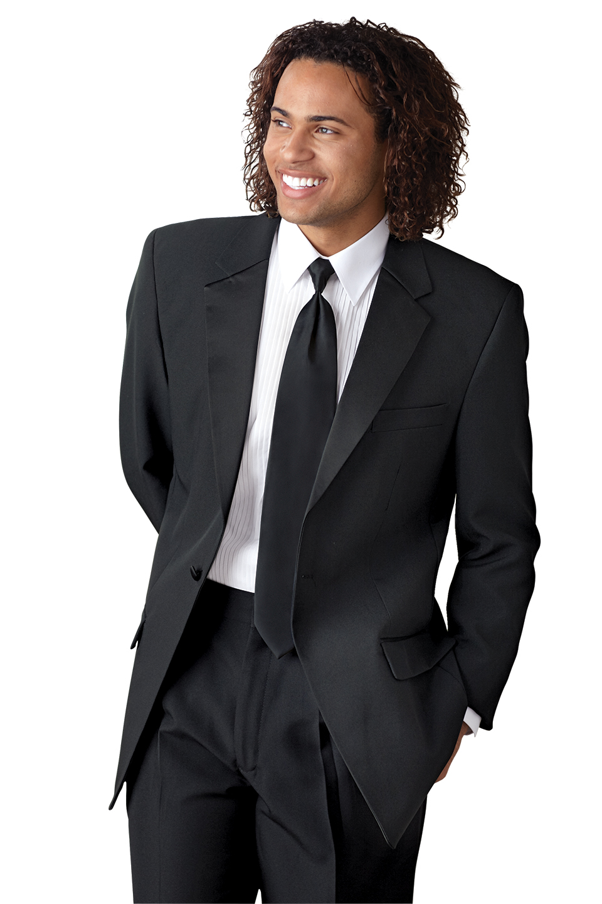
Three (3) Connecting Principles
The “look” of your students determines their brand so you must pay attention to. . .
. . .Your Choir“look.”
How was this “look” achieved?

Slide 45


Marcia’s Hands and Shoes Philosophy
Festival Checklist
Conductor Attire
Attire for Ladies:
*Identical to ensemble or longer dress
or skirt—definitely BELOW knee
*Formal pants
*Black pumps—not a high heel
*No mobile jewelry or hair styles
Attire for Men:
*Identical to ensemble or suit/tux
*Black shoes that have been shined
*No mobile jewelry or hair styles

Slide 46
Marcia’s Hands and Shoes Philosophy
Festival Checklist
Performer Attire
Choose a “uniform” look.
Black shoes and socks (or just black socks)
Hair off the face – girls and boys
Shirts either all tucked in or all hanging out
Jackets/shirts buttoned or not buttoned
White t-shirts underneath white dress shirts
No dangling jewelry
—DUH!
No sunglasses

Slide 47
Three (3) Connecting Principles
YOUR “LOOK” REVEALS TWO THINGS:
1. How much you care about yourself
(self-respect)
2. How much you care about others.
Looking good!
What a great way to show students how much you care!

Slide 48
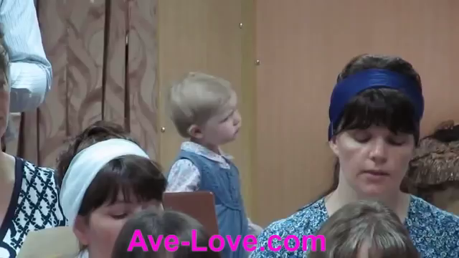
Expressive Body Language Begins Early
Check out this Toddler

Slide 49
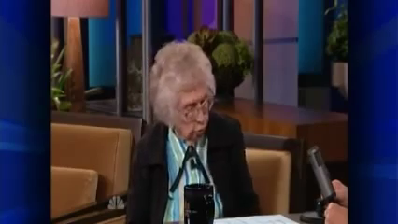
And finally, check out
Dorothy Custer

Slide 50
Got Smart Phone?
marcia@musicedconsultants.net
Thank You, Sponsors!!
University Park
Allocation Committee
Peter Sides

