Slide 1

First Performance
National Day of Celebration
3rd Thursday of November Annually

Slide 2
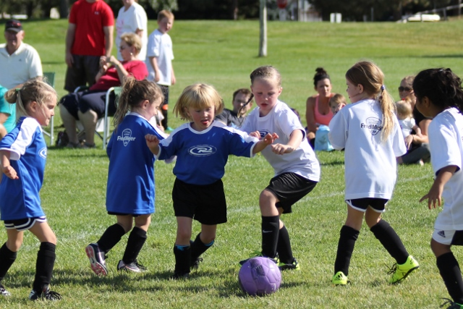

Slide 3
The Results:
  Reduces Beginner Dropout
  Provides Short-Range Achievement
  Goals
  Encourages Engagement with
  Parents
  Strengthens Administrative Support
  Celebrates Musical Accomplishments
  of Beginners

Slide 4
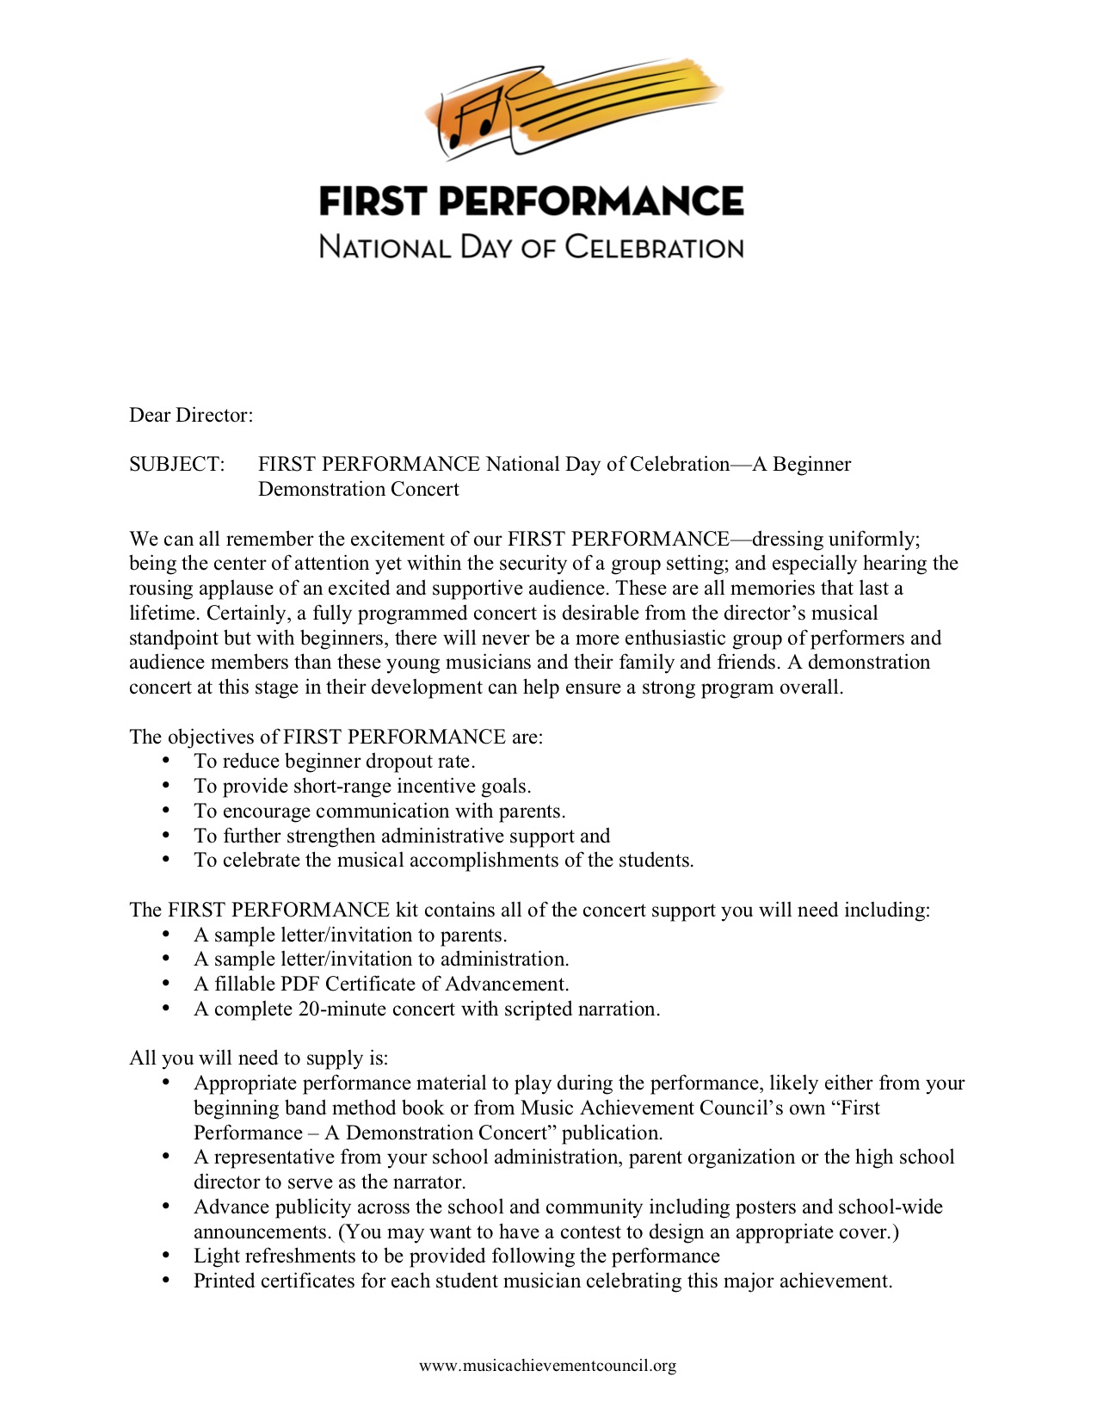
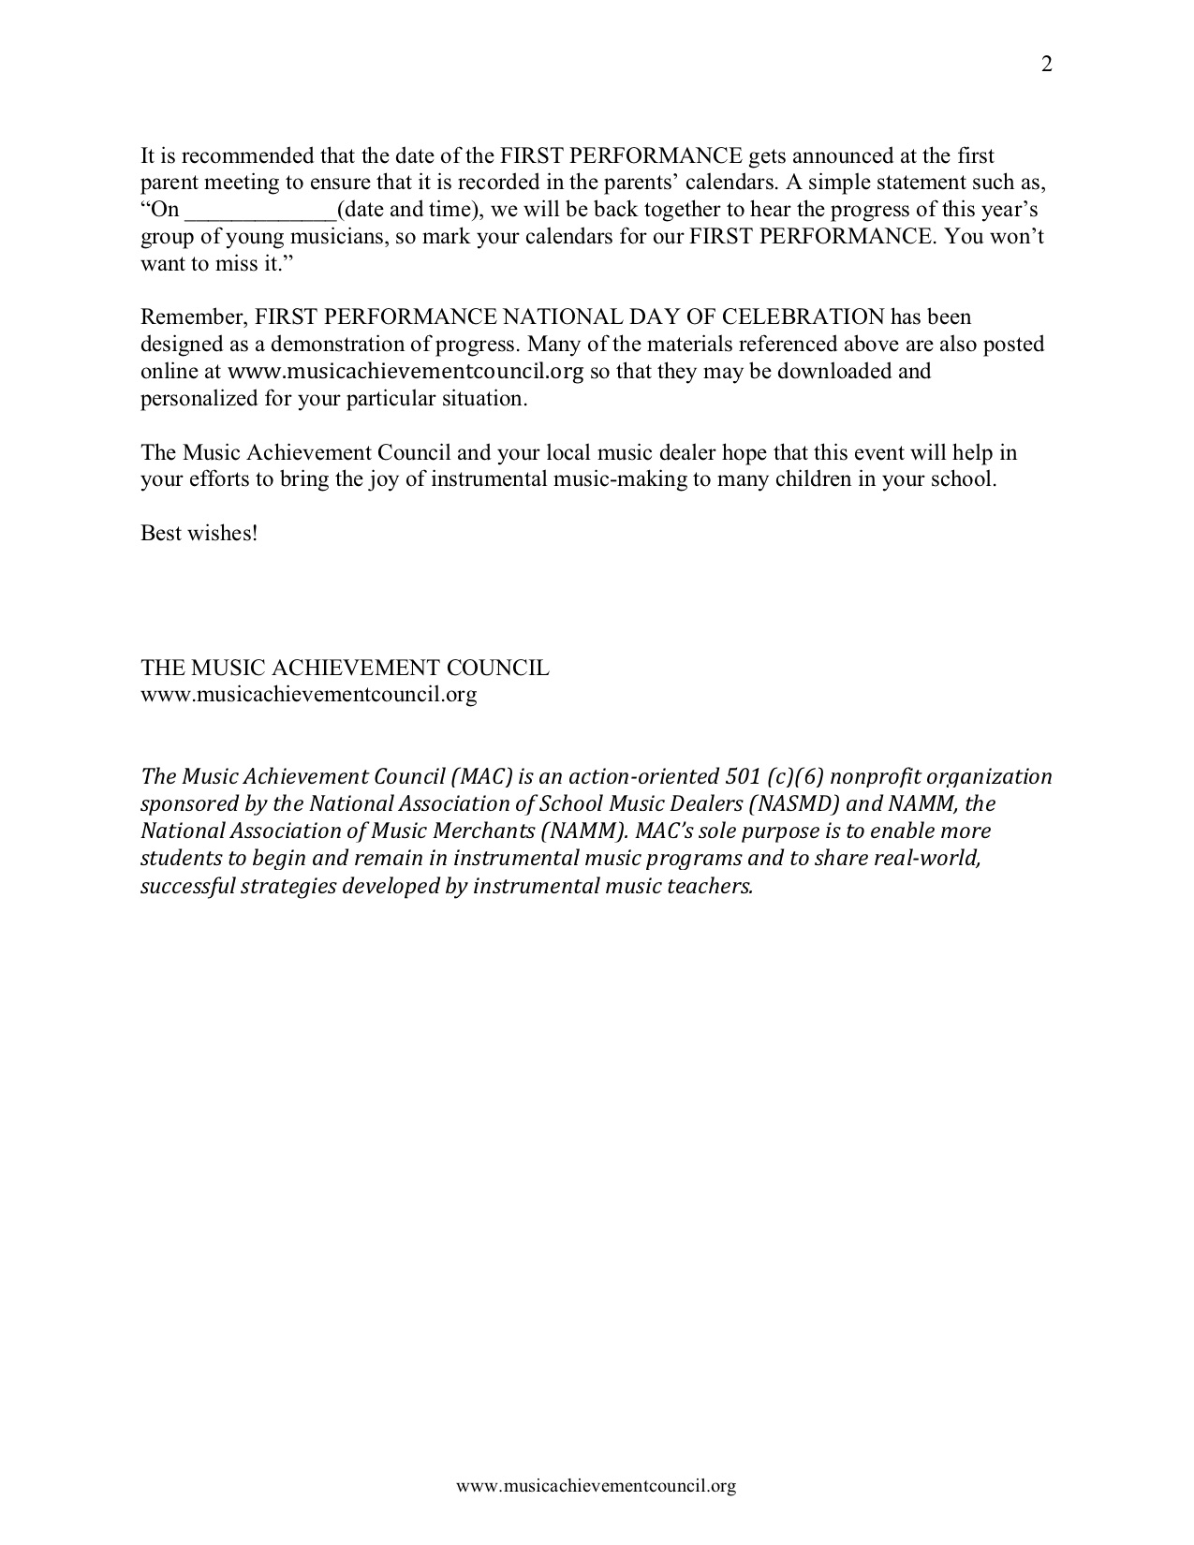
What’s Included?
1. Director Letter with Full Set of Instructions

Slide 5
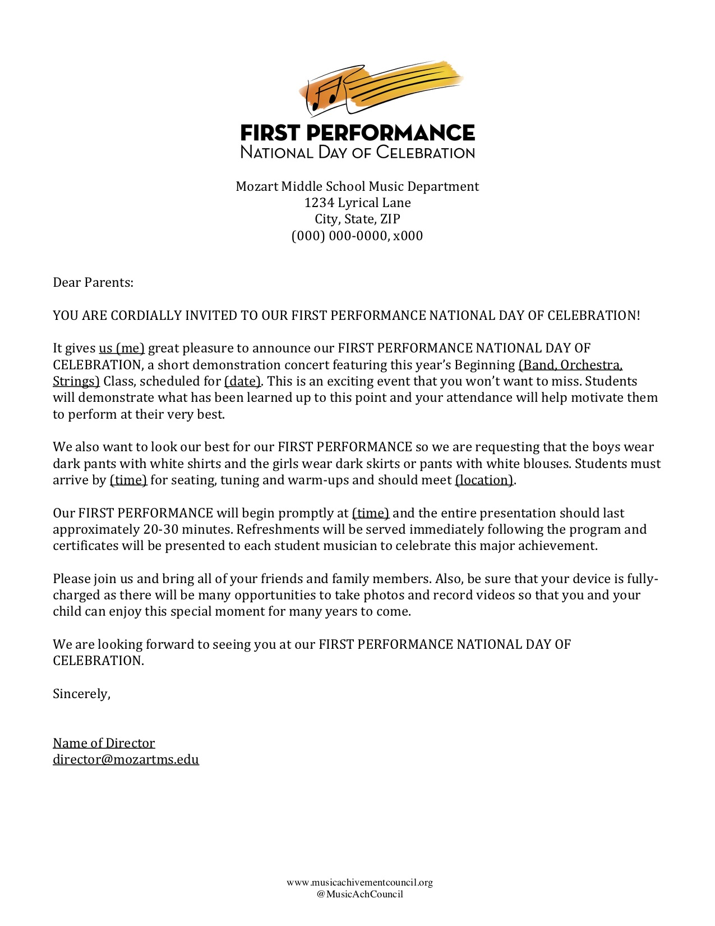
What’s Included?
2. Customizable Letter of Invitation to Parents

Slide 6
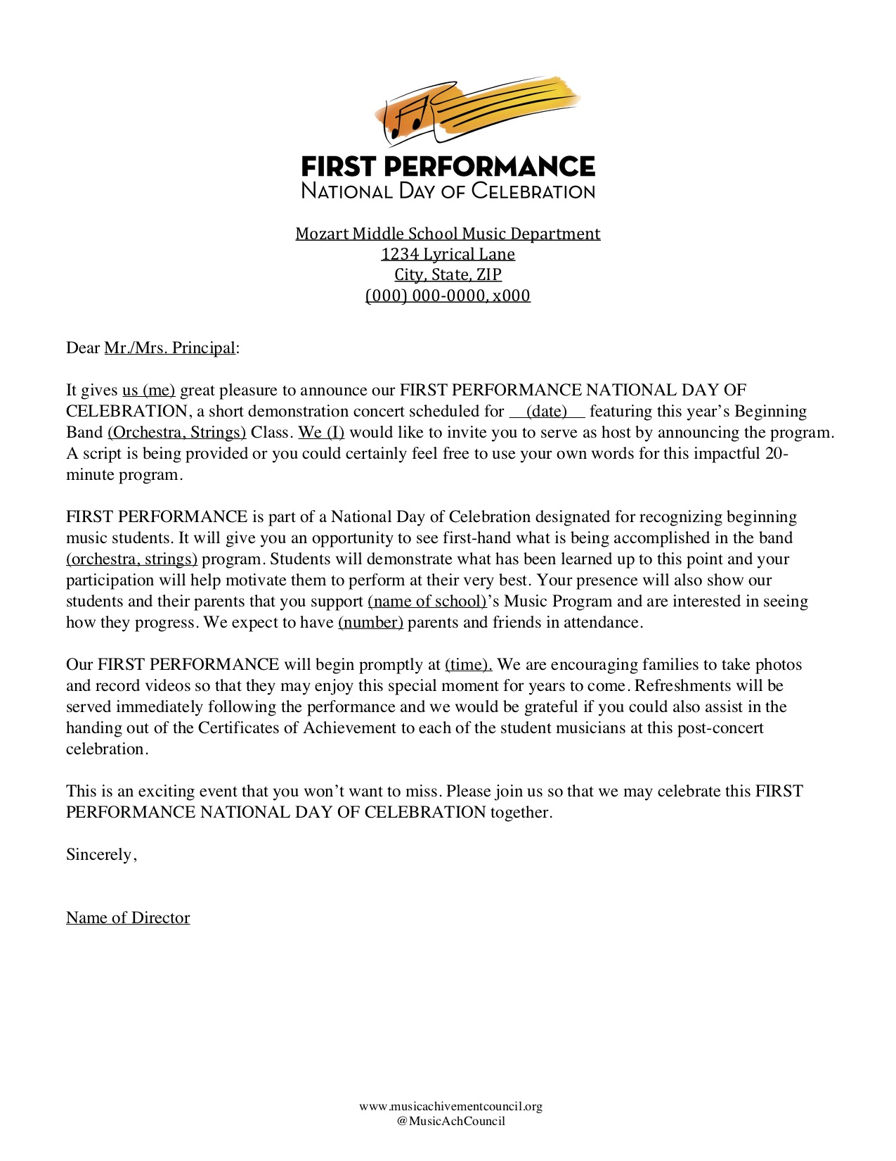
What’s Included?
3. Customizable Letter of Invitation to Principal

Slide 7
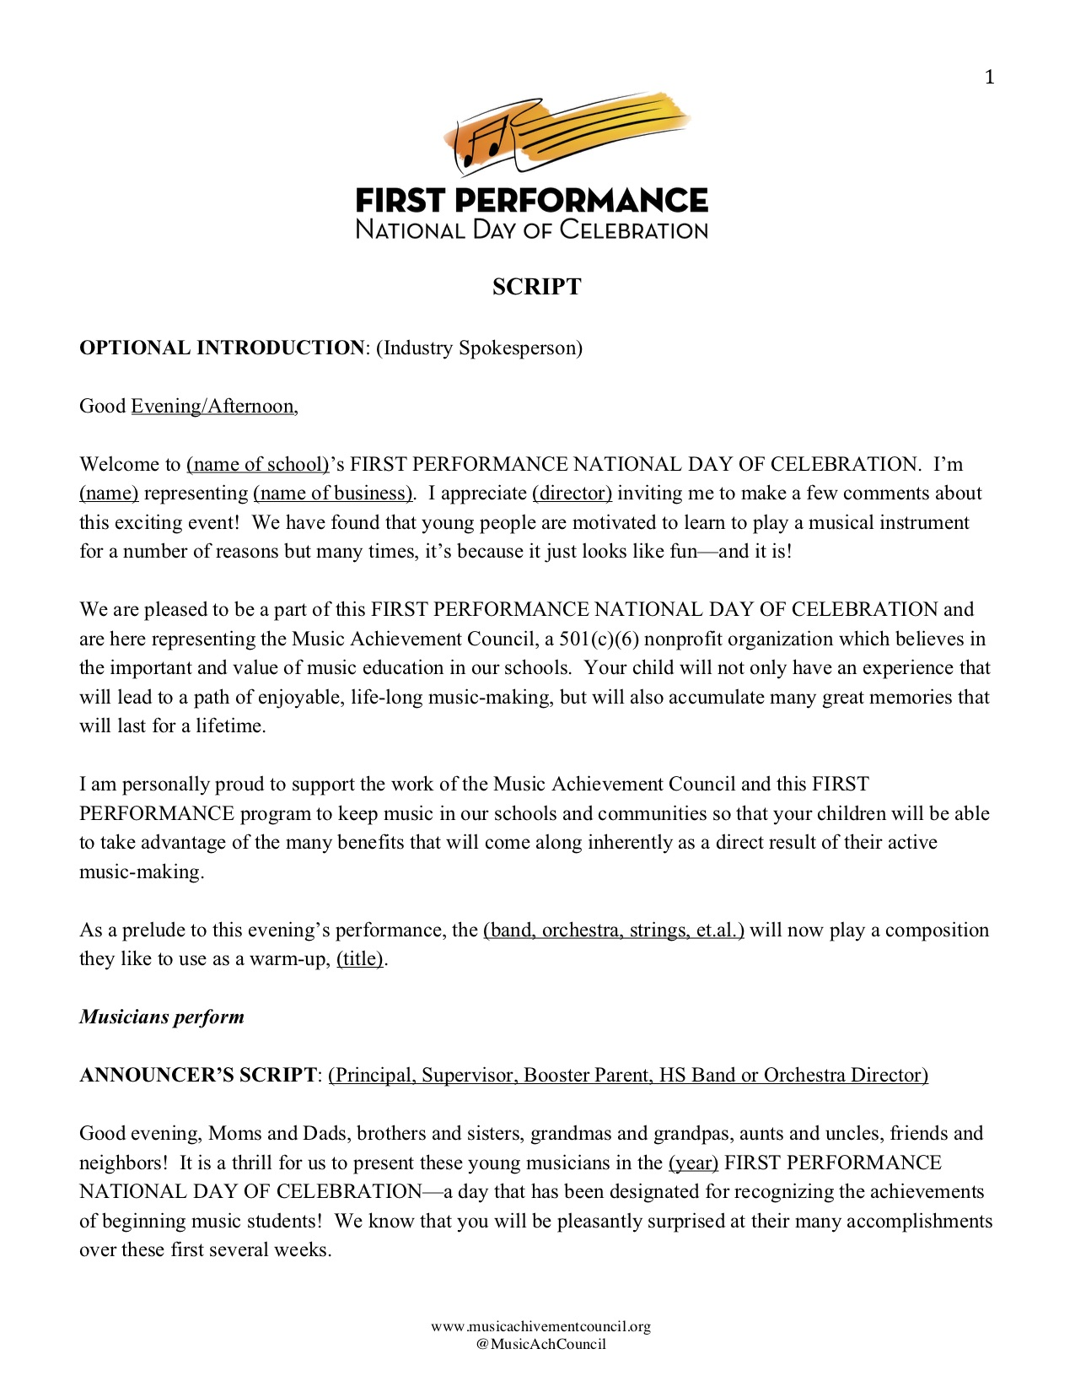
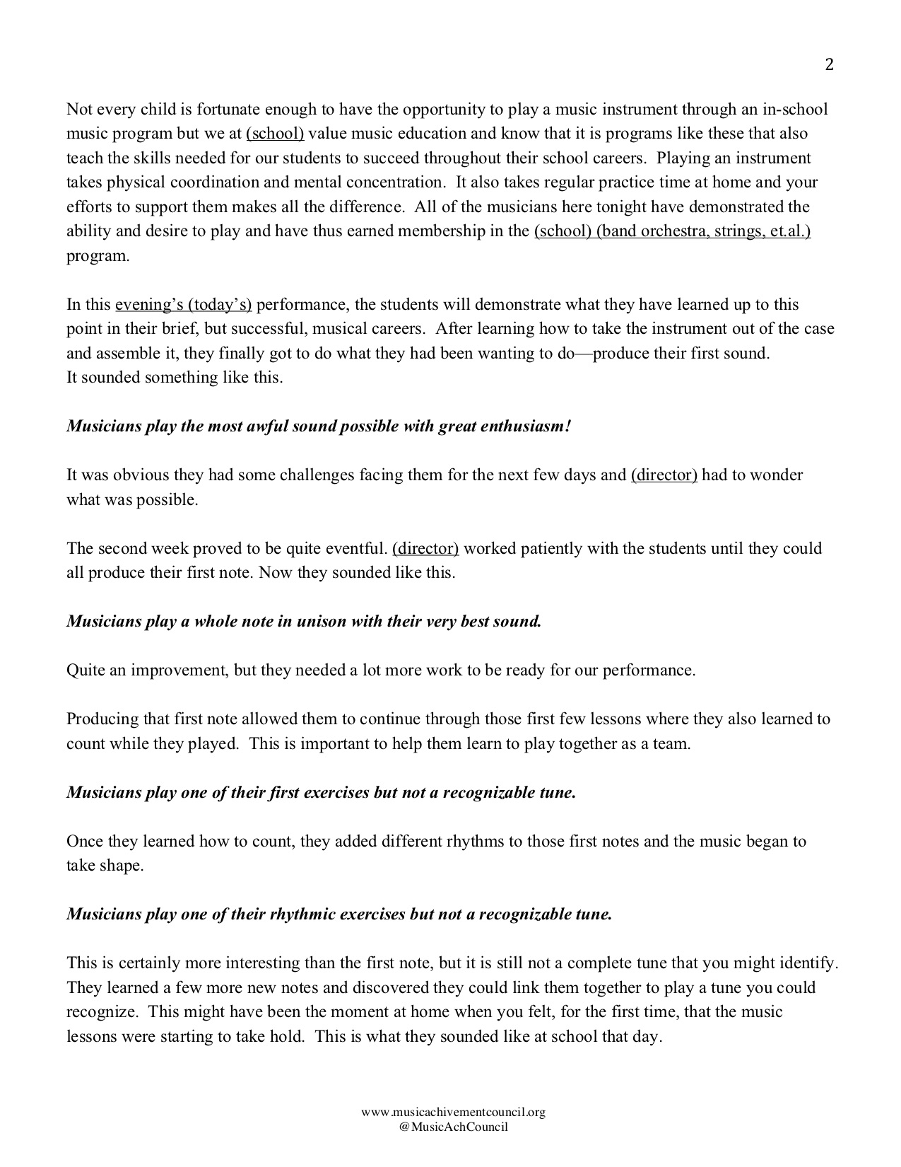
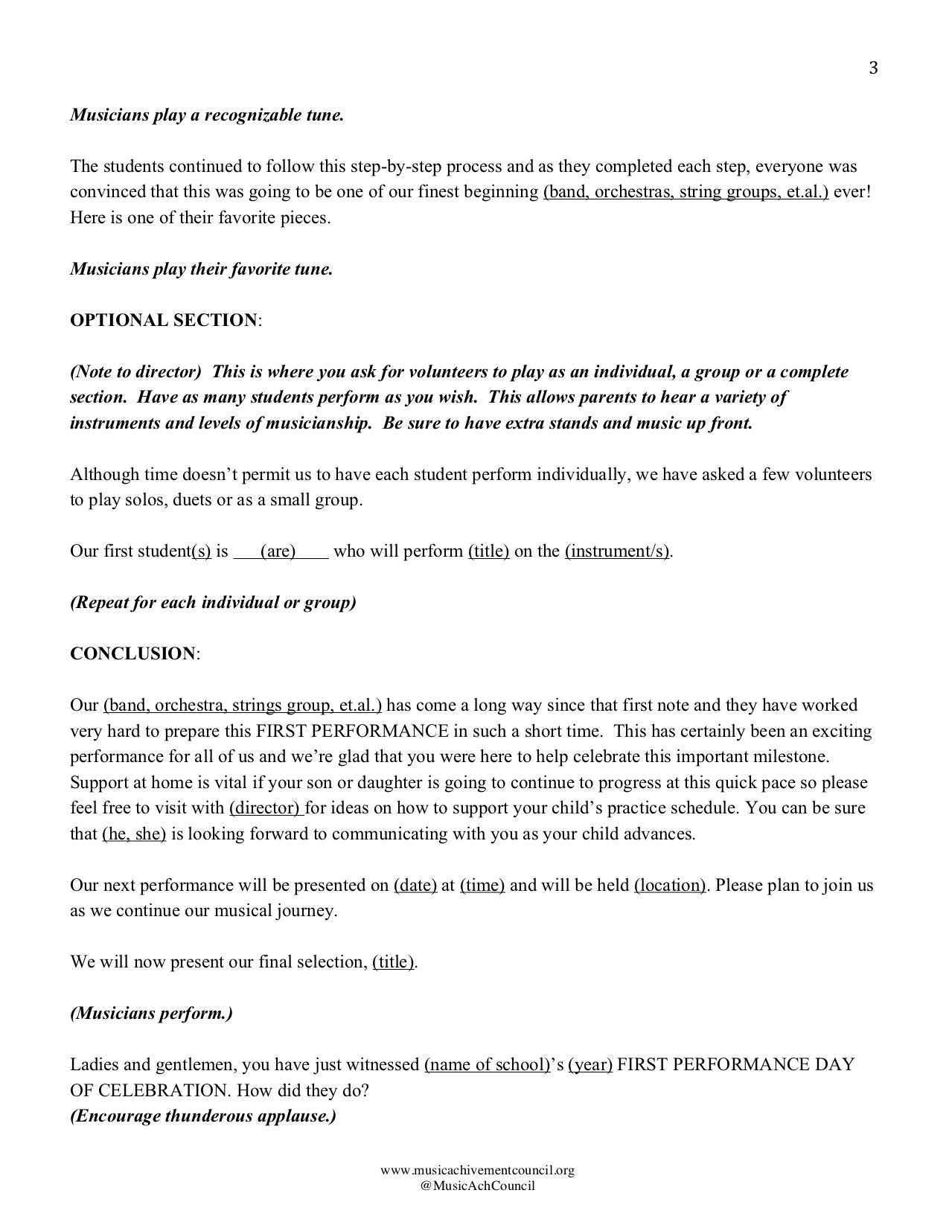
What’s Included?
4. Customizable Script to Make It Your Own!

Slide 8
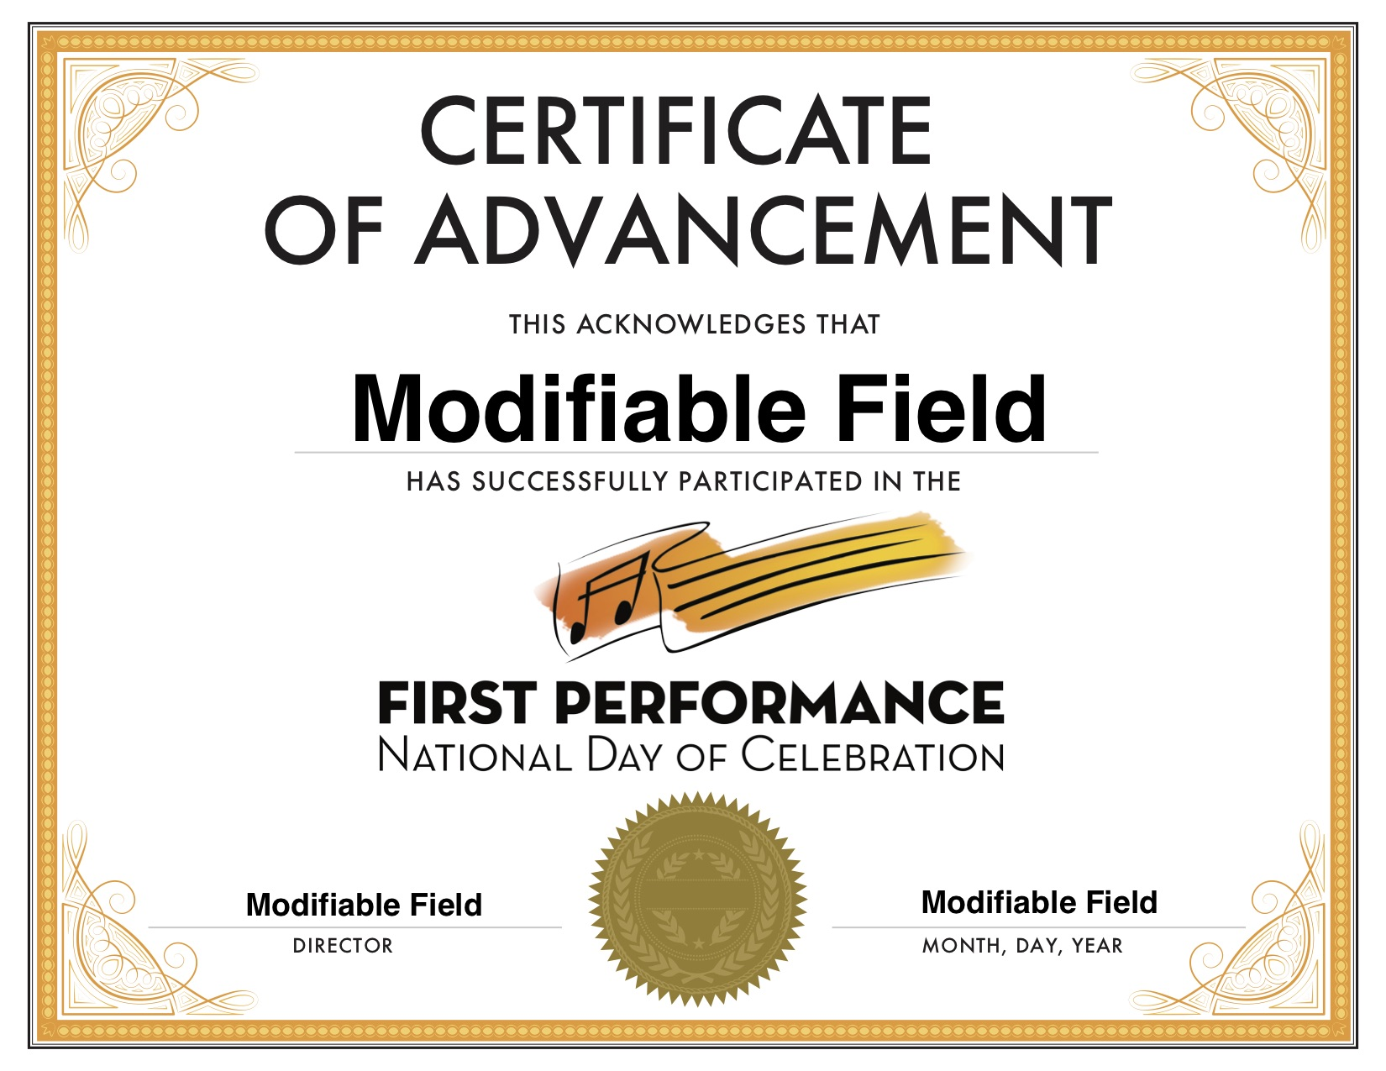
What’s Included?
5. Certificate of Advancement

Slide 9
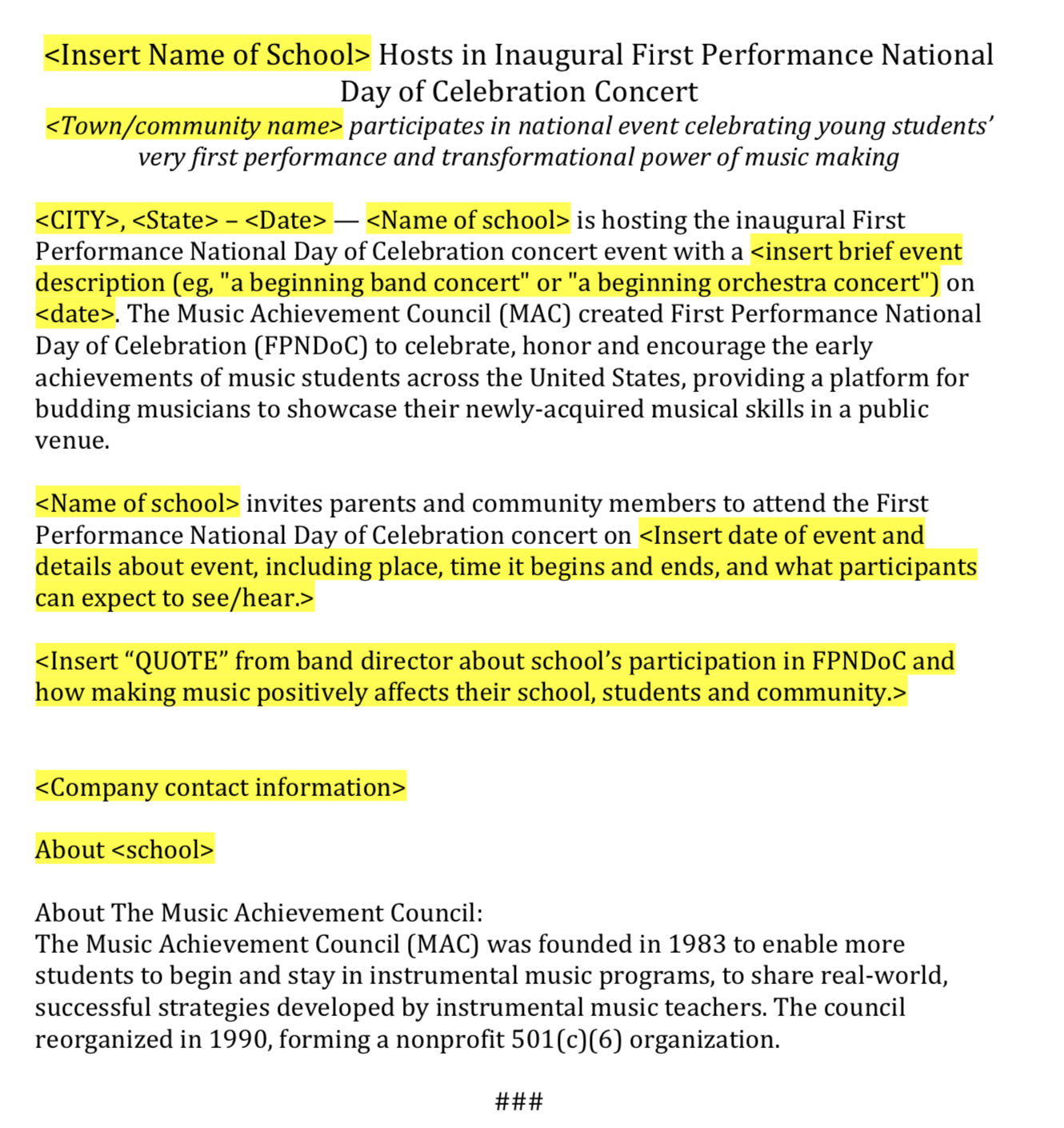
What’s Included?
6. Press Release Template

Slide 10
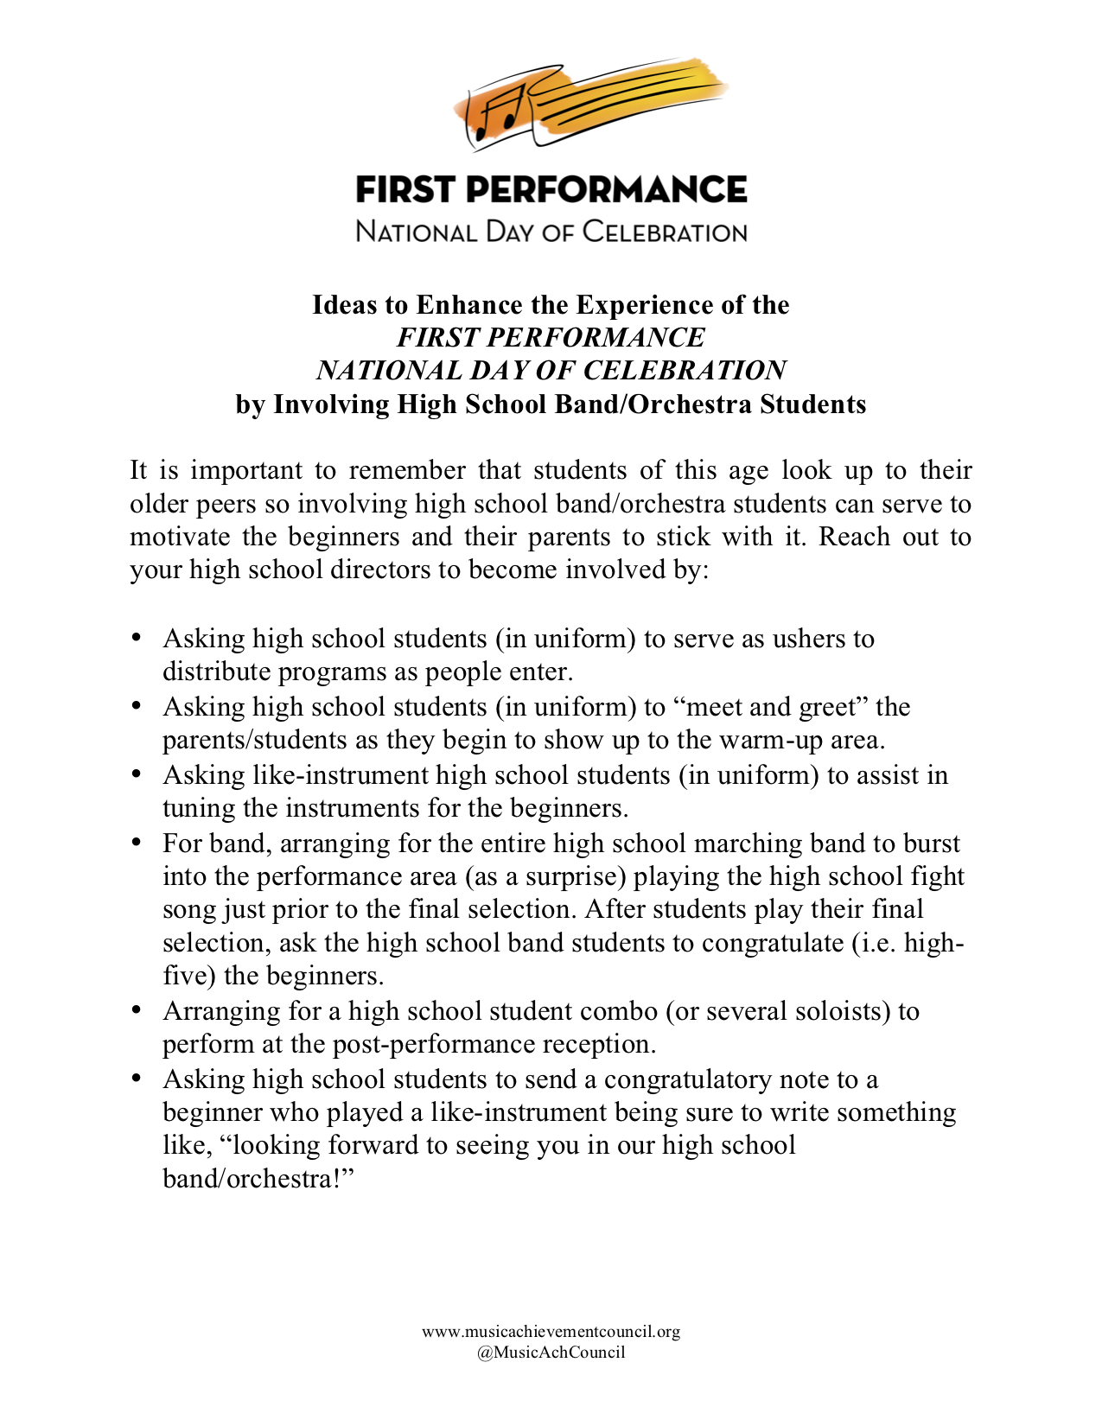
What’s Included?
7. Ideas to Enhance the Experience

Slide 11
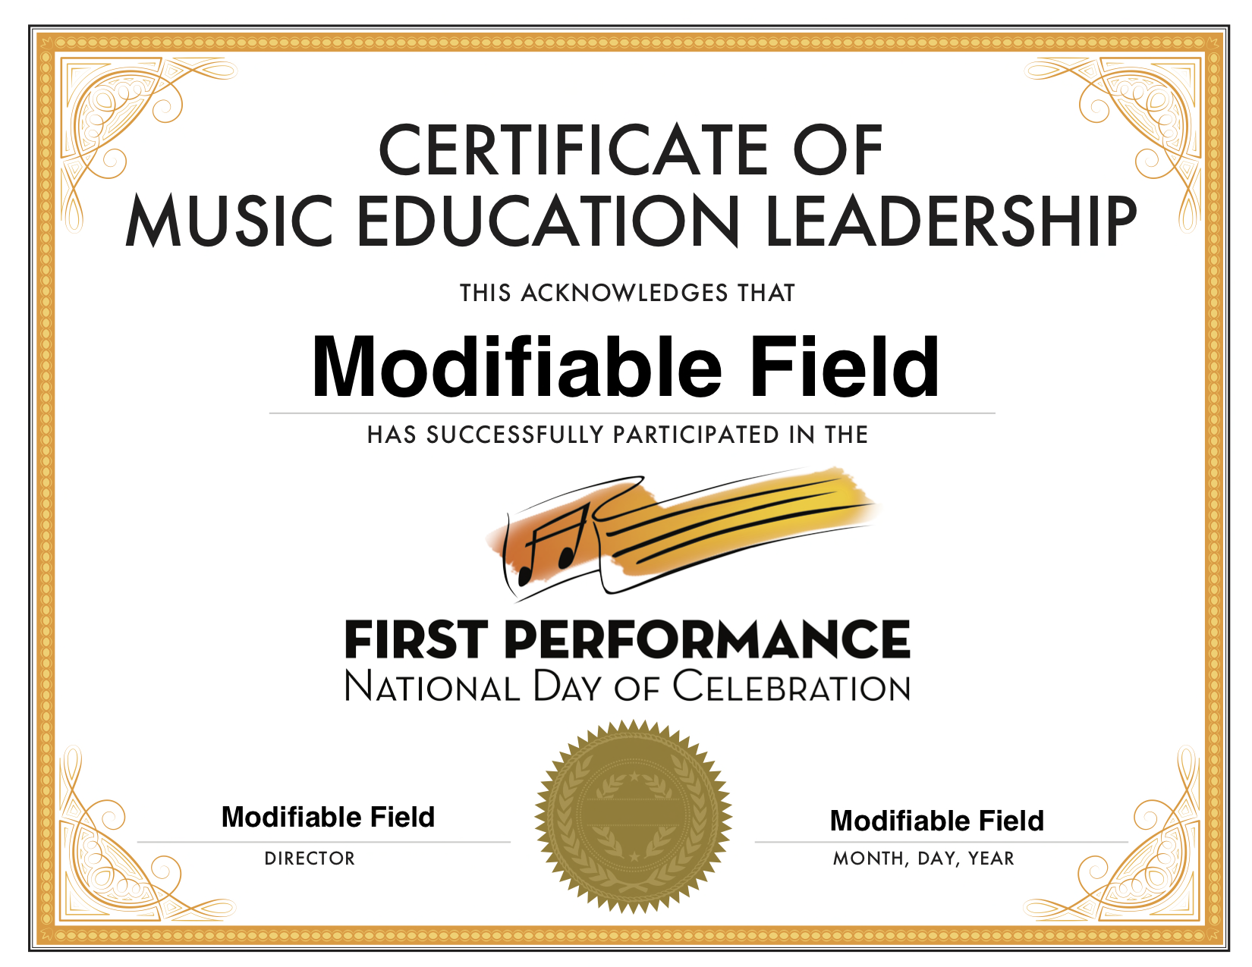
What’s Included?
8. Certificate of Music Ed Leadership for
High School Student Participants

Slide 12
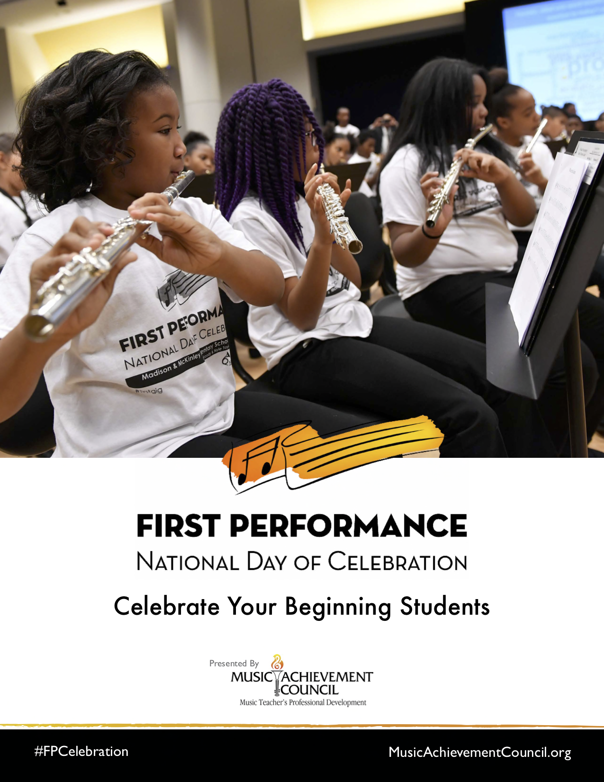
What’s Included?
9. #FPCelebration Toolkit

Slide 13
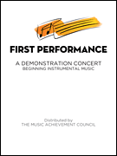
Why Does this Program Work?
The timing of the performance
  Parents want to hear their kids
  play
  Student interest soars and they
  learn to love performing
Students practice more prior to a performance
The audience will be large and enthusiastic!

Slide 14
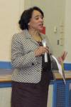
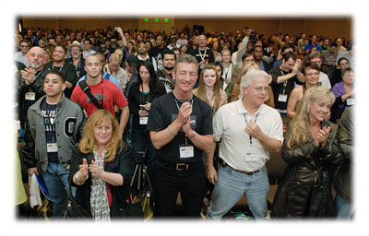
Why Does this Program Work?
Administrators get involved! Many schools have the principal serve as the narrator -- GREAT PR!
The sound of
applause is
infectious

Slide 15
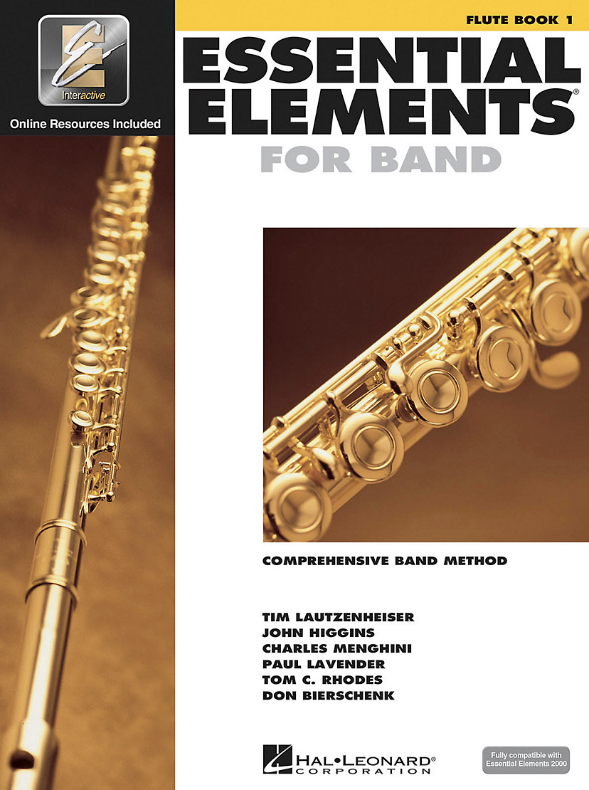
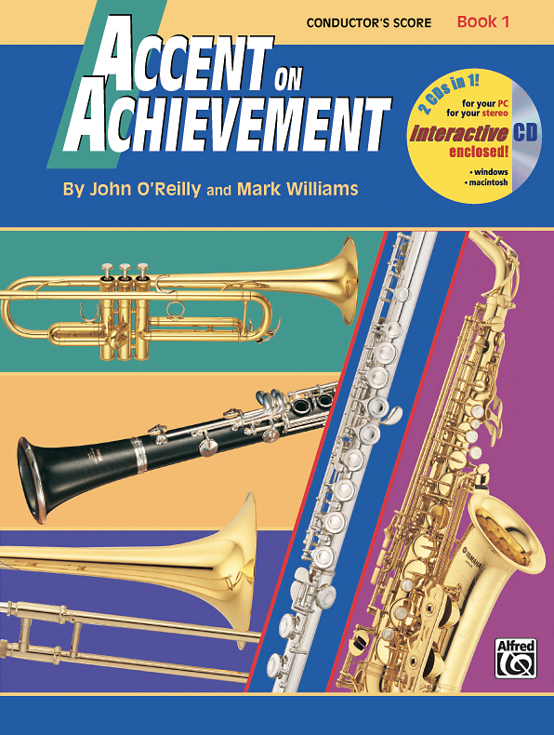
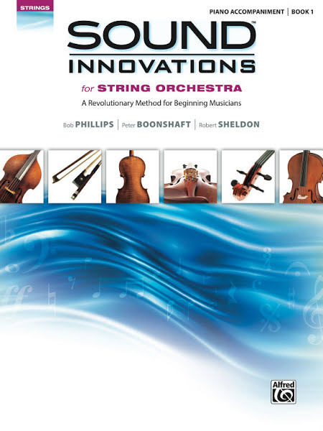
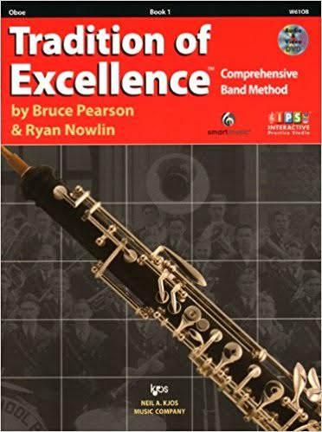
Music
Material
To Use:
Available for
Band or Orchestra at
Local Music Dealers
or online via
Hal Leonard

Slide 16
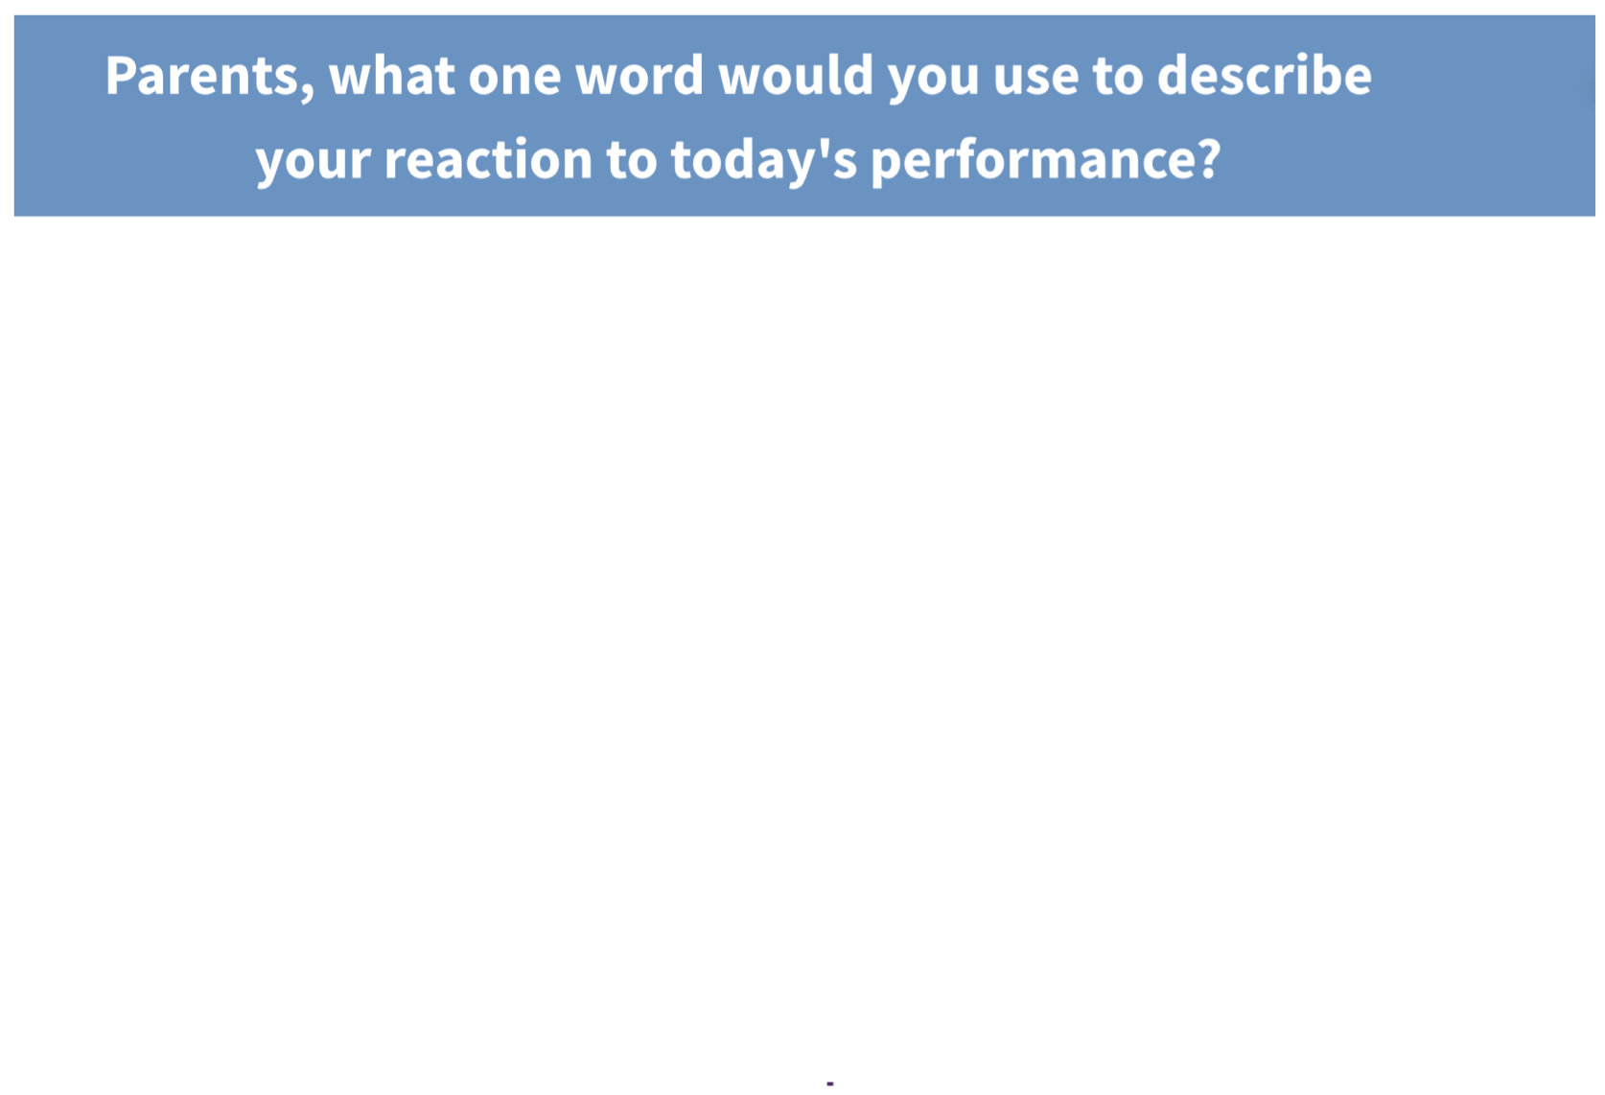
Response from F.P. LIVE at the 2017 Midwest Clinic

Slide 17
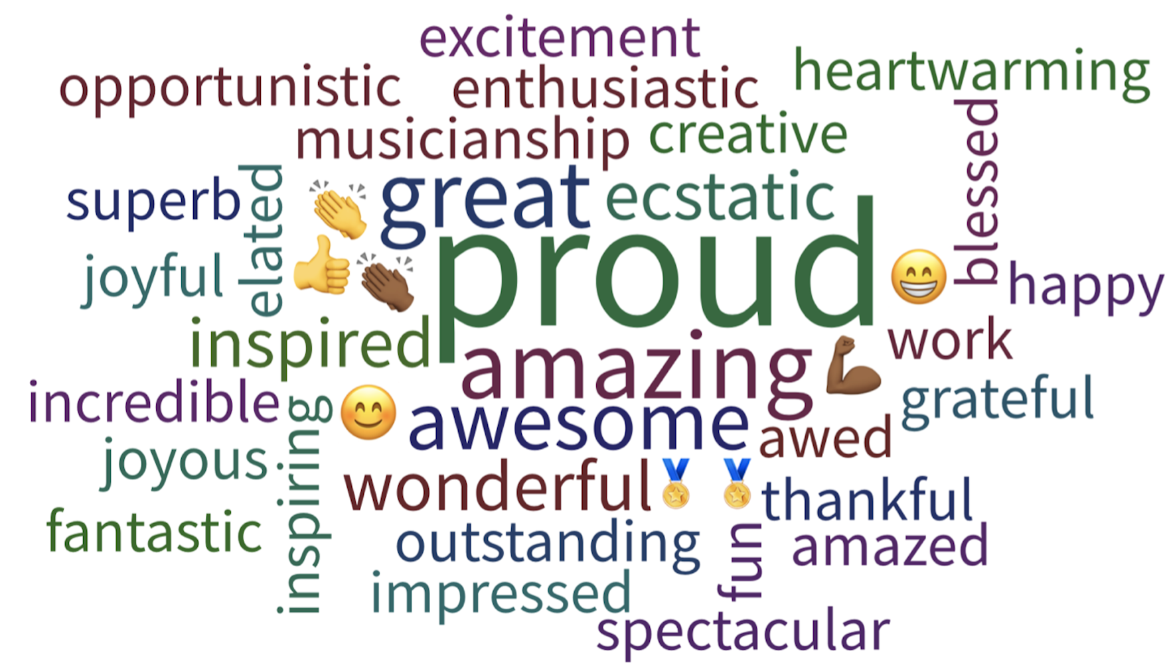
Response from F.P. LIVE at the 2017 Midwest Clinic

Slide 18
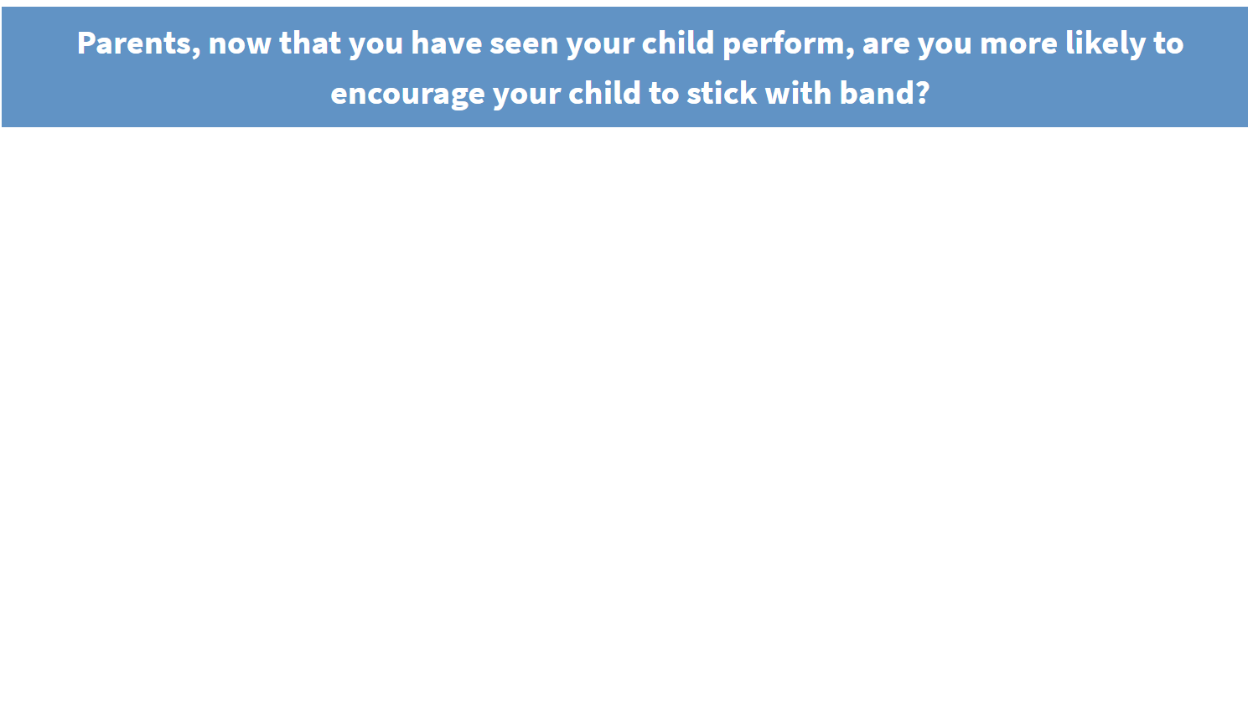
Response from F.P. LIVE at the 2017 Midwest Clinic

Slide 19
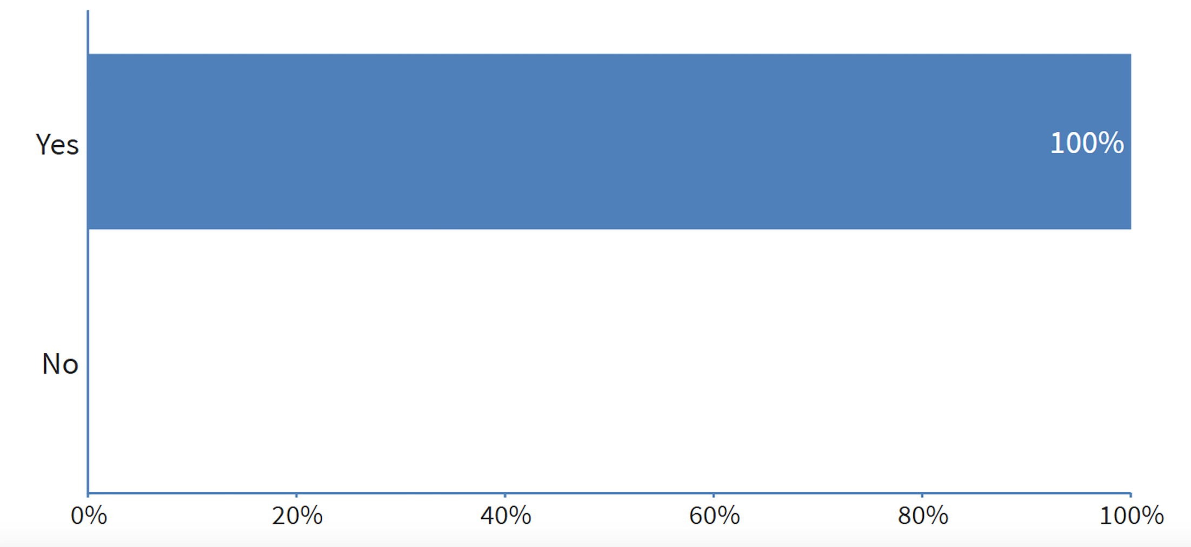
Response from F.P. LIVE at the 2017 Midwest Clinic

Slide 20
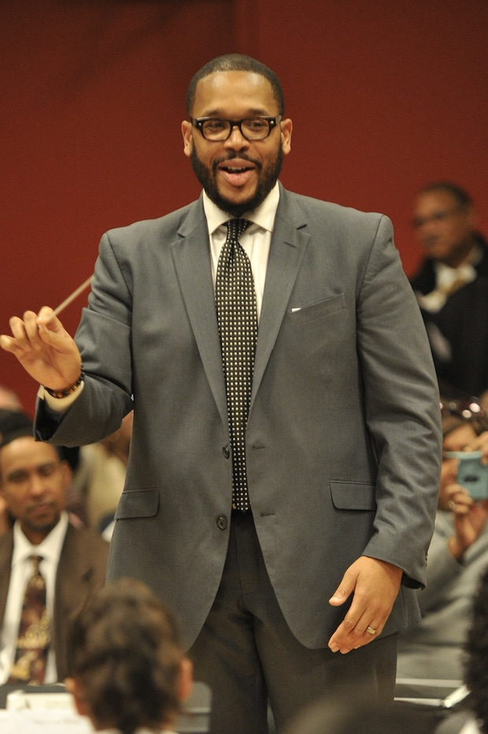
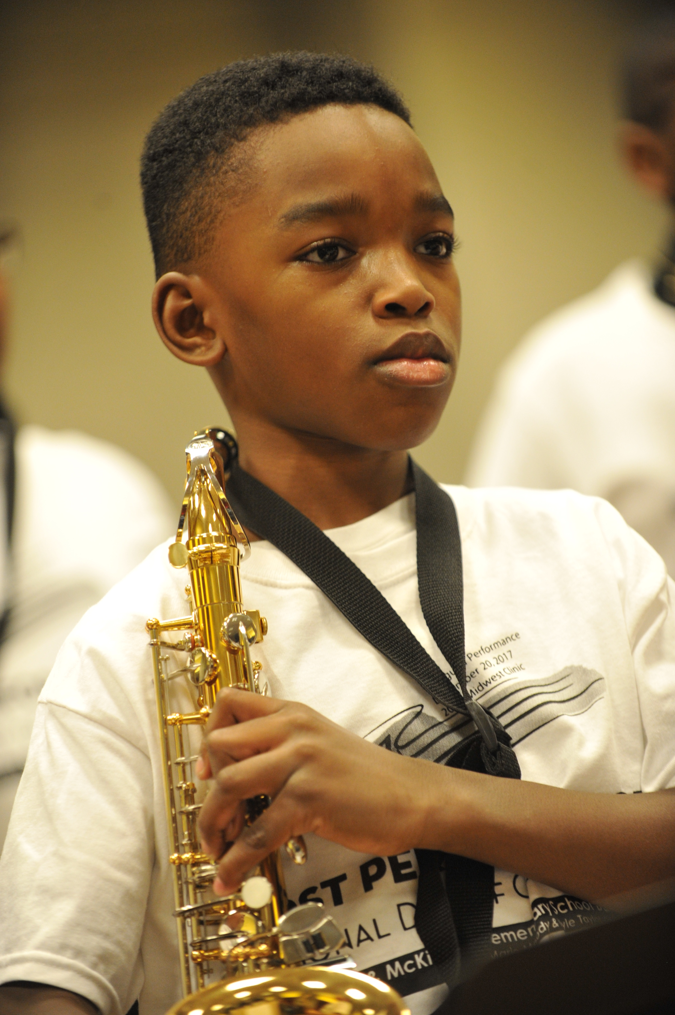
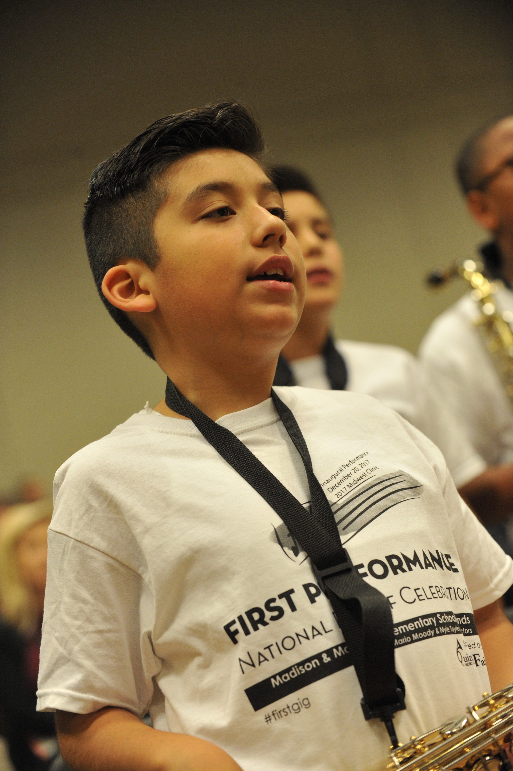
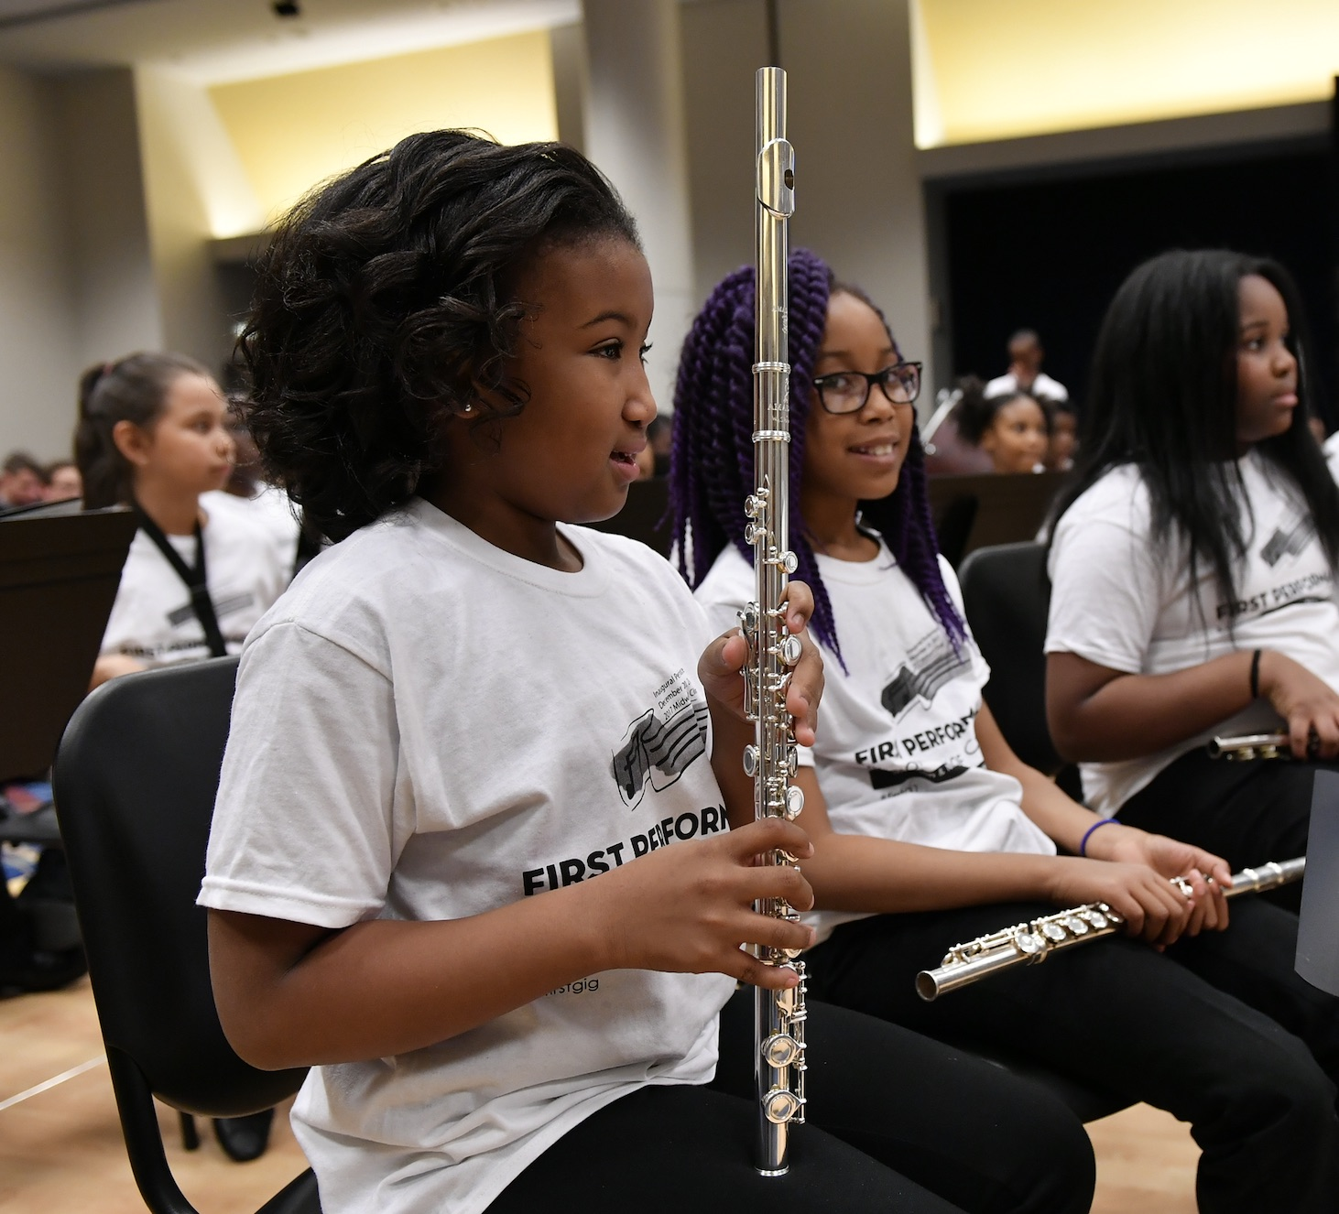
Response from Mario Moody, Director

Slide 21
Response from Mario Moody, Director
The experience of having our 1st year students perform after only playing for 8 weeks has had a profound impact not only on their confidence and expectations for themselves moving forward, it has challenged me to continually grow by making myself vulnerable and aware of what it feels like to "become a beginner." I can relate better to any feelings of apprehension they may feel, and our rehearsals are more effective when my students can feel that every practice counts

Slide 22

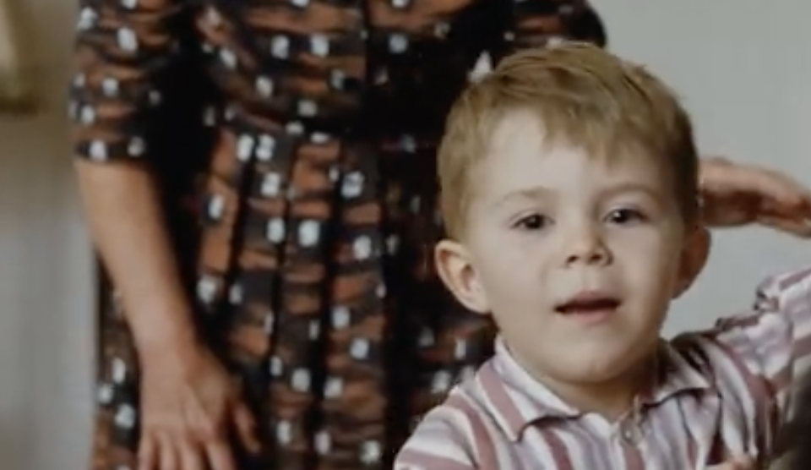
Share Video Clips with Your Colleagues:
Info Here: http://bit.ly/2EXajTm

Slide 23

Share Video Clips with Your Colleagues:
Info Here: http://bit.ly/2EXajTm

Slide 24
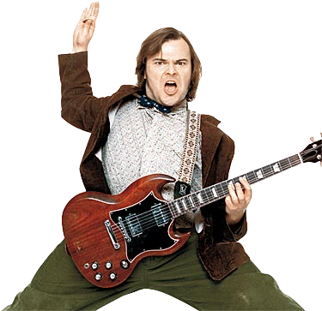

Your Enthusiasm Matters!

Slide 25

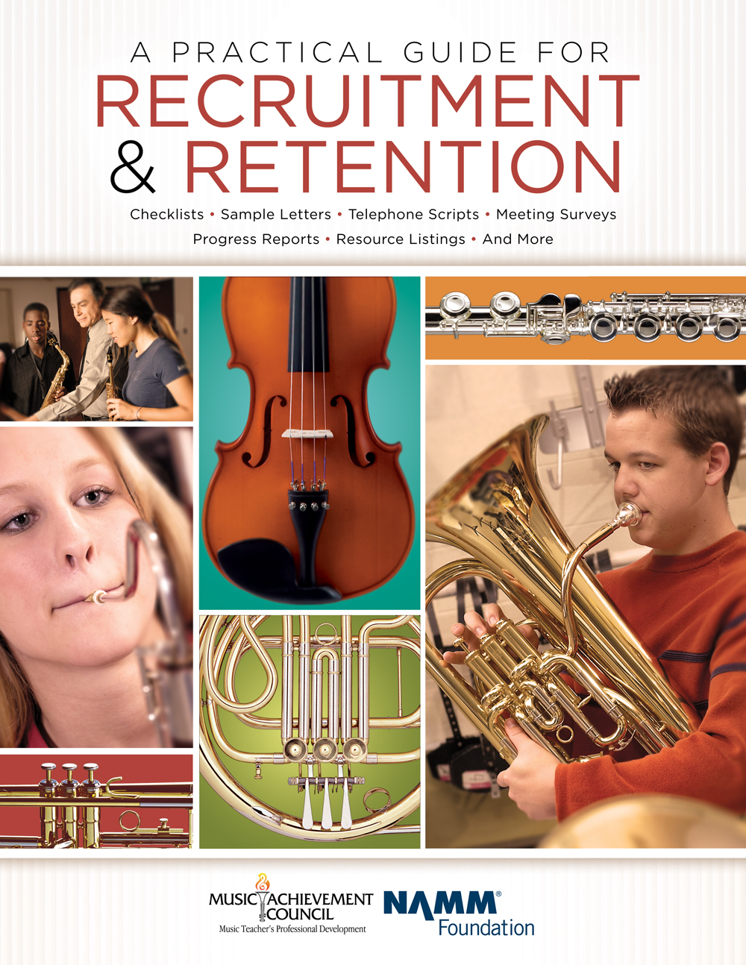
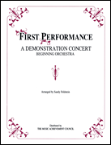
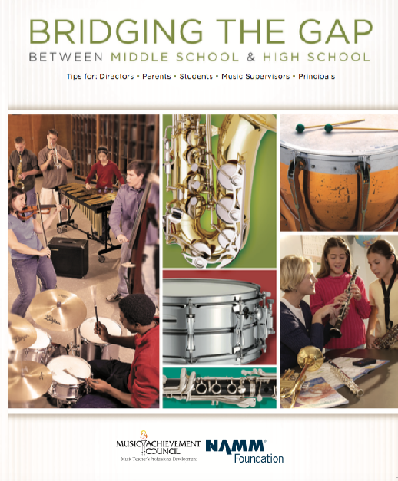
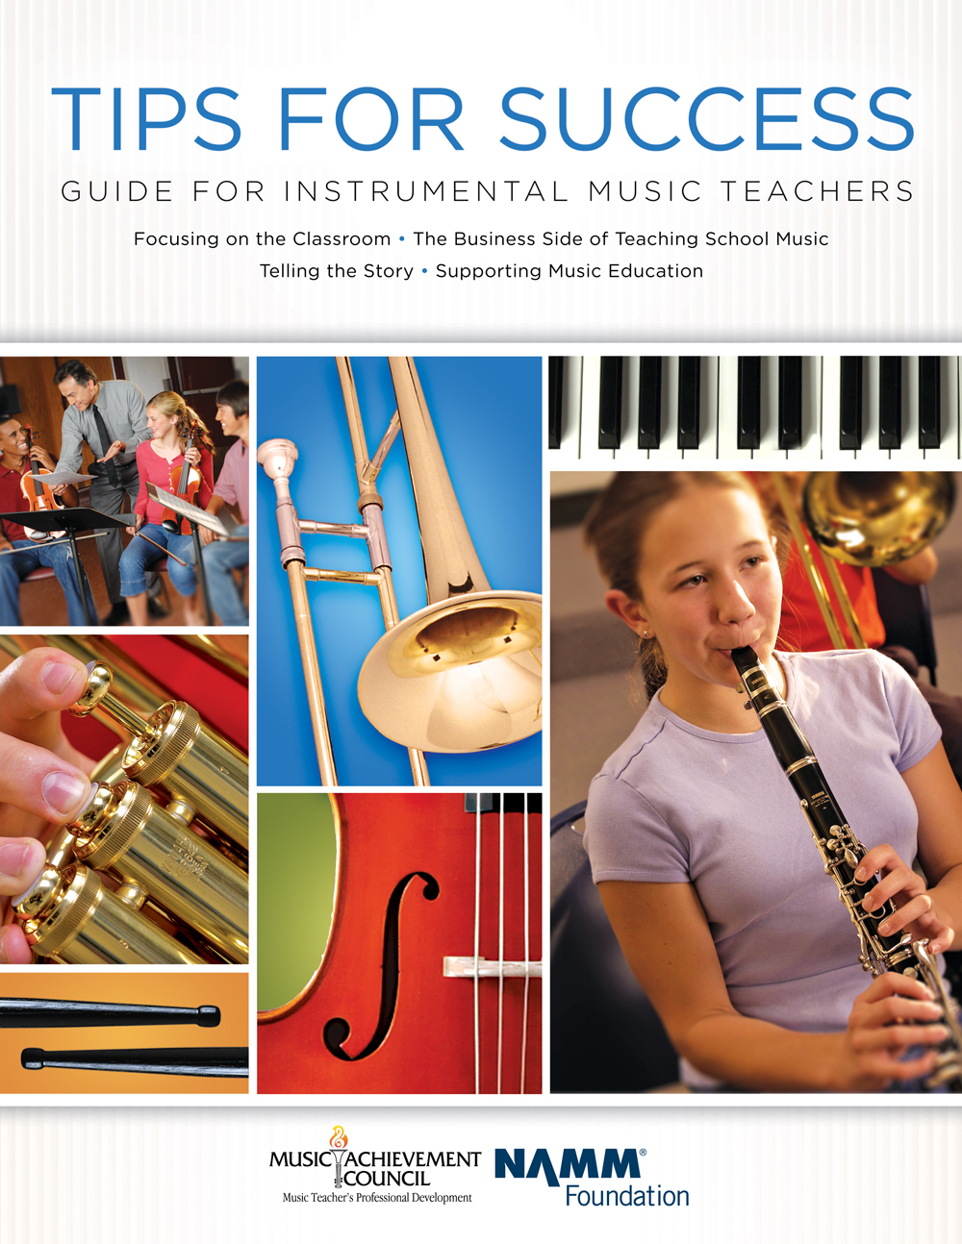
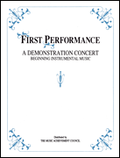
Additional M.A.C. Resources
www.MusicAchievementCouncil.org
Notes:
25

Slide 26









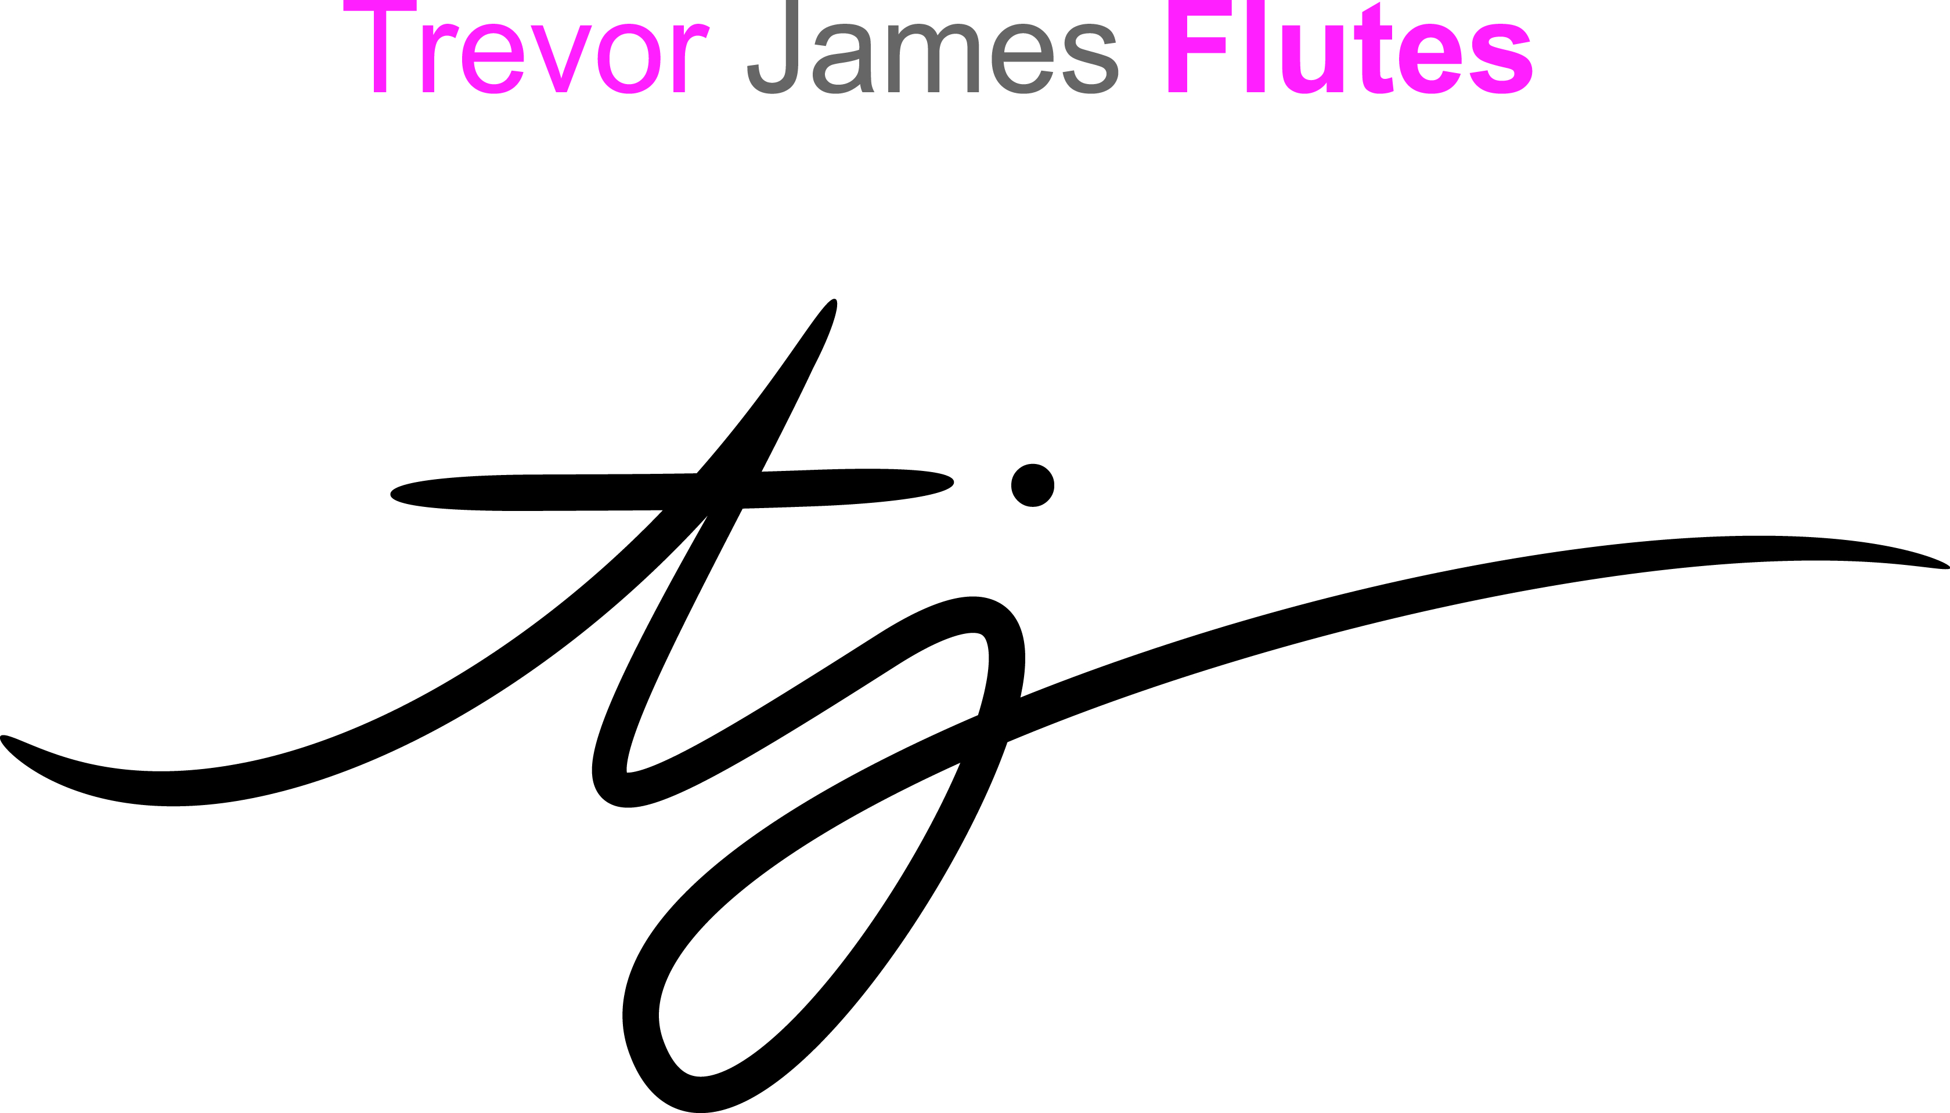


All Materials/Videos are Posted at MusicEdConsultants.net/conference-materials
Thanks to our Sustaining Sponsors!
Notes:
www.musiceducationconsultants.net/mmea2010
26

Slide 27
Contact Information
Marcia Neel marcia@musicedconsultants.net
@MusicEdConsult on Twitter
702.361.3553
Complimentary Recruitment and Retention Materials www.musicachievementcouncil.org

