Slide 1
2019 Mariachi Class
Beginning Tuesday, January 8, 2019
Location: Edison Elementary
Pilot for all 5th grade students in Santa Monica

Slide 2
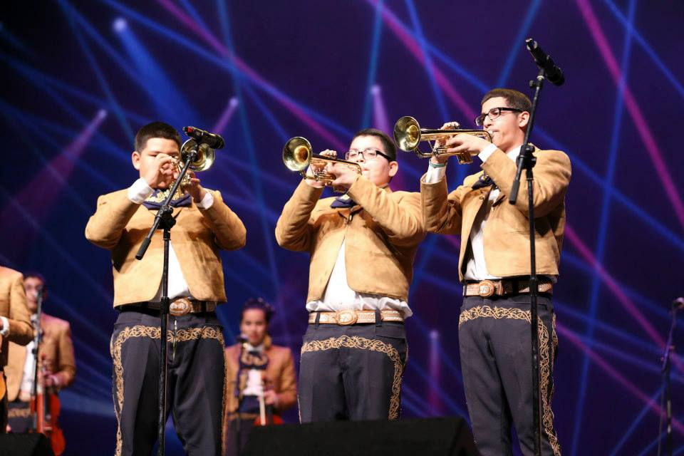
Mariachi 2019
The Why:
SHARED VALUES
Student-Centered:
We make decisions and allocate resources with “students first” in mind.

Slide 3
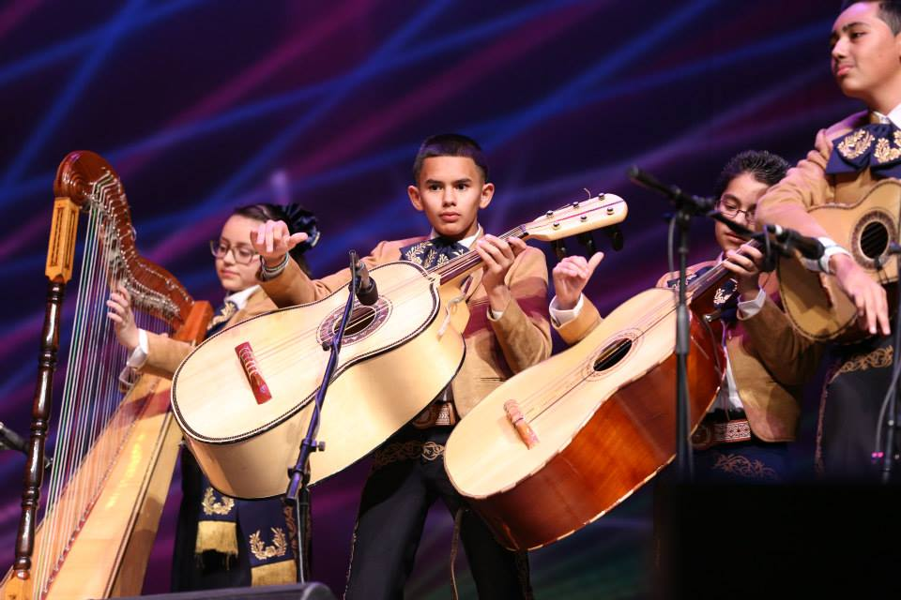
Equity
We meet our students where they are and provide the necessary resources and attention to make all students successful.
Engagement
We engage students in meaningful, rigorous and relevant educational experiences where they are inspired, supported, challenged and motivated.

Slide 4
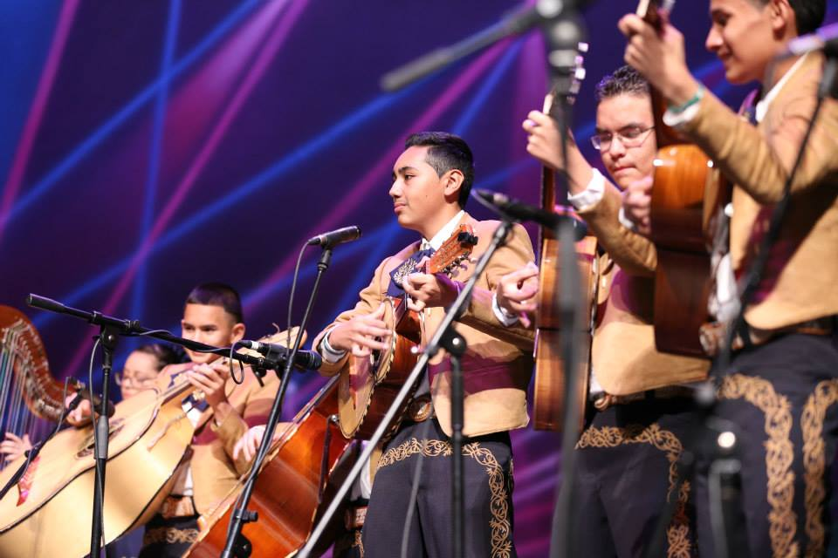
Collaboration
We are stronger when we collaborate, dialogue and listen to each other in a civil, productive way, to improve outcomes for our students.
Diversity
We respect and value our diverse student and staff population as an integral part of our learning community.

Slide 5
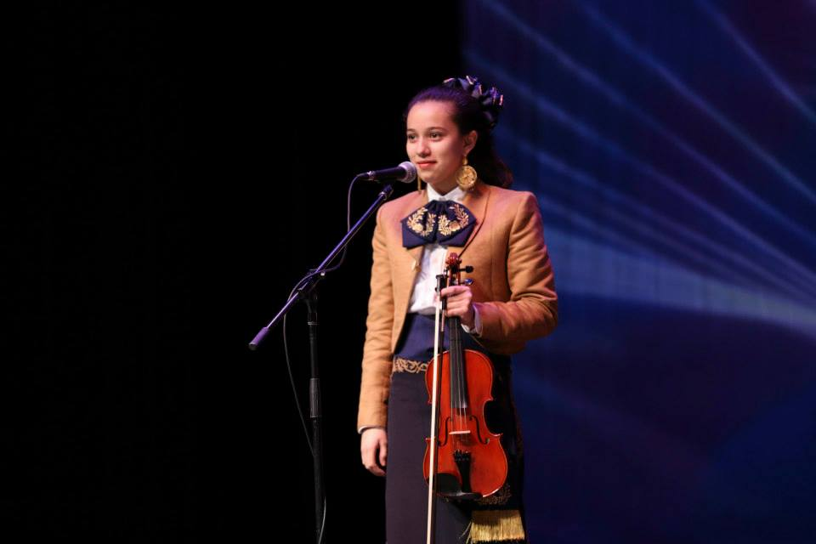
Civility
We work and dialogue with each other in a respectful manner, setting the example for our students of how civil discourse leads to positive outcomes.

Slide 6
Research: Article- “Mariachi and Spanish speaking English learners: District initiatives, models, and education policy”
Marcia MacCagno Neel- Published online: June 15, 2017. Bio: Music Education Consultants, Inc., Las Vegas, Nevada, USA, and Band and Orchestral Division, Yamaha Corporation of America, Buena Park, California, USA
“The impact of participating as an active music-maker in any ensemble by any participant cannot be overlooked, but for Spanish speaking English learners, the standards-based mariachi program provides a culturally familiar and welcoming setting, facilitates new patterns of learning, and addresses the priority of attaining English language proficiency.”
In his opening remarks for the 2014 White House Initiative on Educational Excellence for Hispanics’ National Arts Forum at Pixar Studios, Richard Carranza, former SFUSD superintendent, told more than 150 invited national-level decision makers that, “If you capture their interest, their intellect, commitment, and minds will follow” (White House Initiative on Educational Excellence, 2015).
“Principals also report that this increased activity continues to target the vision of helping parents, families, and the local business and residential community to view the school as more relevant and culturally friendly.”
Notes:
In your packets, I included a research article written by Marcia Neel that supports the “Why” in regard to mariachi music in education. The article includes quotes, data and anecdotes from educators, policy makers and students, but I have included three quotes that stood out for me as to the importance of adding mariachi as an option for students in the district.

Slide 7
History of Mariachi in the SMMUSD
2008
2018
Three year plan written
1st Attempt
2018
2018
Instruments Ordered
1st Teacher PD
Notes:
In 2008, an attempt was made to implement a Mariachi ensemble at Samohi, but after a thorough recruitment process not enough students were willing to sign up for the class and the class was not started as a result.
In 2018, a three year strategic plan for Mariachi to begin at 5th grade in Spring, 2019 and continue thru middle and high school was developed with the support of Music Education Consultants.
Through a generous $22,000 grant from the City of Santa Monica in 2018, five elementary teachers have received training to teach Mariachi using a standardized curriculum and student textbook, ¡Canta, mariachi, canta!
The following instruments and materials have already been purchased: 3 Guitarrons, 3 Vihuelas and 20 guitars/cases with tuners. Texts ordered and received for teachers and students: “Mariachi Music in America” and textbooks for students: “¡Canta, mariachi, canta!”

Slide 8
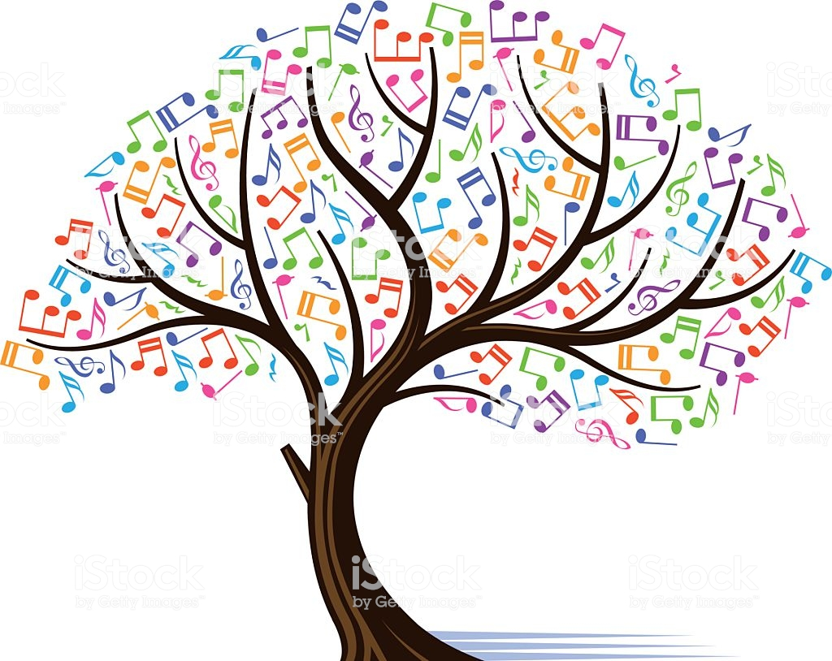

Implementation/Recruitment Timeline
Mariachi Class Begins at JAMS & Edison, 2019
Mariachi PD
2019
First Class
1/8/19
Mariachi Performance
Sign-Up
Link
Notes:
A link for students to sign up for the Mariachi class has been created. All 5th grade students click: https://smapa.formstack.com/forms/mariachi_band
On November 16th, a student mariachi ensemble will perform an assembly during the day for Edison students and will also perform and answer questions in the evening from 7 to 8:30pm for interested students and parents.
On Tuesday, January 8th 3:30-4:30pm, the first elementary mariachi class will beheld at Edison with up to six teachers (5 elementary teachers and one lead mariachi teacher), depending on enrollment.
In the Summer of 2019, SMMUSD middle school teachers will receive mariachi Training/PD through Music Education Consultants.
Fall, 2019, the Introduction to Mariachi class will begin at Edison and the Beginning Mariachi class will begin at John Adams.

Slide 9
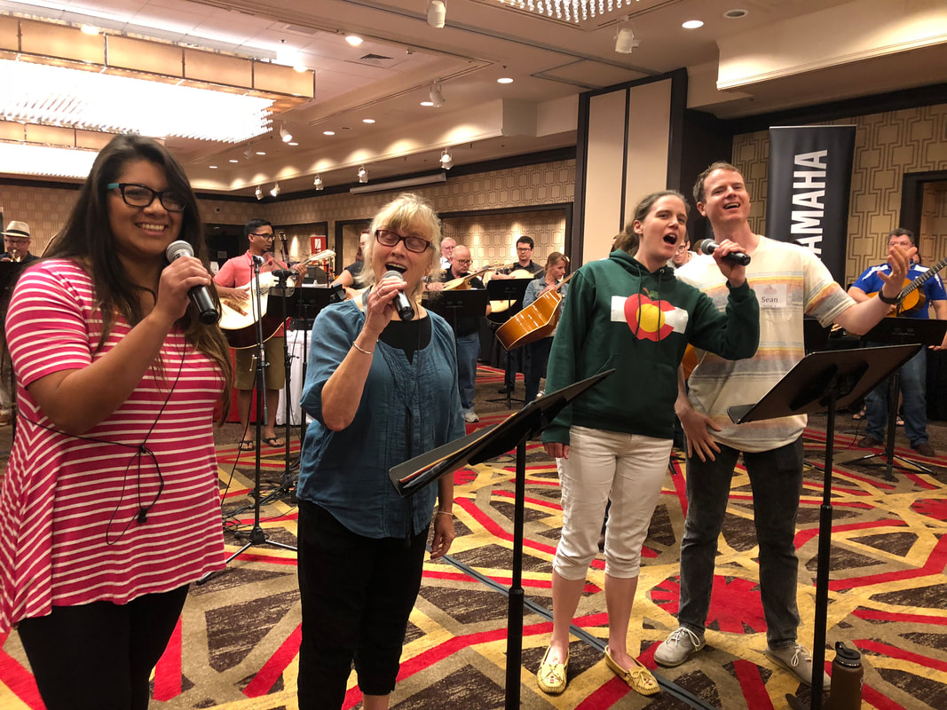
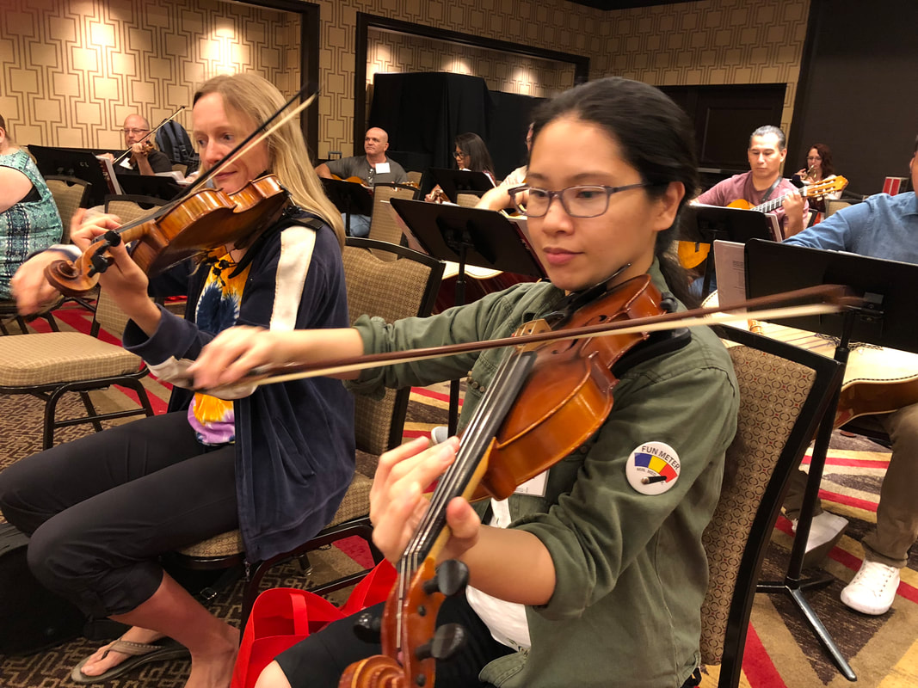

In July 2018, five SMMUSD elementary music teachers received a week of rigorous training in Las Vegas from Music Education Consultants.

Slide 10
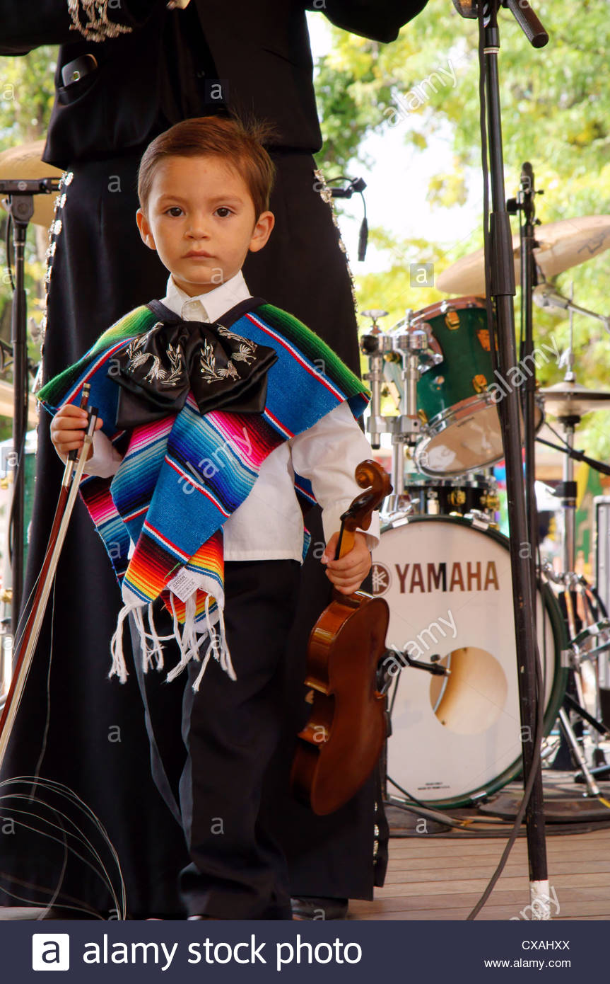
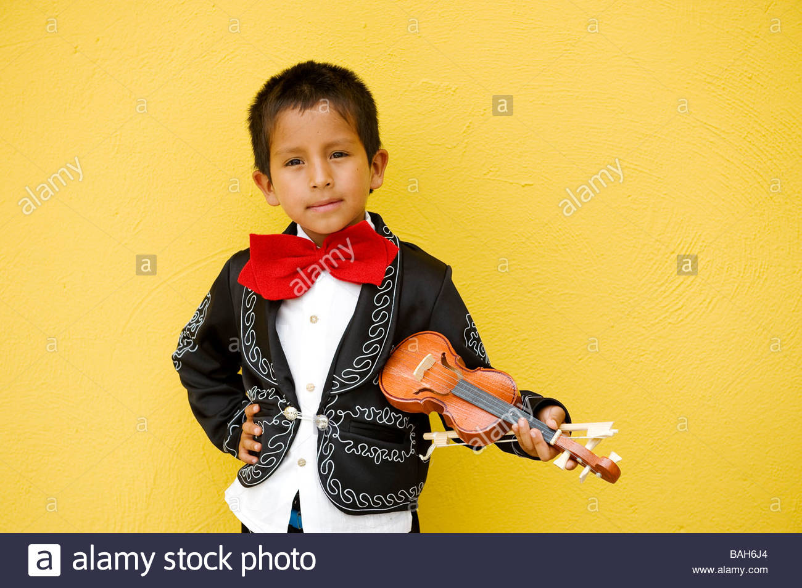
MARIACHI PROGRAM COURSE SCOPES AND GOALS
INTRODUCTION TO MARIACHI (Edison- Classes begin Tuesday, January 8, 2019 from 3:30-4:30pm)
Notes:
This elementary course (after school) is designed as a study in music fundamentals, with each student given the opportunity to learn and participate through singing, listening, reading, notating, and creating while playing the guitar, vihuela and guitarron. Emphasis has been placed on providing meaningful introductory music- making experiences representative of the mariachi genre.

Slide 11
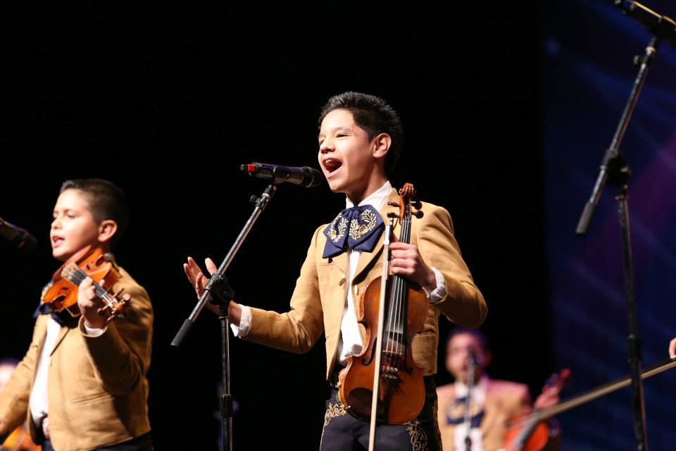
BEGINNING MARIACHI (John Adams Middle School- Fall, September 2019)
Notes:
This middle school one-year course (after school) is designed for the student who is interested in learning to play a mariachi instrument including violin, trumpet, guitar, vihuela and guitarron. It includes the development of skills necessary to become independent as a musician. This course concentrates on the development of note-reading skills, aural skills, singing skills, rhythmic patterns, intonation, and tonality inherent to the mariachi genre. A progression of fundamental and technical proficiency is expected.

Slide 12
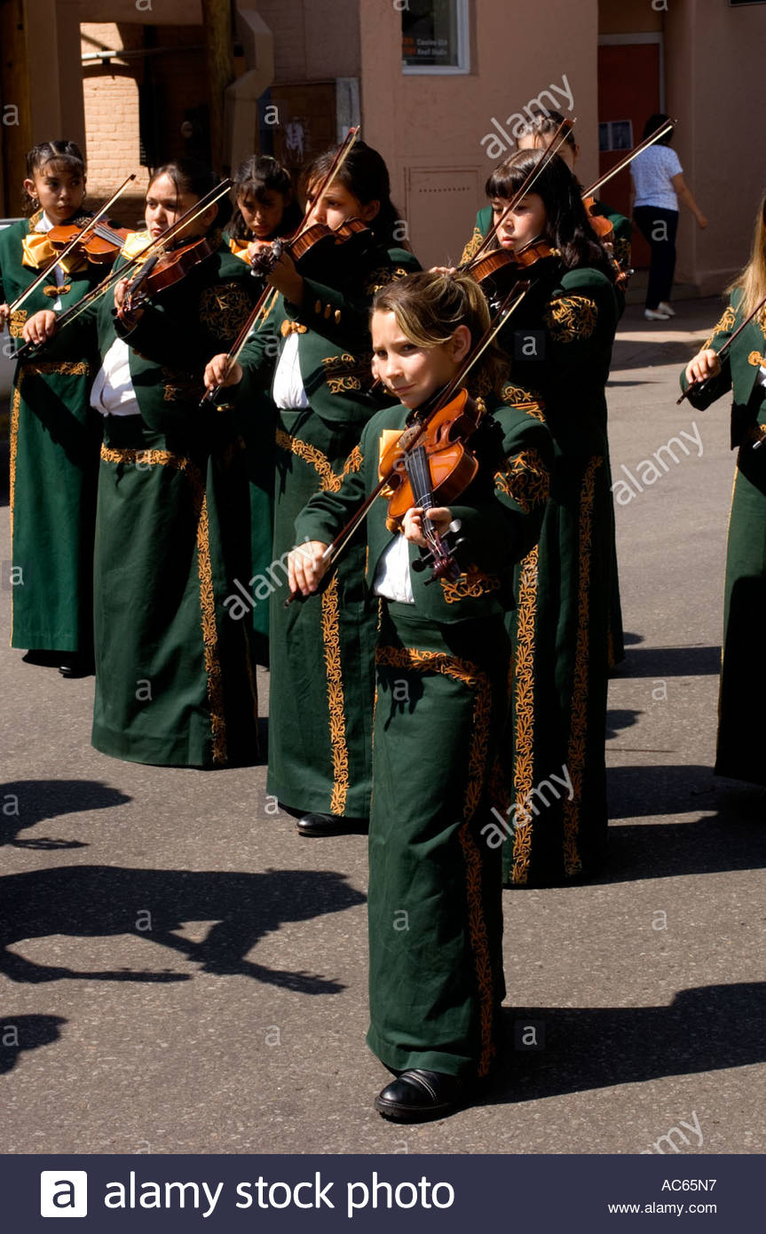
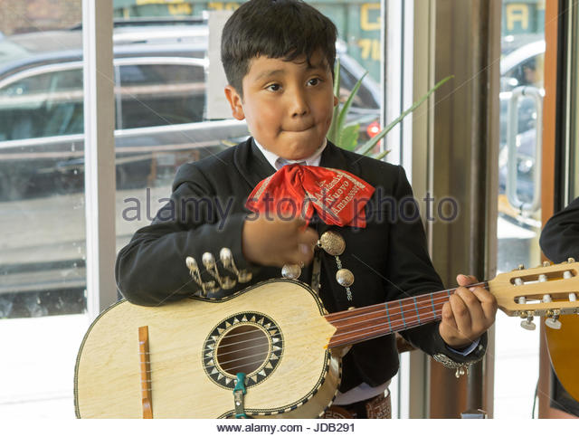
ARMONIA (John Adams Middle School- September, 2019)
Notes:
This middle school one-year course is designed for students with no previous mariachi guitar, vihuela or guitarron experience. Students will be able to demonstrate a variety of the basic mariachi styles, vocal and instrumental techniques and basic note-reading skills required to become a successful mariachi musician. Areas of concentration include correct posture, aural skills, intonation, flat picking, rhythmic patterns, chord study, melody construction, tonality inherent to mariachi music, musical forms, tablature notation, improvisation and performing.

Slide 13
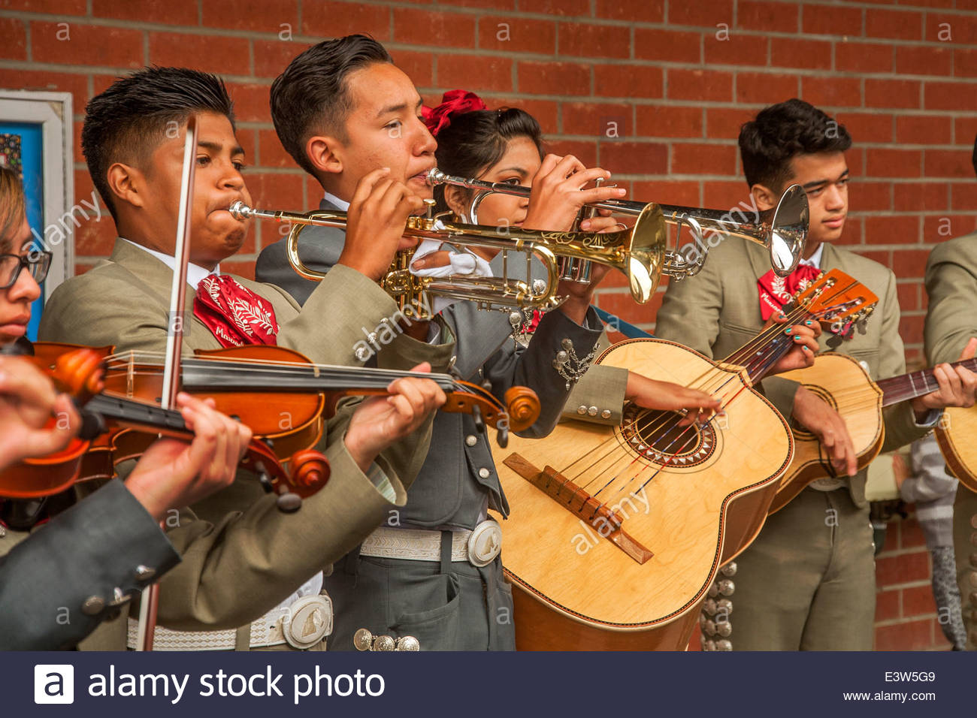
MELODIA (John Adams Middle School- September, 2019)
Notes:
This one-year beginning level course is designed for students playing violin or trumpet. Students will be able to demonstrate a variety of the basic mariachi styles, vocal and instrumental techniques and basic note-reading skills required to become a successful mariachi musician. Areas of concentration include correct posture, aural skills, intonation, rhythmic patterns, melody construction, tonality inherent to mariachi music, musical forms, improvisation and limited performing experience.

Slide 14
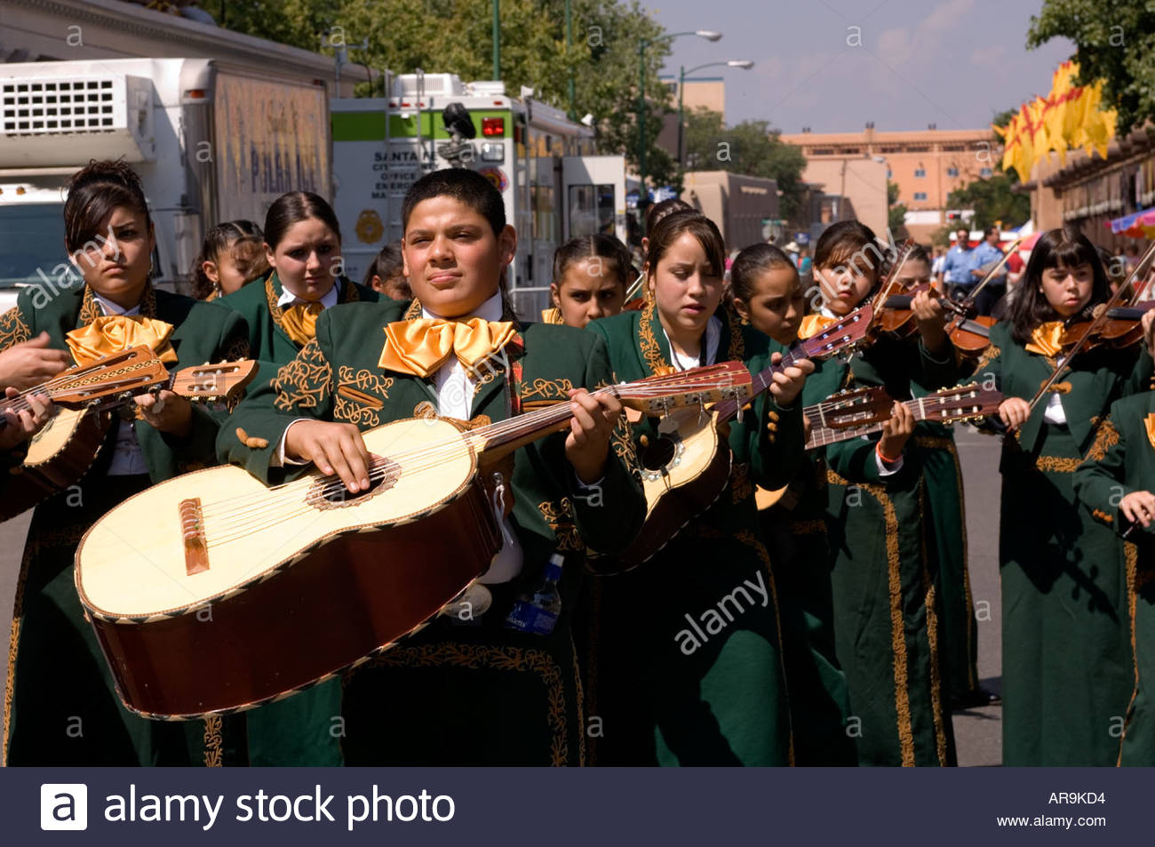
MARIACHI ENSEMBLE I
(John Adams Middle School- September, 2020)
Notes:
This one-year course is designed for the purpose of allowing students to play in an ensemble which specializes in beginning level Mariachi ensemble literature.

Slide 15
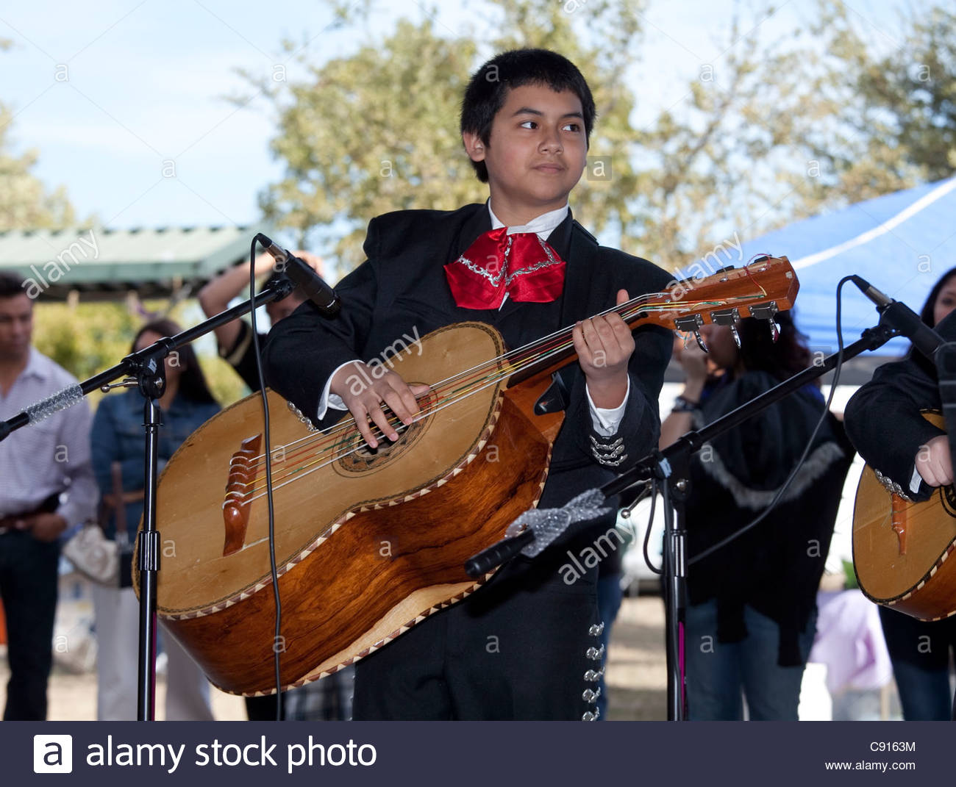
MARIACHI ENSEMBLE II
(John Adams Middle School- September, 2021)
Notes:
This one-year course is designed for the purpose of allowing students to perform in an ensemble which has a selected membership and which specializes in performing more complex level Mariachi ensemble literature implementing playing techniques beyond what is provided in the Mariachi Ensemble I Course. A variety of performing experiences will be provided.

Slide 16
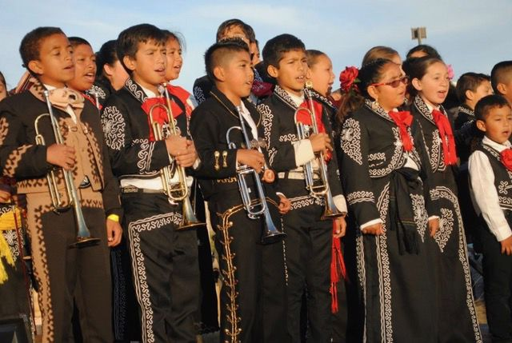
MARIACHI ENSEMBLE III
(John Adams Middle School- September, 2022)
Notes:
This one-year course is designed for the purpose of allowing students to perform in an ensemble which has a selected membership and which specializes in performing advanced mariachi ensemble literature implementing advanced playing techniques beyond what is provided in the Mariachi Ensemble II Course.

Slide 17
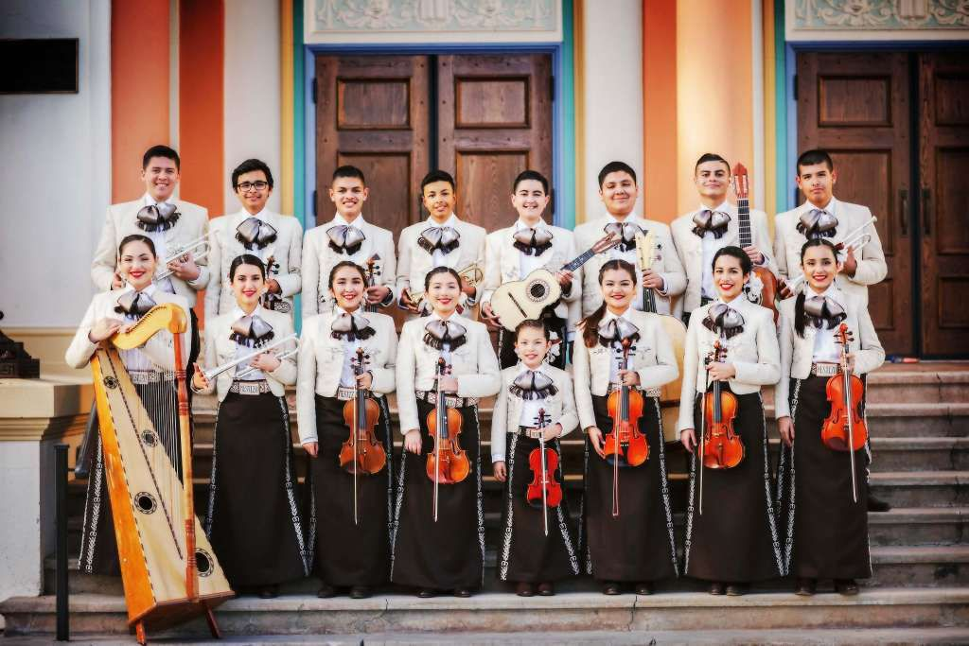
Samohi Mariachi
2023- MARIACHI ENSEMBLE I
2024- MARIACHI ENSEMBLE II
2025- MARIACHI ENSEMBLE III

