Slide 1
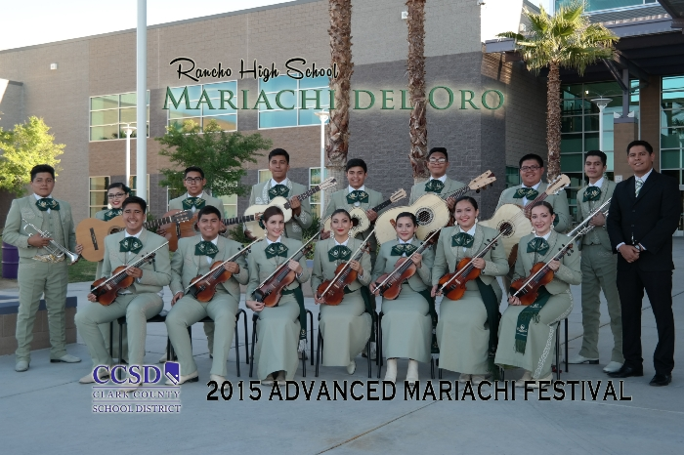
Broadening Your Base: From Zero to Mariachi
Robert Lopez
Clark County School District, Las Vegas, NV

Slide 2
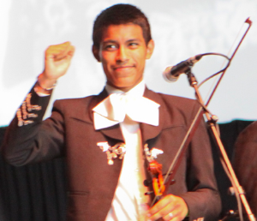
Why Mariachi?
Benefits of a School Mariachi Program
Involves More Students in Music
Provides an entry-level music
experience at anytime
Helps keep students in school
Increases student self-esteem and
  self-confidence
Provides an effective bridge to parental involvement
Celebrates/Recognizes this specific culture and heritage
It’s FUN!!!!!

Slide 3
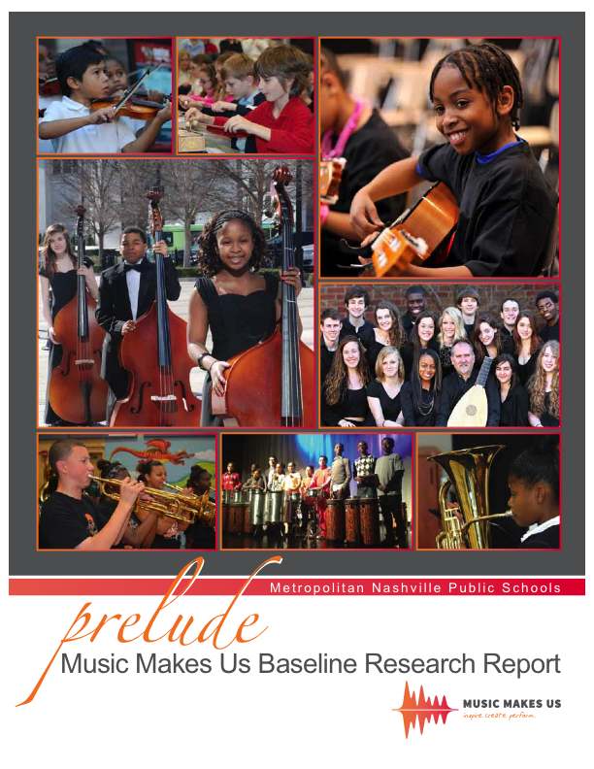

Slide 4
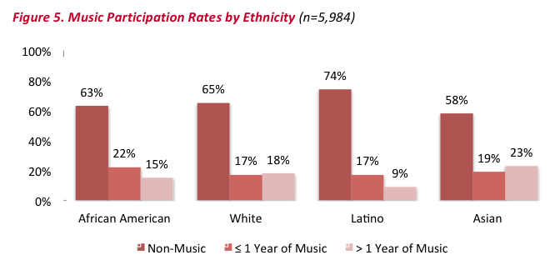
Music Participation Rates by Ethnicity
Music Makes Us Baseline Research Report

Slide 5
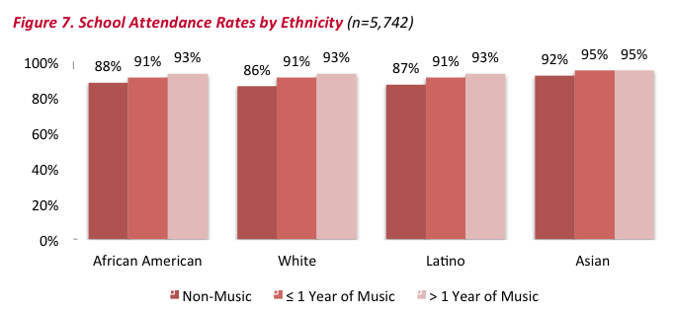
School Attendance Rates by Ethnicity
Music Makes Us Baseline Research Report

Slide 6
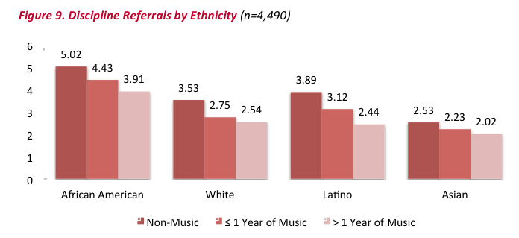
Discipline Referrals by Ethnicity
Music Makes Us Baseline Research Report

Slide 7
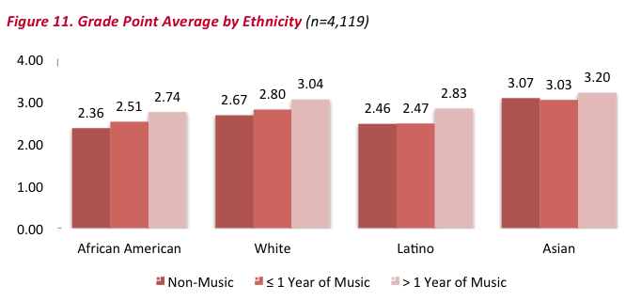
GPA by Ethnicity
Music Makes Us Baseline Research Report

Slide 8
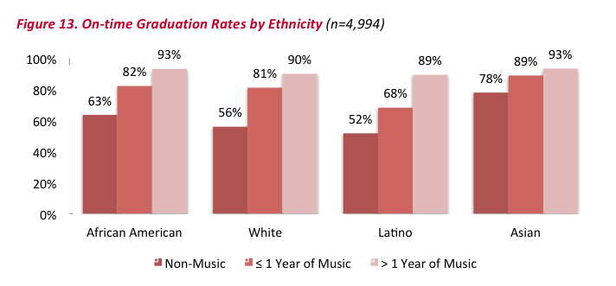
On-time Graduation Rates by Ethnicity
Music Makes Us Baseline Research Report

Slide 9
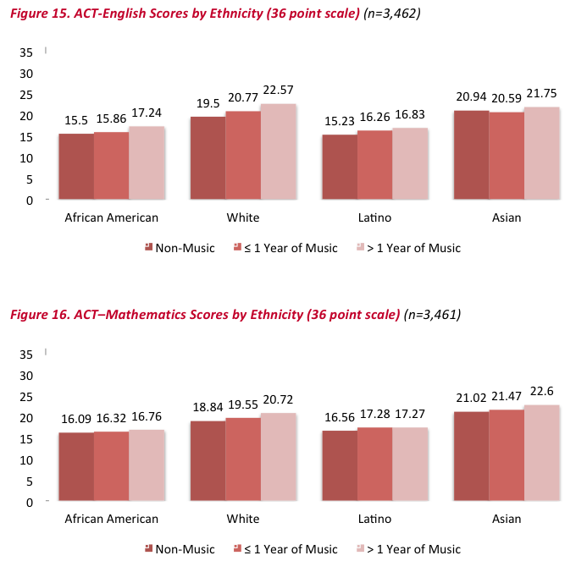
ACT Scores (English) by Ethnicity
ACT Scores (Math) by Ethnicity

Slide 10
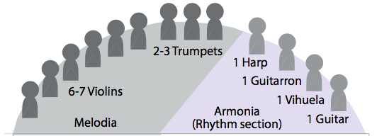
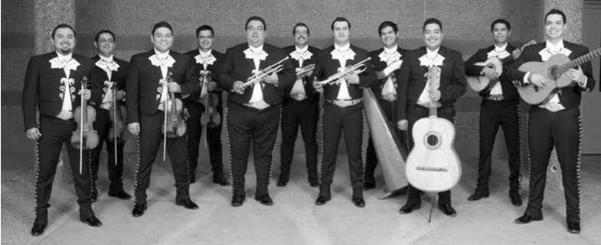
The Mariachi Ensemble
Use Photo of Sol de Mexico

Slide 11
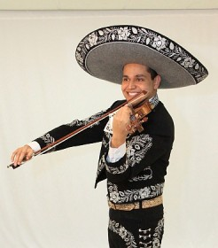
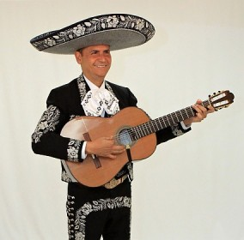
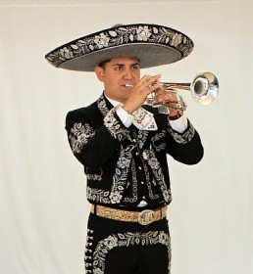
Instrumentation
Traditional Instruments
Erick Hernandez
Violin
Jesus (Chuy) Hernandez
Guitarra
Jorge Contreras
Trompeta
Notes:
11

Slide 12
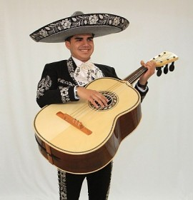
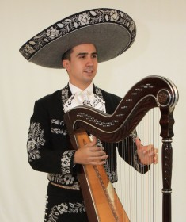
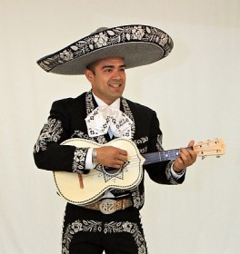
Instrumentation
Characteristic Instruments
Jorge Flores
Guitarron
Guillermo Acuna
Arpa
Antonio Zúñiga
Vihuela
Notes:
12

Slide 13
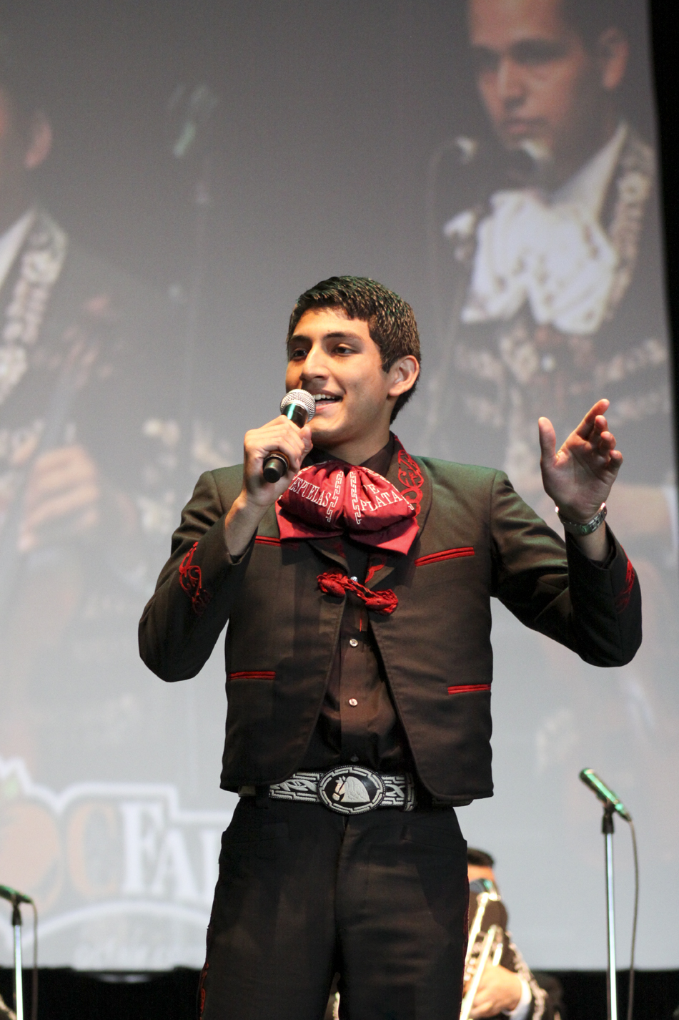
Some New Terms
1. Melodia
Violin, Trumpet
Voice
2. Armonia:
The Rhythm Section
Guitar, Vihuela
Guitarron, Arpa
3. Mánico
Strumming Pattern
Notes:
13

Slide 14
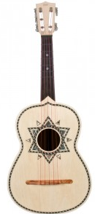

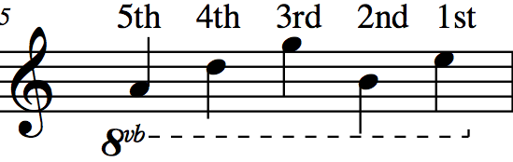
Characteristic Instruments: The Vihuela
A
D
G
B
E
5
4
3
2
1

Slide 15
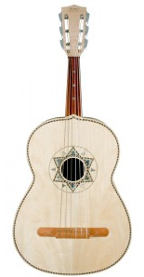
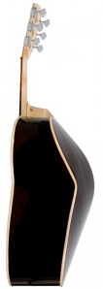
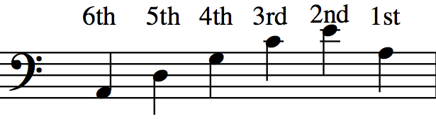
Characteristic Instruments: The Guitarron
A
D
G
C
E
A
T
6
5
4
3
2
1
Written Range: Sounds Octave Lower

Slide 16
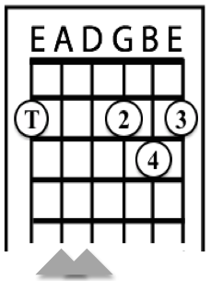
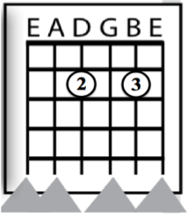
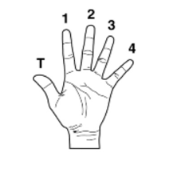
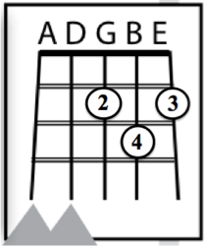
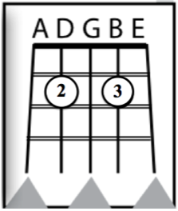
Today’s Chords: D Major, A7
Key of “Re”
Primera
Segunda
D Major
A7
*Use thumb if hand is
large enough. If not, do
not play E String.
*
Guitarra
Vihuela

Slide 17
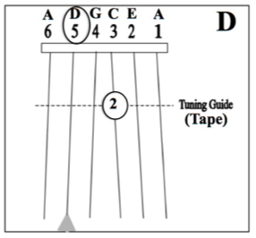
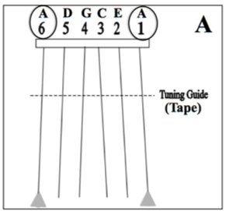
Guitarron Notes: D, A
Key of “Re”
Tape: One Whole
Step from Nut

Slide 18
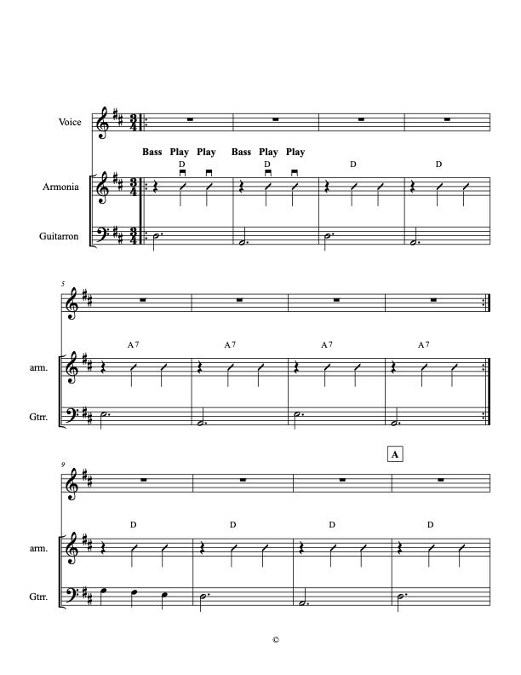
Ranchera Valseada Style
3/4 Time Signature Mánico: Down Strums
Mostly Major Keys Golpe Strum
HINT: Have students speak text in rhythm before playing.

Slide 19
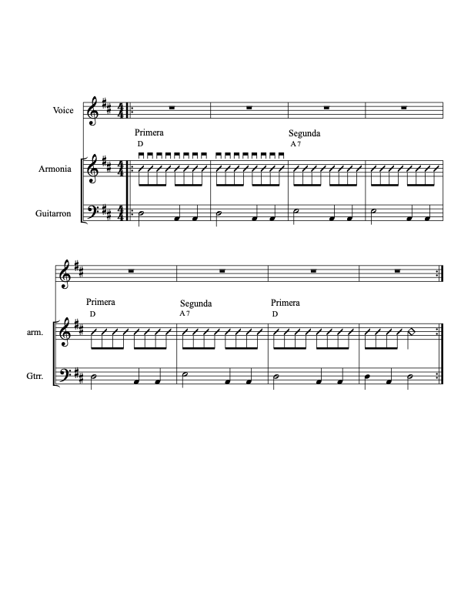
Bolero Style
Mánico: Note Down Strums Common Time
Note Guitarron Rhythm Mostly Major Keys
Notes:
19

Slide 20
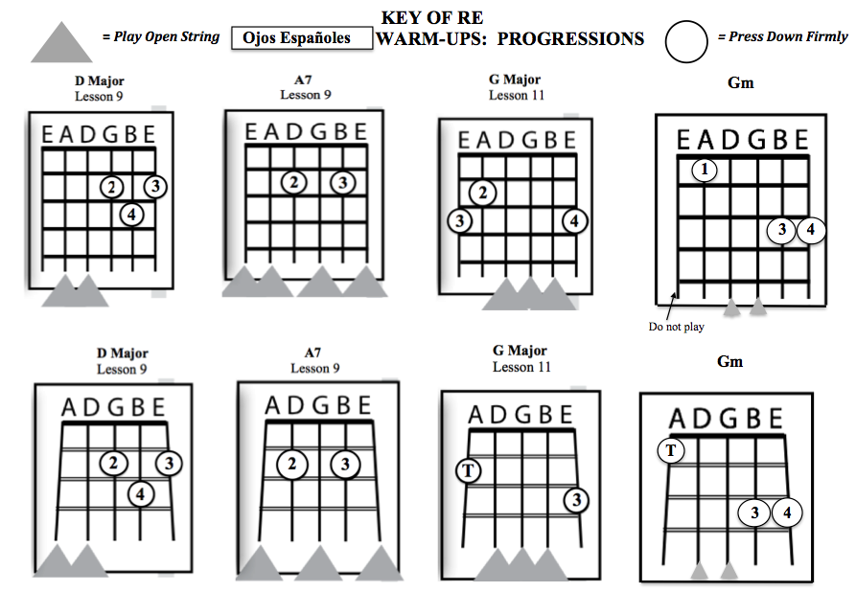

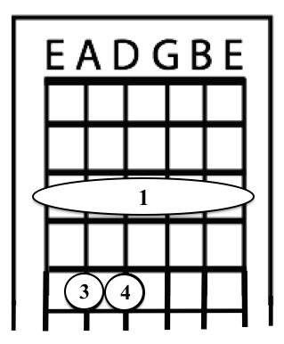
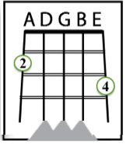
Ojos Españoles
(Spanish Eyes)
Gm
New Chord
New Chord
Notes:
20

Slide 21
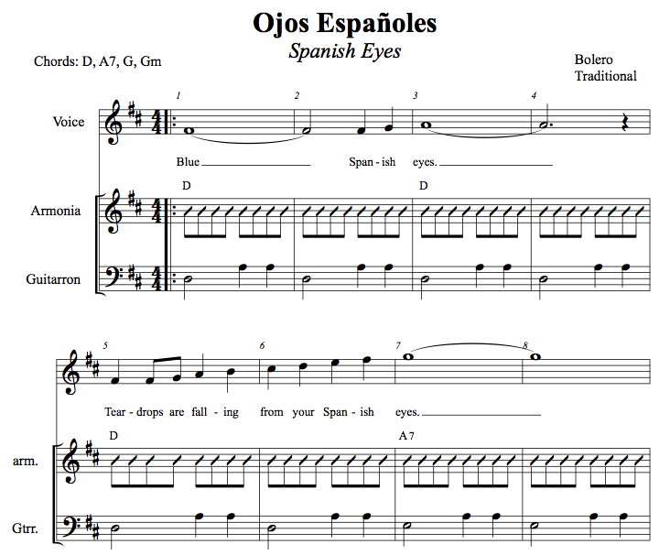
21
Notes:
21

Slide 22
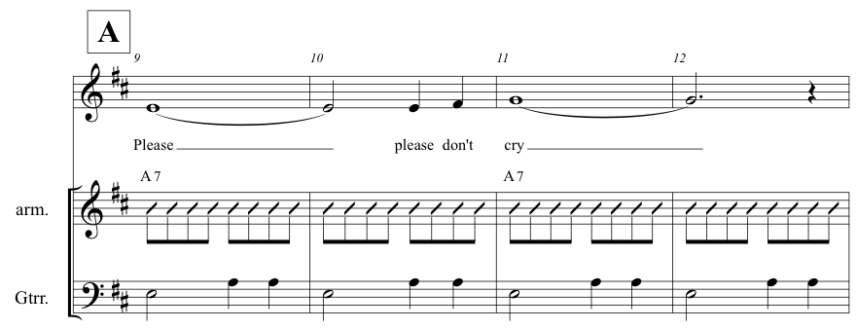
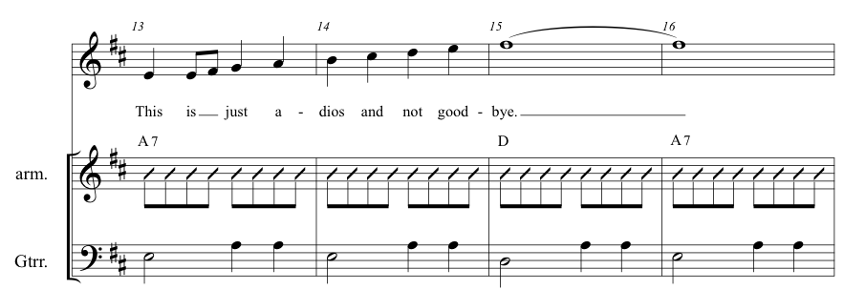
Notes:
22

Slide 23
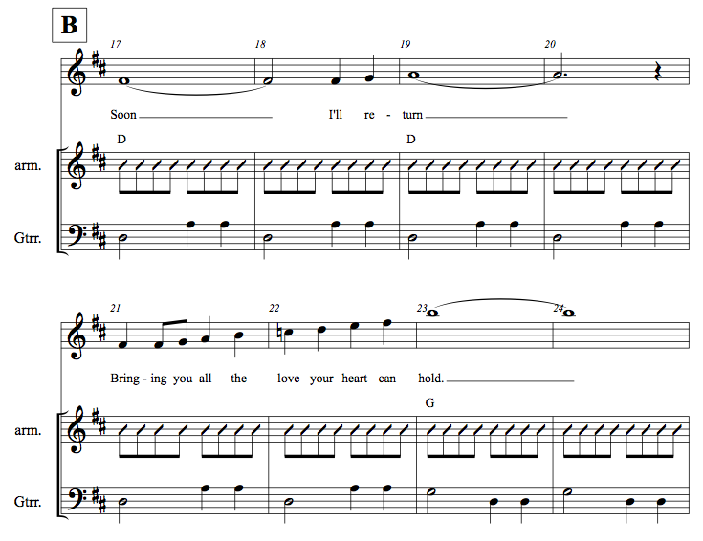
Gm Coming Up
23
Notes:
23

Slide 24
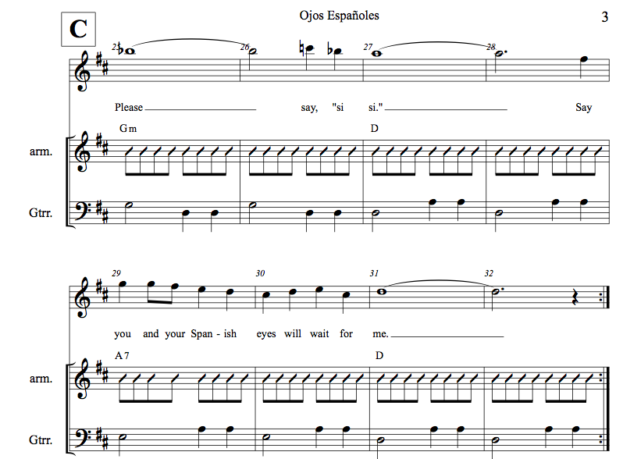
Skip Repeats
24
Notes:
24

Slide 25
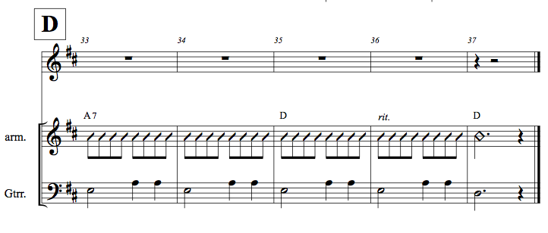

Slide 26
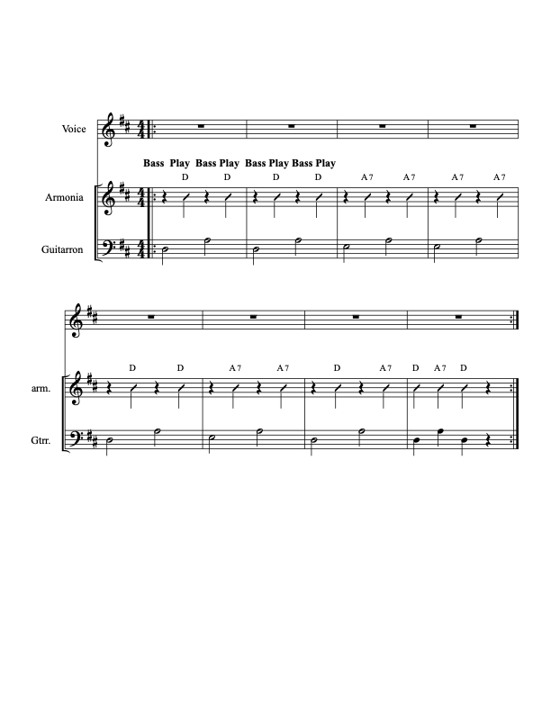
Ranchera Lenta (Romantica) Style
Mánico: Note Down Strums
Note Guitarron Rhythm
4/4 Time Signature
Mostly Major Keys
Articulation
HINT: Have students speak text in rhythm.

Slide 27
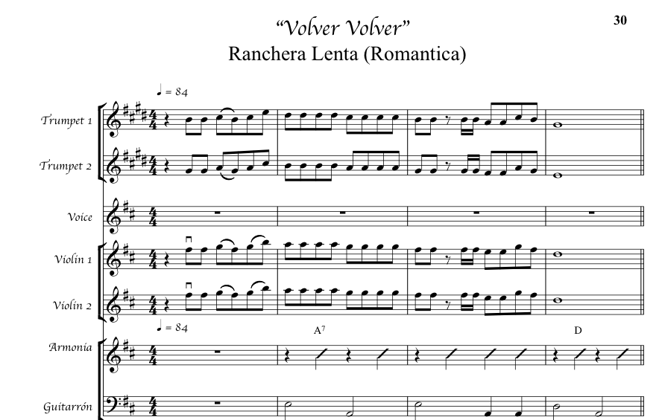
Volver, Volver
Mánico: Note Down Strums
Note Guitarron Rhythm
4/4 Time Signature
Mostly Major Keys

Slide 28
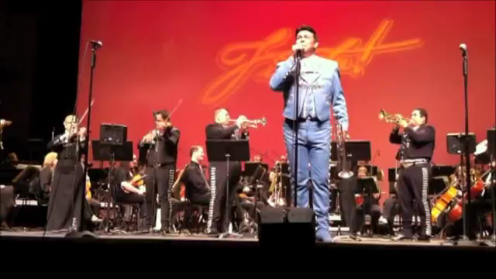
Having Fun with: Volver, Volver
Mariachi Sonido de Las Vegas featuring
Maestro Jose Hernandez

Slide 29
What is the Son?

Slide 30
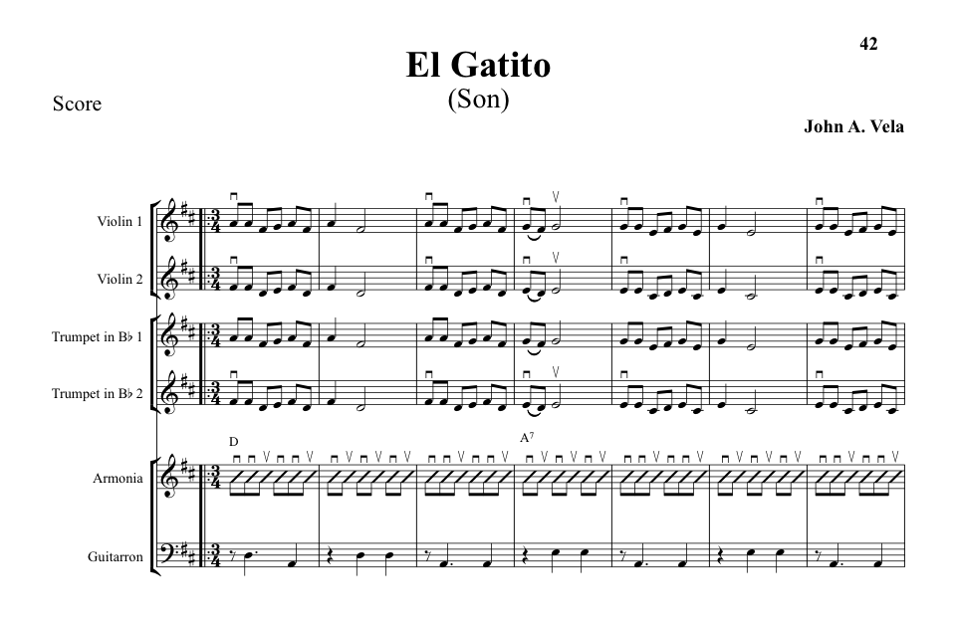
Simplified Son Style

Slide 31
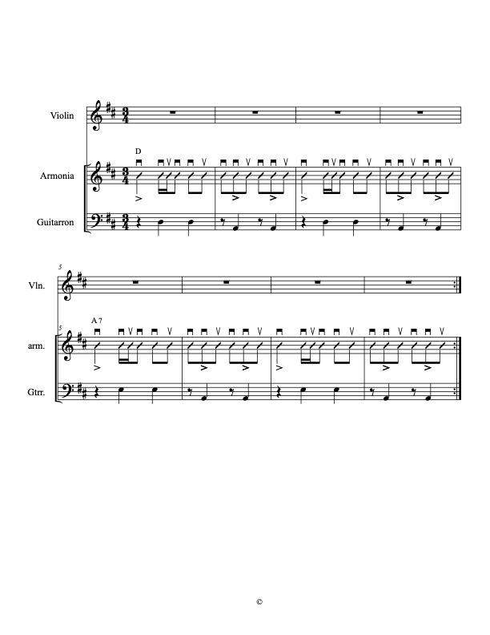
The Son
Perhaps the most Traditional Song Style in Mariachi Genre
Mánico: Alternating 3/4 -6/8 Feel

Slide 32
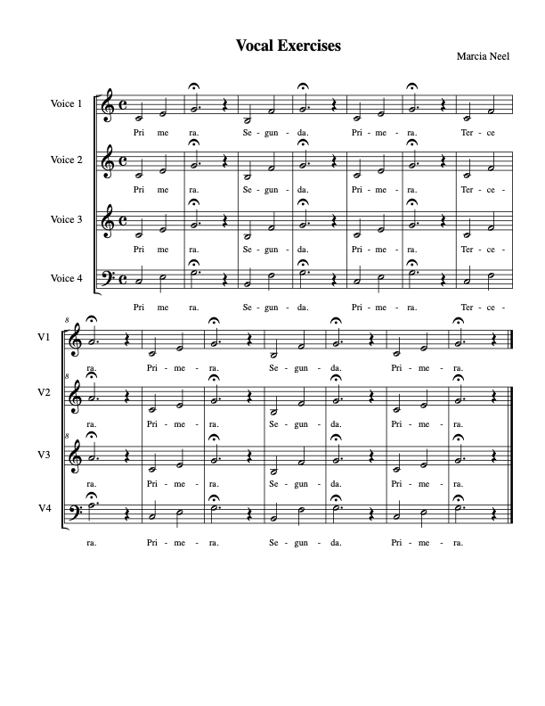

Slide 33
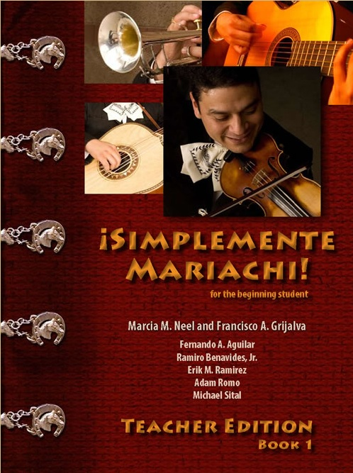
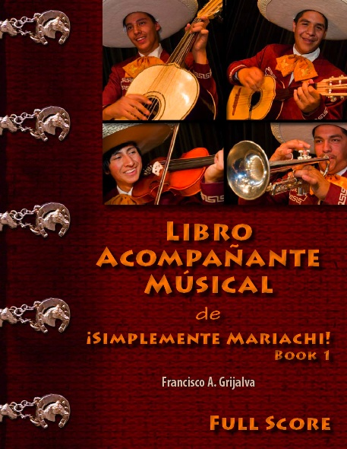
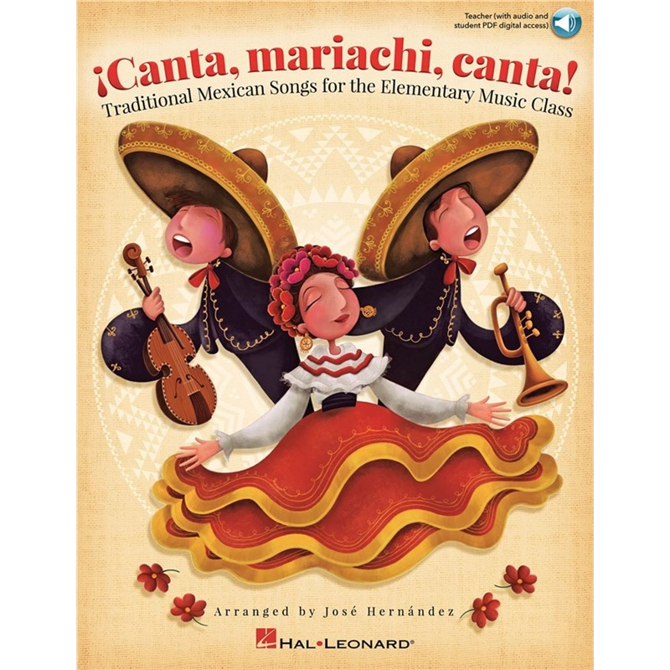
Must-have Standards-based Materials for Beginning Level Program
Method Series Song Book Elementary Book
Has Orff parts.
Accompaniment can be
played on piano.

Slide 34


More References for Beginning Level Programs
Must-have Materials

Slide 35





Released from
Hal Leonard!
Arranged by
Jose Hernandez

Slide 36


Slide 37


Slide 38

The Fabulous Golden Nugget
Hotel and Casino Las Vegas
National Mariachi Workshops
for Educators®
3 Grad Credits Available
July 6-10, 2020
www.musicedconsultants.net/
2020-mariachi-workshops

Slide 39



Instrument Options
KNOW YOUR VENDOR!!!
You Get What You Pay For!
ALWAYS Buy from a Reputable Dealer!

Slide 40



Uniform Options
White Shirt and Black Pant with Basic Moño
Traje de Gala
(Full Mariachi Suit)
Decorative Jacket
with pant/skirt
and coordinating Moño.
Vaquero Uniform
(Ranch/Cowboy)
Decorative pant/skirt
and shirt with
Coordinating Moño

Slide 41

Bailey MS Mariachi
Year 2 of Program

Slide 42

MUCHAS GRACIAS!!!
Posted Online at:
www.musicedconsultants.net/conference-materials

