Slide 1




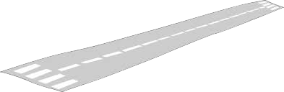


Slide 2
What is a FPNDoC?
NASMD 2018
Marcia Neel
George Quinlan, Jr.

Slide 3
FPNDoC is. . .
A specific day set aside
to recognize and celebrate the achievements of
Beginning Instrumental Music Students
The 3rd Thursday of November

Slide 4
Goals. . .
To reduce beginner dropout rate
To provide short-range incentive goals
To encourage communication with parents
To further strengthen administrative support
To celebrate the musical accomplishments of the beginning students.

Slide 5
How?
Through the presentation of a
TURN-KEY demonstration concert that
showcases the musical skills of the beginners for the very first time
in a public setting.

Slide 6
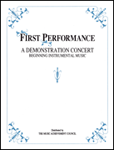

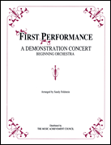
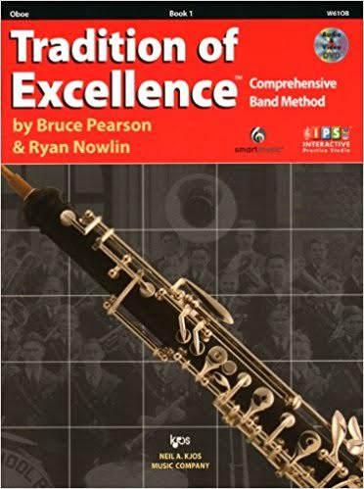
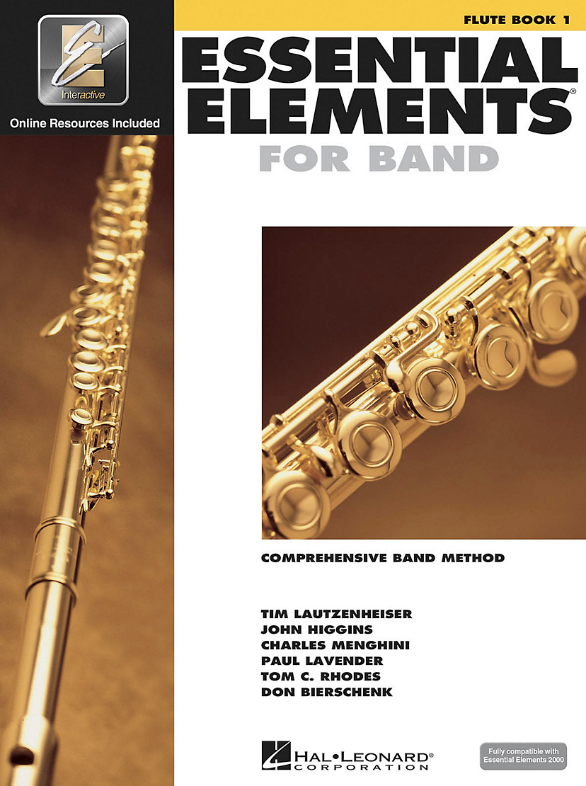
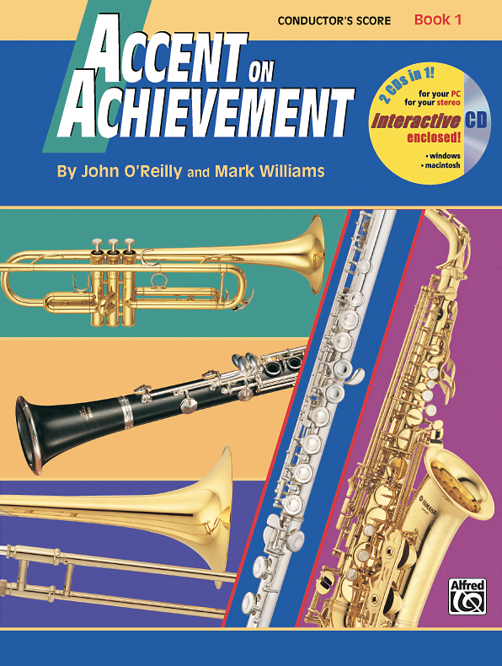
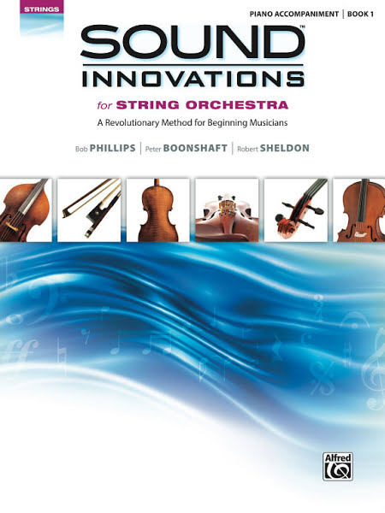

Slide 7
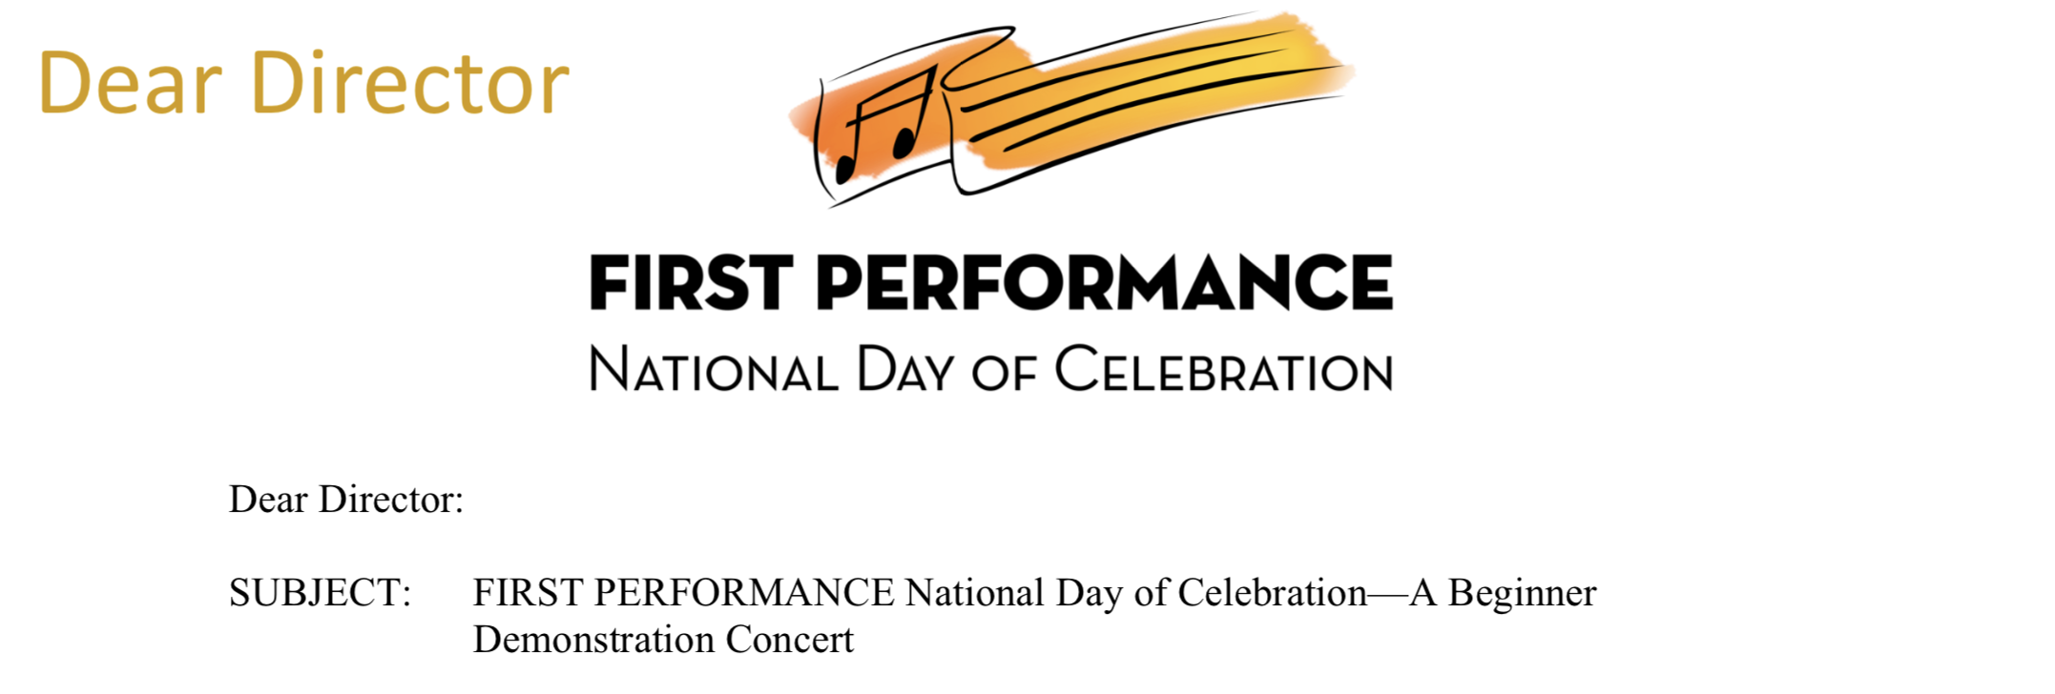
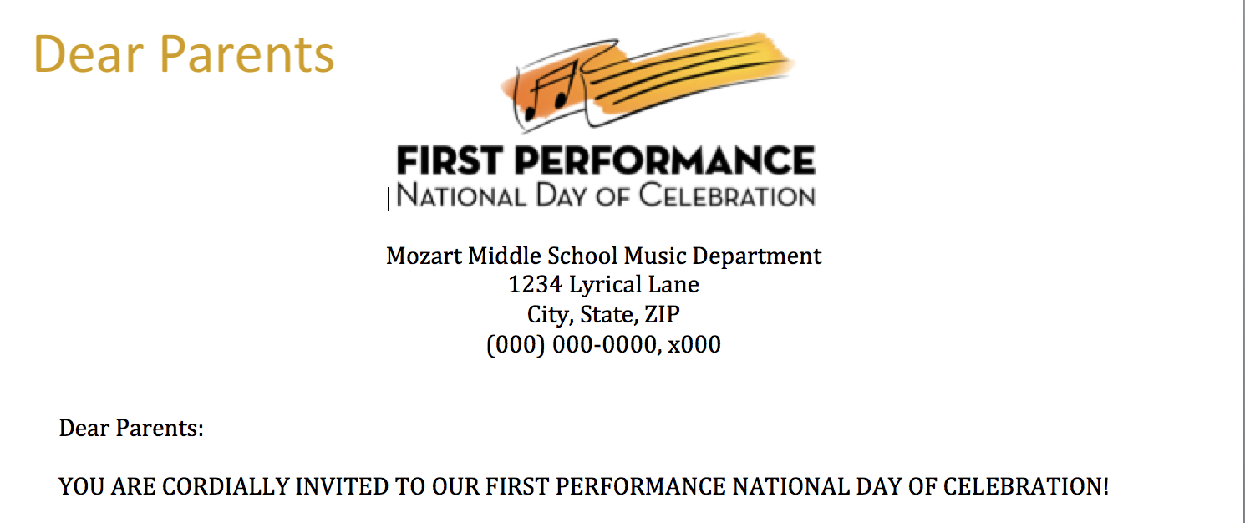
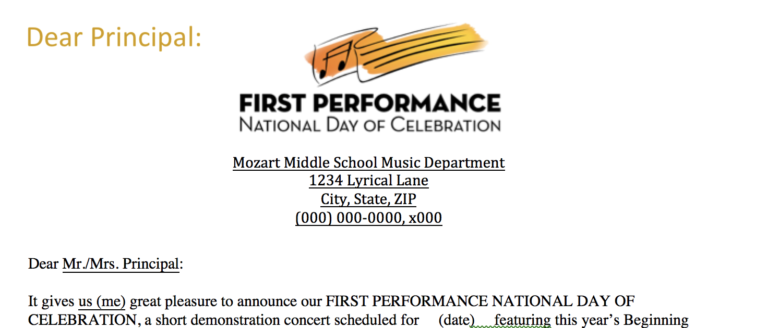
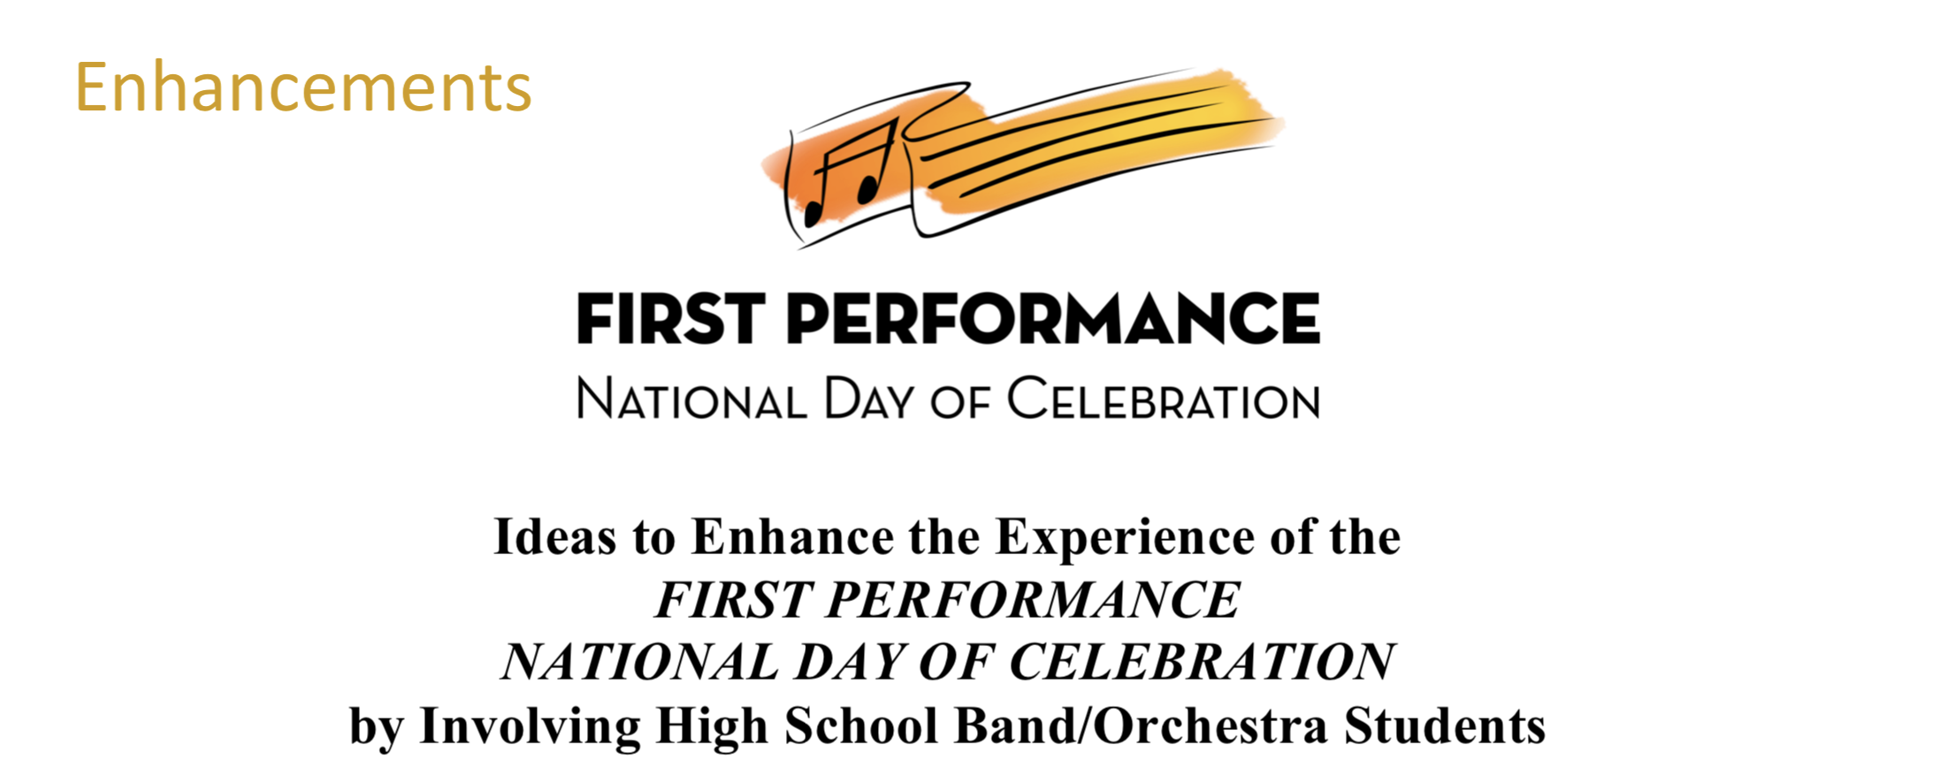
What’s Included?

Slide 8

What’s Included?
Script Template or use it to GET CREATIVE
and Make It Their Own

Slide 9
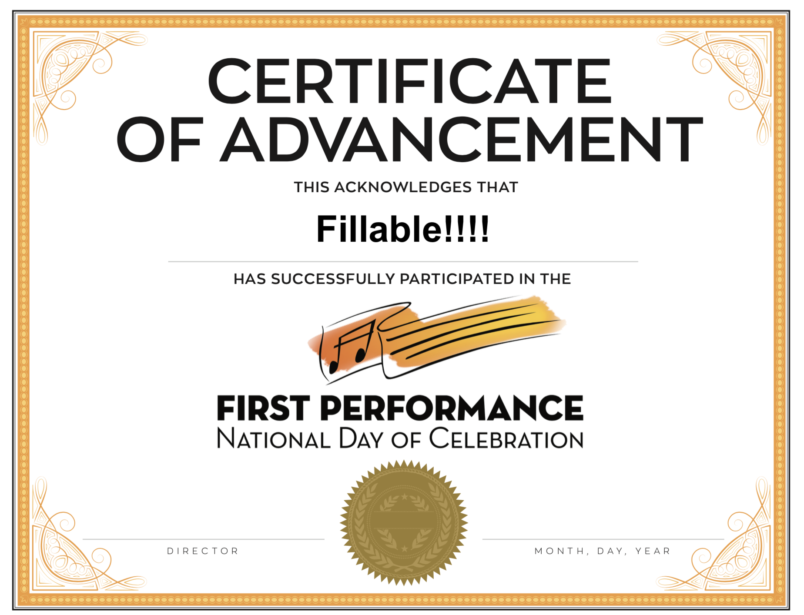

Slide 10
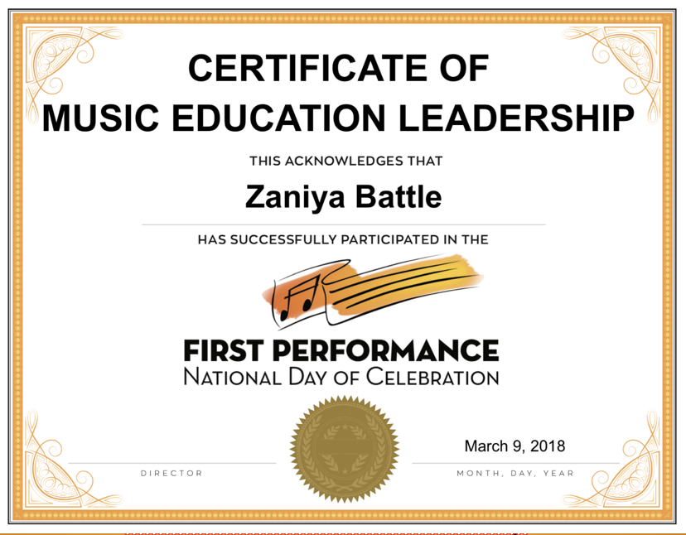

Slide 11

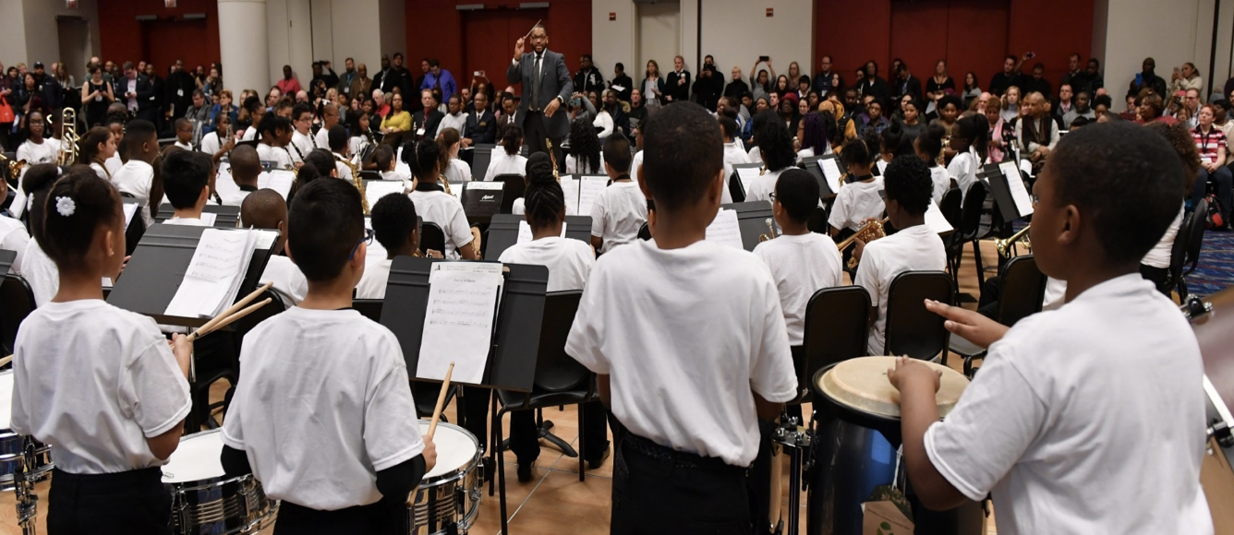
2017
Session

Slide 12
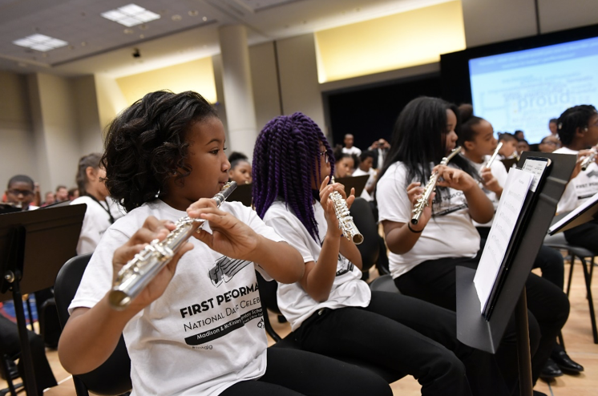
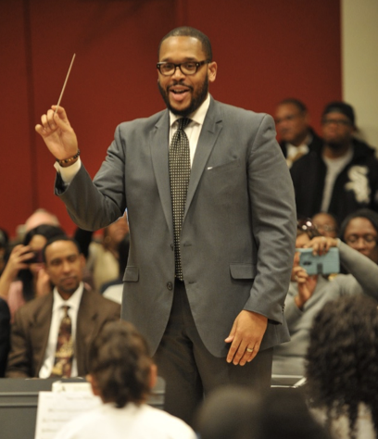
2017
Session

Slide 13
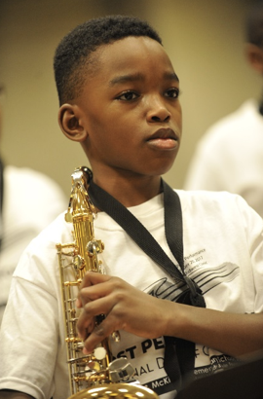
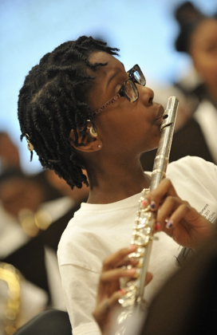
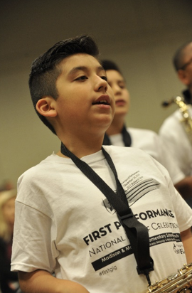
2017
Session

Slide 14

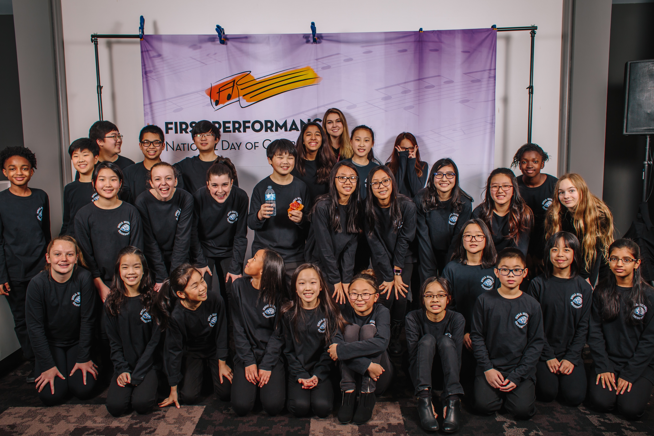
2018
Session

Slide 15
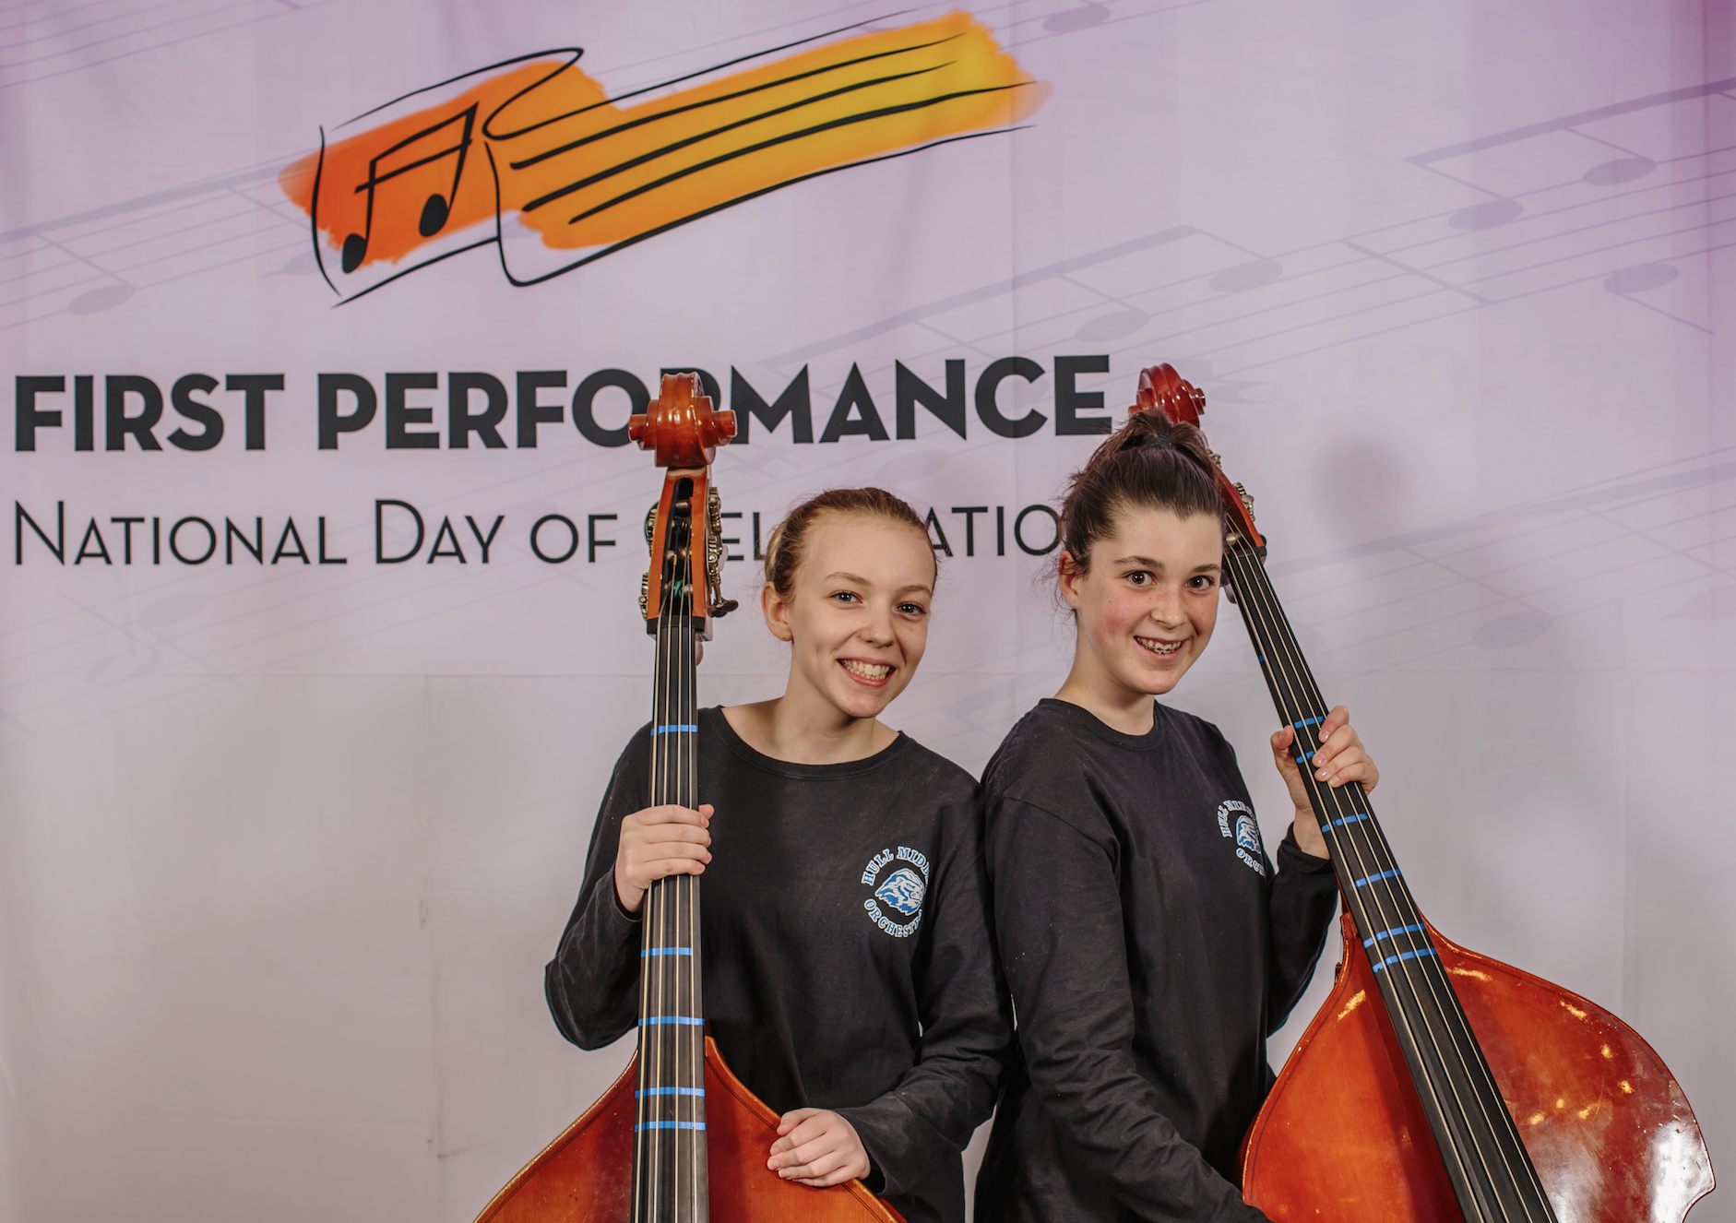
2018
Session

Slide 16

2018
Session

Slide 17
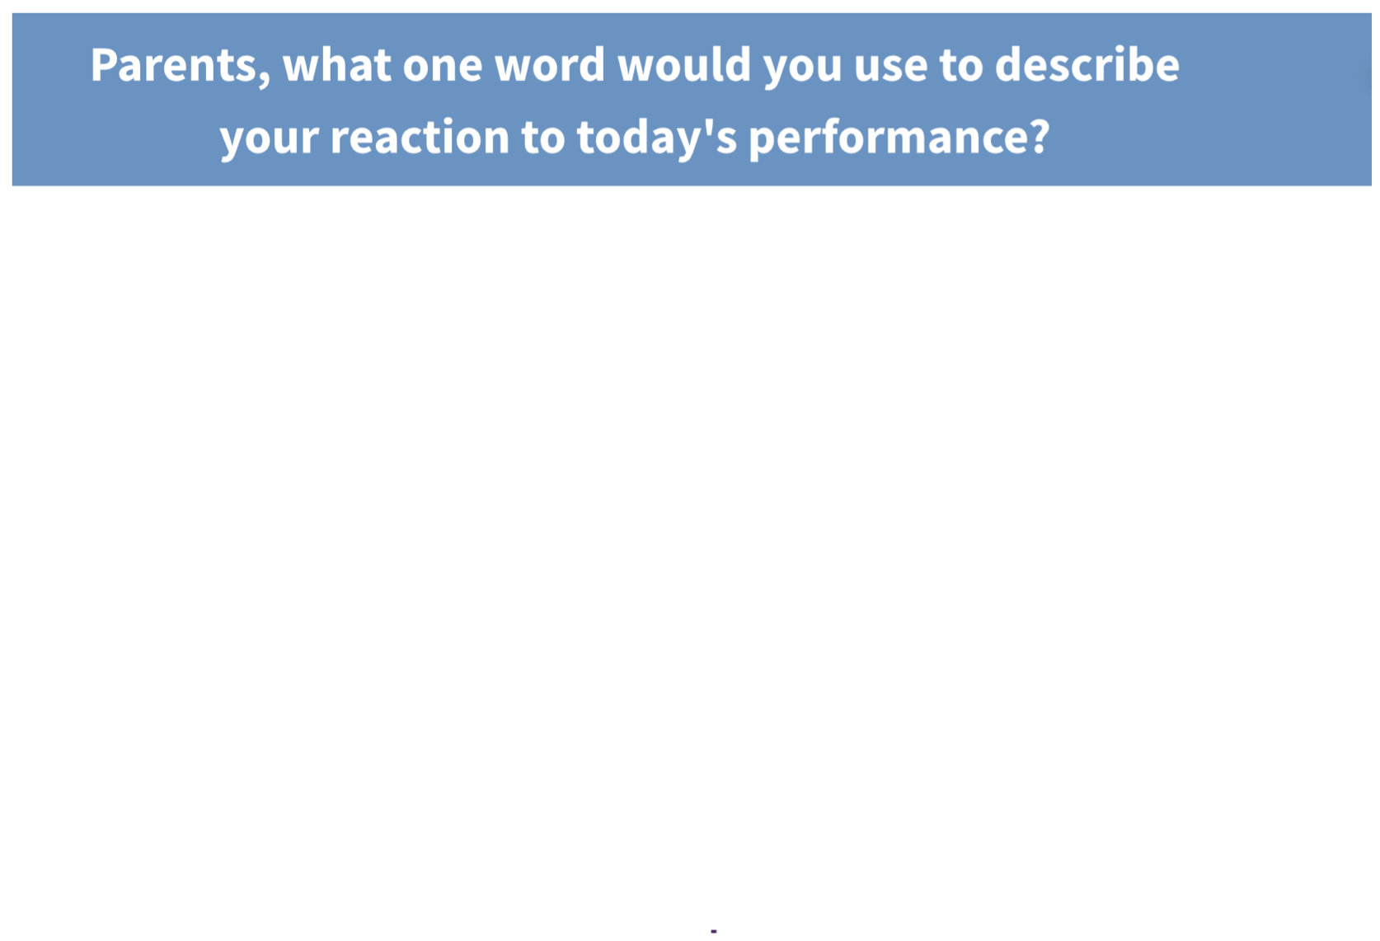
2017
Session
Asked at Midwest and ASTA
FPNDoC Sessions

Slide 18
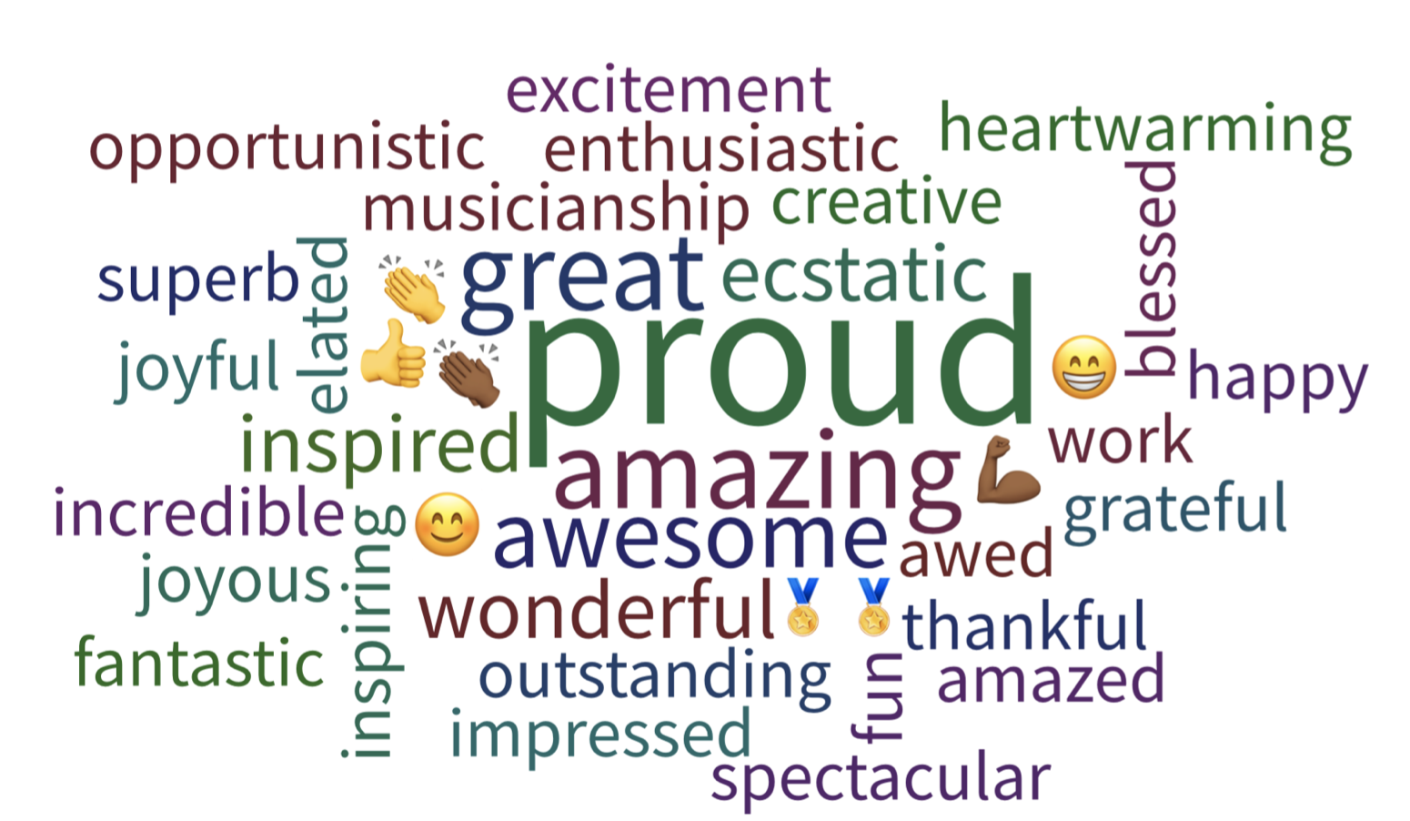
2017
Session

Slide 19
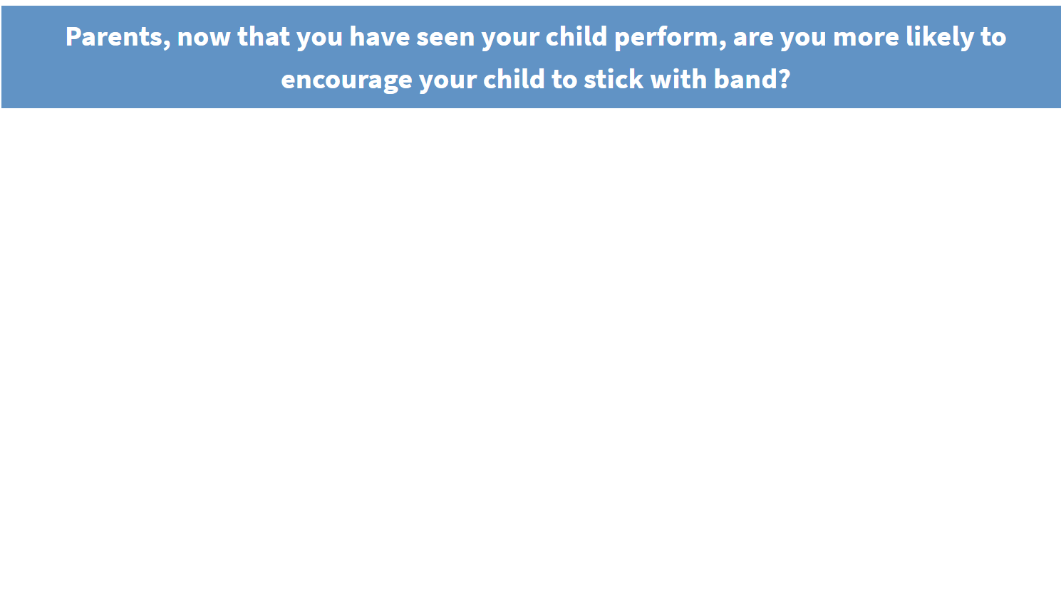
2018
Session
Asked at Midwest and ASTA
FPNDoC Sessions

Slide 20
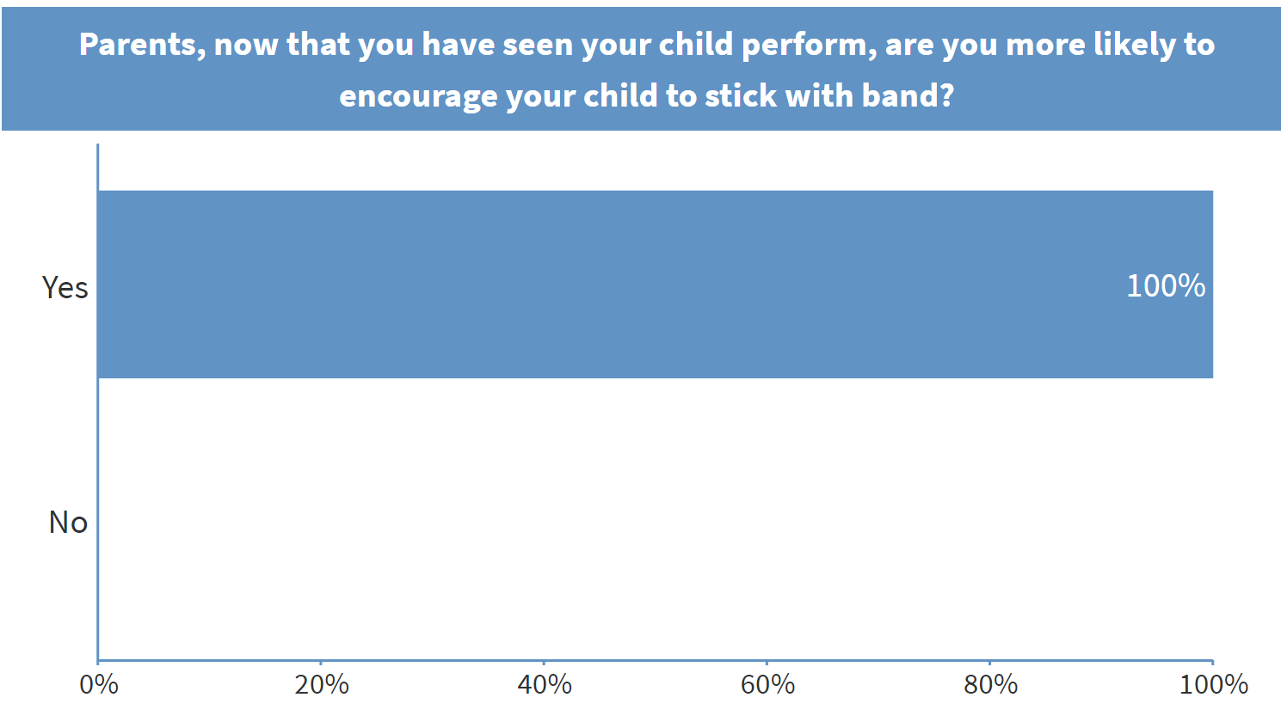
2018
Session
Received the identical answer
at each Session!

Slide 21
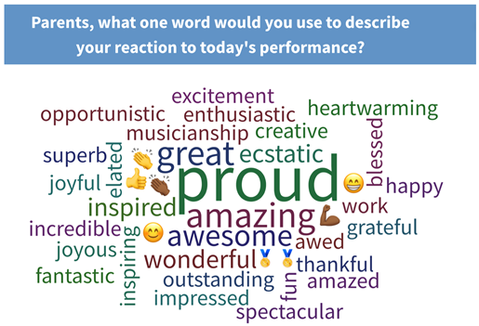

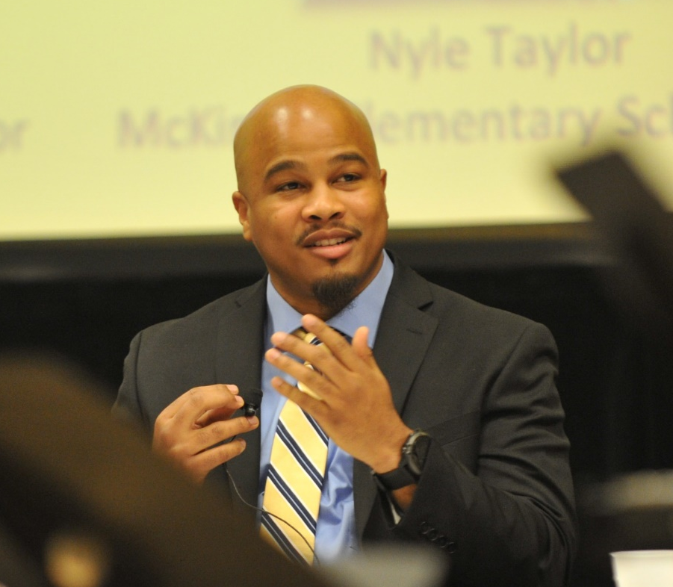
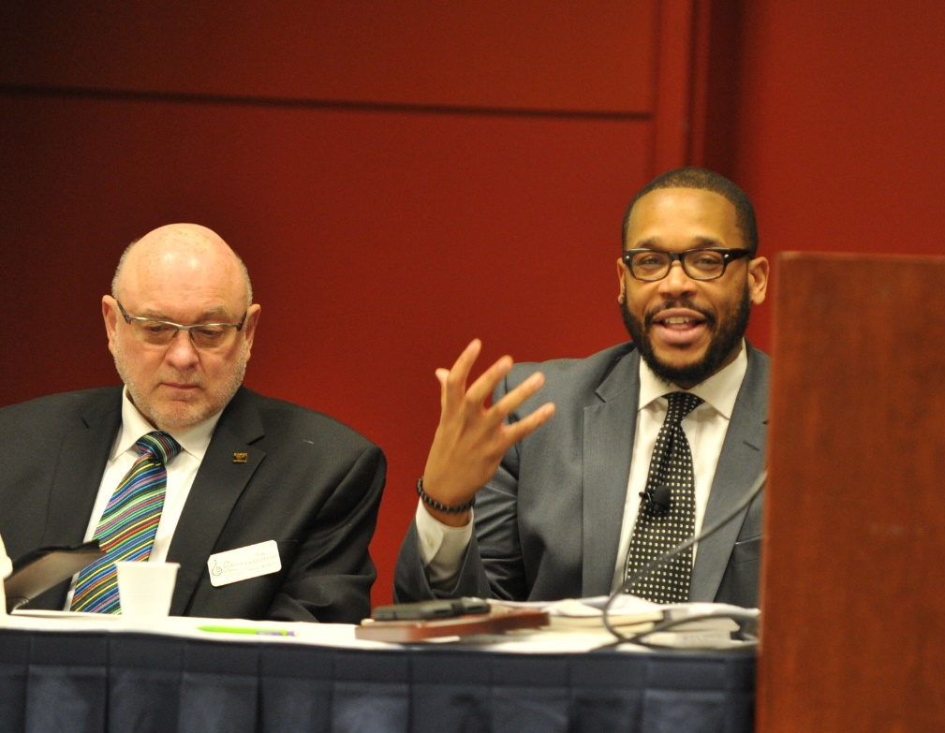
2017
Panel
“It changed how I teach beginners altogether!”
www.musicachievementcouncil.org

Slide 22
What Can. . .
. . .the Teachers Do?
. . .the Parents Do?
. . .the Local Dealers Do?
. . .the Associate Members Do?
. . .the Publications Do?
What Will M.A.C. Do?
What Will NAMM Foundation Do?
What Will NASMD Do?

Slide 23
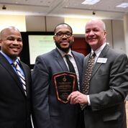
What Will YOU Do?
Save the Date for the National First Performance Day of Celebration on
November 15, 2018!
The Music Achievement Council invites you to participate in on
November 15, 2018!
www.musicachievementcouncil.org

Slide 24
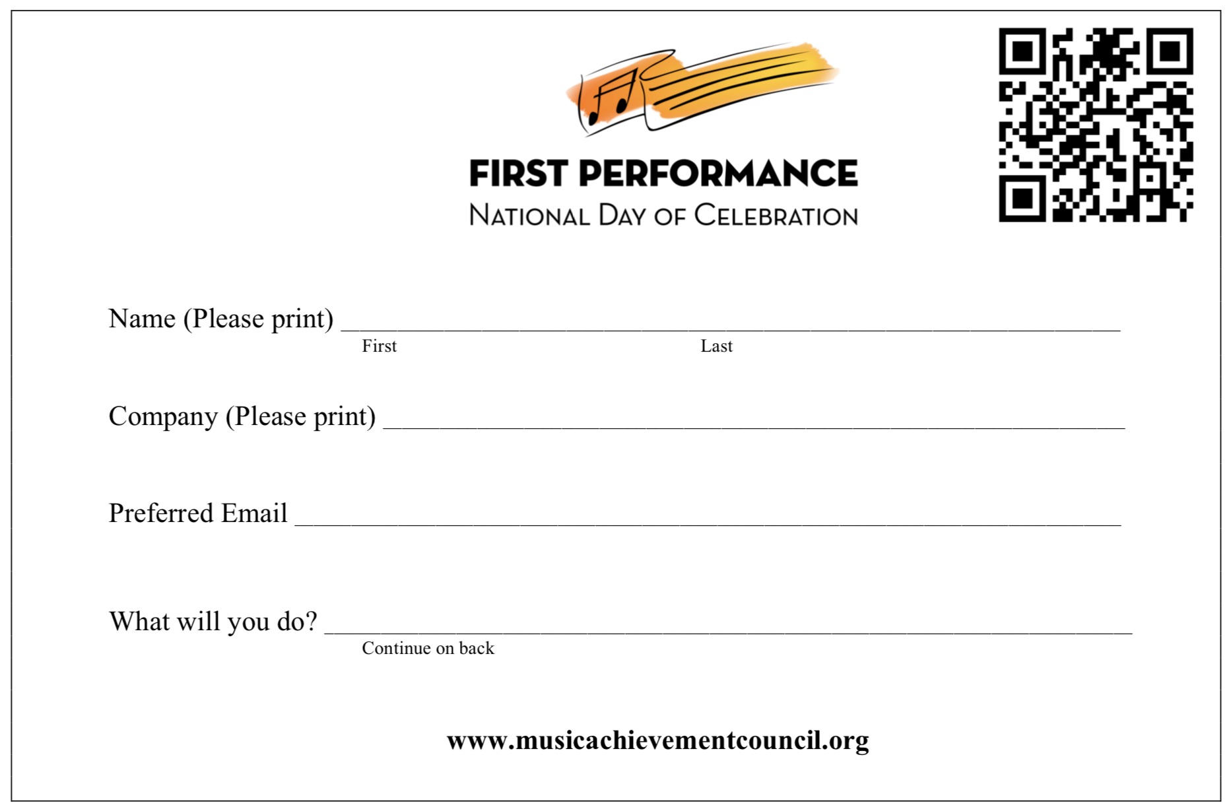
SIGN UP to receive your
Toolkit this summer!
www.musicachievementcouncil.org

Slide 25

Download the FREE Materials at:
www.MusicAchievementCouncil.org
Download this Powerpoint at:
www.musicedconsultants.net/nasmd2018
www.musicachievementcouncil.org

Slide 26












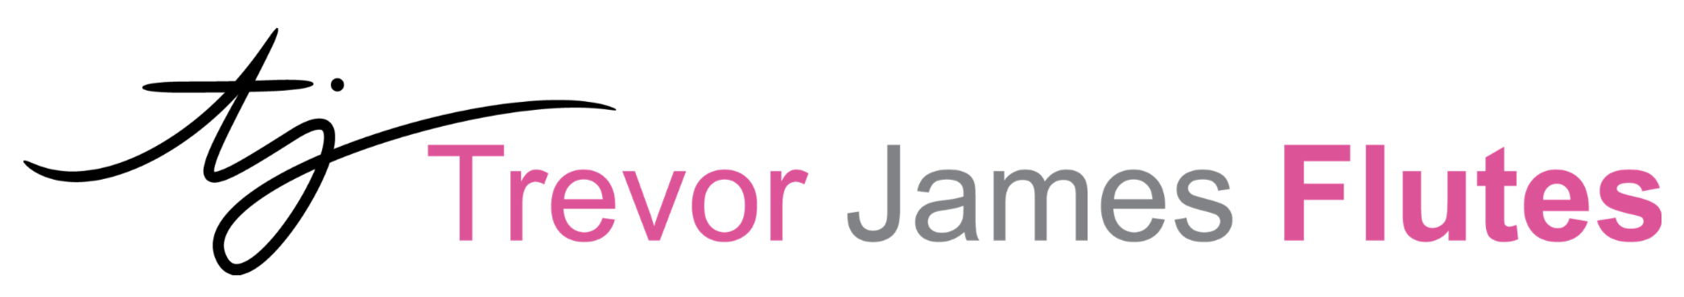


@MusicAchConsult
Thanks to our Sustaining Sponsors!
www.musicachievementcouncil.org
Notes:
www.musiceducationconsultants.net/mmea2010
26

