Slide 1
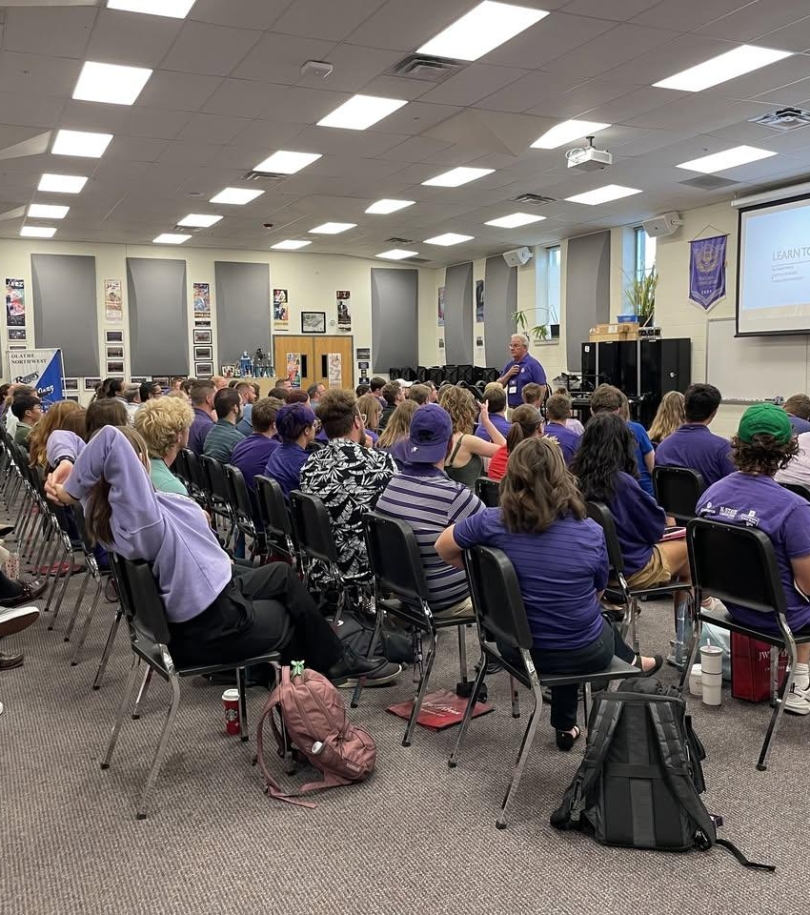



Building the Pipeline:
Encouraging Educators
Mike Kamphuis
Conn Selmer
Bob Morrison
Quadrant Research
Marcia Neel
Yamaha Corporation of America

Slide 2
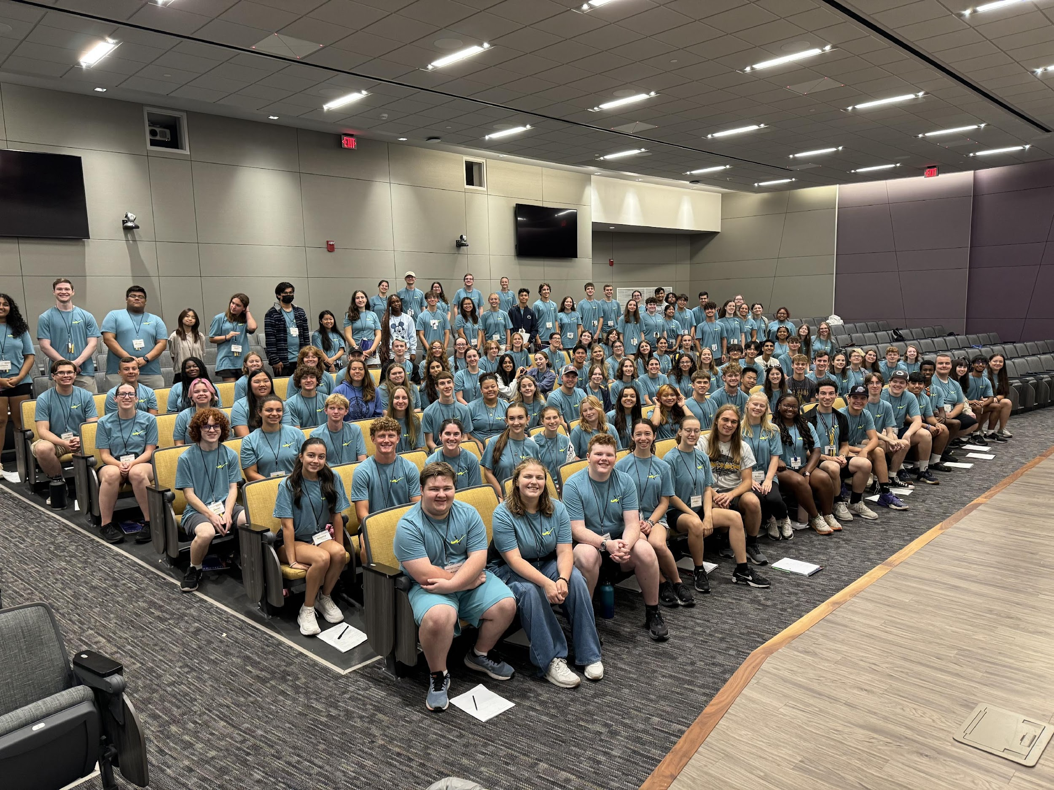
Key Areas of Focus
Recruitment, Retention and Mentoring
01
Teach Music Coalition
02
Enhancing College Recruitment
03
Developing Mentorship
Programs
04
Early Outreach for Student
Engagement
05
New Educational Opportunities
For Music Industry Careers

Slide 3


teachmusic.org
In response to the nationwide teacher shortage, the TeachMusic Coalition was formed to help find resources and solutions for the immediate, short term, and longer-term challenges facing the music educator workforce, working to retain, shepherd, diversify, and recruit the next generation of music educators.
This coalition is made up of many industry partners, including the American Choral Directors Association, the American String Teachers Association, Music for All, the National Association for Music Education, the National Federation of State High School Associations, the NAMM Foundation, and many others.

Slide 4
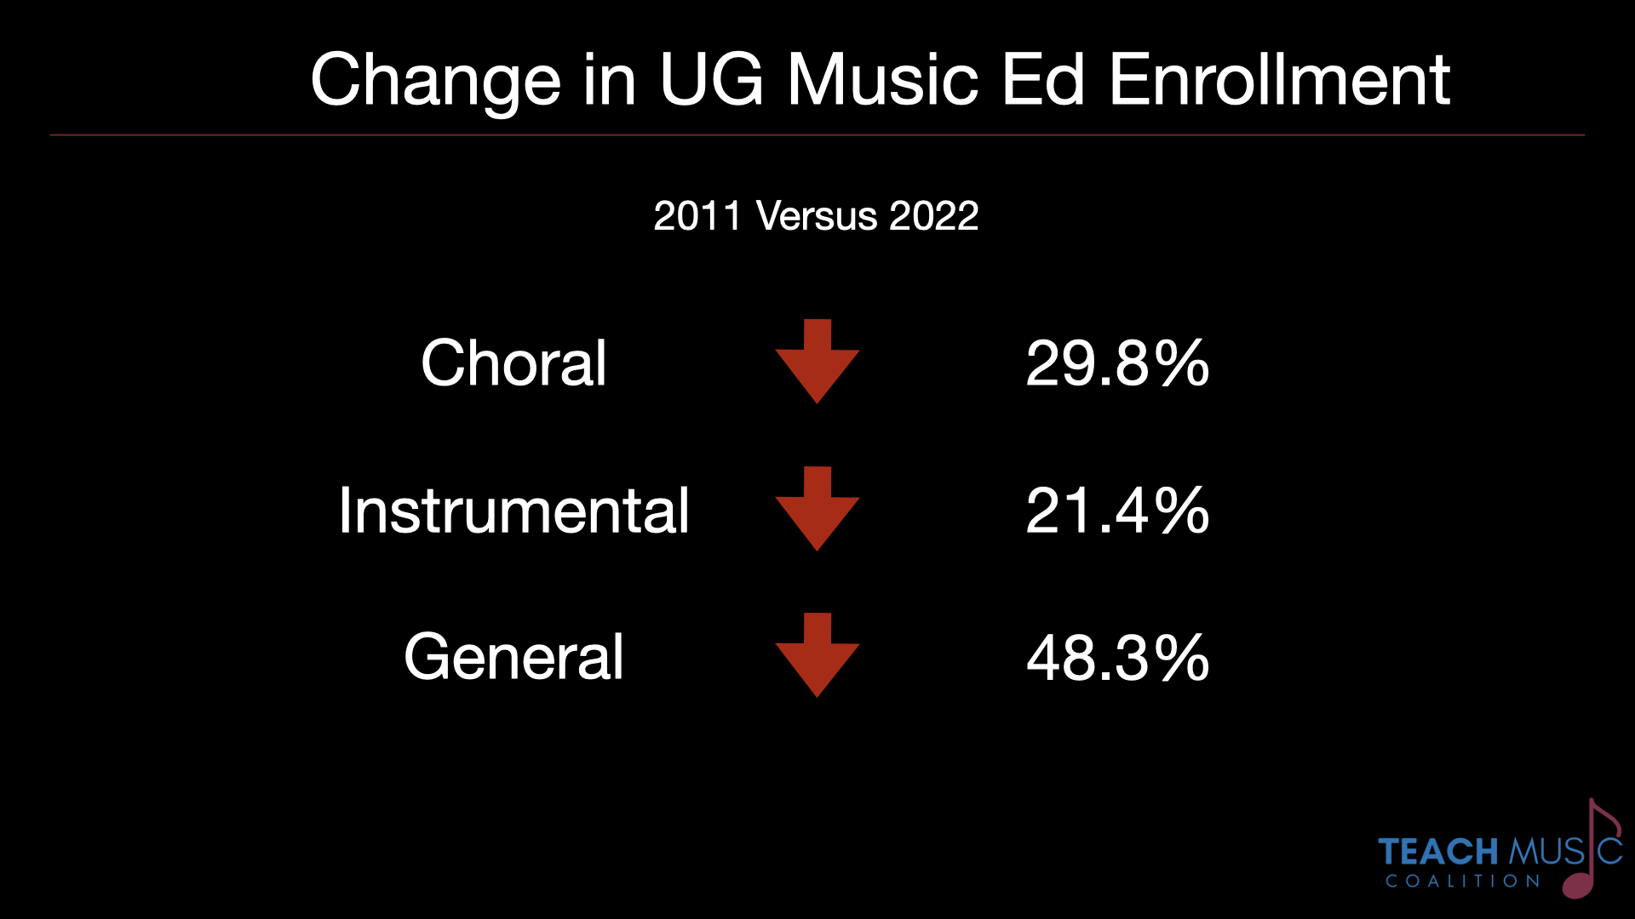

Slide 5
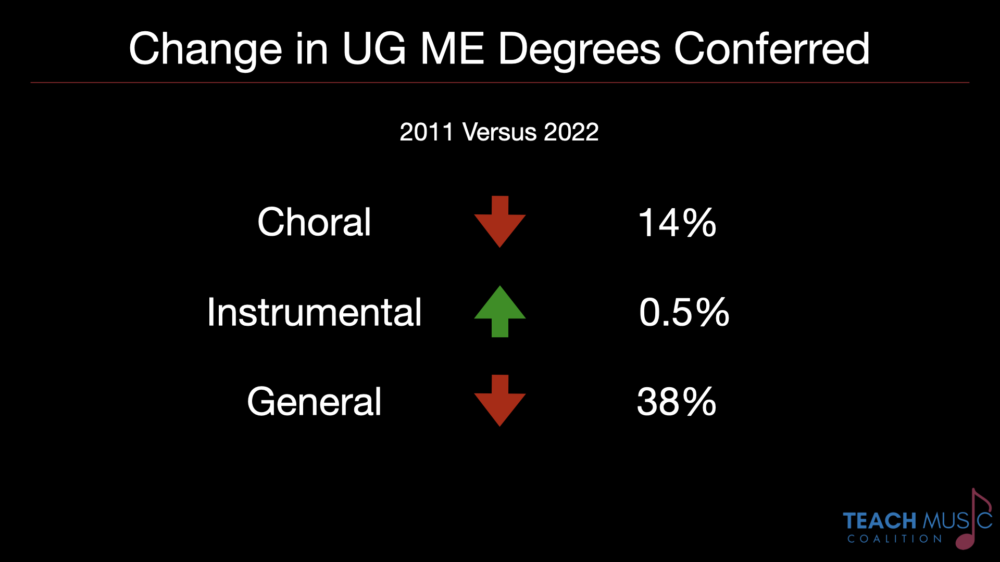

Slide 6
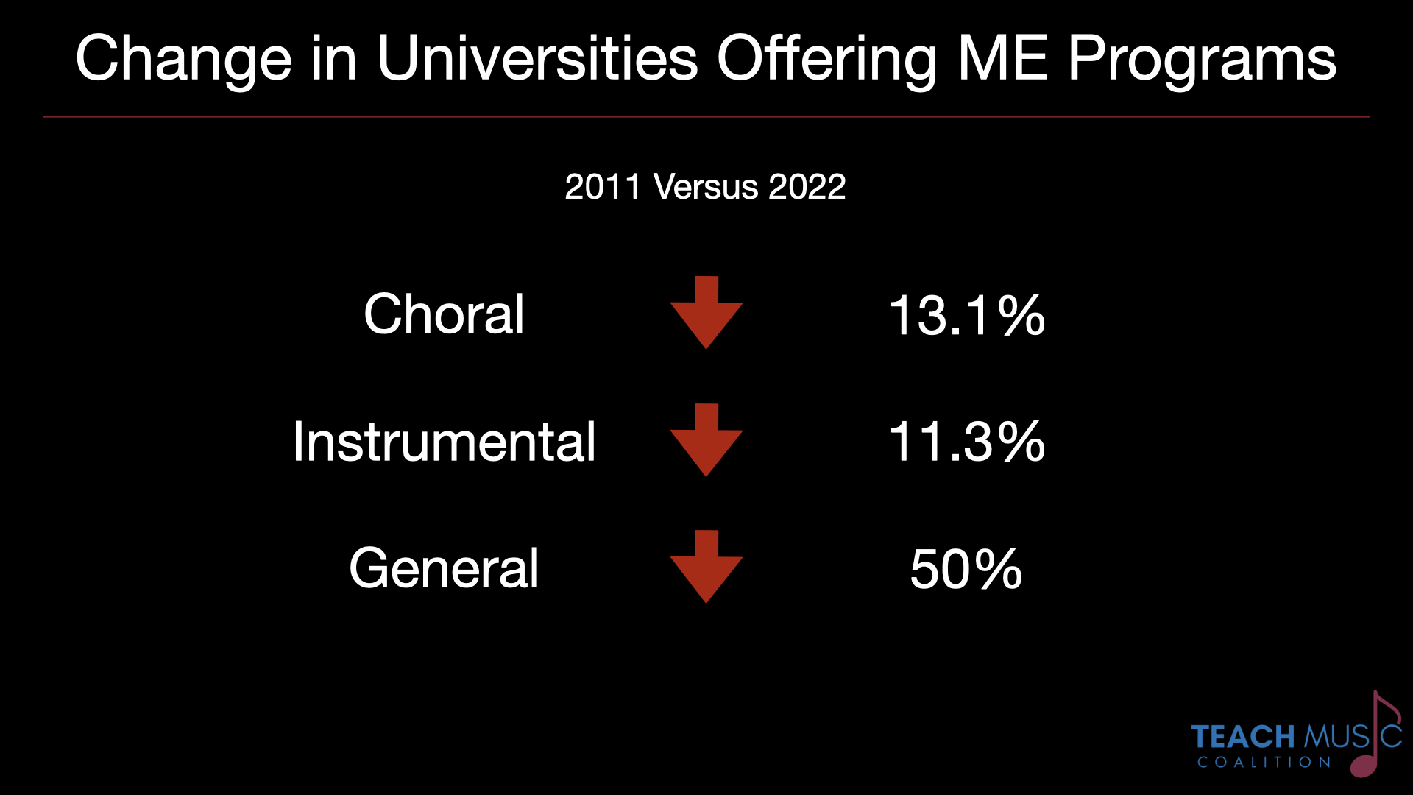

Slide 7


Slide 8
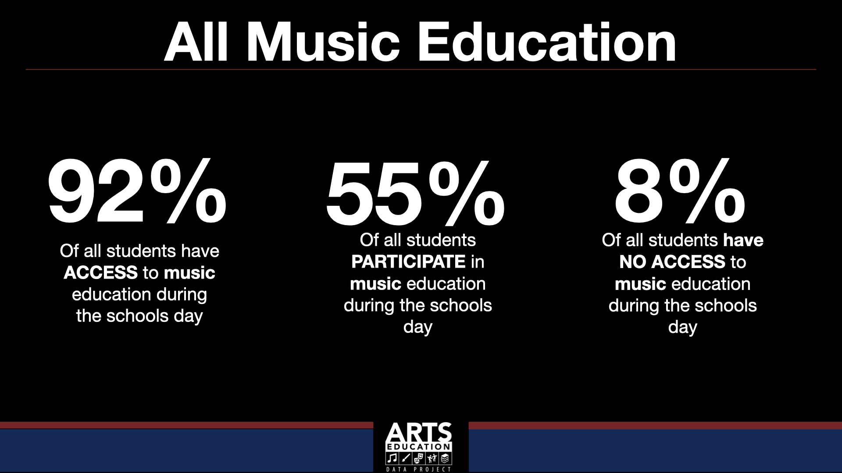

Slide 9
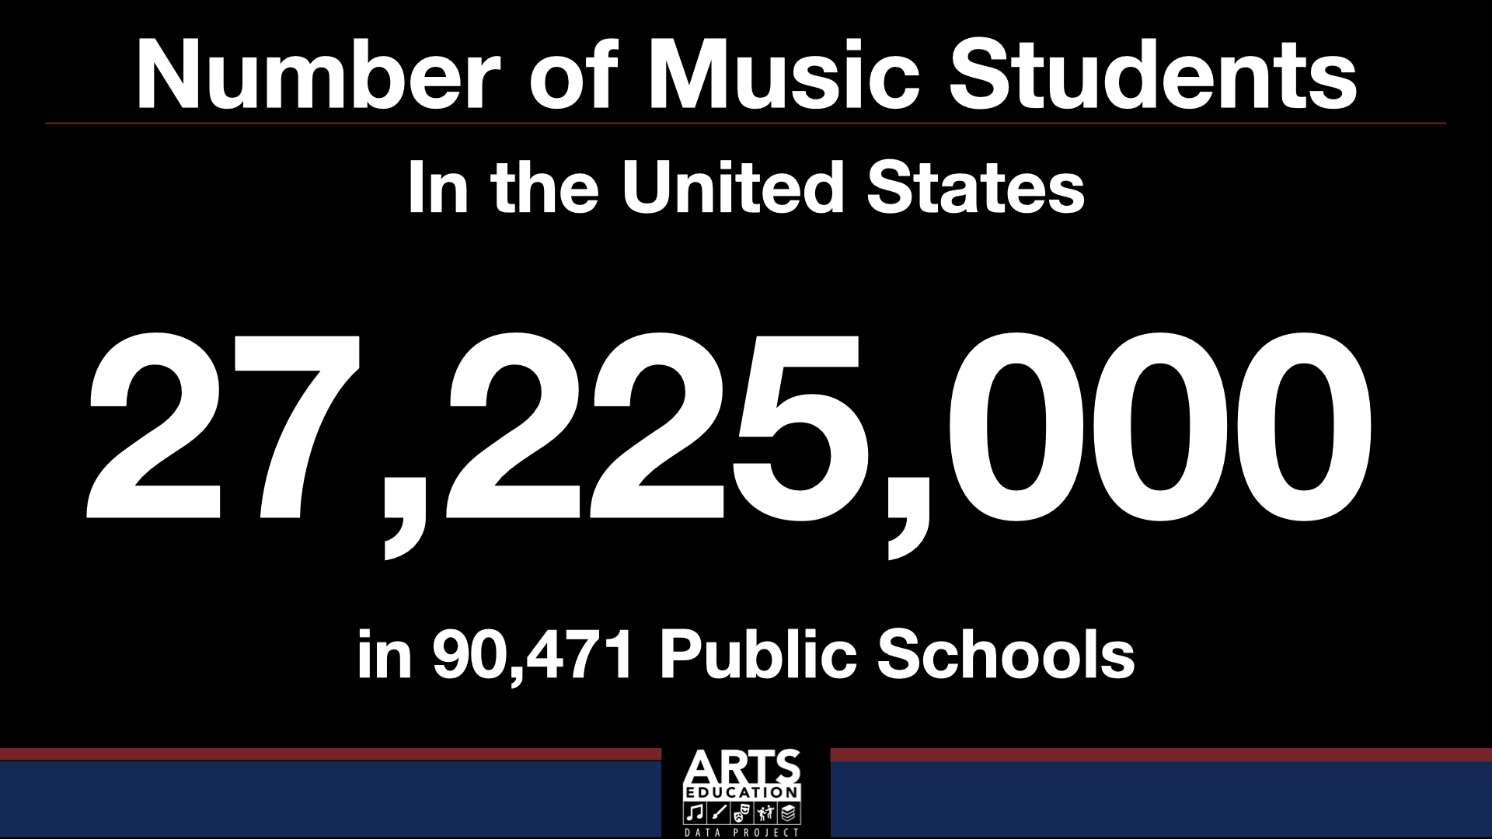

Slide 10
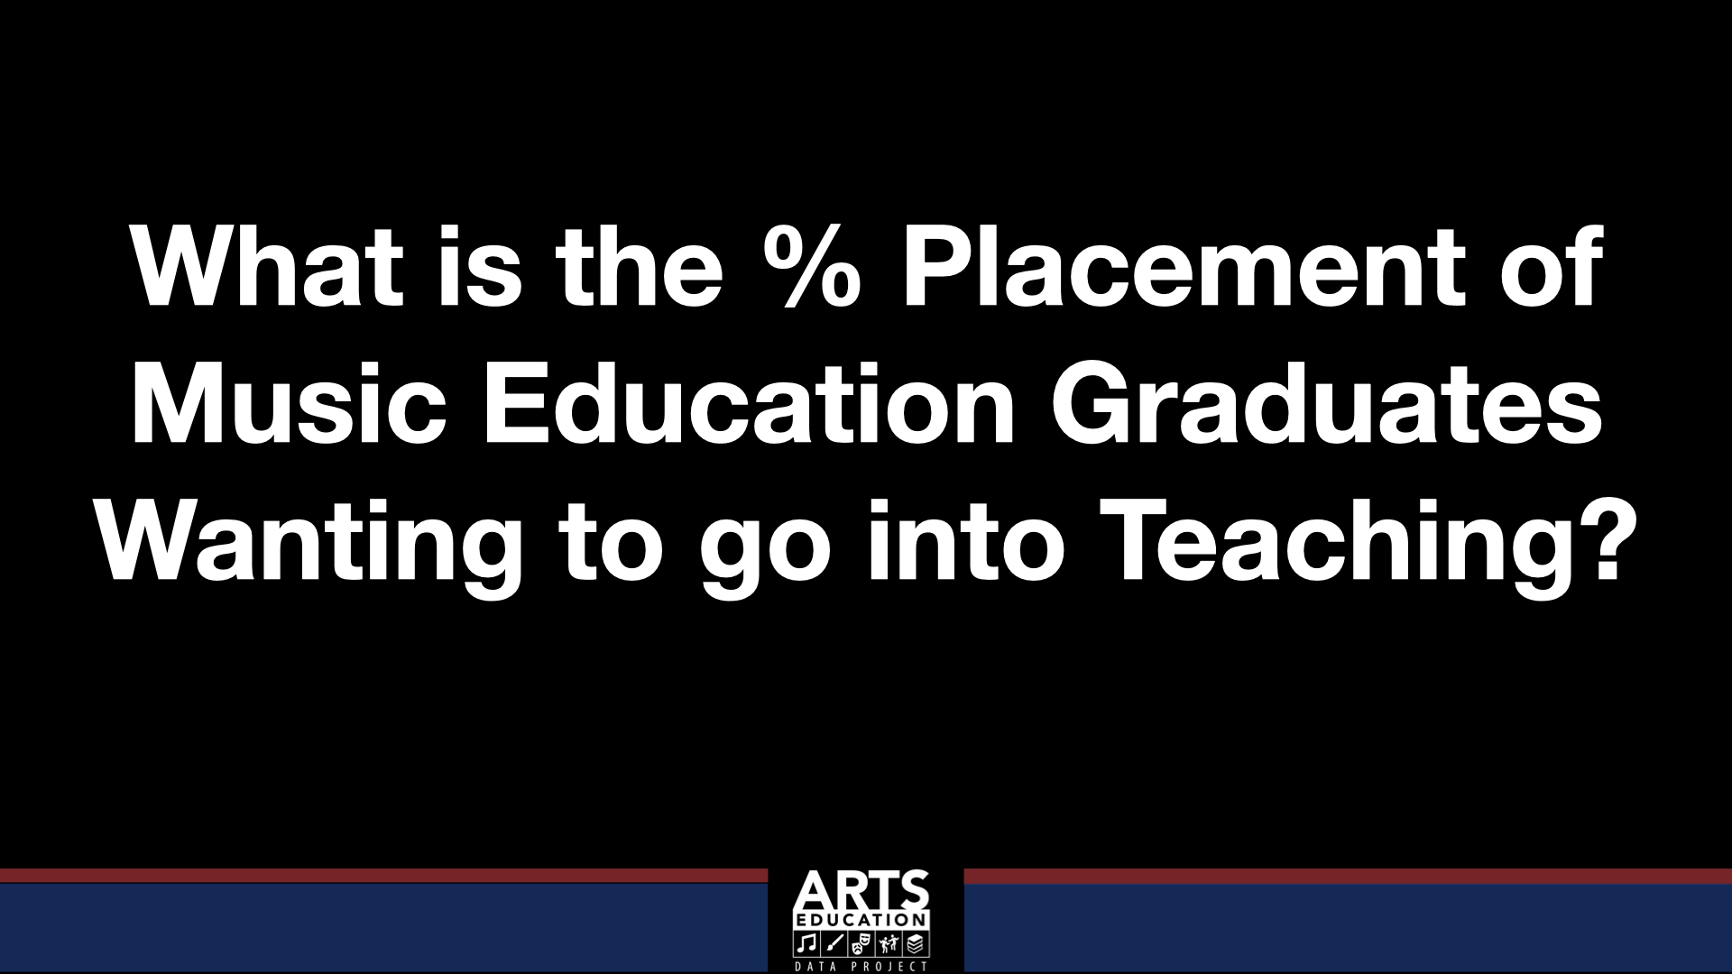

Slide 11
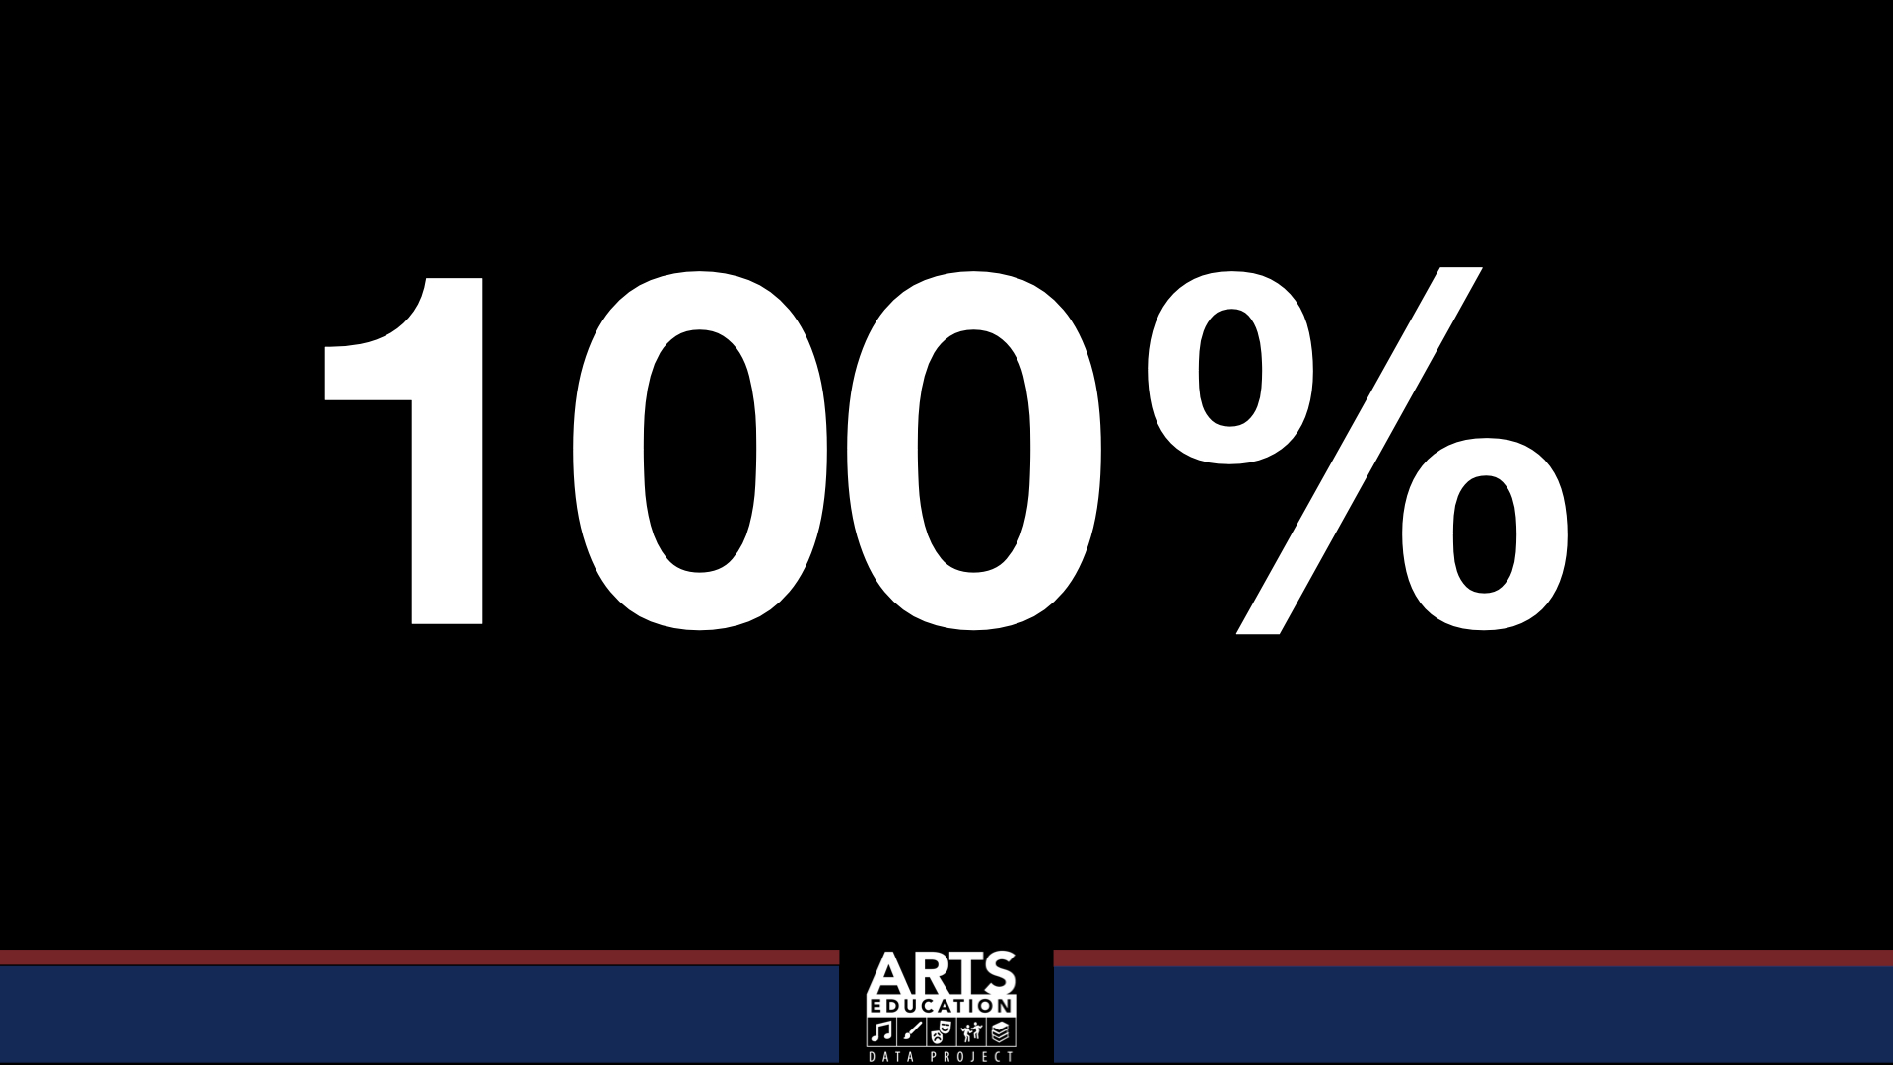

Slide 12
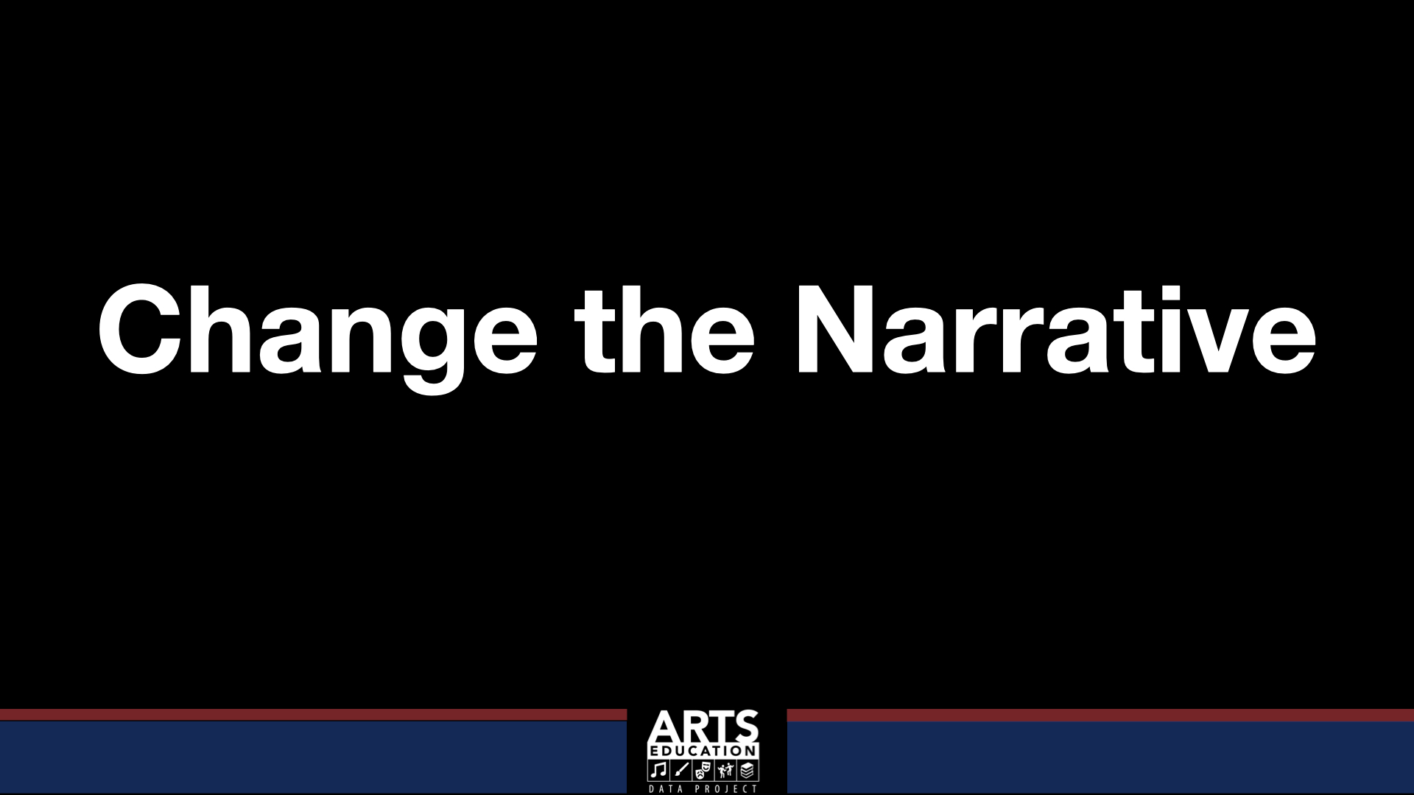

Slide 13
teachmusic.org
Information and resources for:
        Students, Parents, Educators, Counselors
Alternative Certification – Information organized by state to fully understand the process
Placement Tools
Job Board (Newly Launched)
Frontline Proactive Recruiting (Spring 2025)
Direct Feed from Frontline (December 2025)
Mentoring Workgroup – Replicable models (Iowa/Idaho)

Slide 14


teachmusic.org

Slide 15
Teachmusic.org

Slide 16



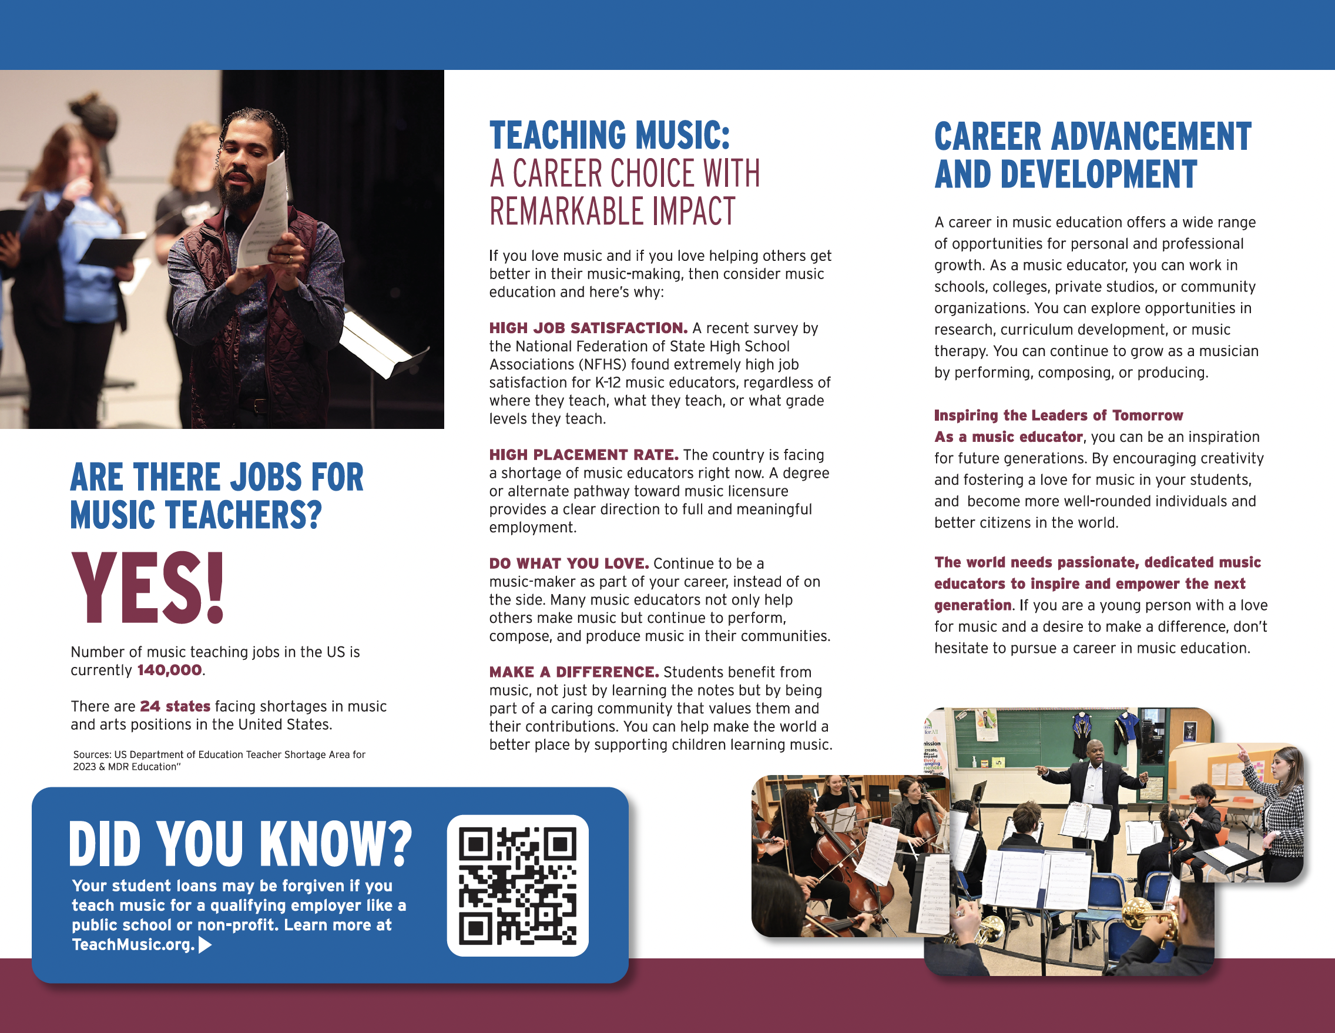
teachmusic.org

Slide 17

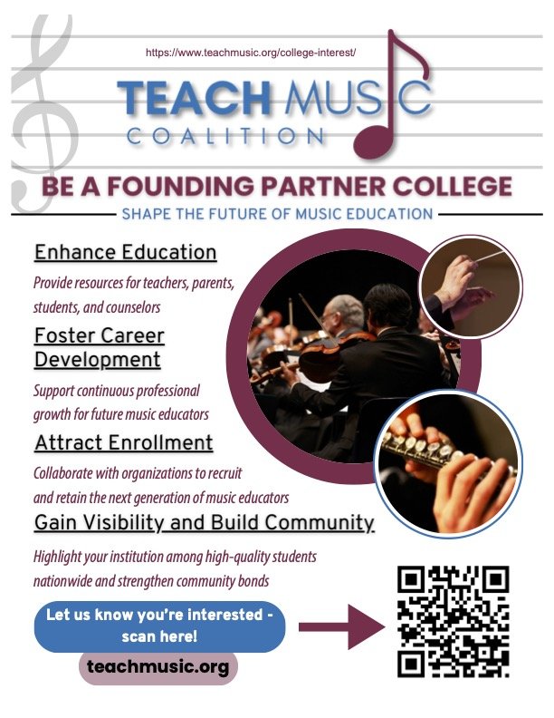
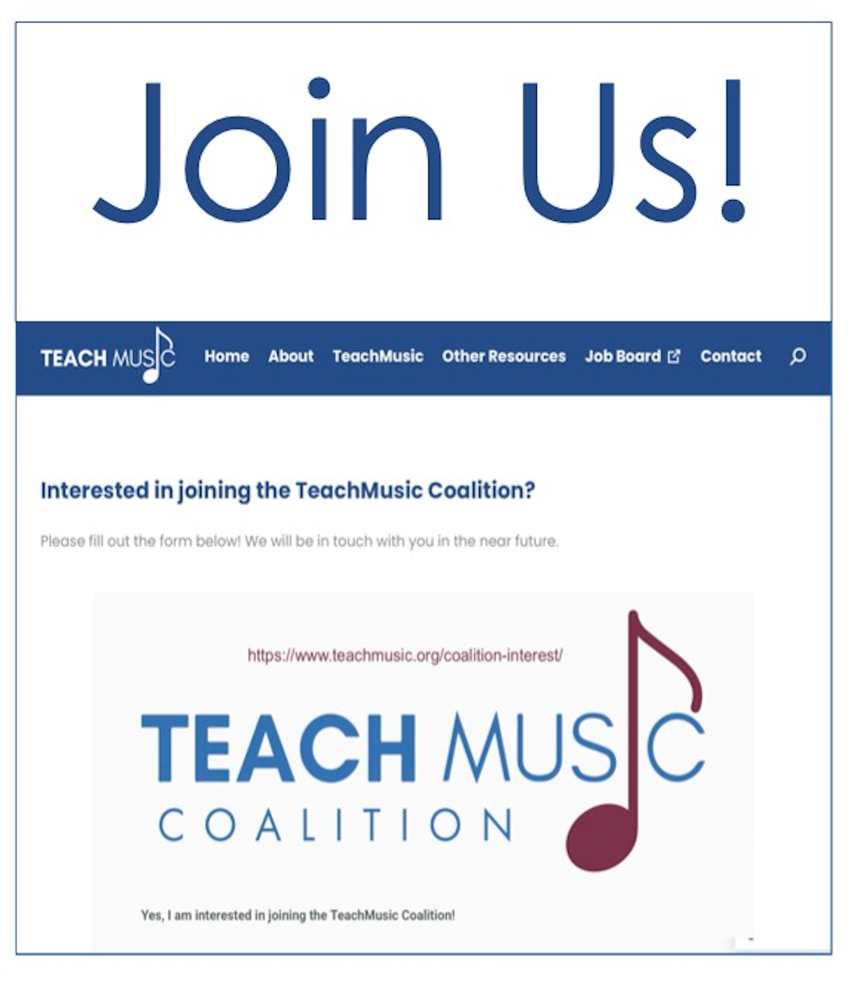
teachmusic.org

Slide 18
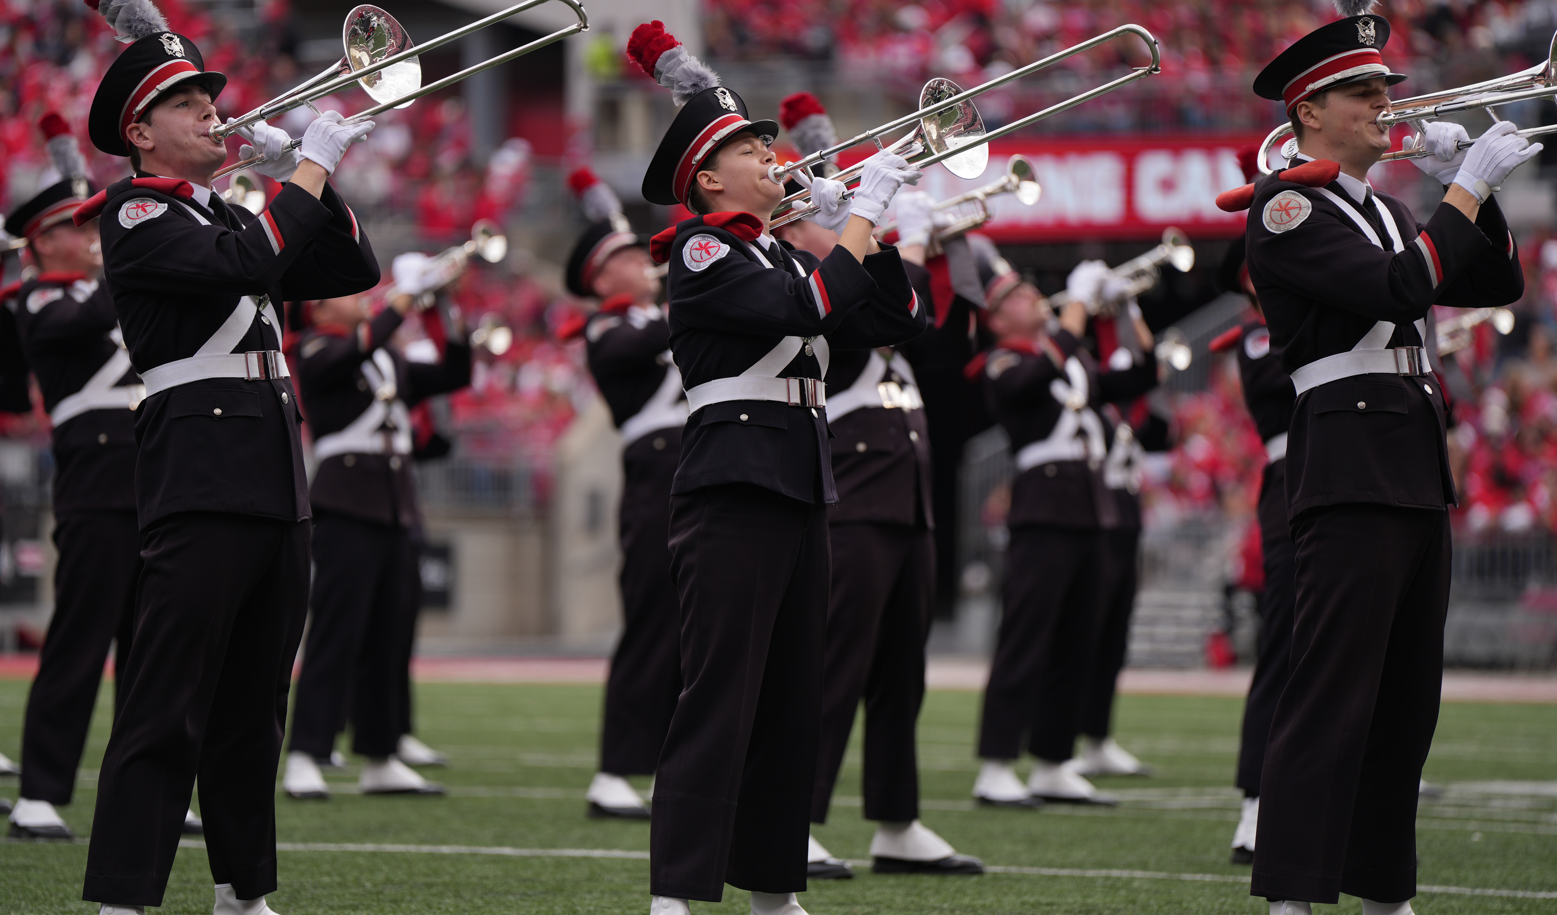
2.a
Enhanced University Recruitment
Thinking outside of the ”norm”
K-16 Initiative
Music ed majors serve as role models to inspire younger students to follow the same path. Use pro-sports model to emulate. Get youngsters on campus early through Junior Conservatory Programs.
Universities have a unique opportunity to engage high schools in different ways then they have in the past.
Vertical Alignment
Middle School → High School → College
Establish a collaboration between university and district educators to establish a music educator career pipeline. Explore how older students can better serve younger students.
Expanding College Outreach and Recruitment
Enhance university/school district relationships
Collegiate NAfME Networking through
Shadow a Music Ed Major Day & College Game Day event similar to how college athletes are recruited.

Slide 19




2.b
College & University Case Studies
University of South Carolina
UNC - Greensboro
The University of South Carolina launched a Music Teaching Artists Certificate Program early January, 2025 to address the teacher shortage in South Carolina.
This model allows those with an undergraduate degree in music to apply for a Post-Baccalaureate Certificate in Music Education to provide them with the knowledge and skills needed for teaching.

Slide 20
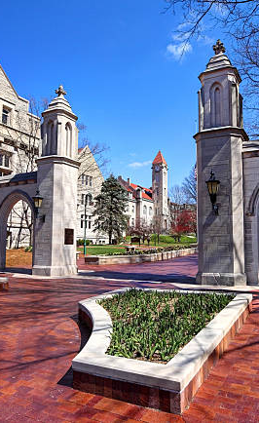
2.c
Additional University Recruitment Strategies
Collegiate NAfME students serve as ambassadors for Music Ed Showcase Days and/or Shadow a Music Ed Major Day.
Paid work-study programs in local schools for collegiates to teach lessons, sectionals while also getting valuable teaching experience.
Summer music programs/On-campus programs as recruiting opportunities
  Carnegie Mellon Pre-college “Try-out” Program
  Ohio State University Jr. Conservatory

Slide 21

2.c
The High Cost of Higher (Music) Ed
State-funded Promise Scholarships
Eligibility Steps: Nevada
Continuing Eligibility Steps
Choose Eligible CC Institution
Students remain eligible for up to 3 years providing they continue to meet Title IV Financial Aid Satisfactory Academic Progress (SAP) and enroll in at least 12 credits.
Be a Nevada Resident
Have obtained a HS diploma
Submit NPS application and FAFSA
Meet with a mentor prior to 1st semester
Meet with a mentor annually
Complete 8 hrs of community service during the last year of high school
Complete 8 hrs of community service each fall and spring semester.
Enroll in at least 12 credit hours

Slide 22

3.a
Exemplary High School Models
Portage PS (MI) Human Services Career Pathway: Educator Academy: Cultivates foundational skills for a successful career in the field of education. Students work directly with young learners in an educational setting.
CCSD Teacher Academy College Pathway Program (TACPP)
Guides students in grades 8-12 toward a successful teaching career. Dual credit offered
Nevada State University's Teacher Academy Pipeline Project (TAPP) The program provides opportunities for high school students to earn college credits at a reduced cost, participate in field trips to college campuses, and engage in learning experiences alongside peers interested in education.

Slide 23

3.b
What Can Current Educators Do?
Creating opportunities for high school students to experience success in education
Leadership development in high school ensembles
  Peer mentoring
  Section leader
Connecting drum majors and student leaders to music ed pathways
Strengthening student leadership roles in music programs
  Student led activities

Slide 24




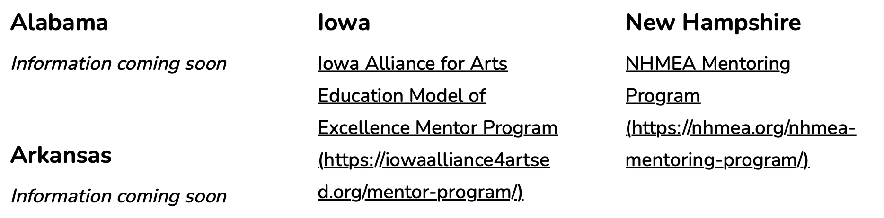
3.b
Mentoring Programs
State Music Education Association

Slide 25

4.b
Additional Mentorship Opportunities
Activating opportunities at both the local and state level
Life coach opportunity especially for those in more rural communities
Leveraging School Music Dealers and their experienced reps to be a support mechanism for the teachers – not just transactional.

Slide 26
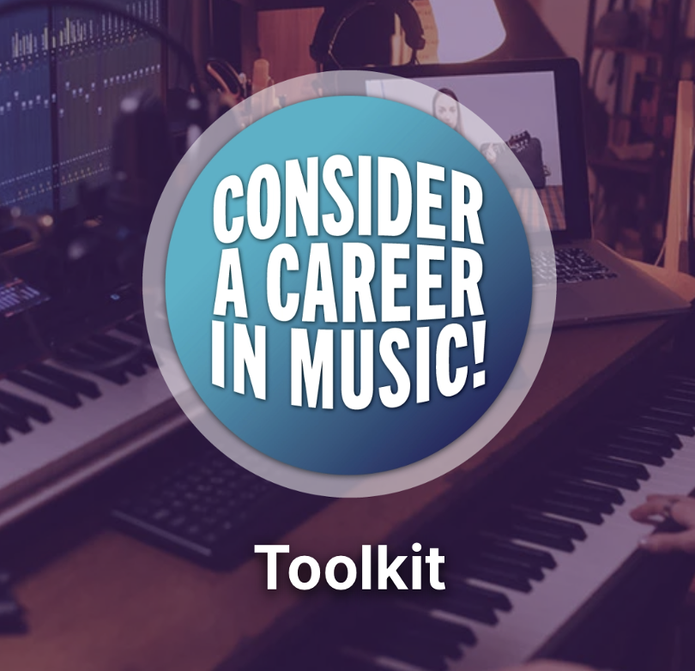

5.a
Preparing Students for Music Industry Careers
Creating opportunities for high school students to experience success in the Music Industry
Individually designed for Educators, Counselors, NAMM Members, Students and Parents include:
Brochures, Posters, Handouts
Powerpoints, Scripts and Guide
Media Tiles
Templates
Discussion Prompts
https://careers.namm.org/toolkit

Slide 27
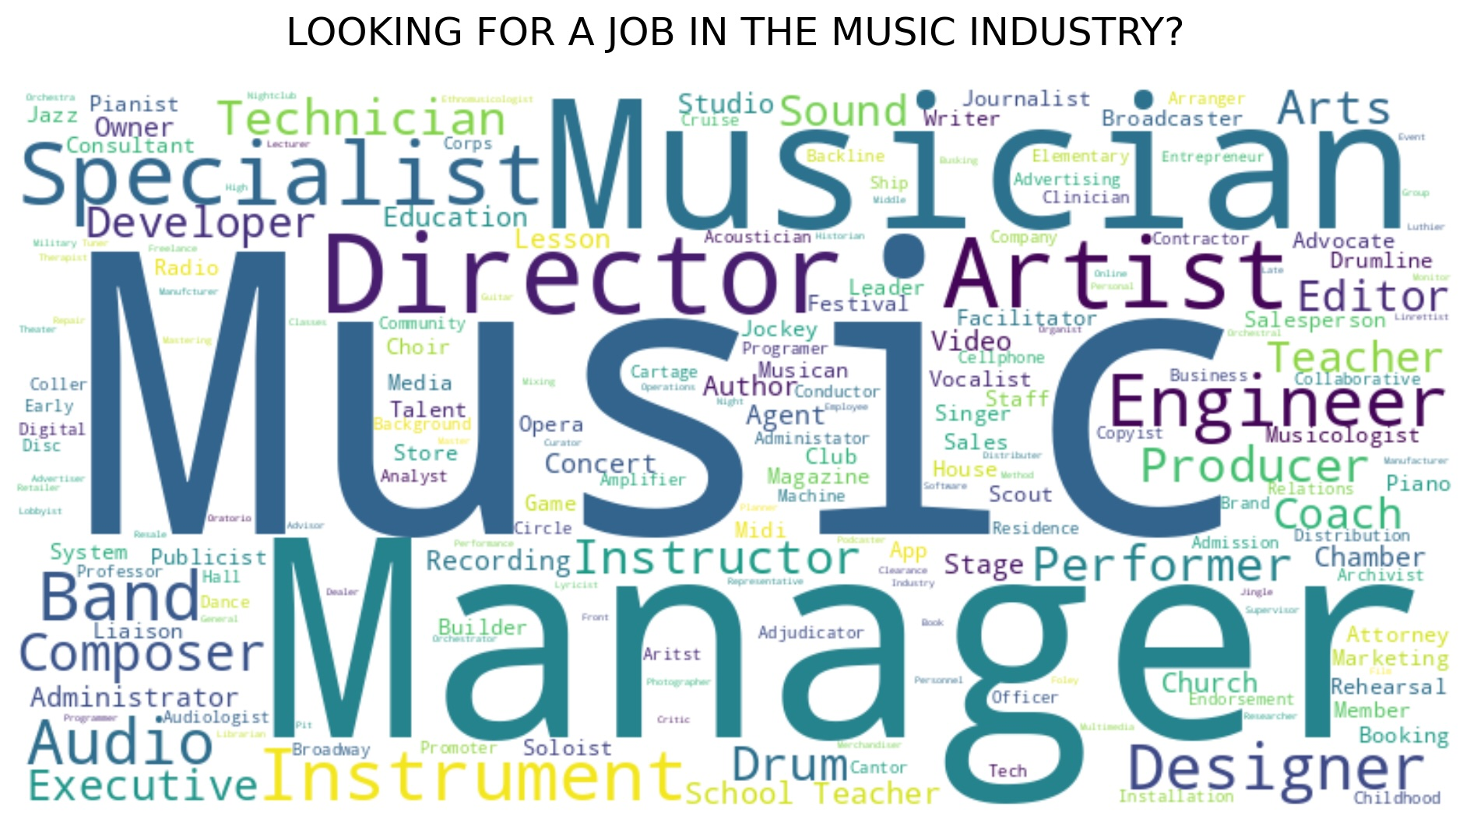
5.a
Preparing Students for Music Industry Careers
”What should I major in to get a job in the industry?”
Music Industry
Music Business/Management
Music Production and Engineering
Recording and Production
Contemporary Writing and Production
Film and Media Scoring
Song Writing

Slide 28
Early Outreach
Call to Action
Inspire students to consider music education before college
What does our path to success look like?
Expand Mentoring
Boost Recruitment
Support new educators with structured mentorship programs
Strengthen college partnerships and provided incentives for music majors
Grow TeachMusic Coalition
Build our national coalition to sustain recruitment and mentorship efforts.
Industry Careers
Expand career pathways beyond traditional teaching roles
Advocacy and Data
Use research and policy to drive long term systemic change

Slide 29
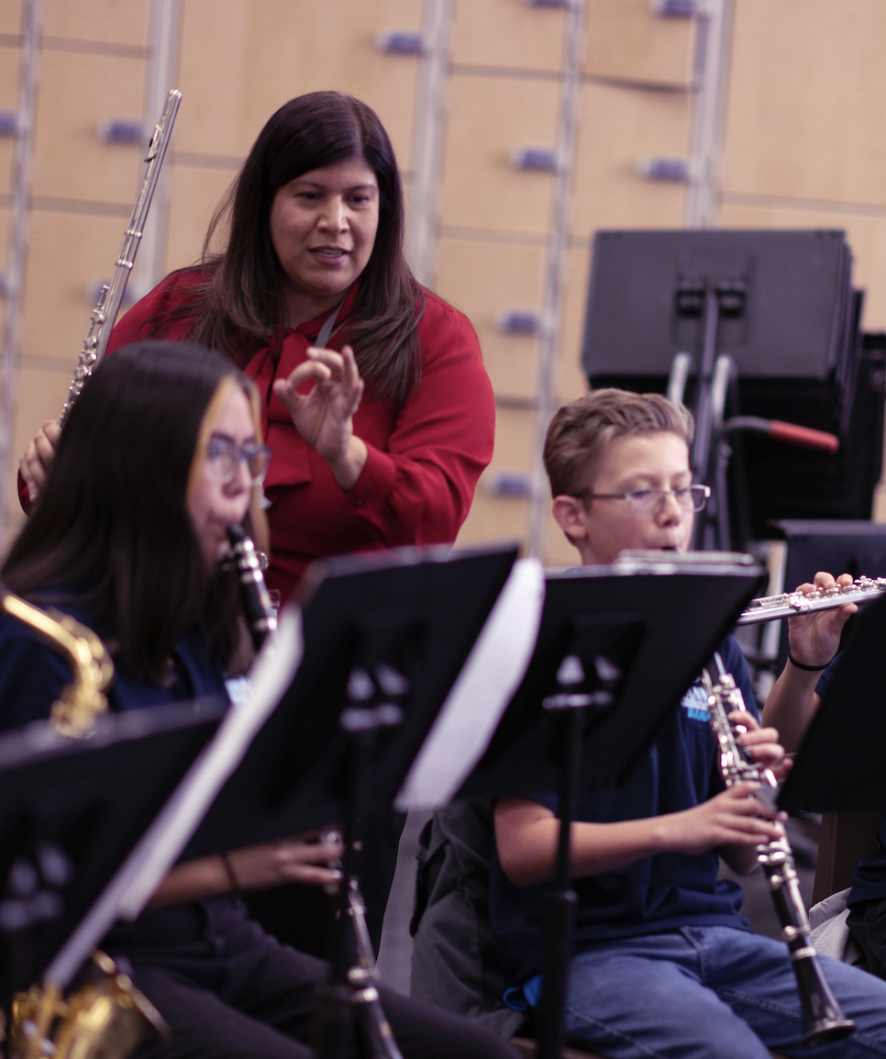

5.a
Miss anything?
It’s all right here!

