Slide 1
Teaching Materials & Strategies for Younger Mariachi Players
Marta Ocampo
National Mariachi Workshops for Educators
July 11, 2019

Slide 2

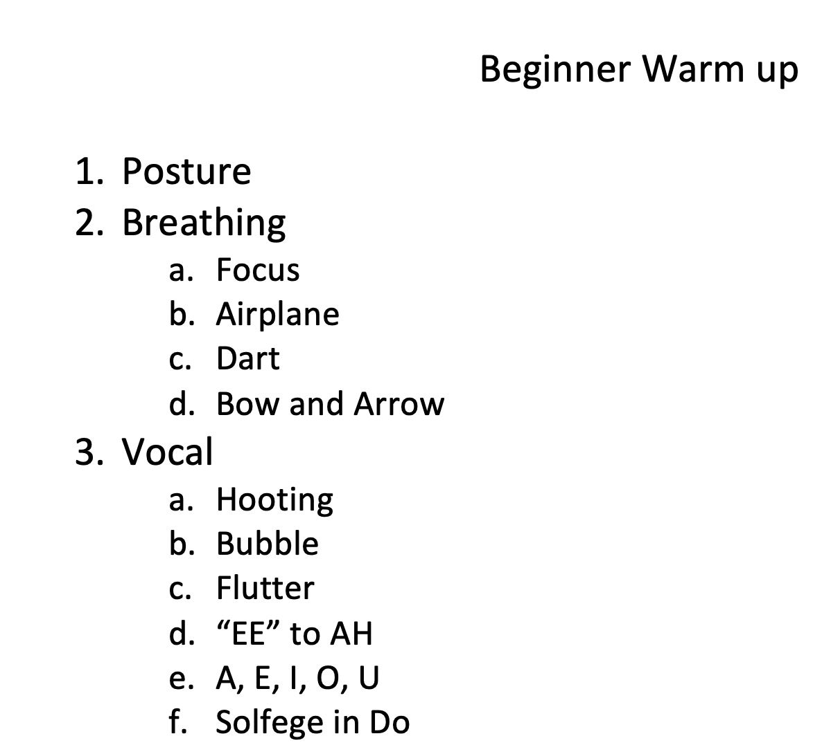
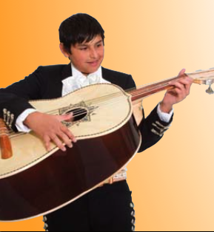

Slide 3
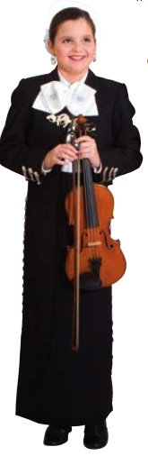
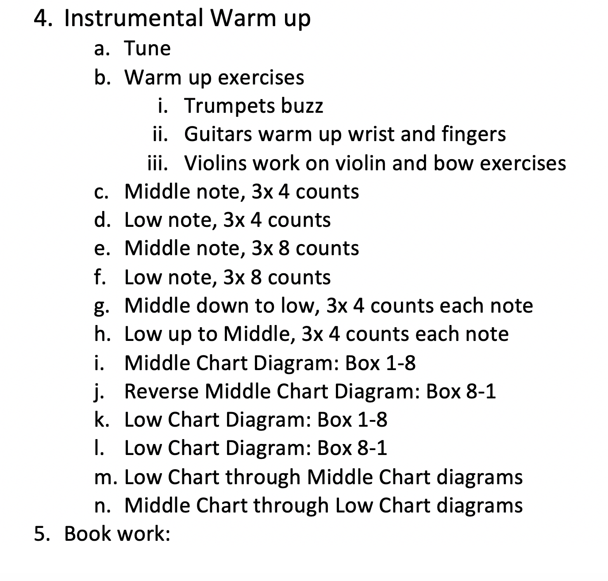

Slide 4
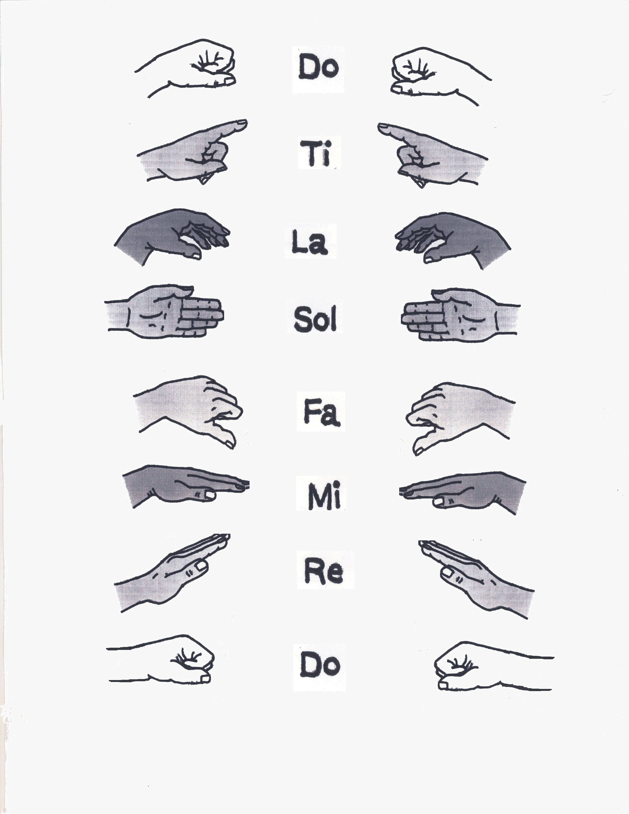
Solfegio

Slide 5
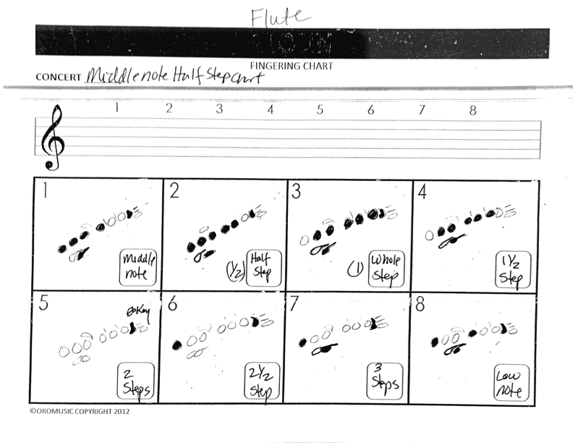
Flute Middle Chart

Slide 6
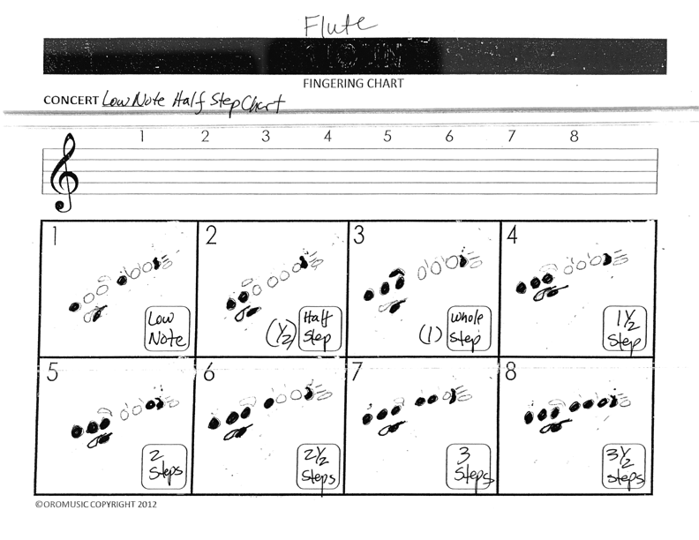
Flute Low Chart

Slide 7
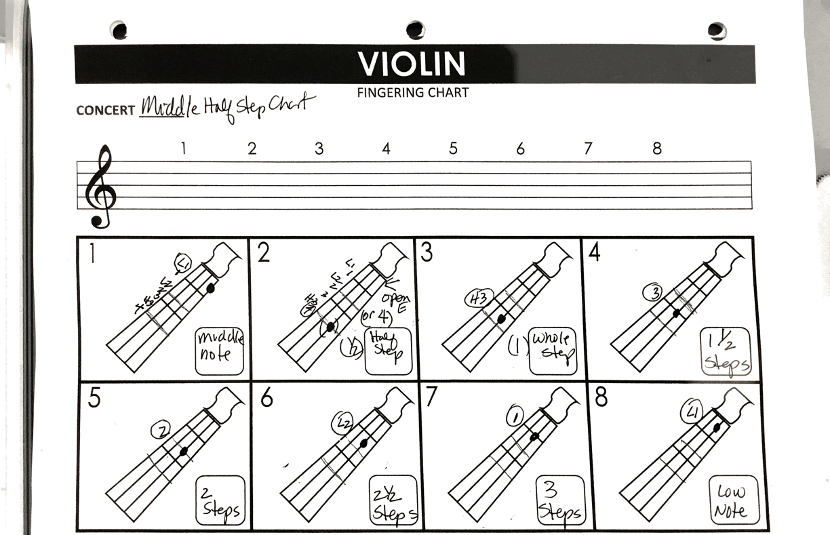
Questions and/or Comments

Slide 8
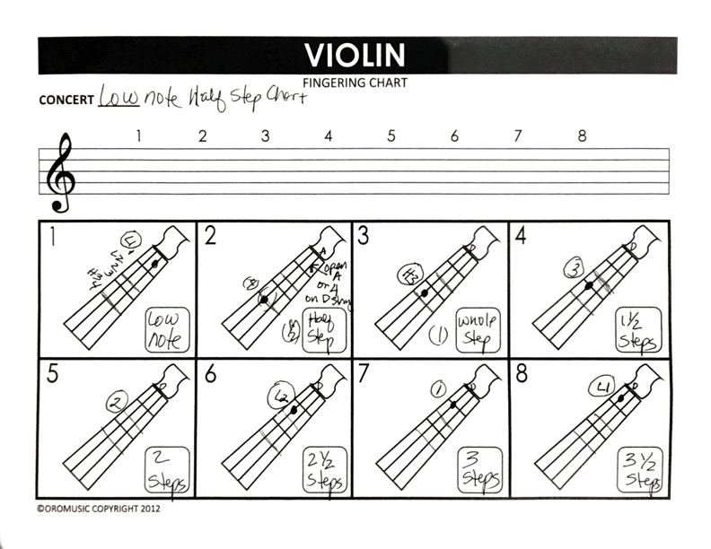
Questions and/or Comments

Slide 9
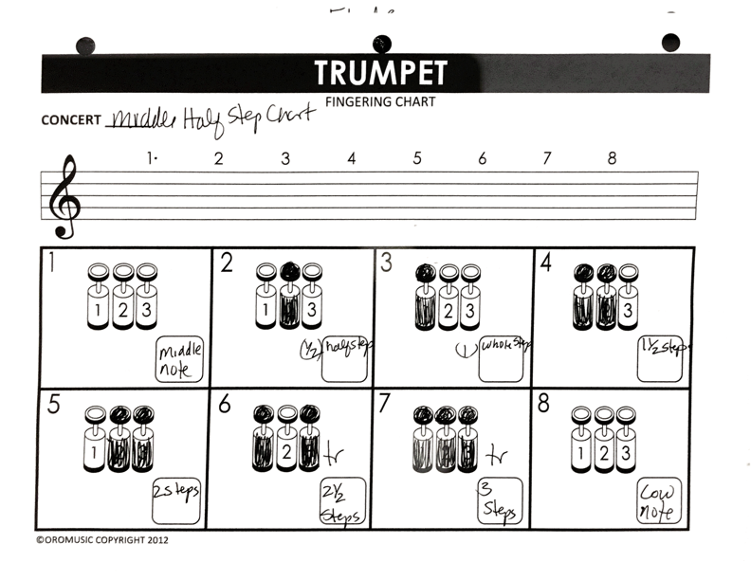
Questions and/or Comments

Slide 10
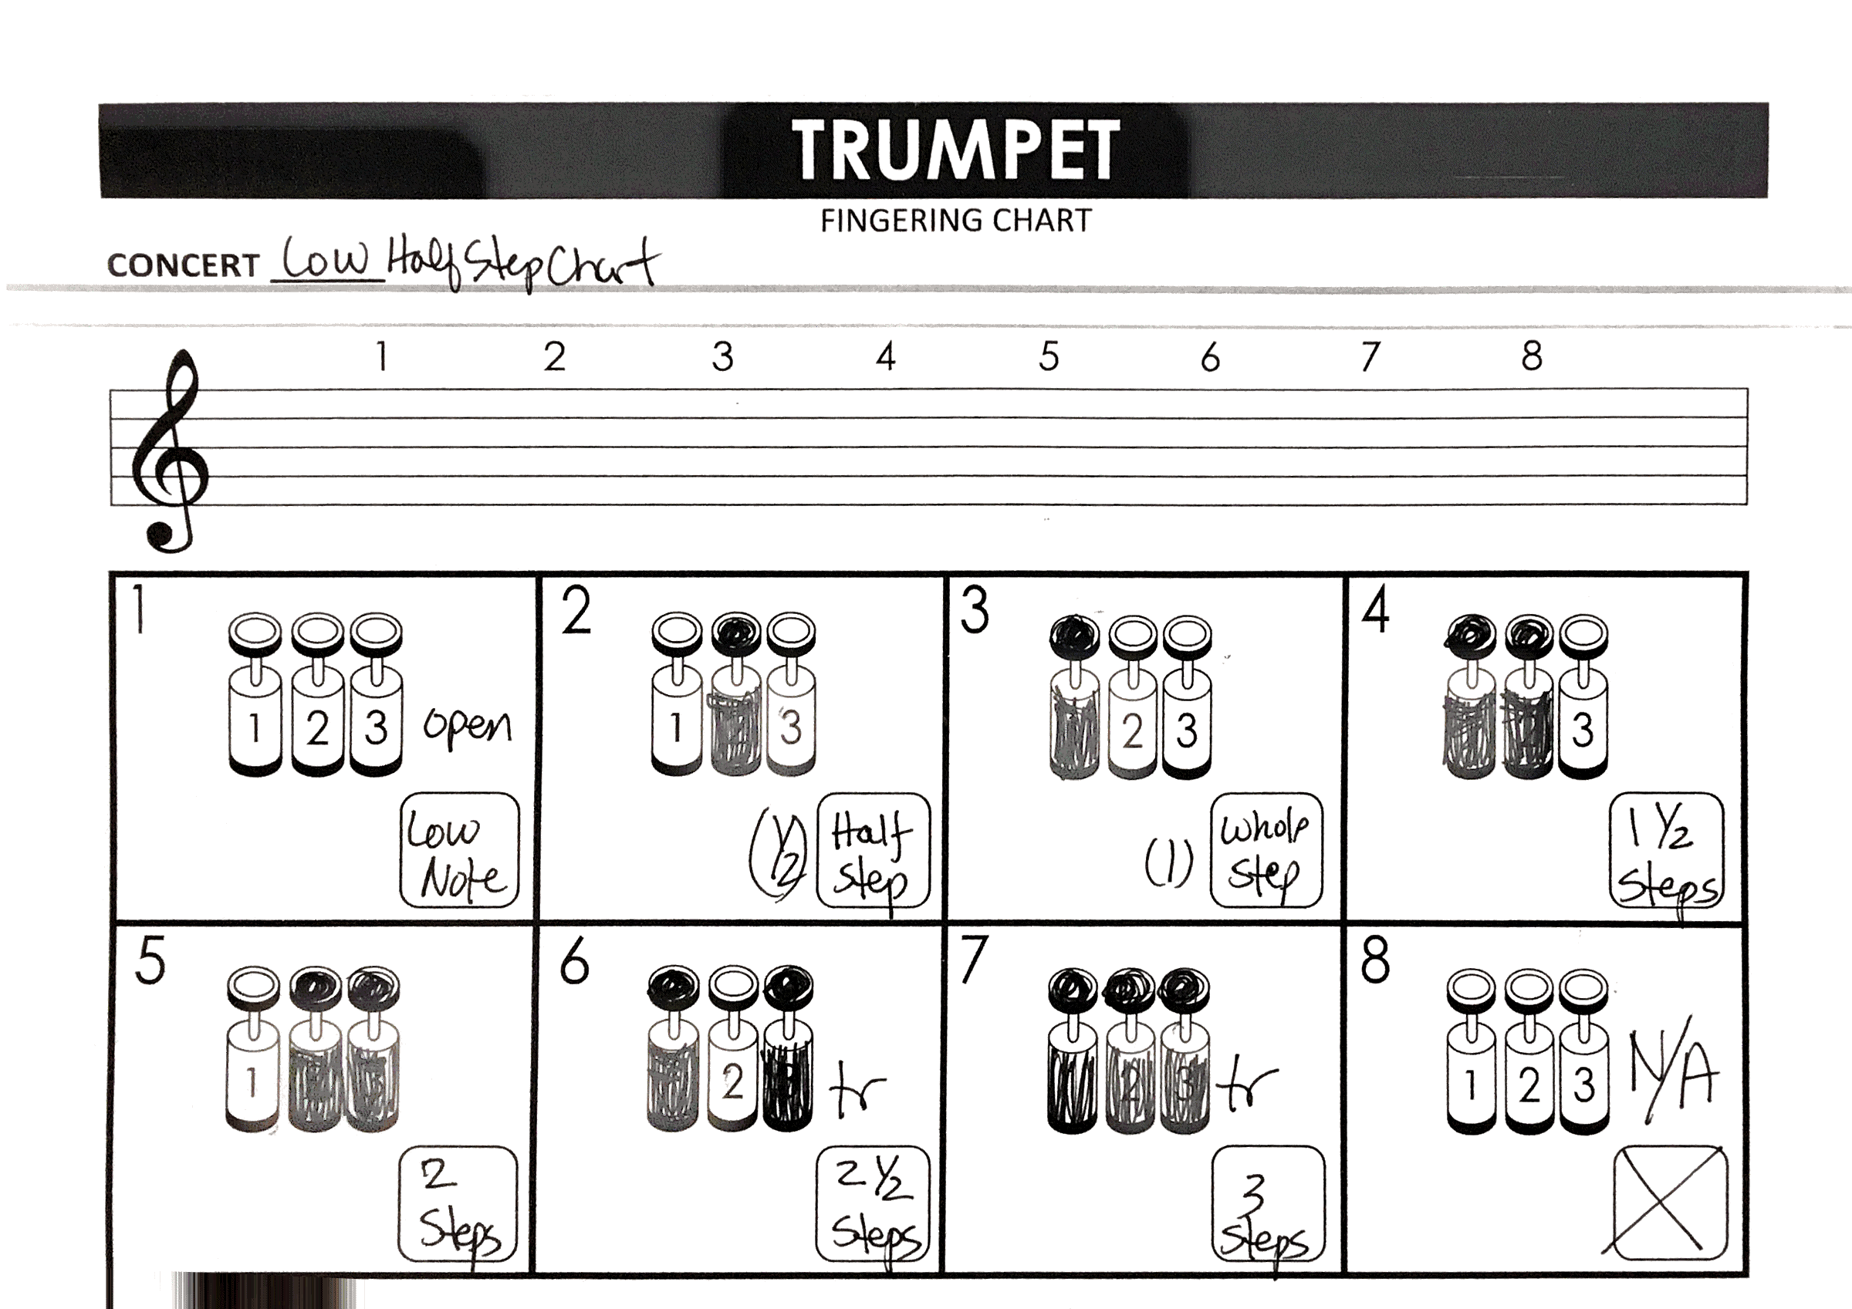
Questions and/or Comments

Slide 11
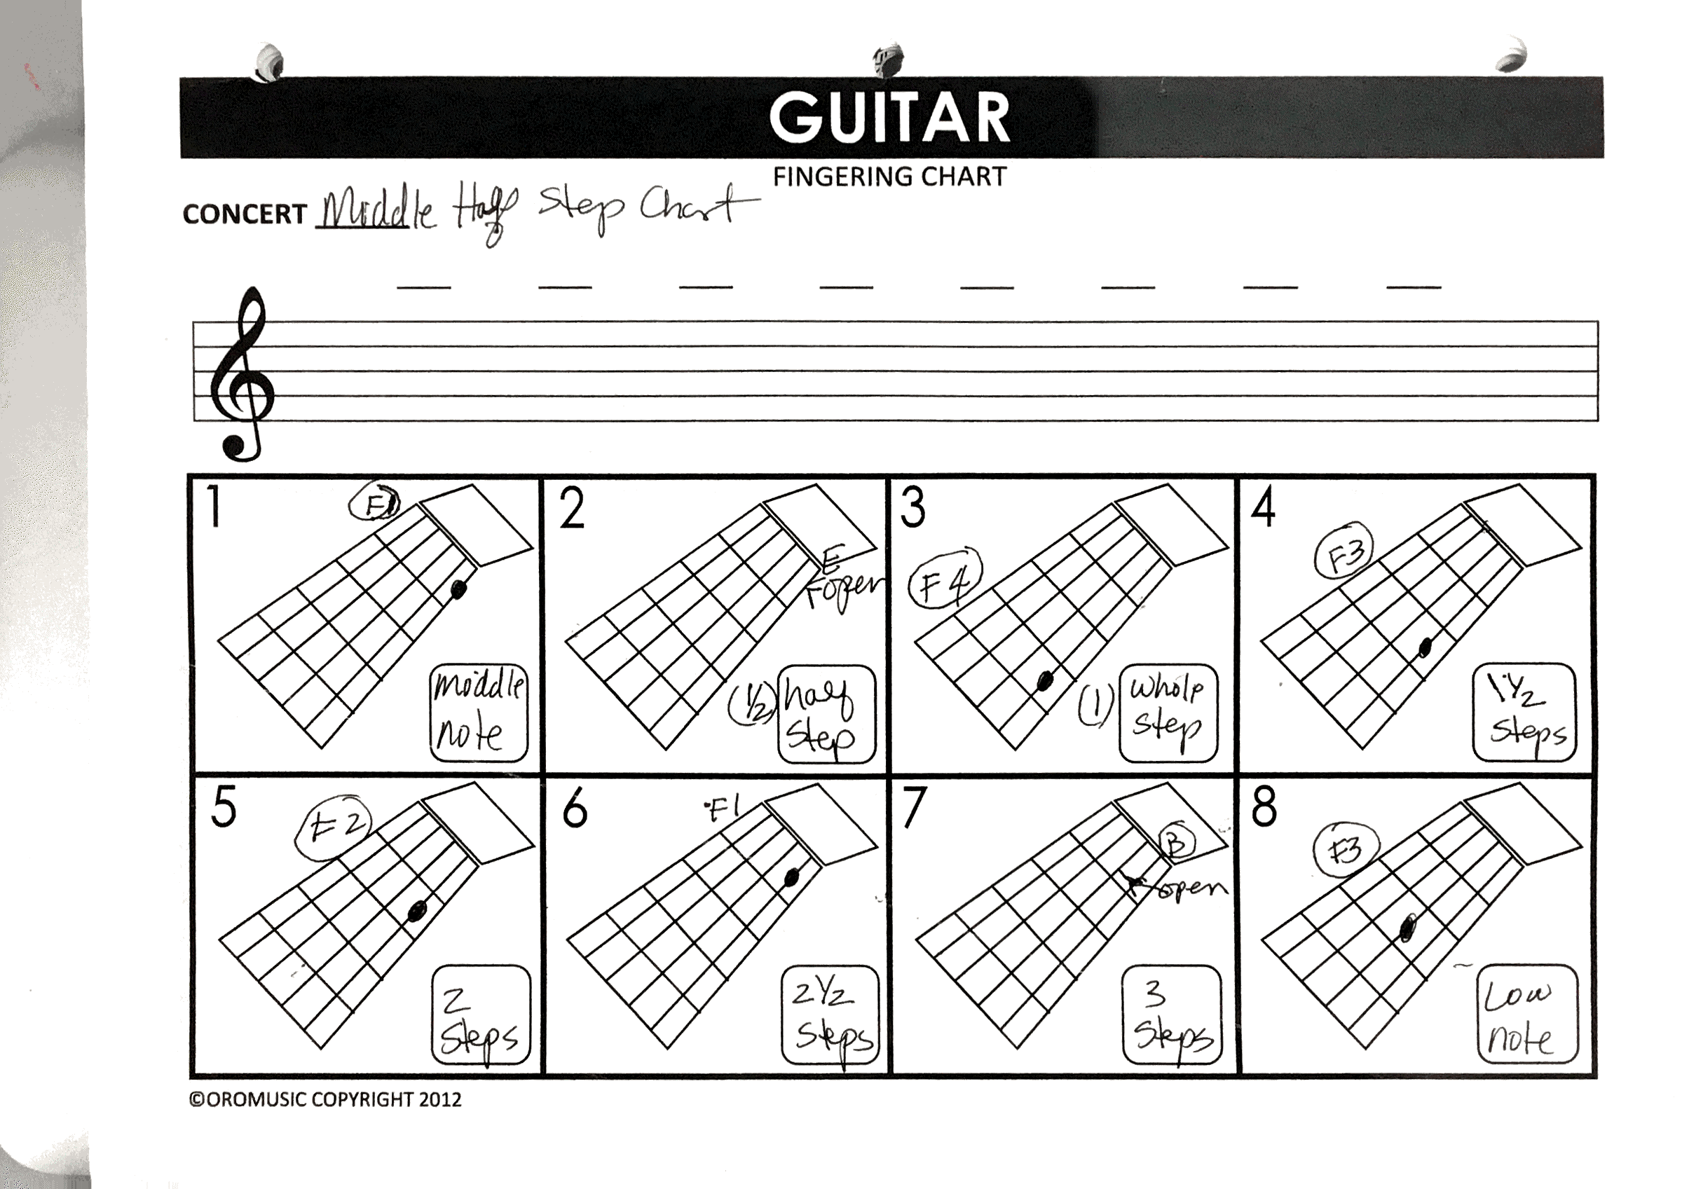
Questions and/or Comments

Slide 12
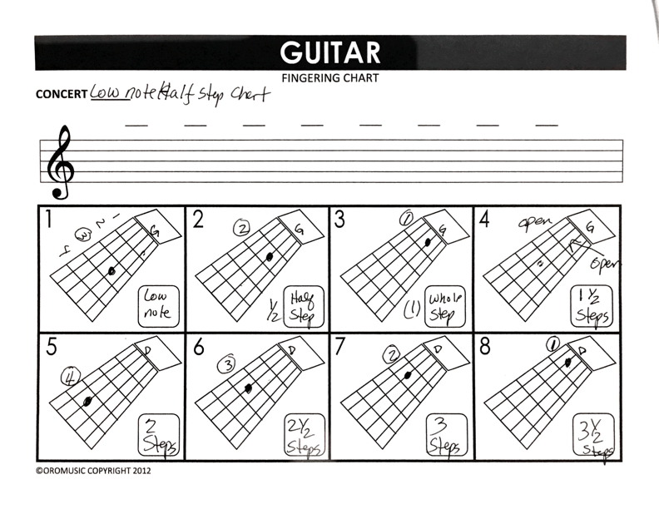
Questions and/or Comments

Slide 13
Violin/guitar Chromatic Range

Slide 14
Trumpet Chromatic Range

Slide 15
Reminton 1, 2 & 3

Slide 16
Scale the Wall Flute/Violin

Slide 17
Scale the Wall Guitar

Slide 18
Scale the Wall Trumpet

Slide 19
Scale the Wall Harp

Slide 20
Scale the Wall Certificates

Slide 21
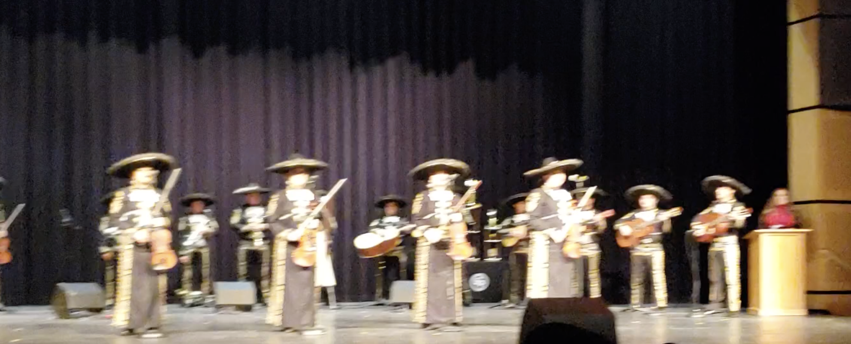
Questions and/or Comments

Slide 22

Questions and/or Comments

Slide 23
Questions and/or Comments
Email me @:
Marta.Ocampo@gpisd.org

