Slide 1
The Mariachi Vocal Instrument
Marcia Neel and Monica Fogelquist
NATS Conference
June 23, 2018

Slide 2
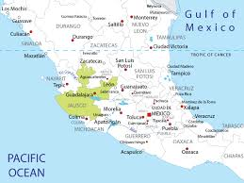
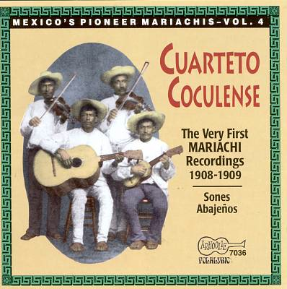

Brief History of Mariachi Music
Mariachi music originated in the region that encompasses the Mexican states of Jalisco, Michoacán, and Colima
The precursor to the modern mariachi dates back to the late 19th century

Slide 3
Brief History of Mariachi Music
With an increase in nationalism, mariachi music has catapulted to the forefront of popular culture as a vehicle to unite all regions of Mexico
The music is featured in radio and film and taken abroad

Slide 4
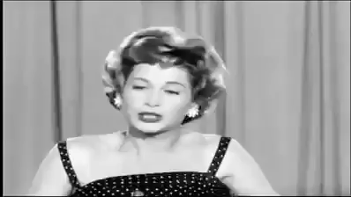
Evolution of the Mariachi Ensemble
Original configuration: Either guitarrón or harp as bass instrument, two violins, and vihuela
By the 1950s, the mariachi as we know it today had been established: six violins, two trumpets, guitarrón, vihuela, and guitar.
*The flute is not part of the standard instrumentation of the mariachi.

Slide 5
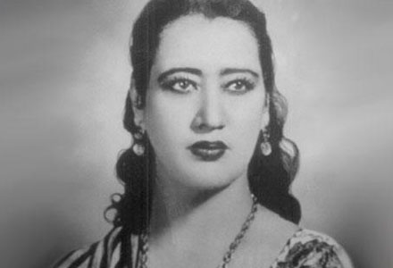
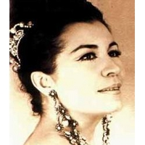
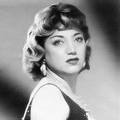
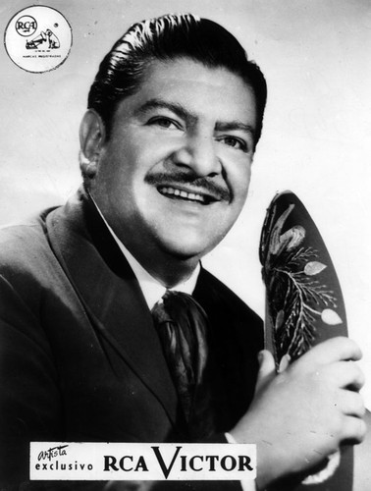
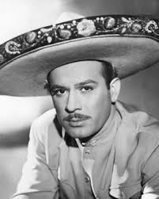
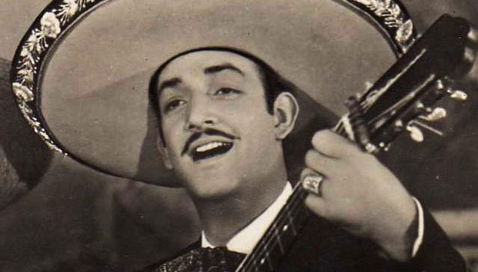
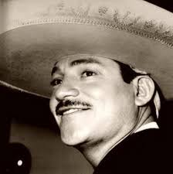
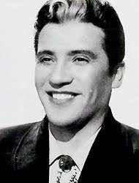
Early Ranchera Singers
Lucha Reyes
Lola Beltrán
Amalia Mendoza
José Alfredo Jiménez
Jorge Negrete
Pedro Infante
Javier Solís
Miguel Aceves Mejía

Slide 6
Important Things to Consider
The Language: Studying the Spanish language is critical. The ability to correctly pronounce lyrics is important, but understanding the meaning of the lyrics is what will bring the music to life.
INTERPRETATION IS EVERYTHING!
    Public school language classes for the students—make the experience interdisciplinary
    Adult school language classes for instructors/older students
    Online language classes

Slide 7
Important Things to Consider
The sociocultural significance of the music.
    Folk music
    Origins lie in lower class society
    Themes vary from heartache, celebration of life, patriotism
    Learn the nuances of the various musical genres that the mariachi plays

Slide 8
Mariachi Song Styles and Related Characteristics
Rancheras
    Can be in 2/4 (polka),3/4 (valseada), 4/4 (lenta, romantica)
    Simple melodies that often repeat or alternate between verse melody and refrain melody
    Themes mostly lie in heartache
Sones
    Song form native to the mariachi
    Alternates between 3/4 and 6/8
    Syncopated rhythms
    Verse melody, refrain melody

Slide 9
Mariachi Song Styles and Related Characteristics
Boleros
    Most subdued song type interpreted by the mariachi
    Requires more vocal control
    Many songs require the singer to build vocal intensity as song progresses
Huapangos
    Borrowed from the Huasteca region of Mexico (northeastern region of the country)
    Falsetto singing is used for effect
    Requires strength and control of both chest and head voices

Slide 10
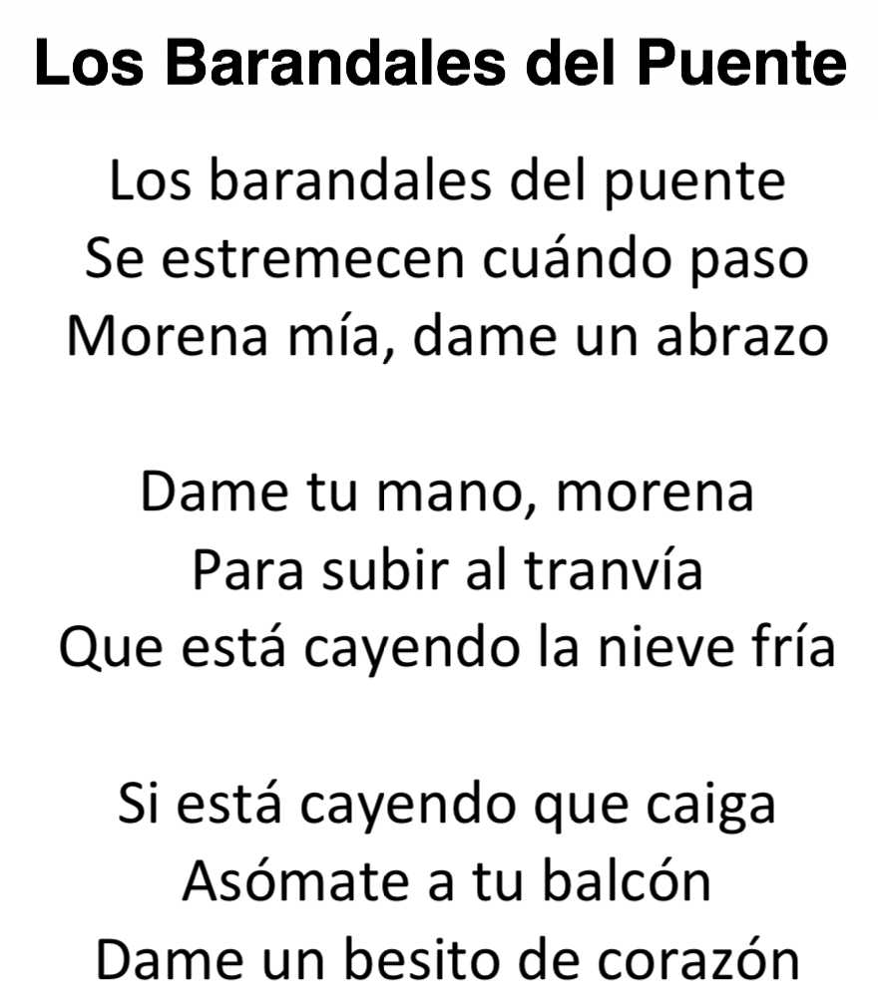
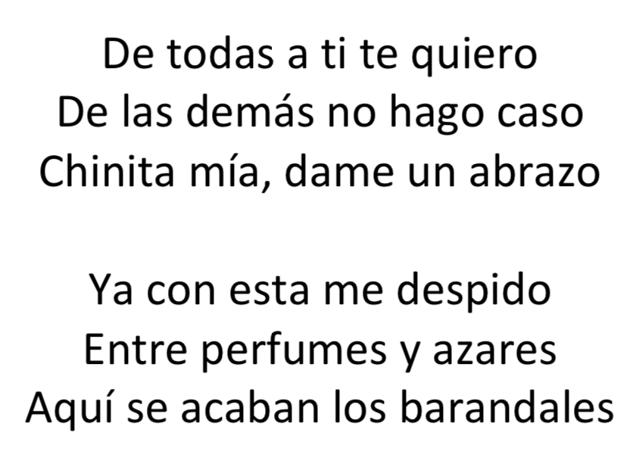

Slide 11
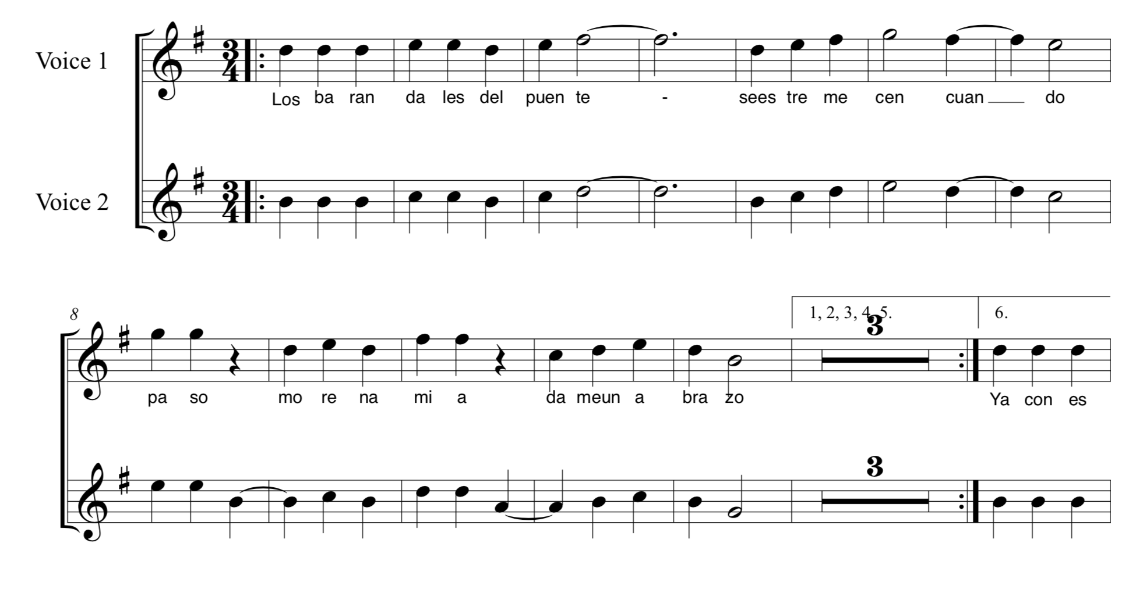
Los Barandales del Puente
Canción Ranchera

Slide 12
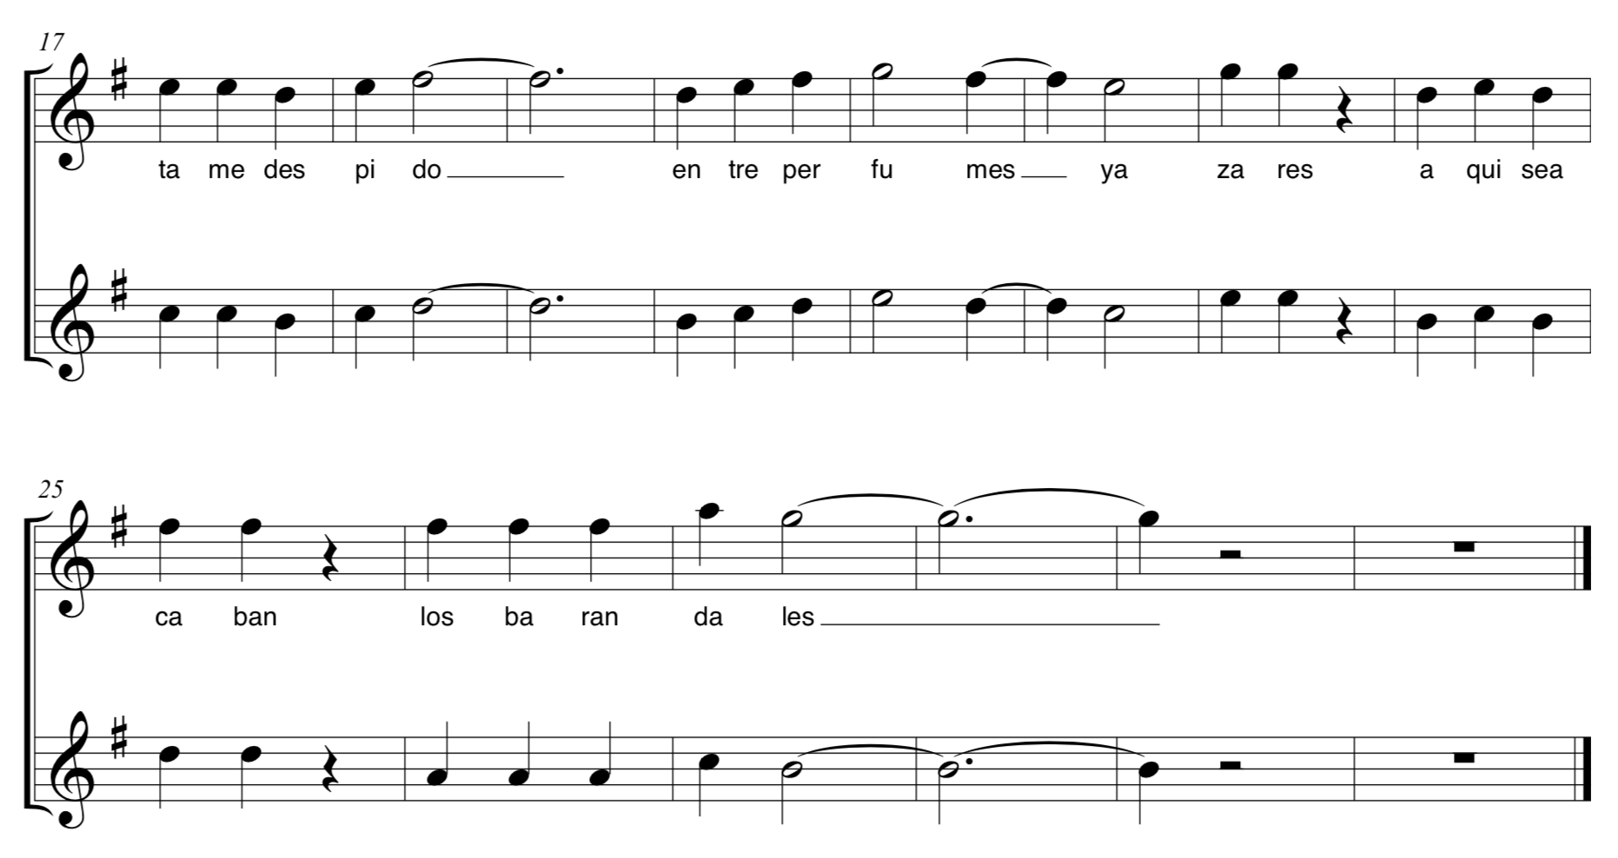
Los Barandales del Puente
Canción Ranchera

Slide 13
More to Consider
Singing always requires use of the chest voice. The only time the head voice is used is for effect, primarily in singing huapangos. The head voice should not be regularly used, even when singing softer boleros.
Not everyone will have the voice to interpret all types of songs. Play up the students’ vocal strengths and carefully choose repertoire.
Vocal exercises can help increase chest voice range.

Slide 14
More to Consider
Always warm up before singing
Do not overexert the voice attempting to sing something so intense
Get out of your own way. Basic technique remains the same no matter what is being sung. The interpretation is what changes.

Slide 15
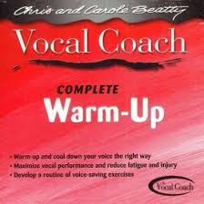
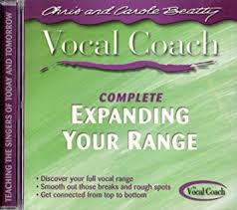
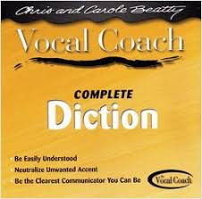
The Vocal Coach
Excellent exercise series to warm up and expand vocal range
Diction exercises

Slide 16
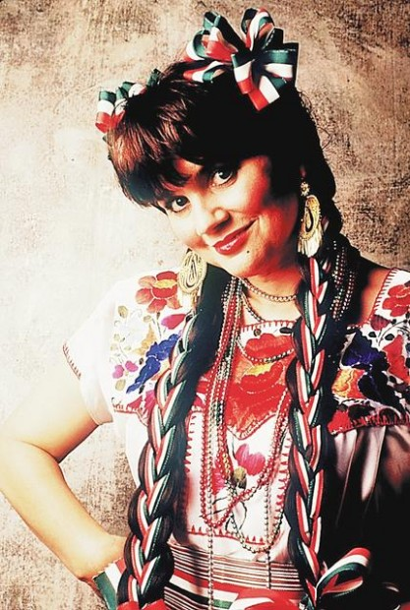
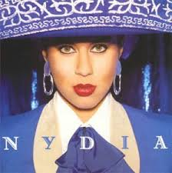
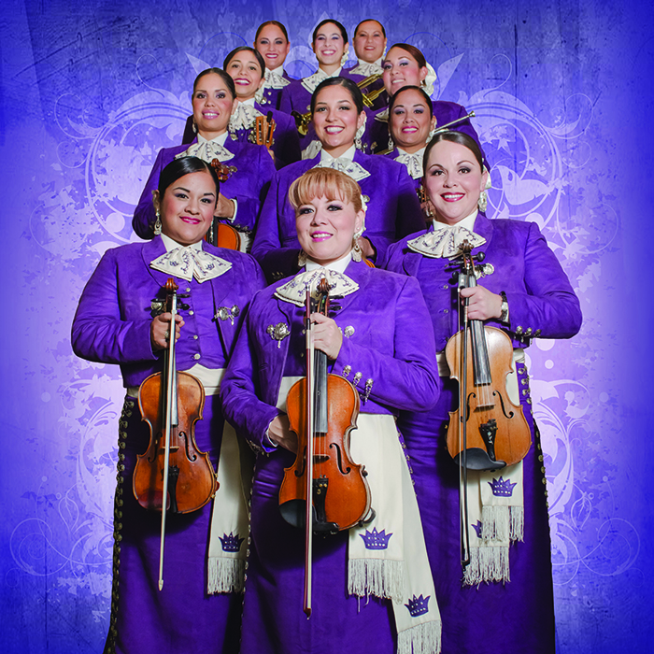
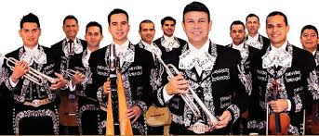
Examples
Linda Ronstadt
Nydia Rojas
Mariachi Sol de México
Mariachi Reyna de Los Ángeles

Slide 17
Questions and/or Comments

